Slide 1
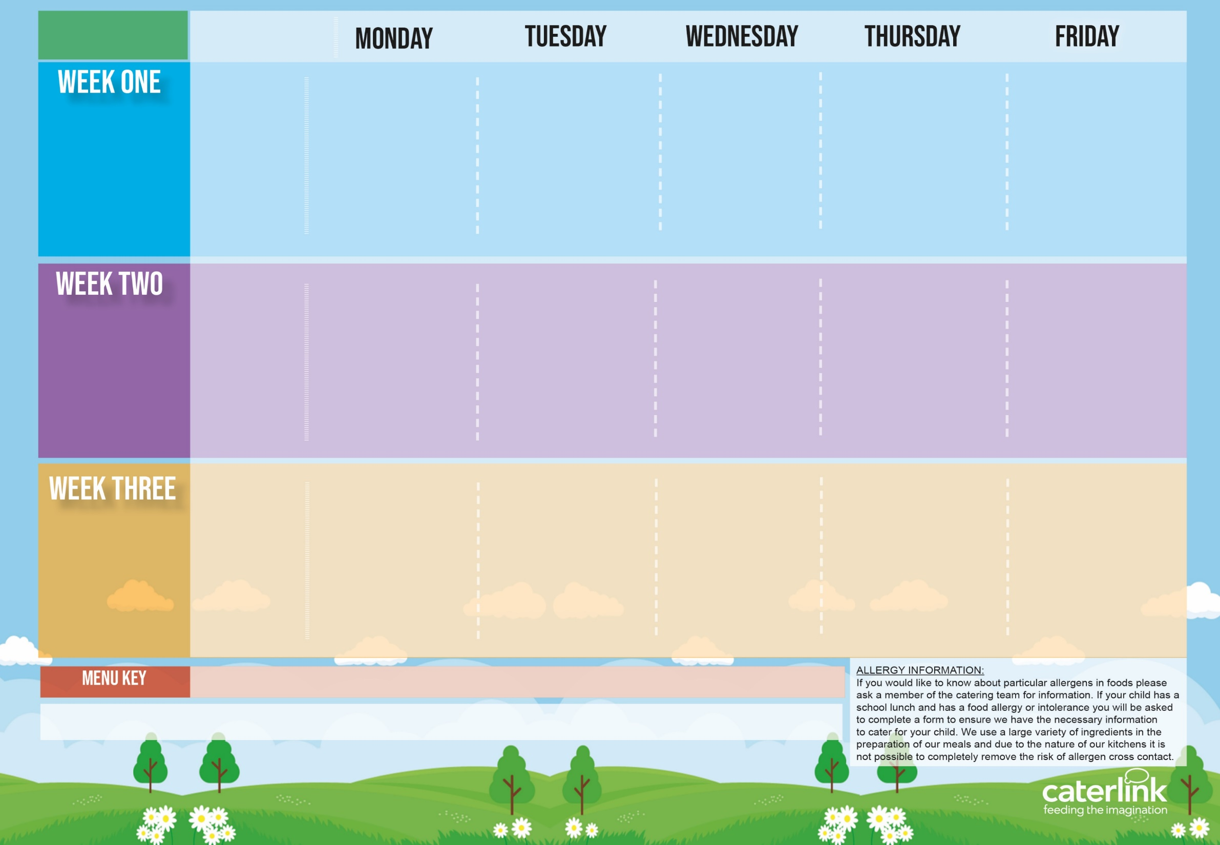







Spring Summer
2025
Option One
Option Two
Vegetables
Dessert
Macaroni Cheese | Chicken or Margherita Pizza with Salads | Roasted Pork Sausage, Roast Potatoes & Gravy | Spaghetti Bolognaise | Fishfingers with Chips & Tomato Sauce
Tomato Pasta | Mild Mexican Chilli with Rice | Roasted Quorn, Roast Potatoes, & Gravy | NEW Chefs Special Chickpea Curry with Rice | Cheese & Bean Pasty with Chips & Tomato Sauce
Vegetables of the Day | Vegetables of the Day | Vegetables of the Day | Vegetables of the Day | Vegetables of the Day
Apple Flapjack | Summer Lemon Cake | Fruit Platter | Savoury Cheese Scone | Strawberry Jelly with Mandarins
01/09/25
22/09/25
13/10/25
Option One
Option Two
Vegetables
Dessert
Sweet Potato Curry with Rice | Pork Hot Dog with Wedges & Tomato Sauce | Roast of the Day, Stuffing, Roast Potatoes, & Gravy | Chefs Special Chicken Korma with Rice | Battered Fish or Fish Fingers with Chips & Tomato Sauce
Cheese and Tomato Pizza with Salads | Vegan Hot Dog with Wedges & Tomato Sauce | Vegetable Soya Roast, Stuffing, Roast Potatoes & Gravy | Spaghetti and Meatballs | Cheese and Tomato Quiche with Chips
Vegetables of the Day | Vegetables of the Day | Vegetables of the Day | Vegetables of the Day | Vegetables of the Day
Iced Vanilla Sponge | NEW Strawberry and Apple Crumble with Custard | Freshly Chopped Fruit Salad | Peaches and Ice Cream | Vanilla Shortbread
08/09/25
29/09/25
20/10/25
Option One
Option Two
Vegetables
Dessert
All Day Vegetarian Breakfast | Build a Burger | Roast of the Day, Stuffing, Roast Potatoes & Gravy | Ham and Cheese Whirl with Rice, Greek Salad and Tzatziki | Breaded Fish or Fish Fingers and Chips
Classic Vegan Bolognaise | Build a Vegetarian Burger | Veg Wellington, Roast Potatoes & Gravy | Cheese Whirl with Rice, Greek Salad and Tzatziki | All Day Vegetarian Breakfast
Vegetables of the Day | Vegetables of the Day | Vegetables of the Day | Vegetables of the Day | Vegetables of the Day
Pear & Cocoa Upside Down Cake | Cheese and Crackers | Fruit Medley | Jam and Coconut Sponge | Oaty Cookie
15/09/25
06/10/25
Added Plant Protein
Wholemeal
Vegan
Chef’s Special
Available Daily: - Freshly cooked jacket potatoes with a choice of fillings - Bread freshly baked on site daily- Daily salad selection – Fresh Fruit and Yoghurt

