Slide 1
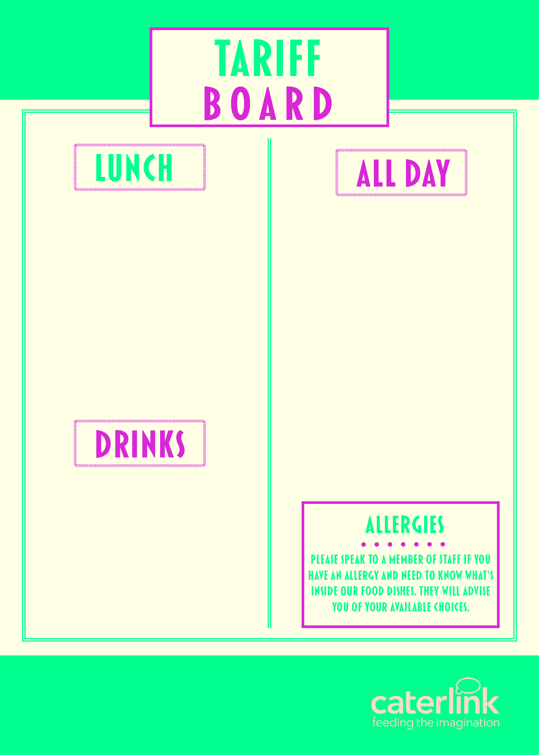
MEAL DEAL | £2.80
PIZZA SLICE | £1.80
JACKET POTATO & 2 FILLINGG | £2.49
PASTA, SAUCE & CHEESE | £2.49
PANINI (2 FILLINGS) | £2.54
HOMEBAKE | £1.16
COOKIE | £1.16
SANDWICHES / BAGUETTES FROM | £2.00
FRUIT POTS | £1.60
WRAPS FROM | £2.35
SALAD POTS FROM | £2.00
CHIPS / WEDGES | £1.59
SAUSAGE ROLLS | £1.59
HOT FILLED ROLLS | £2.43
CROISSANT | £1.54
PAIN AU CHOCOLAT | £1.54
BEEF / CHICKEN BURGER | £2.49
WATER | £1.17
RADNOR FIZZ | £1.39
RADNOR SPLASH | £1.39
JUICE CARTONS | £1.11
(OTHER DRINKS AVAILABLE FROM | £1.00

