Slide 1
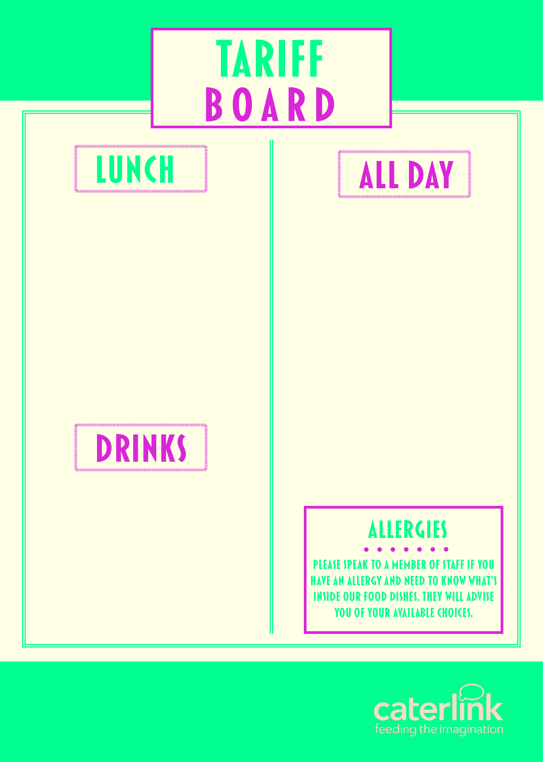
MEAL DEAL | £2.80
PIZZA SLICE | £1.70
JACKET POTATO & 2 FILLINGG | £2.35
PASTA, SAUCE & CHEESE | £2.35
PANINI (2 FILLINGS) | £2.40
HOMEBAKE | £1.15
COOKIE | £1.10
SANDWICHES / BAGUETTES FROM | £2.00
FRUIT POTS | £1.60
WRAPS FROM | £2.35
SALAD POTS FROM | £2.00
CHIPS / WEDGES | £1.50
SAUSAGE ROLLS | £1.50
HOT FILLED ROLLS | £2.30
CROISSANT | £1.45
PAIN AU CHOCOLAT | £1.45
BEEF / CHICKEN BURGER | £2.35
WATER | £1.10
RADNOR FIZZ | £1.32
RADNOR SPLASH | £1.32
JUICE CARTONS | £1.05
(OTHER DRINKS AVAILABLE FROM | £1.00

