Slide 1
2023

Slide 2
Introductions
Sally Kennedy - Head teacher of County Upper School
Ben Jeffery - Head of lower School
Notes:
Sally to start -introduce all
Sally-background experiences including transition of school types; LA background
Ben talks about primary experience

Slide 3
Moving forwards
Thanks for your comments and questions
In 2023 County Upper (new name tbc) will have years 7 - 13. The year 7 and 8s will be taught at the Westley campus.
Year 9-13 at the County Upper campus
Notes:
The decisions have happened and there is nothing to be gained from discussing the past

Slide 4
School Identity
School Name
School Logo
Uniform
The vision is the biggest part of the school’s identity…

Slide 5
Vision
Opportunity to be innovative and ambitious
‘County’ to become the best school in the area
This is not Westley and not Horringer
Take the best from three tier model
We want to hear from you
Notes:
We are really excited about this. It is a bit like starting a new school but even better!
Important to be mindful of the situation and sensitive towards staff

Slide 6
What will make the lower school great?
High quality teaching from excellent teachers from two successful schools
A school where the staff know all the students
Amazing pastoral support
High expectations
Brilliant opportunities outside the curriculum
A middle school feeling
Being part of one big school
Being on a split site

Slide 7
Timeline
September 2022 - Westley and Horringer will be open with years 6 - 8
August 31st 2023 Westley Middle and Horringer Middle will close
Admissions -we will confirm how this will work in September
In 2023 County Upper (new name tbc) will have years 7 - 13. The year 7 and 8s will be taught at the Westley campus
Notes:
Thanks for your comments and questions
The decisions have happened and there is nothing to be gained from discussing the past
When we were employed it was to be head of CUS and Head of Westley -we have been asked to lead this re-organisation from this point forward
To add info re admissions for Y7/8/9 for Sept 2023

Slide 8
Transition for Students
Students need to bond together and mix with other students.
I will be visiting Horringer Court regularly next year and will meet students and lead assemblies with Horringer staff: Horringer students need to know that they are not joining Westley.
Bairstow and the pastoral team!
Programme of Planned sessions to support transition:
Taster / Wow days (PE, music, science)
Mixed groups team building events
Teachers collaborating over tutor groups
Summer school
Extra transition for SEND students and other vulnerable groups
Follow up and review whether it worked and plan for next year
Notes:
Speak to the students to ask them what they want

Slide 9
Families
Good communication
Get the message out there on social media
Monthly newsletters
New website?
Put myself out there and answer any questions
Frequently asked questions on the website

Slide 10
Families
Visits in the holidays
Open evenings
Invite families on the same days as students come

Slide 11
Curriculum
Similar proportion of subjects to current middle schools
Emphasis on a broad curriculum that values all subjects
Regular cross site planning and collaboration

Slide 12
Staffing Structure and the recruitment process
All roles are ring fenced for Horringer and Westley staff to apply for
Staff will be in place by the end of this term
Leadership team including year leaders
Middle leaders
Pastoral team
Office staff
Notes:
Rolling programme through this half term -we have currently appointed Head of Lower School, Assistant Headteachers and KS3 COre subject leads and SENDCo and next wednesday we will appointed subject cluster leads for the non-core subjects.

Slide 13
new staffing structure -current projection
Head of Lower School
Assistant Head of Lower school/ Head of Year 7 and 8 x 2
Head of English, Maths, Science
Head of Humanities, PE and Enrichment, MFL, Performing and Visual Arts
Classroom teachers
LSAs , Family Support Worker, Pastoral Lead, Cover Supervisor

Slide 14
Infrastructure and Systems
Shared across both sites
Rewards systems
Behaviour expectations and systems
Parent platform (reports/ homework/ rewards/ incidents)
Timetabling systems/ school day
Curriculum teams

Slide 15
Uniform
2023 all students at the Lower School site will wear County uniform.
We will consult on this
We will follow the guidelines that the government have introduced
Uniform will be smart and will be able to support financially for those that need this.
All year groups (Year 7-11) will have the new uniform
We will have more answers by Christmas after consulting with students with governors, staff, students and parents

Slide 16
Transport
We are honouring all current transport arrangements
We will look at fresh routes
We are in meetings with The Suffolk Transport Team to get
more answers

Slide 17
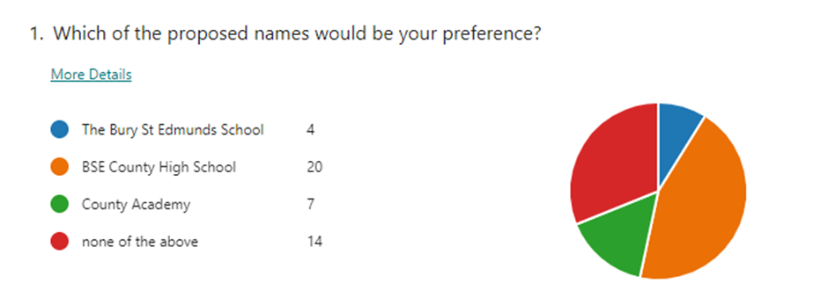
Next steps

Slide 18
Planning
11 classes currently projected for Year 7 and 8
Mixed ability classes for most subjects
Classes will be mixed up with Horringer, Westley and hopefully many more students (as with Y9 transition currently)
Transition events and activities through the year
Y7/8 students will visit the ‘County Site’; Y9/10/11 students will visit the lower site
Staff will work predominantly at one site
This is not just a one year plan

Slide 19
Next steps
Governance
Staff recruitment and retention
Extracurricular activities
Teacher assessments
Notes:
I can only really speak for my two headships in Unity schools where we have successful schools and low staff turnover.

Slide 20
Thank you

