Slide 1

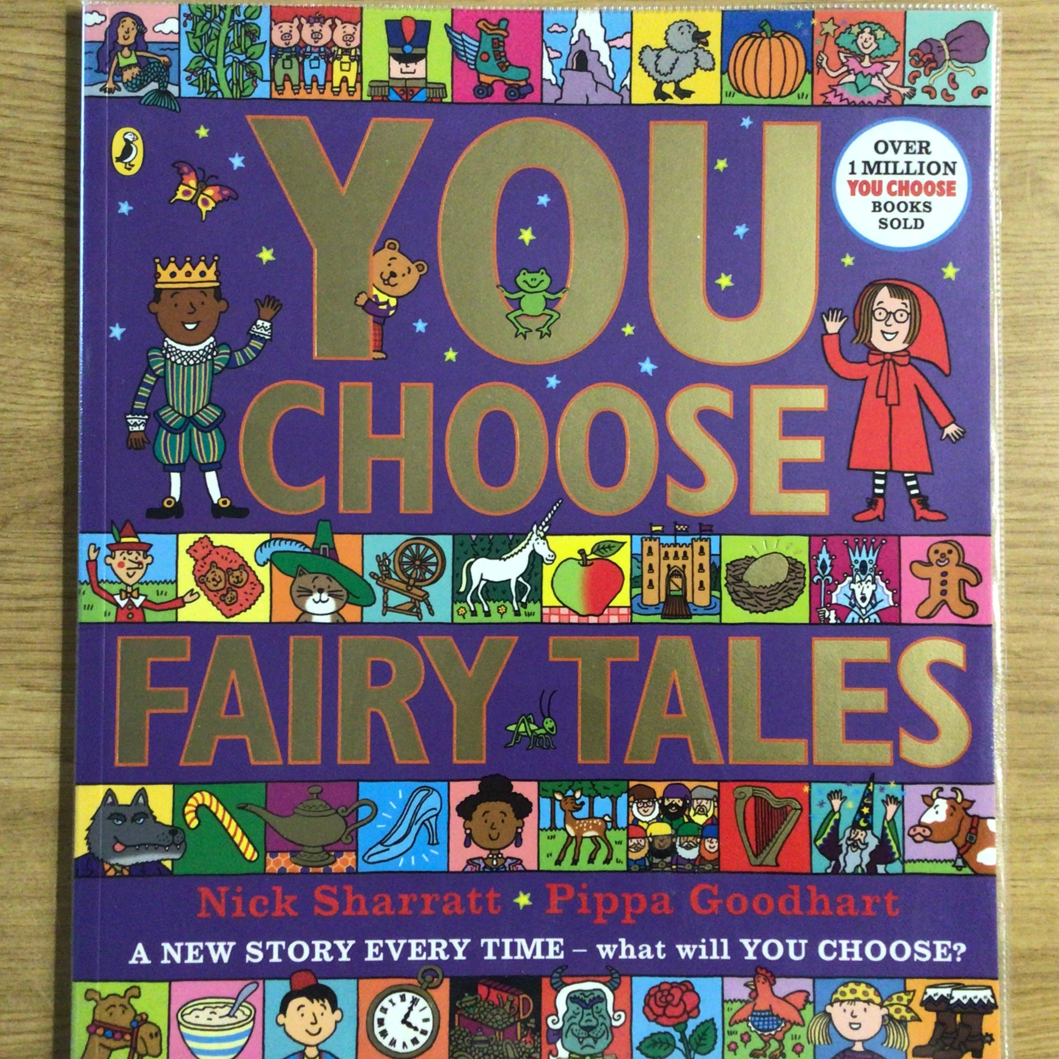
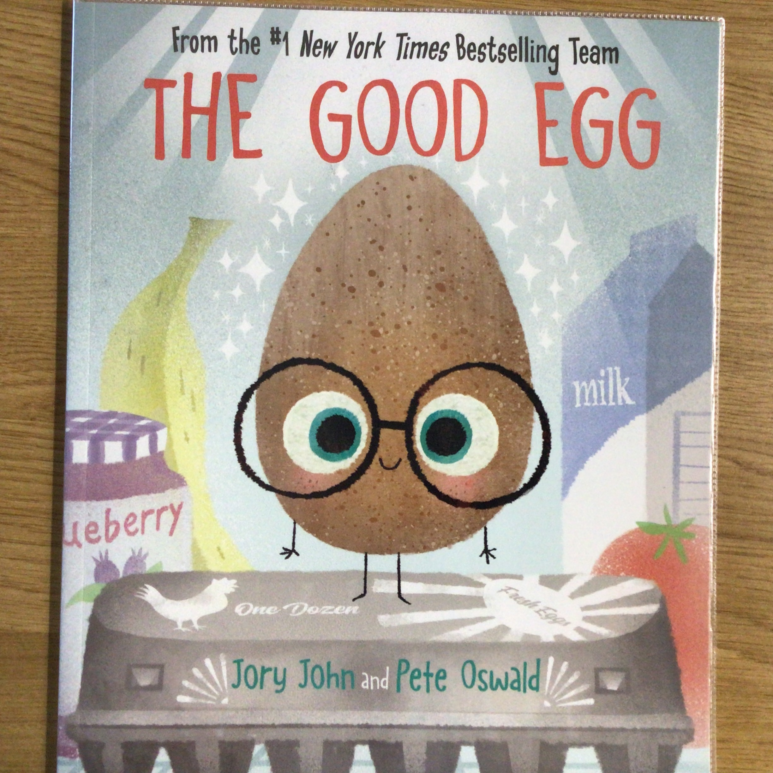
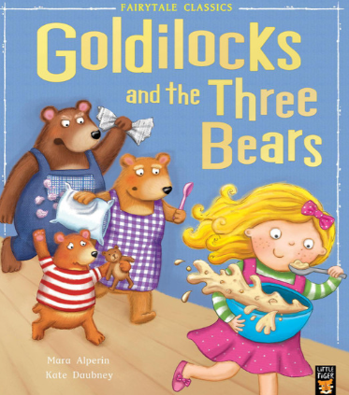
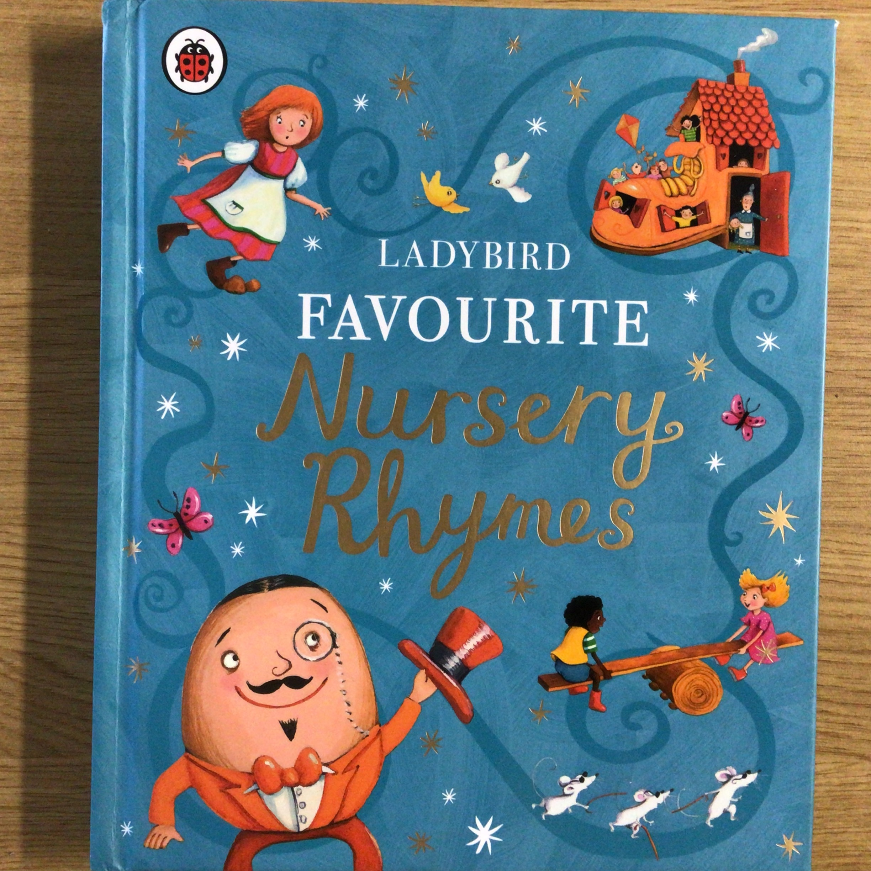
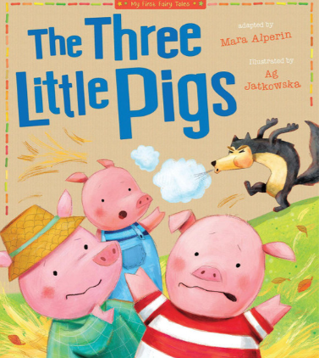
Spring 1 Newsletter -Nursery
This half-term our theme for learning is Traditional Tales
We'll be exploring through stories rhythm, rhyme, safety and behaviour, maths and literacy.
Our Nursery rhyme to know this half term is: Humpty Dumpty
Communication and Language We'll be learning to use speech to tell stories with expression. We will recite repeated elements of familiar stories. | Personal Social and Emotional Development We'll be learning all about staying safe, safe people, places and safe choices.
Art and Design We'll be learning to choose and manipulate materials to create. We'll learn how to collage and draw to represent, and to use scissors. | Physical Development We'll be learning to play simple co-operative games. We’ll refine our skills with tools such as spoons, pencils, scissors and more!
Maths We'll be learning how to recognise numbers to 5. To compare and order and measure things by size. | Reading and Writing We will begin to mark our work with letters from our name. We will use marks to communicate ideas.
Things to try at home
Sing – Humpty Dumpty.
Collect – things to count
Read – books with traditional characters
Talk about – ways to stay safe
I Spy – numbers and letters
Play – with small dolls, puppets and character figures
Key days & dates: Library days – Tuesday/Wednesdays P.E – Wednesday/Thursdays Wow Wednesday –28th February
Holidays – 16th February to 20th February

