Slide 1




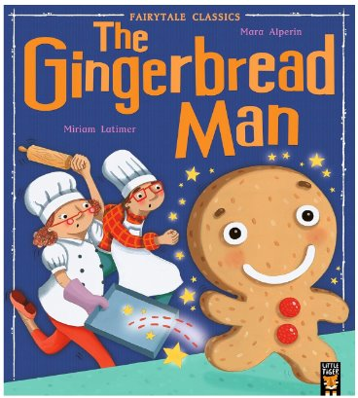
Autumn Term 2 Newsletter – Reception
Welcome to a busy but exciting term in Reception!
Phonics - | Writing- | Maths-
We will start teaching the children to recognise the single letter sounds: d, e, f, v, k, l, r, u, j, w, z. We will teach them to blend simple words e.g. dog, leg, van, jug, zip. | We will teach the children to write simple CVC words and begin to write simple captions. We will teach them to form angled patterns, Eights, Spirals, Left-to-right orientation with good pencil control. | We will learn about the composition of 1, 2, 3, 4 and 5. We will also be exploring length and weight. We will continue practising counting to 20, and beyond.
P.E- We will be teaching gymnastics, body management and dance. | Art and design- The children will practise their colour mixing by painting pumpkins, and light and dark pictures. | Understanding of the World- We will explore celebrations around the world e.g. Halloween, Bonfire Night, Diwali and Christmas. We will also discuss Light and dark.
Nativity – Monday 15th December 9.30am and 2.15pm (NO tickets needed, but please only come to one of the performances!)
The books we will read are:

