Slide 1


Accelerated Reader

Slide 2
The importance of reading
Only 3 in 10 young people read daily in their own time
Nearly a fifth of children asked in a survey said they would embarrassed if their friend saw them reading
Young people who enjoy reading are 5 times as likely to read above the expected level for their age compared to children who do not enjoy reading at all
Reading for pleasure has a positive impact on children’s attainment in reading and writing.
Developing a love of reading can be more important for a child’s educational success than their family’s socio economic background-
Children who enjoy reading achieve more highly right across the curriculum.
Notes:
Start with stats about reading. Sad facts. Why is it so important that we get it right? Reading for pleasure tails off as children learn to read andother factors get in the way- TV, Computers etc..

Slide 3
Aims of Accelerated Reader
To improve standards of reading (both word recognition and comprehension)
To help children develop a love of reading
To help children choose suitable books for themselves and try different genres
Notes:
Discuss aims. Works as a kind of carrot and stick but in process chn learn to love reading and come across different books and learn own tastes

Slide 4
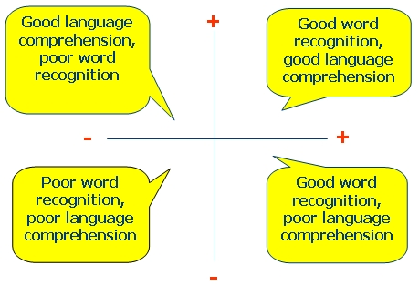
The skills of reading
Notes:
2 aspects to reading. AR works on both. If we only focus on word recognition children can move up levels to quickly.

Slide 5
Star Reading test
Your child will take one of these tests at different points throughout the year.
Tests ability to read (decode) and comprehend what they have read.
Takes about 15 minutes.
Teachers have summary of results- e.g number of questions answered correctly, time taken etc..
Notes:
How does AR work?

Slide 6
ZPD (Zone of proximal development)
Each child is assigned a ZPD based on their Star Reading Test
ZPD is the range of books that will challenge a child without causing frustration or loss of motivation. Children will mostly choose books within their ZPD (e.g. 2.3-3.1). They are allowed to read some above or below their ZPD from time to time.
Notes:
ZPD- may be lower than expected but we are going with them for now and teachers will adapt if necessary. BOOK LEVEL PROBS- WE’RE WORKING ON AGE APPROPRIATE (LY- Y3 ) Please let us know if any books are unsuitable.

Slide 7
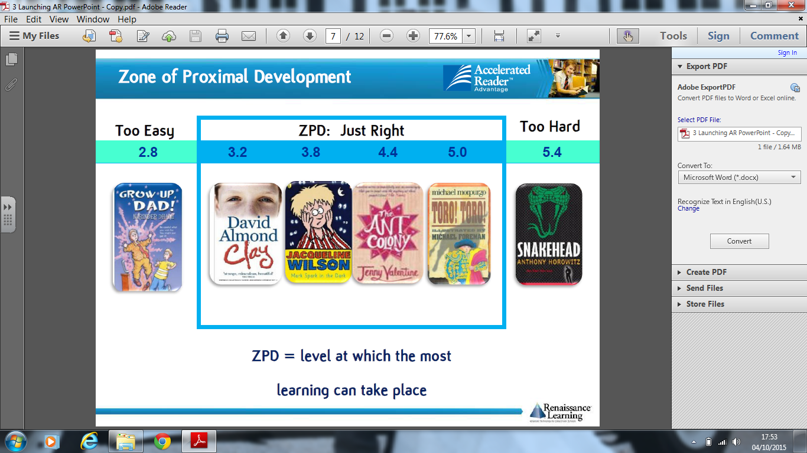

Slide 8
Taking a quiz
Each time a child finishes a book, they take a short quiz on that book.
Questions check their understanding of the story and words in text.
Children should refer to the book as much as they want while doing the quiz.
They are given a score at the end. They should achieve 85% or more.
Aim for 1 quiz a week
Notes:
If child scores less, adult will discuss with them problems they may have had with book and help them choose better book, slightly lower within ZPD etc..T looks at data each week- how many quizzes etc.. 1 quiz a week except for long books.

Slide 9
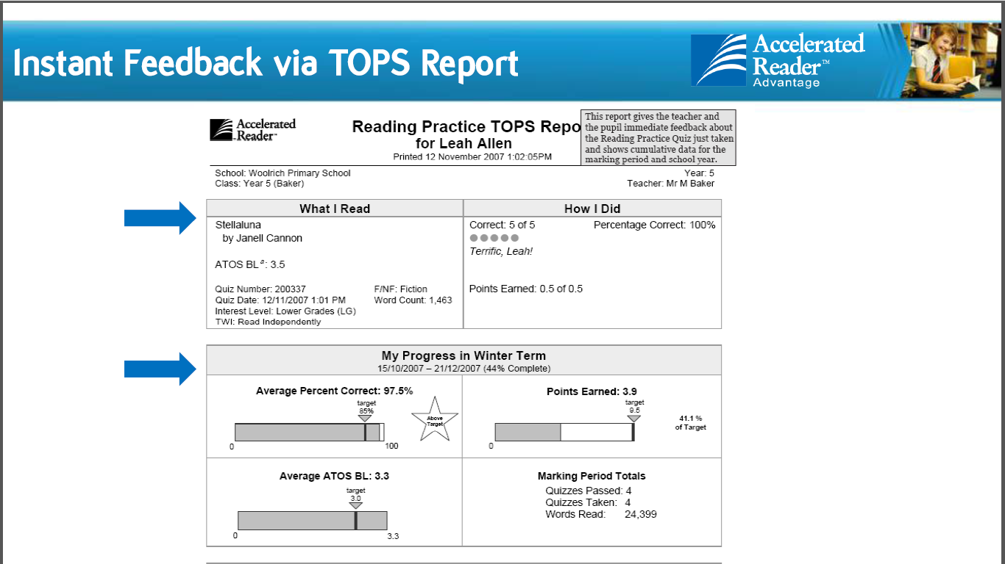

Slide 10

Class reading time
9.45- 10.15 every day is reading time
Time for quizzes, book change, group reading and silent reading
Teacher dialogue with children about quizzes
CHILDREN ARE STILL EXPECTED TO READ AT HOME SEVERAL TIMES A WEEK. IT IS PART OF THE HOMEWORK.

Slide 11
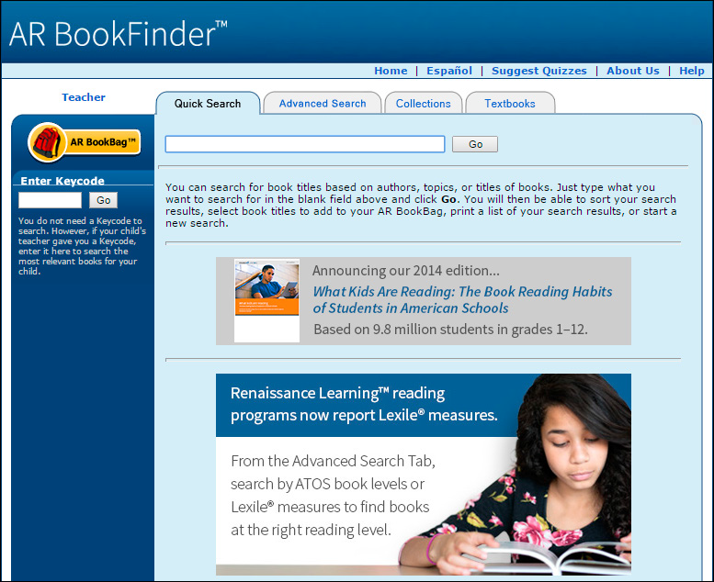
Notes:
Can’t do quizzes at home but you can look up books. School website- AR bookbag

Slide 12

Word Millionaires!
A word count is kept for every child based on how many words they have read.
Aim is to become a Word Millionaire!
Notes:
Y5- several children made it last year. Certifcates also given out for most quizzes done, highest 100% record (for LAPS too)

Slide 13
Children’s views
They said they enjoyed quizzes and having the chance to read every day
They like the competitive element of word counts and scores for tests
“I just used to rush through books and not really understand them and now I read more carefully.”
Notes:
Teachers much more aware of how children are doing and what they are reading. Lots of conversations about reading in class and chn recommending books etc..

