Slide 1


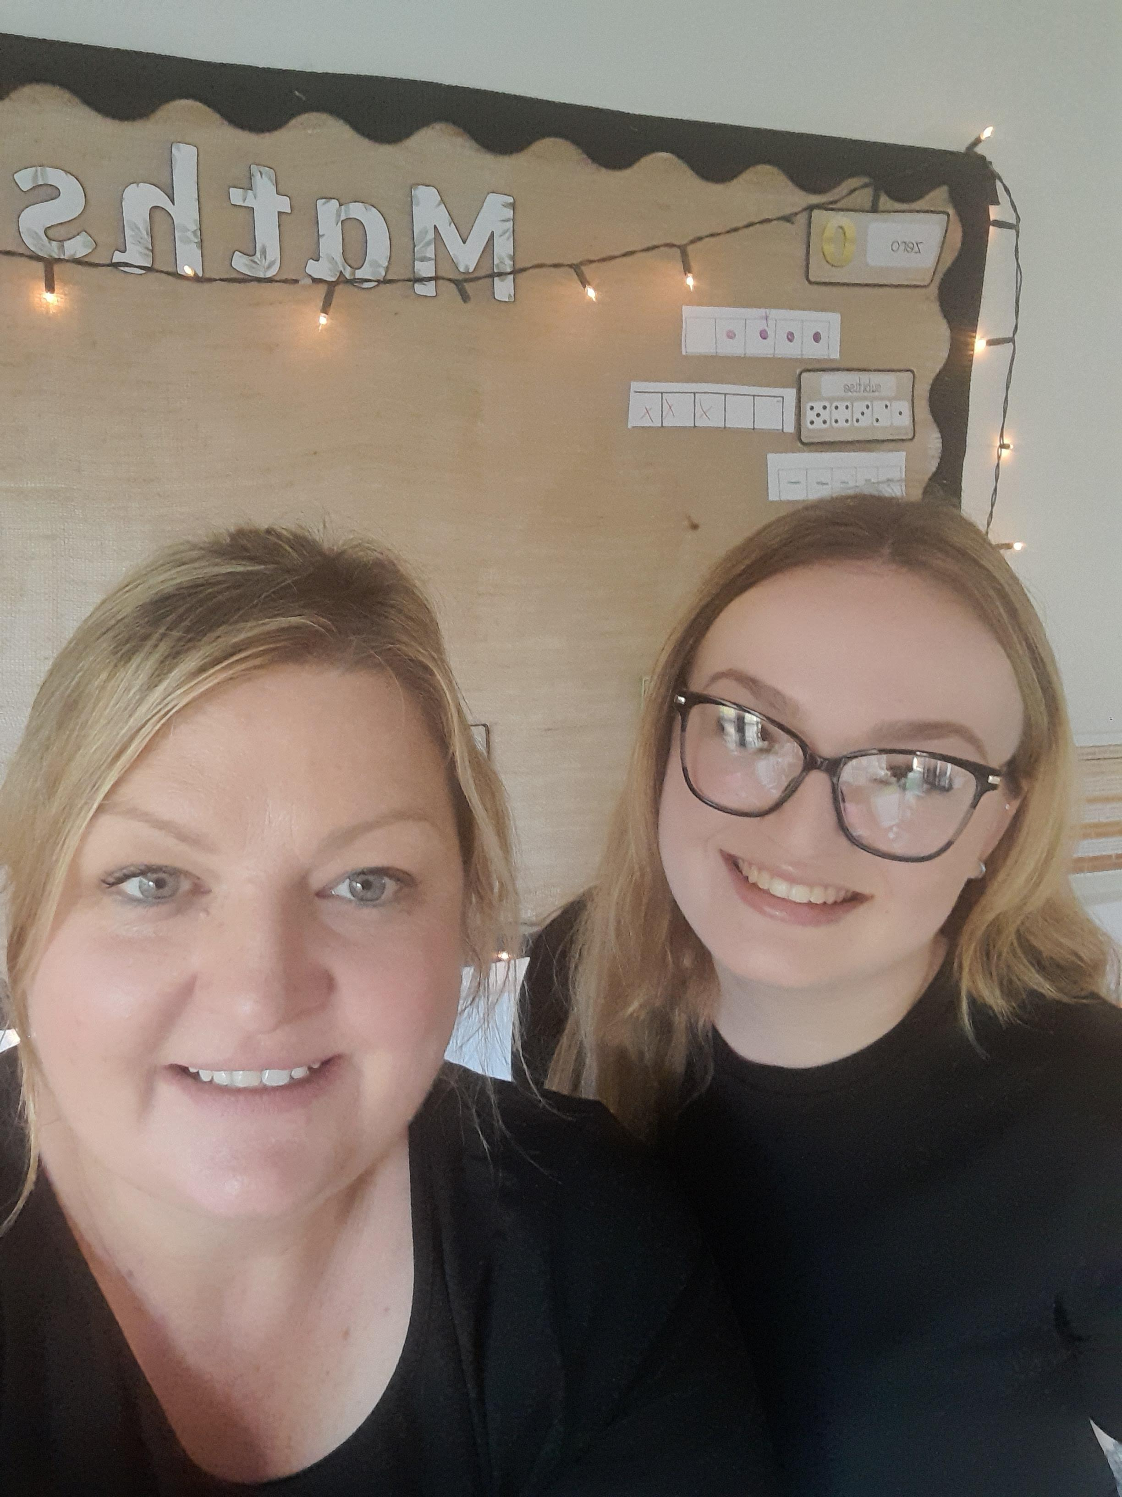
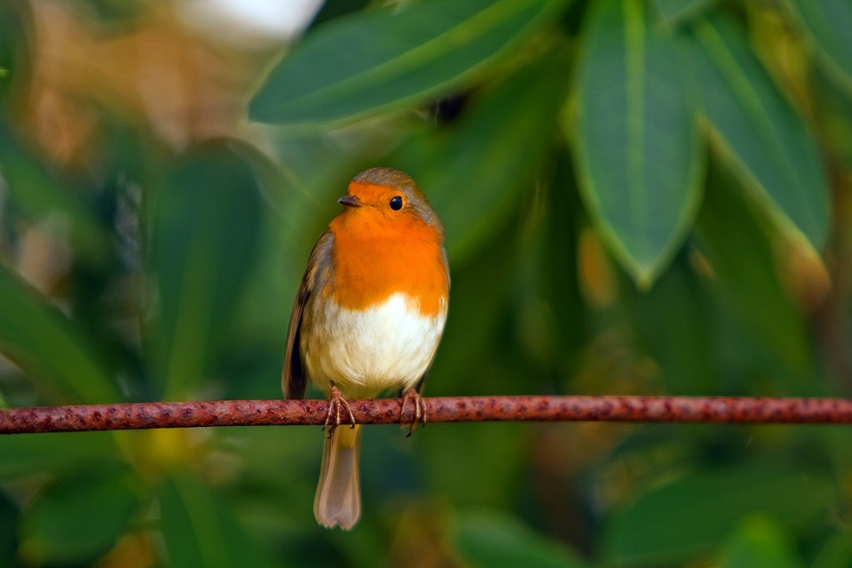
ROBINS CLASS
Newsletter
Autumn 2024
Welcome to the Autumn Term.
We hope you all had a refreshing break and are excited to embark on this new adventure in Robins Class. At Wickhambrook Primary Academy, we believe that strong communication is key to a successful partnership. If you have any questions or concerns, please feel free to chat with us after school, arrange a convenient time for a meeting, or reach out via ClassDojo. We’re eager to get to know both you and your child better in the coming weeks and look forward to a fantastic term ahead!
Early Writing
This term, we’ll focus on key skills for early writing, including shoulder movement, fluidity in the elbow and wrist, and finger dexterity—critical for a comfortable pencil grip.
Children will start by practicing letter formation in their names using a name card. As they progress, they’ll learn to form letters (graphemes) following our Sounds-Write phonics programme. To support this at home, we’ll send a laminated sheet showing how to write each letter using our handwriting scheme.
Maths
In Robins, we use the White Rose scheme for Mathematics, focusing on building a solid foundation in number skills. Our aim is for children to confidently count and deeply understand numbers up to 10, including their relationships and patterns. We’ll begin with activities like counting songs, ordering, grouping, and daily calendar routines. As we progress, children will explore numbers up to 10 further through learning one more/less and simple addition and subtraction.
Outdoor Clothes
In Robins Class, we are outside every day…whatever the weather!. Please ensure your child has wellies in school and a waterproof coat every day. Please also keep a spare pair of socks and underwear in your child’s bag just in case!
Key Dates
28th October-8th November : Half Term
Tuesday 10th December: 09:30am and 14:00pm
Friday 20th December: End of Term
.

Slide 2
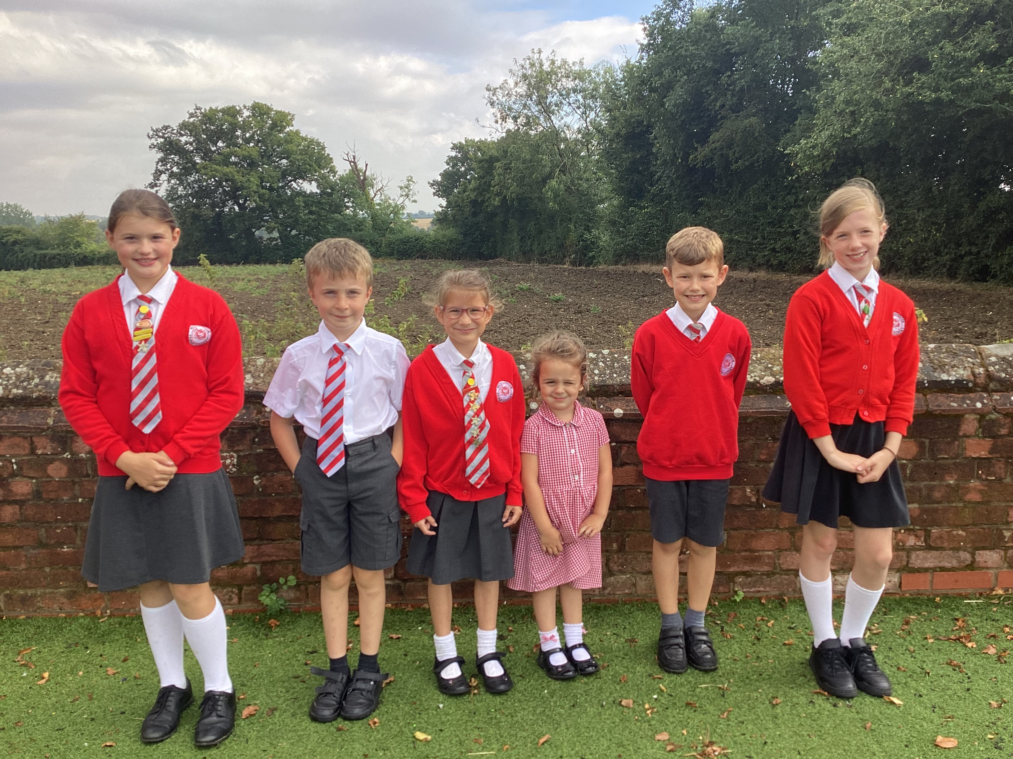

Phonics
A daily Sounds-Write phonics session will take place each morning in Robins class as well as a brief revision session in the afternoon. This will consist of learning the sounds of the letters in the alphabet (phonemes), which spellings represent these phonemes (sound-spelling correspondences) and then encouraging your child to segment the sounds in words and blend them together to read. These sessions are very ‘hands on’ and active. We will send home the sounds we are learning each week to practice at home.
Reading books
We aim to inspire a love of reading from an early age. Reading goes beyond just recognising words; it starts with exploring wordless books. These books allow you and your child to discuss what’s happening in the pictures while learning to turn pages from left to right. Asking questions about the images helps build comprehension skills that are essential for their learning journey. As phonics lessons continue, your child will receive a reading book aligned with the sounds they’ve learnt. Regular, short reading sessions at home are key. Miss Shore will share more details as the term progresses
Dojo
This is the main platform for communication between parents and staff. We will check Dojo regularly, but not usually during teaching hours, evenings or weekends. If your child is going to be absent from school please contact the school office in the first instance.
We will send weekly updates on Dojo to inform you of what learning is coming up and inform you of any events. Please note that you may receive some photos of the class/your child via Dojo but this is not weekly like you may be used to in a nursery setting.
Name Labels!
Please label all of the clothing, bags, water bottles, shoes, wellies etc that your child brings to school.
PE
Our school PE day is Friday. Please send children in PE kit* every Friday for the whole day.
*PE UNIFORM: Plain red t-shirt or a red polo t-shirt, plain black shorts, skorts or tracksuit (all with or without school logo), black or white trainers.
Our Curriculum
We provide a rich curriculum guided by ‘Development Matters’ and the CUSP Early Foundations, while also following children’s interests to keep the children motivated and engaged. We prioritise communication skills by helping children expand their vocabulary, speak in full sentences, and build positive interactions

