Slide 1

Intent
Mathematics
Intent

Slide 2
Mathematics
Why is Mathematics important?
Intent
Intent
At Wickhambrook Primary Academy, all of our teaching and learning builds on our core values; Respect, Responsibility, Resilience, Commitment and achievement. Through the Maths curriculum at Wickhambrook Primary Academy, we aim to teach our children a rich and progressive curriculum. A high quality mathematics education provides a foundation for understanding the world, to calculate, to problem solve and the ability to reason mathematically - this then leads to a sense of enjoyment and curiosity about the subject.

Slide 3
Mathematics
At Wickhambrook Primary Academy, we encourage children to develop their knowledge and understanding of mathematics and aim for all pupils to become confident mathematicians by the time they progress into secondary school. By providing opportunities to apply their mathematical skills in different contexts and across a range of subject areas, pupils will be able to work systematically to organise information, find patterns and ultimately solutions through independent and collaborative learning.
Intent
Intent

Slide 4
Mathematics
Aims of the Mathematics Curriculum
The national curriculum for Mathematics aims to ensure that all pupils:
Become fluent in the fundamentals of mathematics, including through varied and frequent practice with increasingly complex problems over time, so that pupils develop a conceptual understanding and the ability to recall and apply knowledge rapidly and accurately.
Reason mathematically by following a line of enquiry, conjecturing relationships and generalisations, and developing an argument, justification or proof using mathematical language.
Can solve problems by applying their mathematics to a variety of routine and non-routine problems with increasing sophistication, including breaking down problems into a series of simpler steps and persevering in seeking solutions.
Intent
Intent

Slide 5
Working Mathematically in Key Stage 1
The principal focus of mathematics teaching in key stage 1 is to ensure that pupils develop confidence and mental fluency with whole numbers, counting and place value. This should involve working with numerals, words and the four operations, including with practical resources [for example, concrete objects and measuring tools].
At this stage, pupils should develop their ability to recognise, describe, draw, compare and sort different shapes and use the related vocabulary. Teaching should also involve using a range of measures to describe and compare different quantities such as length, mass, capacity/volume, time and money.
By the end of year 2, pupils should know the number bonds to 20 and be precise in using and understanding place value. An emphasis on practice at this early stage will aid fluency.
Pupils should read and spell mathematical vocabulary, at a level consistent with their increasing word reading and spelling knowledge at key stage 1.
Intent
Intent

Slide 6
Working Mathematically in Lower Key Stage 2
The principal focus of mathematics teaching in lower key stage 2 is to ensure that pupils become increasingly fluent with whole numbers and the four operations, including number facts and the concept of place value. This should ensure that pupils develop efficient written and mental methods and perform calculations accurately with increasingly large whole numbers.
At this stage, pupils should develop their ability to solve a range of problems, including with simple fractions and decimal place value. Teaching should also ensure that pupils draw with increasing accuracy and develop mathematical reasoning so they can analyse shapes and their properties, and confidently describe the relationships between them. It should ensure that they can use measuring instruments with accuracy and make connections between measure and number.
By the end of year 4, pupils should have memorised their multiplication tables up to and including the 12 multiplication table and show precision and fluency in their work.
Pupils should read and spell mathematical vocabulary correctly and confidently, using their growing word reading knowledge and their knowledge of spelling.
Intent
Intent

Slide 7
Working Mathematically in Upper Key Stage 2
The principal focus of mathematics teaching in upper key stage 2 is to ensure that pupils extend their understanding of the number system and place value to include larger integers. This should develop the connections that pupils make between multiplication and division with fractions, decimals, percentages and ratio.
At this stage, pupils should develop their ability to solve a wider range of problems, including increasingly complex properties of numbers and arithmetic, and problems demanding efficient written and mental methods of calculation. With this foundation in arithmetic, pupils are introduced to the language of algebra as a means for solving a variety of problems. Teaching in geometry and measures should consolidate and extend knowledge developed in number. Teaching should also ensure that pupils classify shapes with increasingly complex geometric properties and that they learn the vocabulary they need to describe them.
By the end of year 6, pupils should be fluent in written methods for all four operations, including long multiplication and division, and in working with fractions, decimals and percentages.
Pupils should read, spell and pronounce mathematical vocabulary correctly.
Intent
Intent

Slide 8
Mathematics in Early Years
Mathematics involves providing children with opportunities to develop and improve their skills in counting, understanding and using numbers, calculating simple addition and subtraction problems; and to describe shapes, spaces, and measure
The early learning goals for mathematics
Intent
Intent
Numbers: children count reliably with numbers from 1 to 20, place them in order and say which number is one more or one less than a given number. Using quantities and objects, they add and subtract two single-digit numbers and count on or back to find the answer.
They solve problems, including doubling, halving and sharing. Shape, space and measures: children use everyday language to talk about size, weight, capacity, position, distance, time and money to compare quantities and objects and to solve problems.
They recognise, create and describe patterns. They explore characteristics of everyday objects and shapes and use mathematical language to describe them.

Slide 9
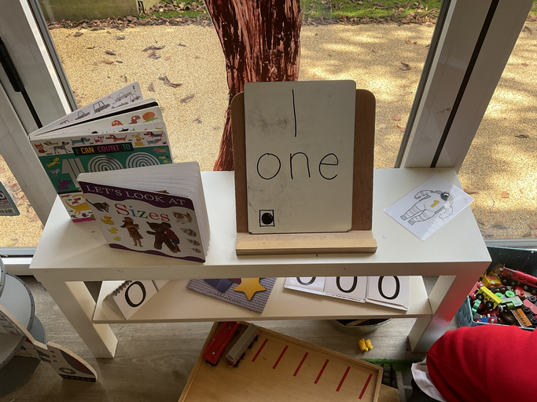
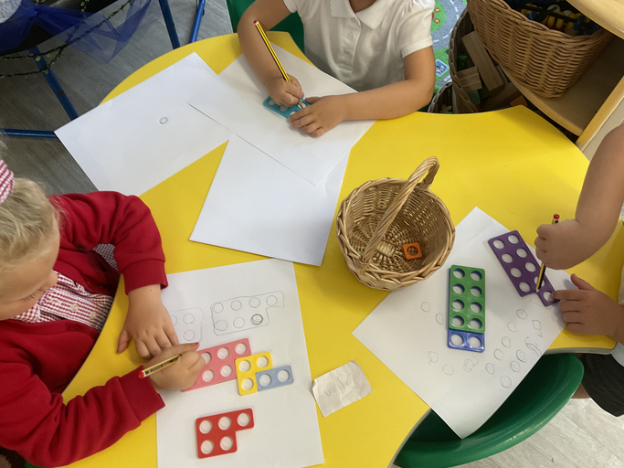
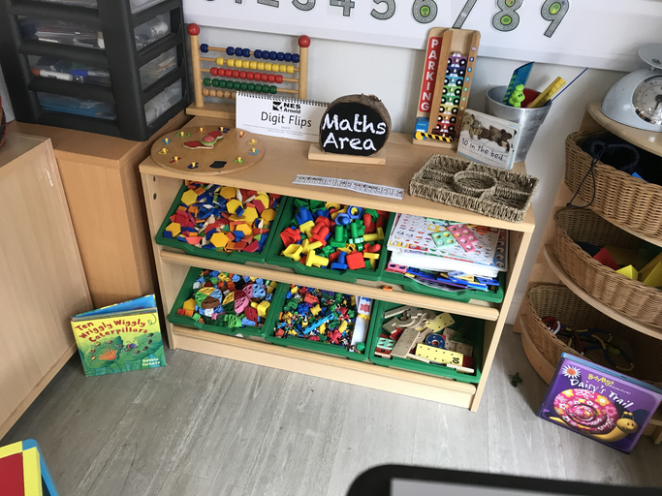
Mathematics in Early Years
Intent
Intent

Slide 10
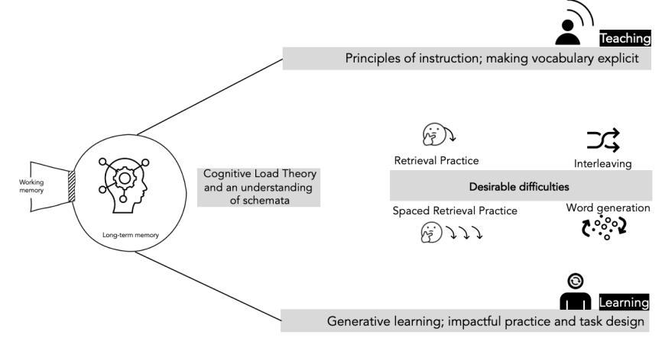
Cumulative Quizzing Model/spaced retrieval (Supporting Cognitive Load)
At the beginning of each lesson, pupils are given the opportunity to carry out retrieval practice through ‘Do it now’, ‘Flashback 4’, ‘3 in 3’ or ‘Skill drills’.
These short quiz’s will be a combination of content taught over the previous days, weeks and months to allow the pupil to connect to prior learning.
Intent
Intent

Slide 11
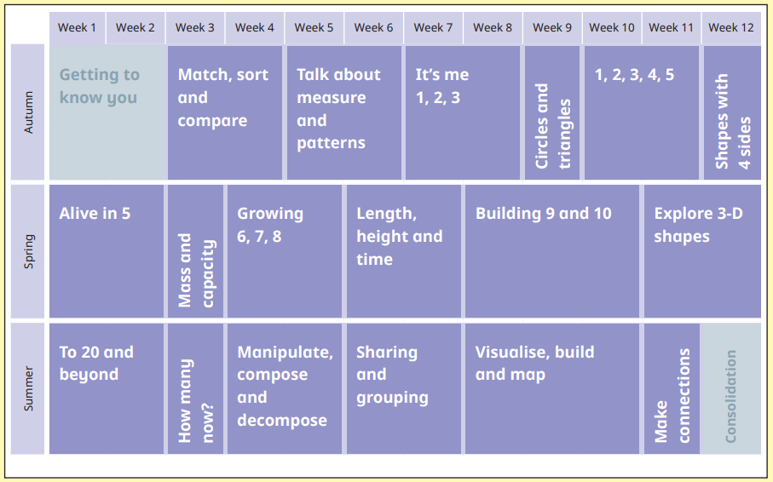
Content and Sequence – EYFS
We follow the White Rose Hub Programme for the children to secure their Mathematical skills.
Intent
Intent

Slide 12
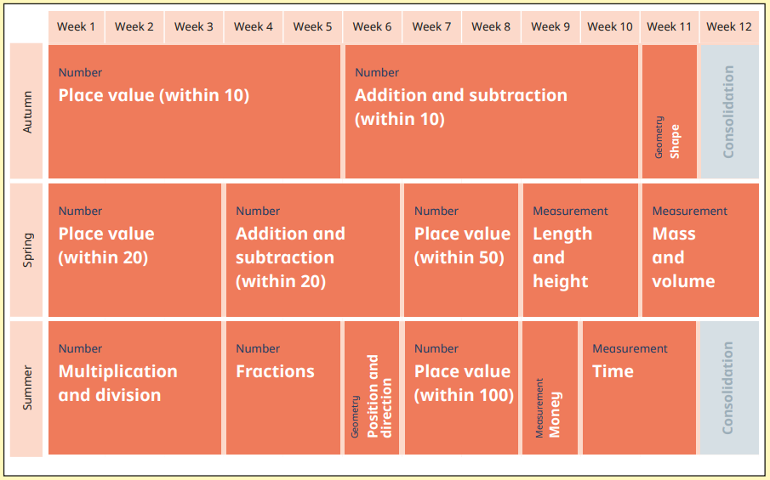
Content and Sequence – Year 1
Intent
Intent

Slide 13
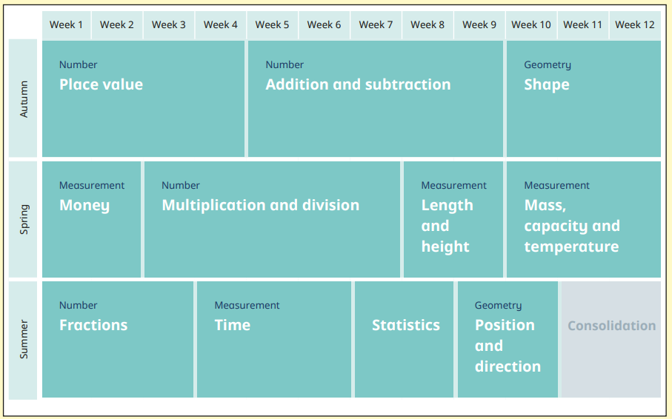
Content and Sequence – Year 2
Intent
Intent

Slide 14
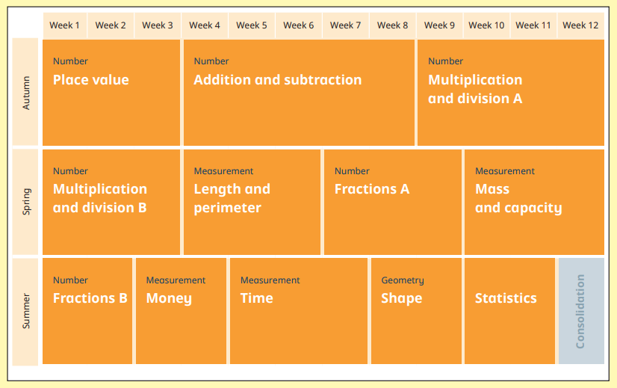
Content and Sequence – Year 3
In Key Stage 2, the White Rose Hub Programme is used for the children to develop depth and mastery in their Mathematical understanding.
Intent
Intent

Slide 15
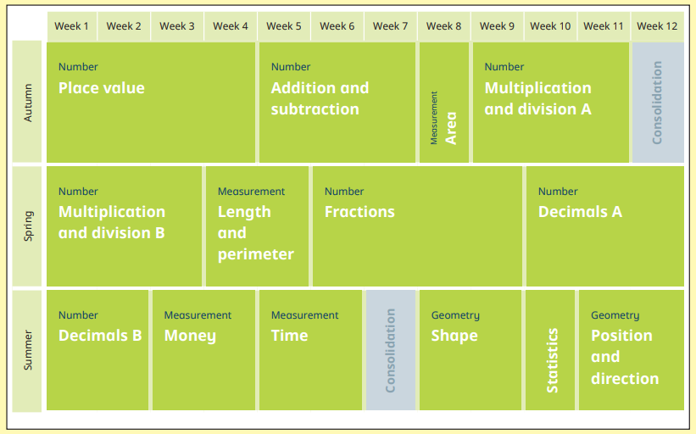
Content and Sequence – Year 4
Intent
Intent

Slide 16
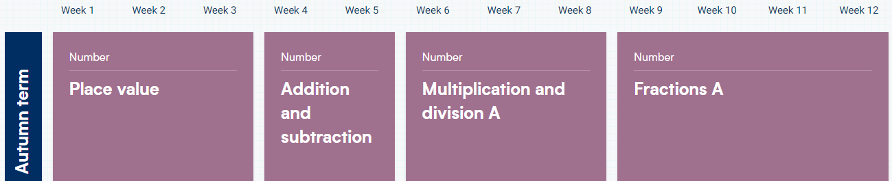
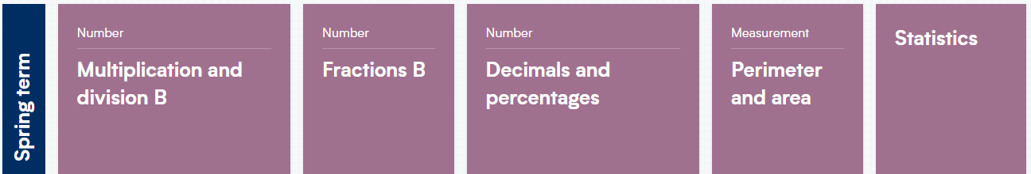

Content and Sequence – Year 5
Intent
Intent

Slide 17
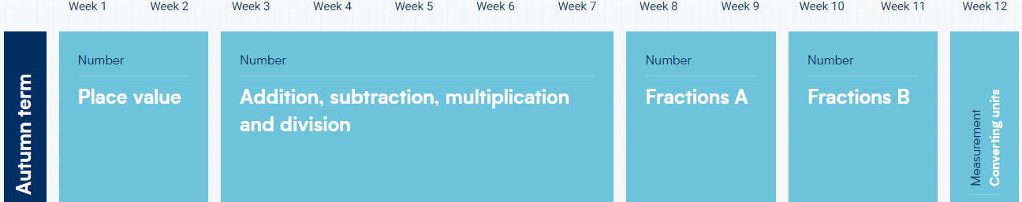
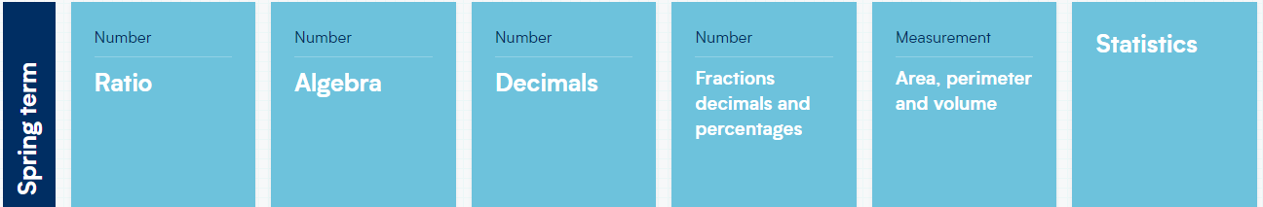

Content and Sequence – Year 6
Intent
Intent

Slide 18
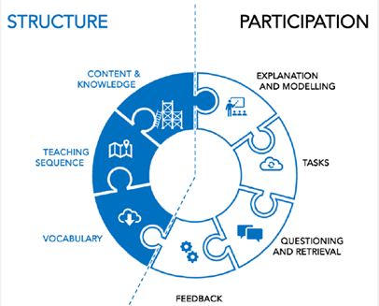
Mathematics
Implementation
Implementation

Slide 19
How is the Mathematical curriculum implemented?
At Wickhambrook, we follow the White Rose Hub scheme following a mastery approach across the whole school. This approach has three key principles: deep understanding, mathematical thinking and language, with problem solving at the heart of our curriculum. Instead of learning mathematical procedures by rote, we want pupils to build a deep conceptual knowledge and understanding.
The curriculum is cumulative - each school year begins with a focus on ‘Place Value’ which is applied throughout the curriculum. A crucial part of a 'deep understanding' in maths is being able to represent ideas in many different ways. We adopt a CPA (Concrete, Pictorial, Abstract) using objects and pictures to represent abstract concepts which is essential to achieving mastery. We believe it is essential for pupils to become independent thinkers in and out of the classroom to fully master mathematical concepts. Good questioning is used to develop pupils’ ability to compare, modify and generalise, all building a deeper understanding of mathematics.
Implementation

Slide 20
How is the Mathematical curriculum implemented?
At Wickhambrook, in Key Stage 2 we continue to use the White Rose mastery approach in the style of Concrete (using a range of manipulatives to support) – Pictorial – Abstract, to ensure that pupils have a true understanding of a concept building on their learning from Key Stage 1. Mastery is not just being able to memorise key facts and procedures and to answer test questions accurately and quickly. Mastery involves knowing why as well as knowing how. It means being able to use one’s knowledge appropriately, flexibly and creatively and to apply it in new and unfamiliar situations. Fluency is developed through offering pupils a wide range of questions and the opportunity to practice new skills. Alongside the mastery approach, we ensure that reasoning is at the core of every lesson. The pupils know that they need to explain why their answer is correct and how they have worked it out. After teachers are certain that pupils have truly mastered a concept, they can then apply their knowledge to problem solving activities.
Implementation

Slide 21
Daily Lessons
EYFS have a maths meeting every morning where they go through and count how many of their friends are in today. In the afternoon, they have a maths lesson where they are taught new concepts and then there are activities in the classroom for the children to apply their learning to.
Key Stage 1 and 2
Every learning session includes the opportunity to develop fluency skills, construct chains of reasoning using relevant knowledge alongside relevant terminology and solve increasingly complex problems in a coherent and systematic way.
Implementation

Slide 22
Interleaved learning -
As WRM is a blocked learning scheme, certain strands of maths are not covered until a later date. To ensure the revisiting of concepts, we plan and deliver interleaved learning sessions as part of our Maths lessons using Flash Backs or questions designed by the teacher from assessment analysis to cover learning from the day before, week before, month before and year before. These focus on fluency skills and some questions are from assessments for teaching strategies to understand the question as well as for consolidation.
Implementation

Slide 23

Multiplication Times Table Check (MTC)
Schools in England are required to administer an online multiplication tables check (MTC) to year 4 pupils. The purpose of the MTC is to determine whether pupils can recall their times tables fluently, which is essential for future success in mathematics. It will help schools to identify pupils who have not yet mastered their times tables, so that additional support can be provided. Pupils in Year 4 are given staggered Times Tables tests to identify focus areas and to help build fluency.
To further support pupils with their multiplication practice we use ‘Times Tables Rockstars’ as an online learning platform, which also offers resources to be used in the classroom. From Year 2
Onwards, the pupils carry out at least 4 TTRS sessions
a week before starting their core maths lesson.
Implementation

Slide 24
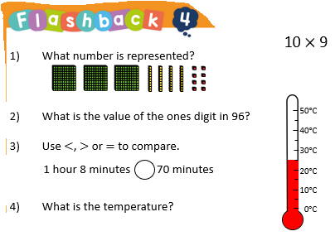
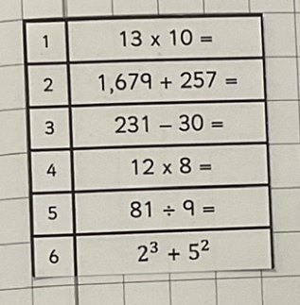
Cumulative Quizzing Model/spaced retrieval(Supporting Cognitive Load)
In Key Stage 2 these are sometimes completed in their book or recorded on Showbie.
Speed Drill
Implementation

Slide 25
Minimum lesson expectations
All maths lessons will incorporate the following elements:
Retrieving a range of Mathematical skills in the form of FlashBacks, Skill drills or 3 in 3. Maths meeting in EYFS and where a teacher feels these are necessarily in Key stage 1 and 2.
TTRS – chanting and 3 minute worksheet
Explicit teaching of vocabulary
Revisiting of prior learning
Question comprehension and applying a method
Whole class feedback
Every child challenged every lesson
Fluency, reasoning and problem solving and mastery in every lesson
Evidence of learning in pupil's books
Implementation

Slide 26
EYFS
At Wickhambrook we understand the importance of early experiences of maths. A significant emphasis is placed on developing a strong grounding in number, understanding that this is a necessary building block for children to excel in the subject.
The two ELG’s for maths are:
Number: Number composition, subitising, recall of bonds to 5 and 10 and doubling.
Numerical pattern: Verbally count beyond 20, compare quantities, explore and represent patterns.
Implementation

Slide 27
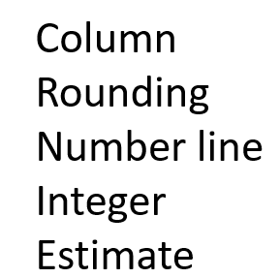
Explicit teaching of vocabulary
Vocabulary instruction is at the heart of the curriculum and subject specific words are incorporated into each lesson. Pupils are taught subject specific vocabulary at the beginning of each lesson and are encouraged to use it orally and apply it in context to develop their mathematical reasoning.
Mathematical Vocabulary:
EYFS and Key Stage 1 - Key Stage 2 –
Implementation
Add
Subtract
More than
Less than
equals

Slide 28
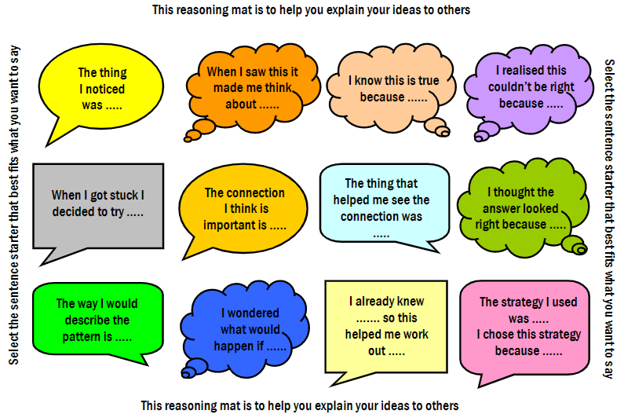
Oracy
When discussing their findings or presenting information, pupils are encouraged to speak using full sentences and incorporating key mathematical vocabulary to describe, discuss, examine, explain, justify and synthesize. This is modelled by teachers using strategies such as, ‘My Turn, Our Turn, Your Turn.’
Pupils are encouraged to use sentence stems to develop their explanation and reasoning skills.
I know this because...
I can prove it by...
I can explain it by...
I can show it...
Implementation

Slide 29
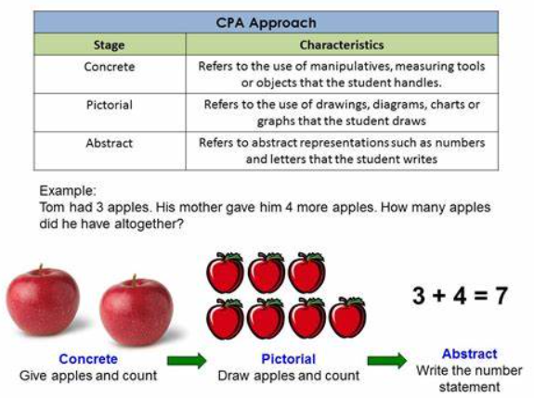
CPA
Implementation

Slide 30
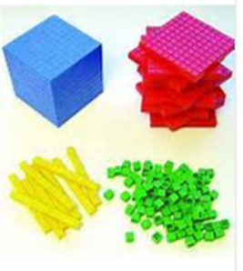
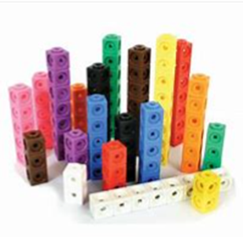
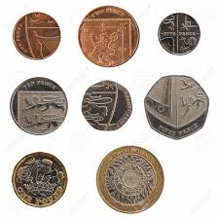
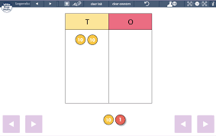
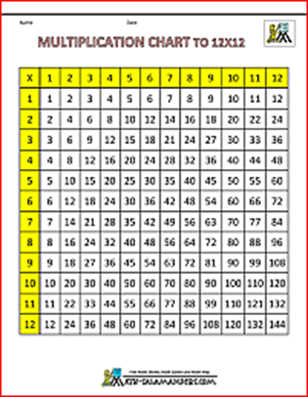
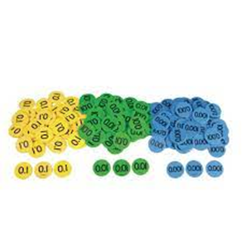
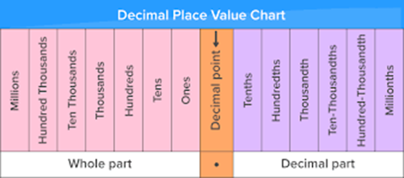
Manipulatives to support learning and independence
To support their work and to encourage independence, pupils have the opportunity to use a wide range of manipulatives, as part of the CPA approach, such as number lines, number squares, dienes and multilink. In Key Stage 2 all children have a 1:1 where they can use White Rose Hub Digital tools to support their learning.
Implementation

Slide 31
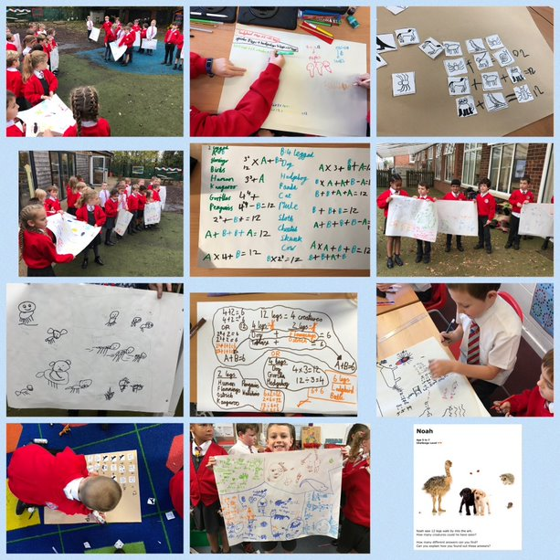
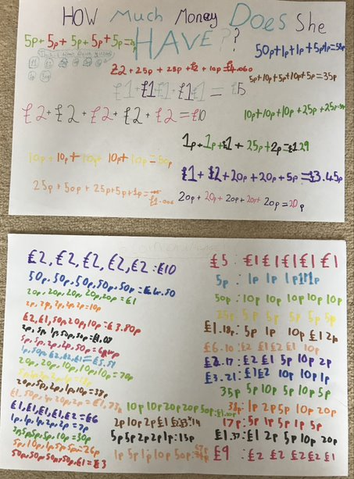
Termly Whole school Nrich days
Each term, the whole school within a week will complete the same Nrich activity for the children to develop their problem solving skills and reasoning through sharing their completed task with the rest of the school.
Implementation

Slide 32
Calculation Policy
Find our calculation policy on the link below.
Unity SP Calculation Policy 2023-24.ppsx
Our aim is to create confident mathematicians grounded with number fluency and calculation skills. We use White Rose methods and representations to ensure we achieve this. The Trust Calculation policy creates a consistent approach across the school and a clear progression of skills. Using the concrete, pictorial and abstract approach allows children to have a much deeper understanding of Mathematical concepts. Children are then able to apply this knowledge to a range of different calculations and problems. Our calculation policy is a working document and even though methods are introduced in specific year groups, we encourage teachers through formative assessment to use appropriate representations depending on the children, ensuring it builds on prior knowledge.
Implementation

Slide 33
Tailoring for SEND
At Wickhambrook Primary Academy, we aim for all mathematics lessons and learning questions to be accessible to all pupils. Pre-teaching of mathematical vocabulary provides all children with the opportunity to demonstrate an understanding of subject specific language. The use of visuals on slides and worksheets to aid understanding and recall. In addition, working walls are used, worksheets with key information on and iPads in Key Stage 2 to minimise cognitive overload, so children can use and apply their knowledge more easily. Sentence stems can be used where necessary to aid with written reasoning and problem solving. A range of manipulatives are available or digital tools for children to use manipulatives that work for them.
Implementation

Slide 34
Continuous Professional Development
All staff have undergone CPD in Cognitive Load Theory, Spaced Practice Retrieval Theory and planning the wider curriculum which has supported the development of a modular wider curriculum.
In addition, staff in Key Stage 2 have been trained in using 1:1 iPads within the classroom to use effectively in Maths lessons. There is also an area for sharing teaching using the iPads, resources and to collaborate with other schools in the Trust on Teams.
Teachers are encouraged to develop their subject knowledge by accessing resources in school and online. White Rose also has videos to support with CPD.
Maths Subject leaders have termly meetings with schools in the Trust and CPD is then provided to staff during staff meetings.
Implementation

Slide 35
Mathematics
Impact​
Impact

Slide 36
How do we measure the impact of mathematics teaching?
As a result of our aims and approach to maths teaching and learning at Wickhambrook you will see:
+ Engaged children who are regularly challenged
+ Confident children who can talk about maths
+ Lessons that use a variety of resources
+ Different representations of maths in classrooms and books.
Subject Leaders use a Padlet as a self-assessment and planning tool for developing their subject.
Both learning walks and books looks take part regularly. This is then recorded on the Padlet to see the impact of mathematics teaching.
Impact

Slide 37
Measuring the impact of Mathematics teaching
Mathematics work is regularly assessed through the use of 'Whole Class Feedback', and pupils are given regular feedback on their successes and development areas within and across modules.
Data received from assessments is analysed using QLA’s and progress is recorded across all year groups. Weekly/fortnightly arithmetic test scores are recorded at a school and trust level and interventions are put in place to enhance learning. Fortnightly, MTC scores are also recorded at school and trust level in Year 3 and 4.
Regular learning walks and book looks are carried out to monitor pupil performance.
Impact
Impact

Slide 38
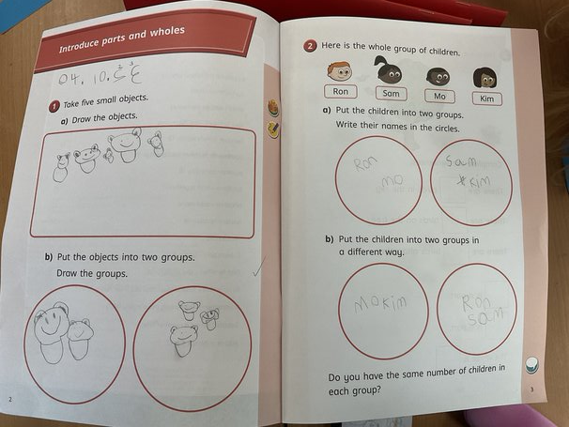
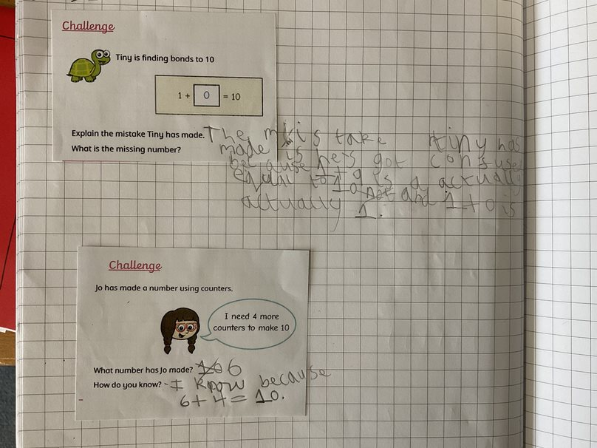
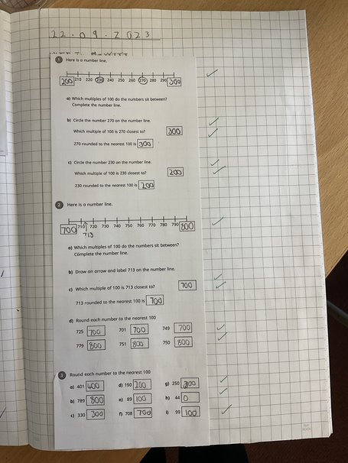
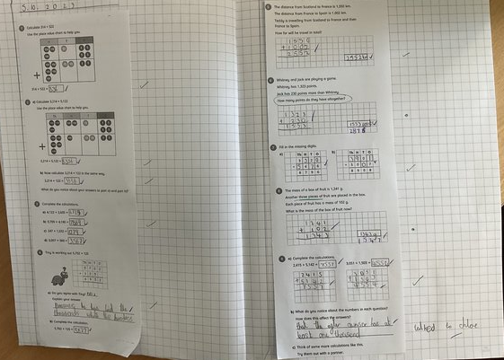
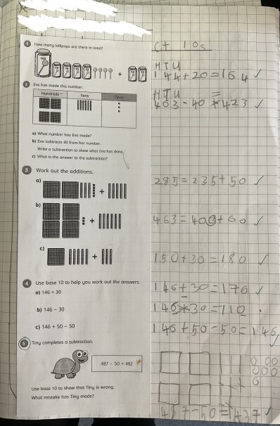
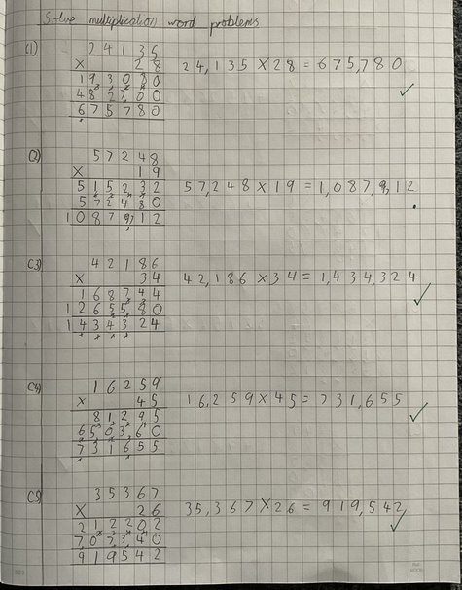
Impact
Impact

