Slide 1
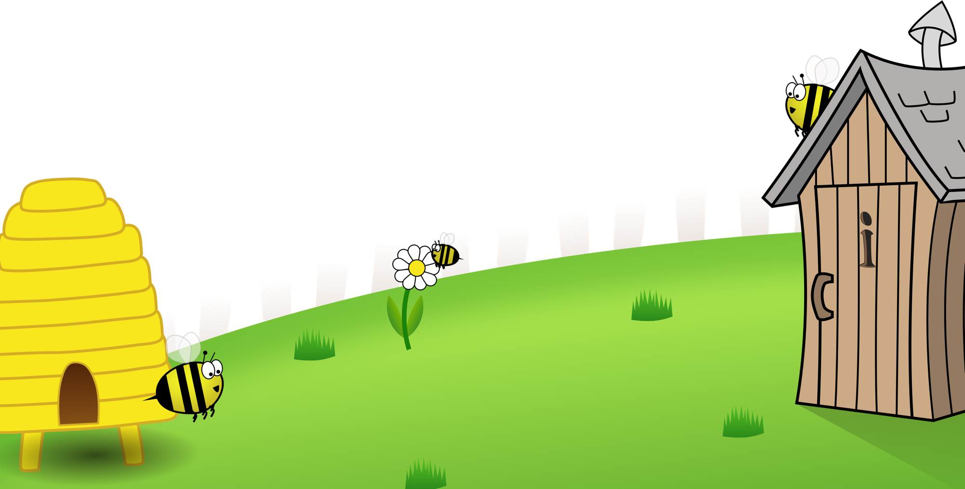
Spelling Scheme of Work
Year 5
All elements of this scheme are copyright © The Spelling Shed Ltd and may not be redistributed without permission.
19/06/19

Slide 2
Spelling lists – Stage 5
Spelling Rules: Words ending in ‘-ious.’
Spelling Rules: Words ending in ‘–cious.’ If the root word ends in –ce the sound is usually spelled ‘-cious.’
Spelling Rules: Ending ‘-cial’ and ‘-tial.’ After a vowel ‘-cial’ is most common and ‘-itial’ after a consonant. But there are many exceptions.
Spelling Rules: Ending ‘-cial’ and ‘-tial.’ After a vowel ‘-cial’ is most common and ‘-itial’ after a consonant. But there are many exceptions.
Spelling Rules: Ending ‘-cial’ and ‘-tial.’ After a vowel ‘-cial’ is most common and ‘-itial’ after a consonant. But there are many exceptions.
Challenge words
Spelling Rules: Words ending in ‘-ant.’ ‘-ant’ Is used if there is an ‘a’ or ‘ay’ sound in the right place.
Spelling Rules: Words ending in ‘-ance.’ ‘-ance’ Is used if there is an ‘a’ or ‘ay’ sound in the right place.
Spelling Rules: Use –ent and -ence after soft c (/s/ sound), soft g (/j/ sound) and qu. There many exceptions to this rule.
Spelling Rules: Words ending in ‘-able’ and ‘-ible.’ ‘-able’ is used where there is a related word ending ‘-ation.’
Spelling Rules: Words ending in ‘-ably’ and ‘-ibly.’ The ‘-able’ ending is usually but not always used if a complete root word can be heard before it. ‘y’ endings comply with previously learned rules and is replaced with ‘i’ as in rely > reliably
Challenge Words
Spelling Rules: Words ending in ‘-able.’ If this is being added to a root word ending in –ce or –ge then the e after the c or g is kept other wise they would be said with their hard sounds as in cap and gap.
Spelling Rules: Adverbs of time (temporal adverbs) these are words to develop chronology in writing.
Spelling Rules: Adding suffixes beginning with vowel letters to words ending in –fer. The r is doubled if the –fer is still stressed when the ending is added. If the –fer is not stressed then the r isn’t doubled.
Spelling Rules: Words with ‘silent’ letters at the start.
Spelling Rules: Words with ‘silent’ letters (i.e. letters whose presence cannot be predicted from the pronunciation of the word)
Challenge Words
Spelling Rules: Words spelled with ’ie’ after c.
Spelling Rules: Words with the ‘ee’ sound spelled ei after c. The ‘i before e except after c’ rule applies to words where the sound spelled by ei is /ee/ However there are exceptions like those in the spellings.
Spelling Rules: Words containing the letter string ‘ough’ where the sound is /aw/.
Spelling Rules: Words containing the letter string ’ough’ where the sound is /o/ as in boat or ‘ow’ as in cow.
Spelling Rules: Adverbs of possibility. These words show the possibility that something has of occurring.
Challenge Words
Spelling Rules: These words are homophones or near homophones. They have the same pronunciation but different spellings and/or meanings.
Spelling Rules: These words are homophones or near homophones. They have the same pronunciation but different spellings and/or meanings.
Spelling Rules: These words are homophones or near homophones. They have the same pronunciation but different spellings and/or meanings.
Spelling Rules: These words are homophones or near homophones. They have the same pronunciation but different spellings and/or meanings.
Spelling Rules: These words are homophones or near homophones. They have the same pronunciation but different spellings and/or meanings.
Challenge Words
Spelling Rules: Hyphens can be used to join a prefix to a root word, especially if the prefix ends in a vowel letter and the root word also begins with one.
Revision: Year 5 words
Revision: Year 5 words
Revision: Year 5 words
Revision: Year 5 words
Revision: Year 5 words

Slide 3
