Slide 1
Supporting your child through exam season
Year 11 Pre exam parent information evening
Aspirational Brave Compassionate

Slide 2
Welcome
Why are we here?
To support you to help your child succeed
To provide practical revision techniques
To give exam season tips and strategies
Aspirational Brave Compassionate

Slide 3
The journey so far
Chose options in March 2023
2 years of studying their options
2 sets of mocks completed
There is time…
Aspirational Brave Compassionate

Slide 4
Key dates
1st exams begin at the end of April
May half term 26th May
Study leave date in June (TBC)
Final exam… 18th June
Contingency day - Weds June 25th
National unforeseen circumstances
Prom: 3rd July
Aspirational Brave Compassionate

Slide 5
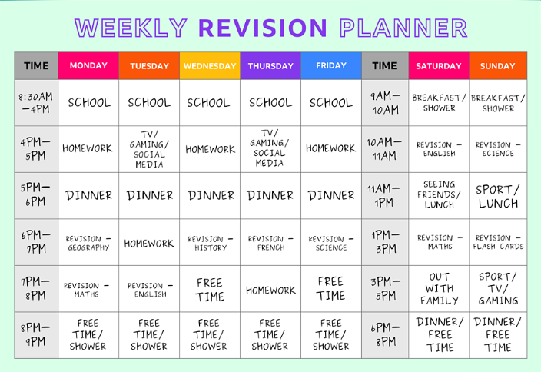
Importance of balance
Revision timetables
Ensure they don’t miss anything
Balance out the day
Focus your time
Settle anxiety
Allow for breaks!
https://www.bbc.co.uk/bitesize/groups/cd5exmm663et
Aspirational Brave Compassionate

Slide 6
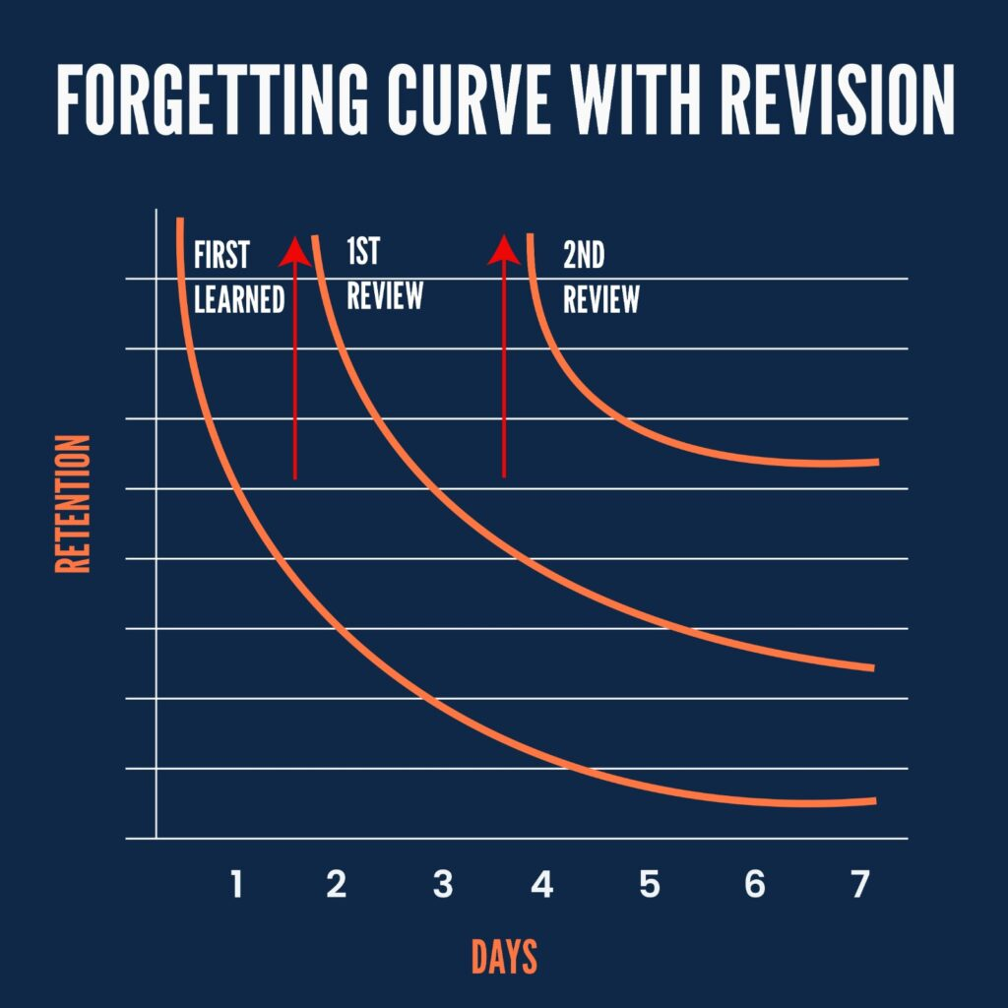
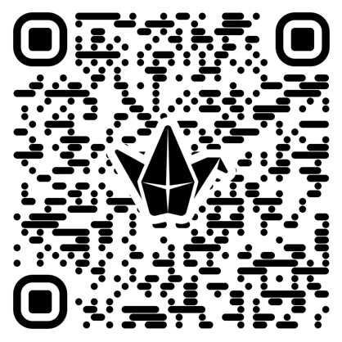
Revision strategies
At this point, answering exam style questions is the most effective way to revise.
Don’t avoid the bits you are unsure on.
Ensure the focus is on the revision content, rather than the creativity.
Past papers and mark schemes are available at:
www.Revisionworld.com
Padlet QR code
Avoid distractions
Revise in a quiet comfortable space

Slide 7
Revision opportunities in school
Muster revision
Study Club
After school revision offer
Core PE revision sessions (optional)
Question level analysis materials from maths
Aspirational Brave Compassionate

Slide 8
On the day exam tips
Night before:
Pack everything you need: avoid those last minute morning panics
Sleep! Zzz
Morning routine:
Up in plenty of time for a good breakfast – feed their brain!
Additional breakfast available in the canteen before morning exams.
Arrive in time to benefit from your specialist teachers being there for pre-exam check in, where staffing allows for it.
During the exam:
Read instructions carefully
Deep breath – and off you go!
If you draw a blank - move on and come back
Plan your longer answers keeping marks available in mind
Check your answers
Aspirational Brave Compassionate

Slide 9
After an exam
Avoid over analysing answers with friends or at home
Focus on the next exam
Take a break before revising again
Stay positive and focus on the bits they knew
Aspirational Brave Compassionate

Slide 10
Top tips:
Encourage without adding pressure
Support your child to plan ahead
Celebrate the small wins
Keep communication open
Expect some stress
Model the ideal habits
Encourage them.
Point out what they're good at.
Tell them daily what they do well.
Make mention of past success, current success with revision, success in previous exams.
Reward effort.
If you look at their work, don’t overly focus upon errors, also point out what they've done well.
Create a suitable environment for revision, reducing distractions
Consider inviting friends round. Shared revision can make it easier and more productive.
Don't join in the general anxiety; be a picture of serene confidence!
Aspirational Brave Compassionate

Slide 11
Practical bits
Absolutely no phones in the room.
No catch up exams
Morning exam time 9:00
Afternoon Exam time 13:30 – bus students including extra time.
Clashes: students will be given some choice in how this is managed – either supervision in-between or back to back.
If there is a disaster, and you are late to an exam - Call the school ASAP and you will be advised from there.
No watches but 2 clocks in the room one analogue and one digital.
Start and finish times will be displayed including extra time.
Assembly for students after easter.
Aspirational Brave Compassionate

Slide 12
Who to contact
Head of Year:
epickerin@samuelward.co.uk
Ed Pickerin will then put you in contact with the most appropriate person.
Aspirational Brave Compassionate

Slide 13
Questions?
Aspirational Brave Compassionate

Slide 14
Course | SWA
Art | AQA
Biology | AQA
Chemistry | AQA
Combined Science: Trilogy | AQA
Design and Technology | AQA
Drama | Pearson Edexcel
English Language | AQA
English Literature | AQA
Film Studies | WJEC Eduqas
French | AQA
Geography | AQA
Health & Social Care (Tech Award) | Pearson BTEC
History | Pearson Edexcel
Hospitality and Catering | WJEC Eduqas
Mathematics | Pearson Edexcel
Music | WJEC Eduqas
PE | OCR Cambridge
Photography | AQA
Physics | AQA
Sociology | AQA
Statistics | AQA

