Slide 1
GCSE Options 2024
Subject name: GCSE Physical Education
Head of Department / Subject contact: Mr Morrison

Slide 2
What will I learn?
GCSE Physical Education
Physical Factors affecting Performance
  Muscles, skeletal, cardiovascular, effects of exercise, training principles, training methods, sports injuries
Social & Cultural Issues in Sport
  Deviance in sport, drugs, gamesmanship, violence, ethics
Practical Sports Performance
  Three sports (Team and/or individual)
Analysis of Performance
  One sport

Slide 3
How will I be assessed?
GCSE Physical Education
Physical Factors affecting Performance
  Exam – 1 hour – 30%
Social & Cultural Issues in Sport
  Exam – 1 hour – 30%
Practical Sports Performance
  Practical assessment – 3 sports – 30%
Analysis of Performance
  Non-exam assessment (NEA) – 10%

Slide 4
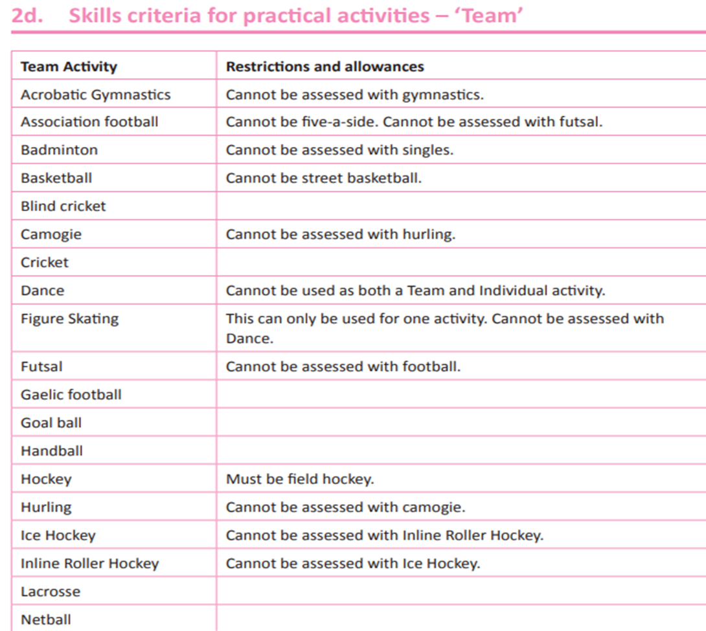
GCSE PE Team sports

Slide 5
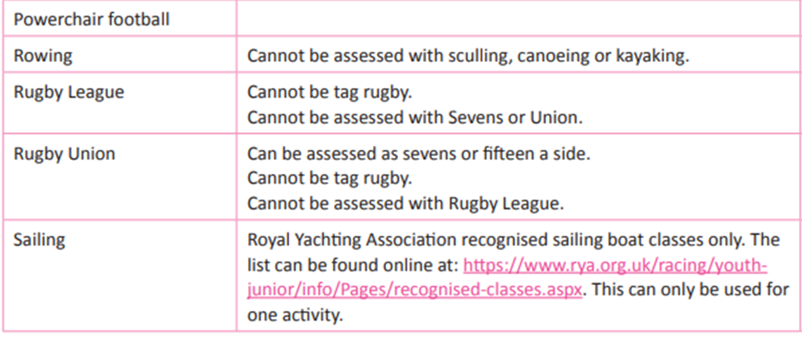
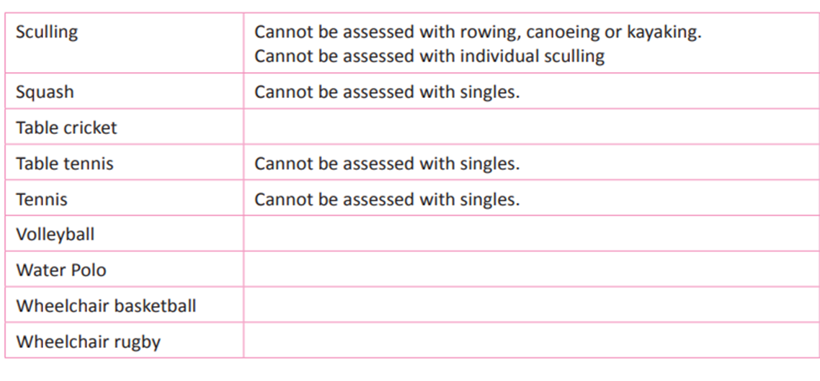
GCSE PE Team sports

Slide 6
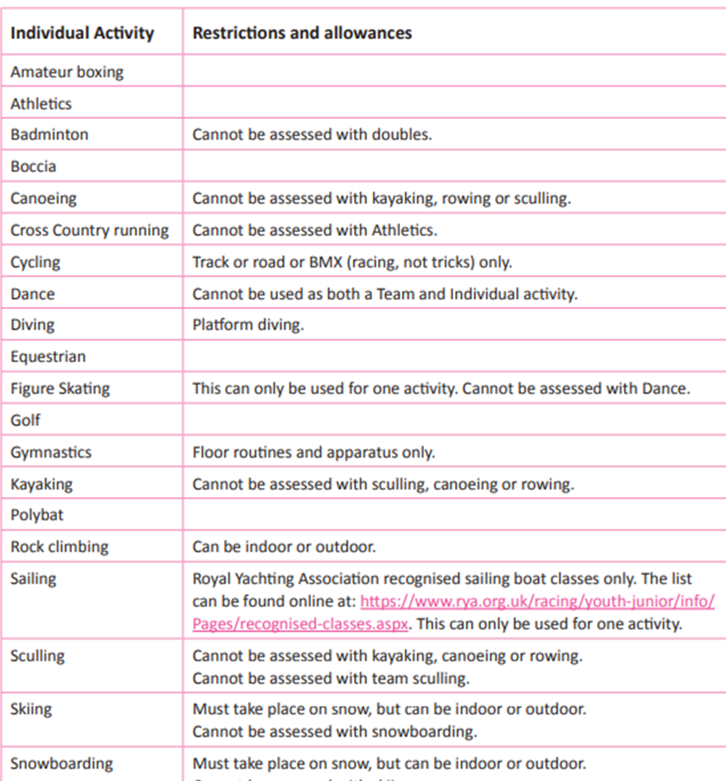

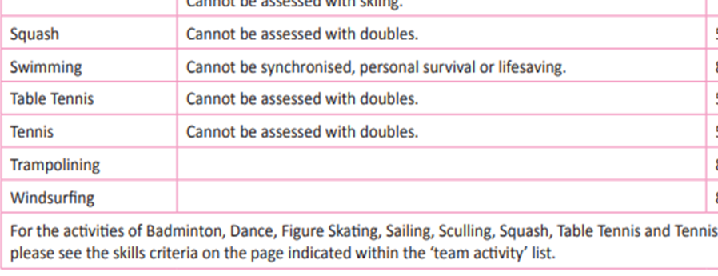

Slide 7
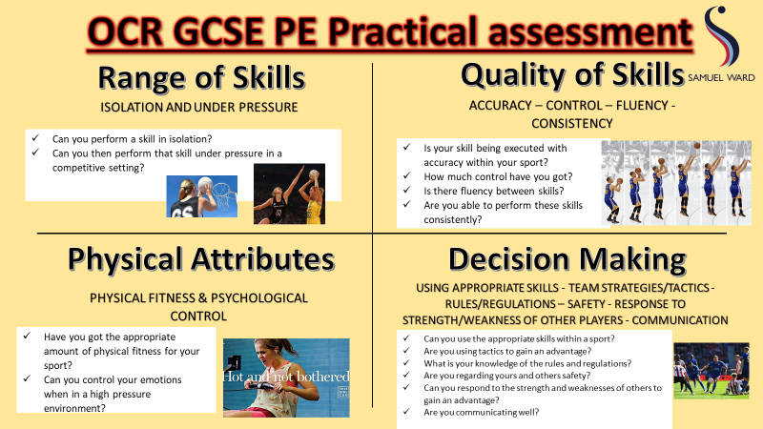

Slide 8
What are the possible progression opportunities?
Many of our former students have gone onto:
  A Level PE or Level 3 Sport
  University – sports science, sports coaching, PE teaching, physiotherapy and a multitude of other careers.
  Particular student successes
  Strength & Conditioning coach with Sunderland 1st Team
  Lead Physiotherapist at Birmingham City Hospital
  PE Teacher here at Samuel Ward
  Built his own Sports Coaching company working with local primary schools
  PT, health and nutrition coach at PureGym.
  Many, many more

Slide 9

WHAT CAREERS DOES THIS COURSE LEAD TO?
Fitness Instructor
Events Management
Gym Instructor
COMMERCIAL
HEALTH AND FITNESS
Sports Development Manager
Health Promotion Officer
Nutritionist
Talent Identification Manager
Outdoor Adventure Instructor
Clinical Exercise Specialist
TEACHING
PE Teacher
Head of Sports Science
SCIENCE
Community Sports Coach
Physiotherapist
Performance Analyst
Children's Sports Coach

Slide 10
Common misconceptions and general advice
GCSE PE - 5 lessons a fortnight – 4 to 5 are theory/classroom. The practical performance takes place as a GCSE group within core PE (3 lessons a fortnight)
Students playing sport outside of school regularly tend to achieve higher marks in their practical grades

