Slide 1
GCSE FILM STUDIES Head of Department: Miss Hopkins Dhopkins@samuelward.co.uk
Aspirational Brave Compassionate
Notes:
Welcome address – context and reason behind the assembly

Slide 2
Key Skills: Creativity Artistic Vision Semiotics Communication Team work Editing Resilience
Aspirational Brave Compassionate
Notes:
Welcome address – context and reason behind the assembly

Slide 3
Key Skills: Creativity Artistic Vision Semiotics Communication Team work Editing Resilience
The study of signs and symbols and their use or interpretation.
late 19th century: from Greek sēmeiotikos ‘of signs’, from sēmeioun ‘interpret as a sign’.
Aspirational Brave Compassionate
Notes:
Welcome address – context and reason behind the assembly

Slide 4
Key Skills: Creativity Artistic Vision Semiotics Communication Team work Editing Resilience
Aspirational Brave Compassionate
Notes:
Welcome address – context and reason behind the assembly

Slide 5
Key Skills: Creativity Artistic Vision Semiotics Communication Team work Editing Resilience
Aspirational Brave Compassionate
Notes:
Welcome address – context and reason behind the assembly

Slide 6
Key Skills: Creativity Artistic Vision Semiotics Communication Team work Editing Resilience
Aspirational Brave Compassionate
Notes:
Welcome address – context and reason behind the assembly

Slide 7
HOW DO WE ANALYSE FILMS?
MISE EN SCENE
MICRO ELEMENTS
CINEMATOGRPAHY
EDITING
SOUND
Aspirational Brave Compassionate

Slide 8
HOW DO WE ANALYSE FILMS?
MISE EN SCENE
MICRO ELEMENTS
CINEMATOGRPAHY
EDITING
SOUND
CONTEXT
MACRO ELEMENTS
REPRESENTATION
NARRATIVE
GENRE
Aspirational Brave Compassionate

Slide 9
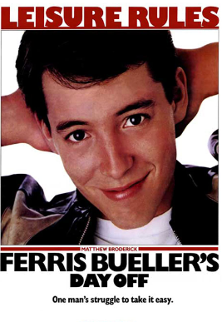
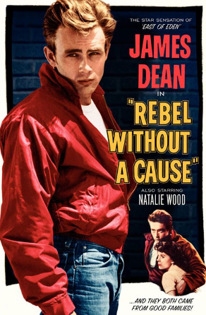
Aspirational Brave Compassionate

Slide 10
GCSE Film Studies Course Breakdown
Unit 1:
US FILM
1 hr 30 mins exam at end of course totaling 35% of your final grade
Unit 2:
Global Film
1 hr 30 mins exam at end of course totaling 35% of your final grade
Unit 3:
Film Production
2-2 1/2 minute production , and evaluation in final year of course, totaling 30% of your final grade.
Aspirational Brave Compassionate

Slide 11
UNIT 3: You Have a Choice of Film Intro or Script
Film Intro
Screenplay
• science fiction
• romance
• horror
• the teenage film
• action
The extract must take the form of one of the following two options:
• the opening of the film or
• an extract from any part of the film which introduces a character.
The extract must be between 2 minutes and 2 minutes 30 seconds.
• science fiction
• romance
• horror
• the teenage film
• action
The extract must take the form of one of the following two options:
• the opening of the film or
• an extract from any part of the film which introduces a character. The extract must be between 800 and 1000 words. It must be accompanied by a shooting script of a key section from the screenplay (approximately 1 minute of screen time, corresponding to approximately one page of screenplay).
Aspirational Brave Compassionate

Slide 12
Film Industry
Aspirational Brave Compassionate

Slide 13
Visit: https://www.screenskills.com/job-profiles/
Film Studies Prepares You for a Variety of Career Pathways
Aspirational Brave Compassionate

Slide 14
Careers: Director Cinematographer Animator Grip Set Designer Sound Designer Editor Props manager Cinema Manager Journalist Photographer Costume Designer
Aspirational Brave Compassionate
Notes:
Welcome address – context and reason behind the assembly

