Slide 1
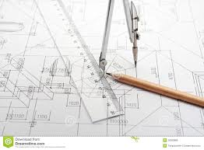
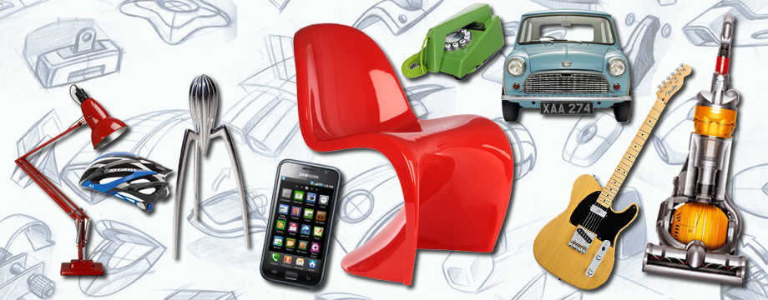
Design Engineering Department
GCSE
Design Technology Option Choice

Slide 3
How our world has change due to advances in..........

Slide 4
DT is an important subject that connects across many disciplines and can give you:
career opportunities in STEM (Science Technology Engineering & Maths)
a greater understanding of technology, society and the environment
a chance to be creative
Advanced problem solving skills
the opportunity to learn practical life skills
Computer design and manufacture

Slide 5
Careers and Courses

Slide 6
The Design Technology Course
Learn skills that are relevant to industry and career paths.
Considered a very highly creditable GCSE subject by Colleges, Universities and employers.
You will develop a wide range of skills in Engineering and Resistant Materials.
Includes 15% Maths and Science
Focuses on functional products

Slide 7
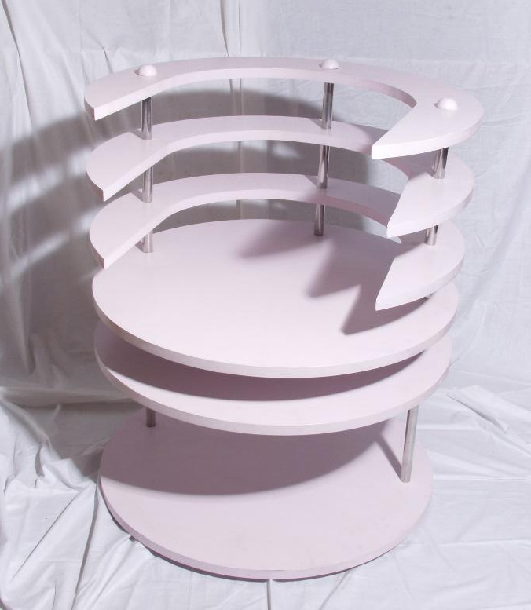
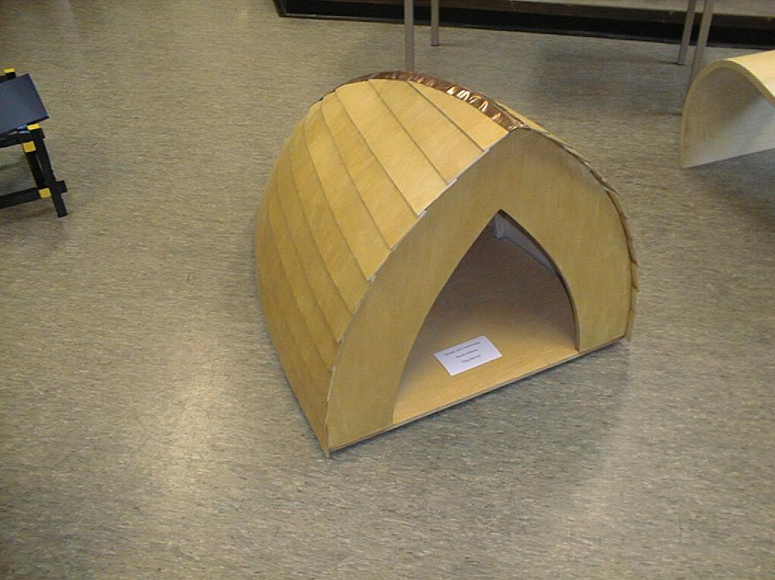
Assessment
Unit 1: Written Paper Exam
50% of total marks
2 hours
100 marks
Tests knowledge on designing and making, design theory and technical principles
Unit 2: Coursework Design and Making:
50% of total marks
A3 design folder and a practical outcome.
Approximately 35 hours

Slide 8
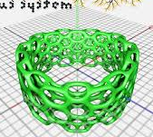
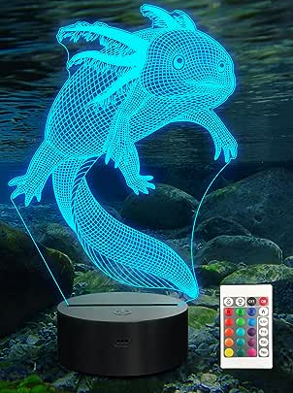
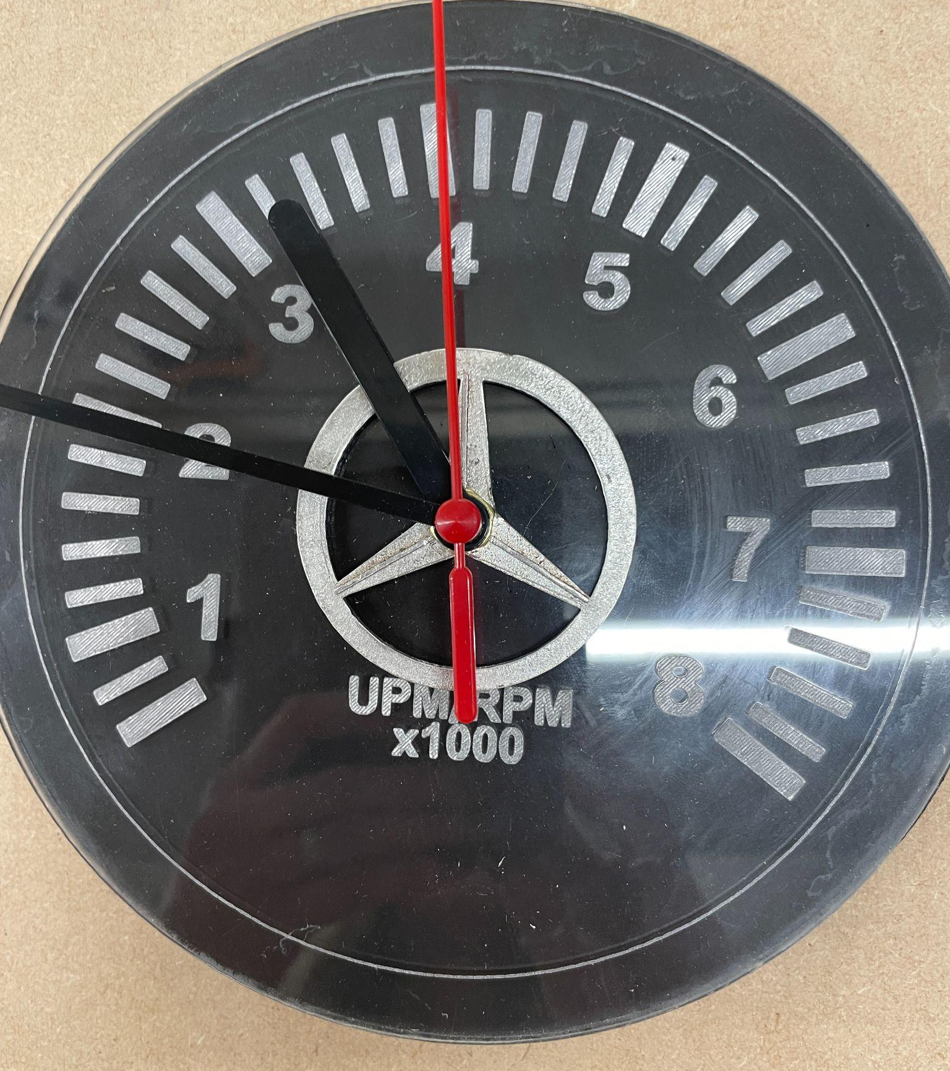
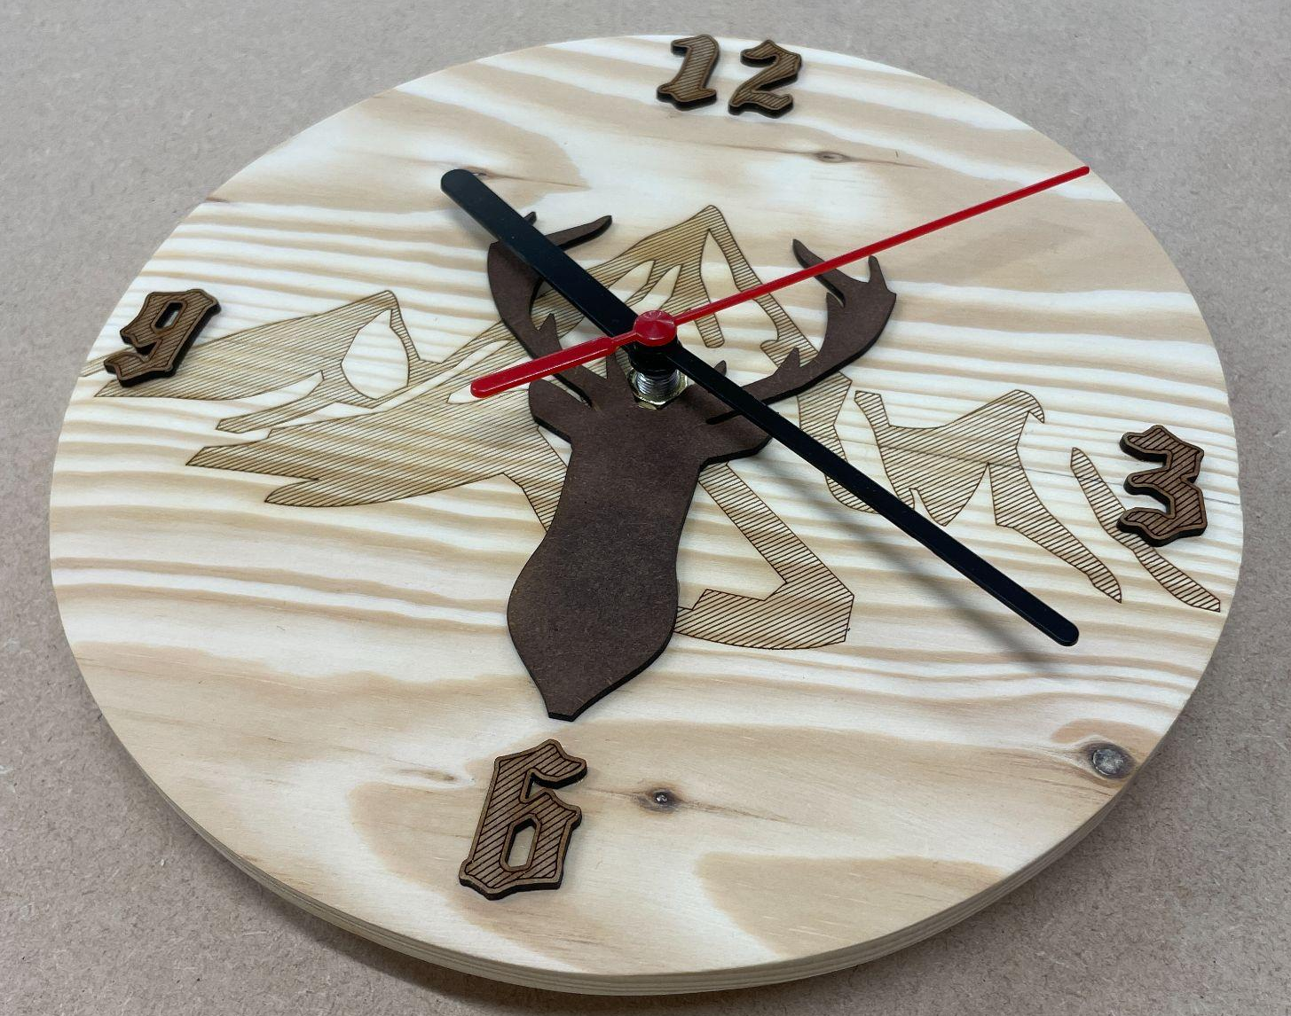
Introduction to materials and processes through a range of mini projects covering resistant Materials, electrical and mechanical technology and computer design skills:
Clock project.
Lighting project.
3D modeling
CAD and 3D Printing
Students choice of project
Y10

Slide 9
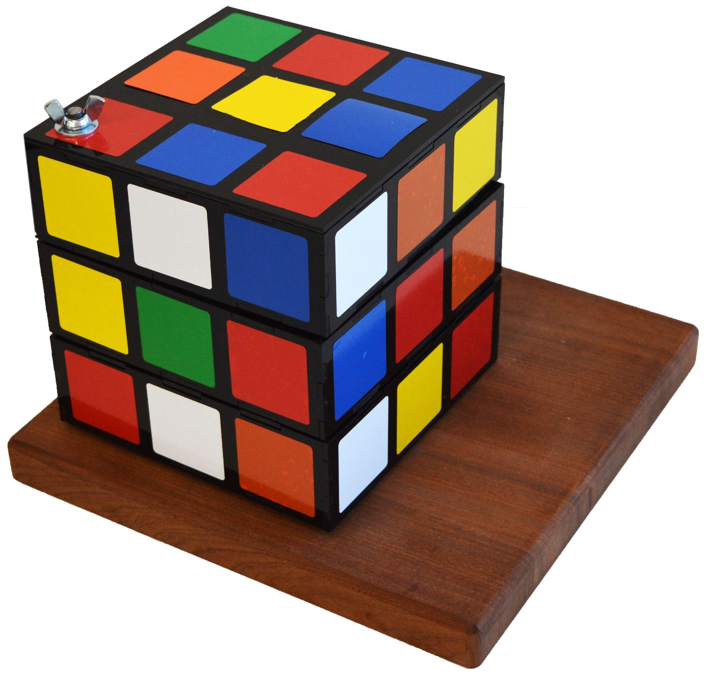
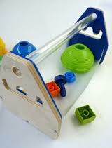
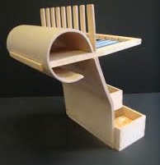
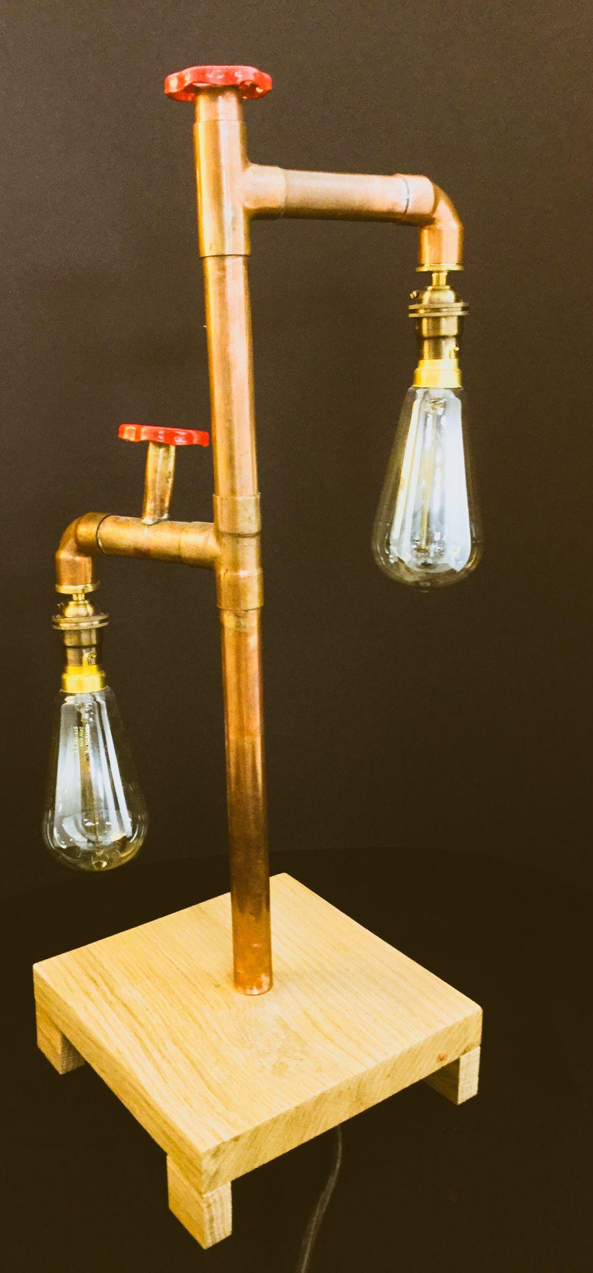
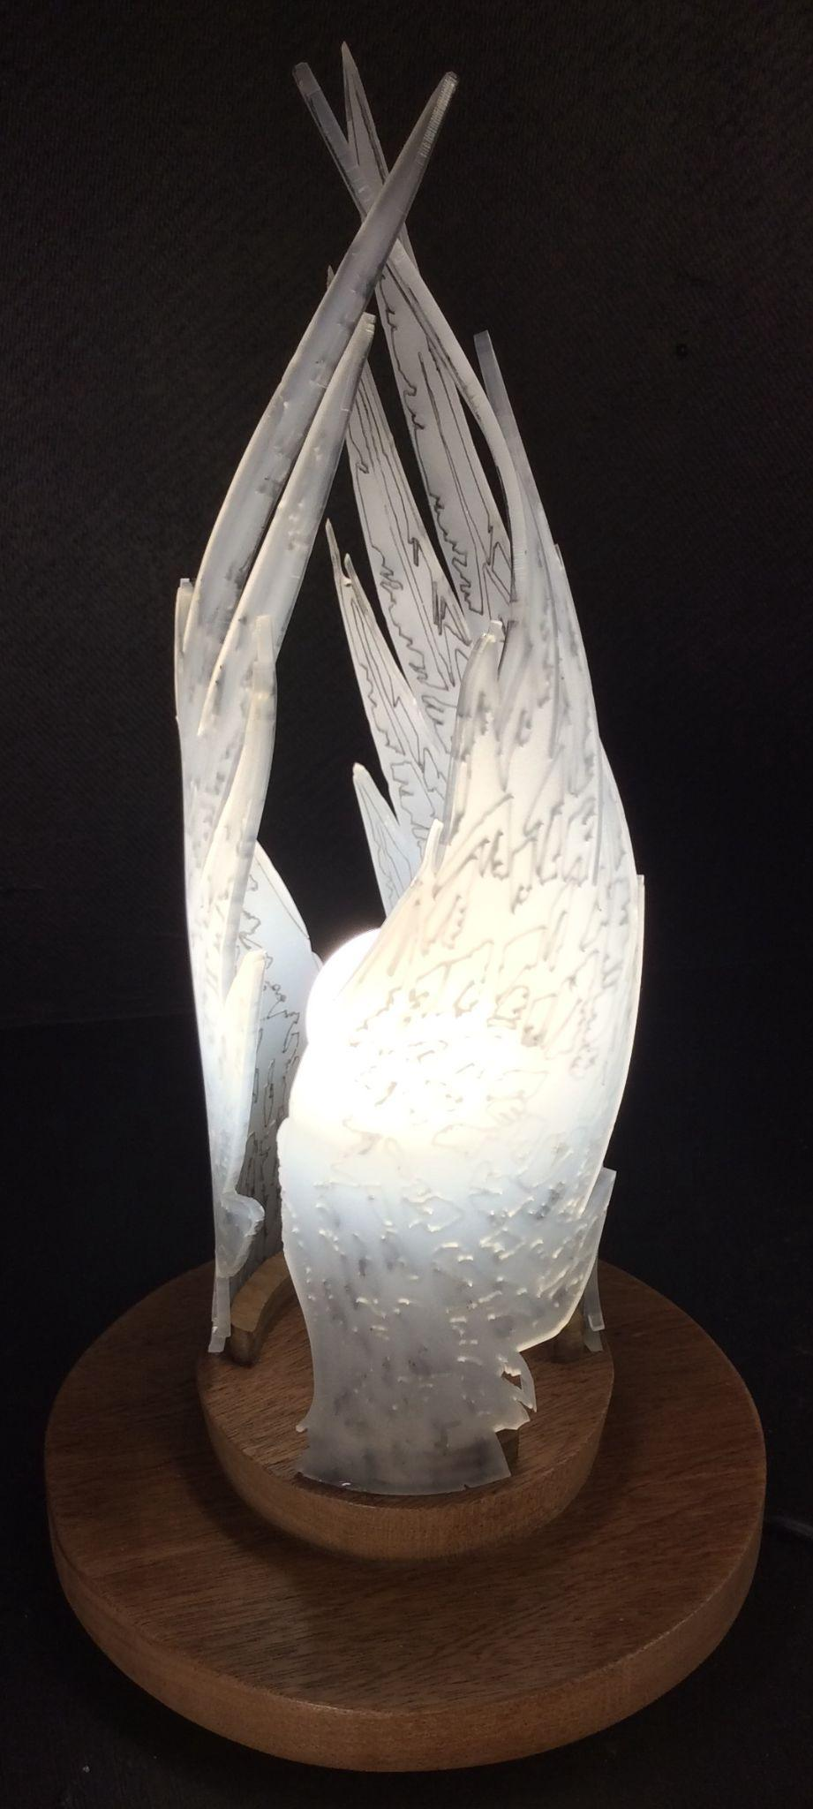
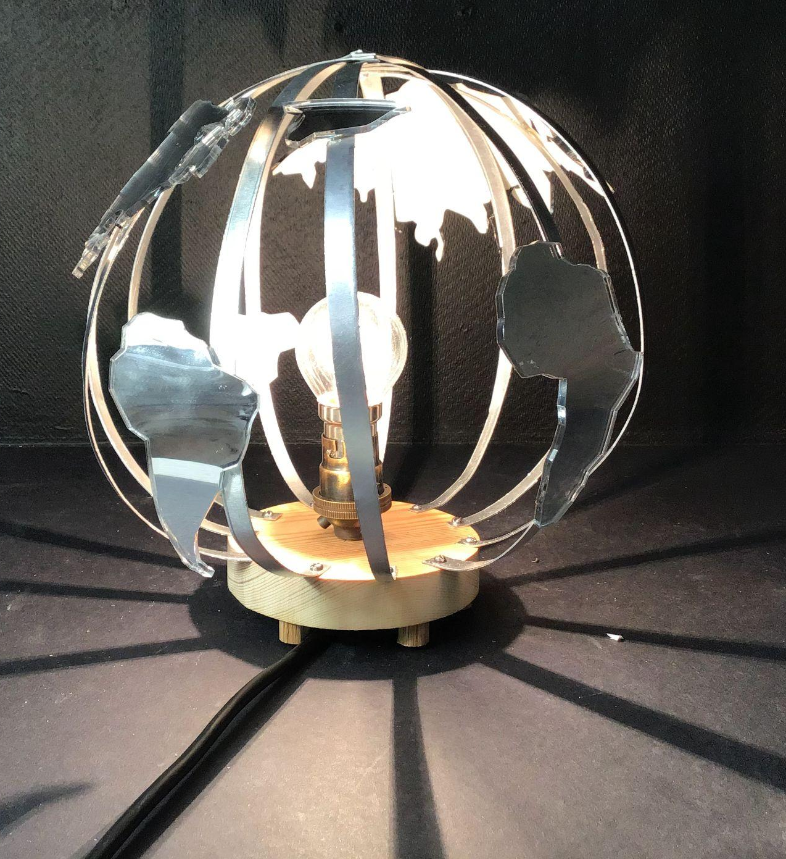
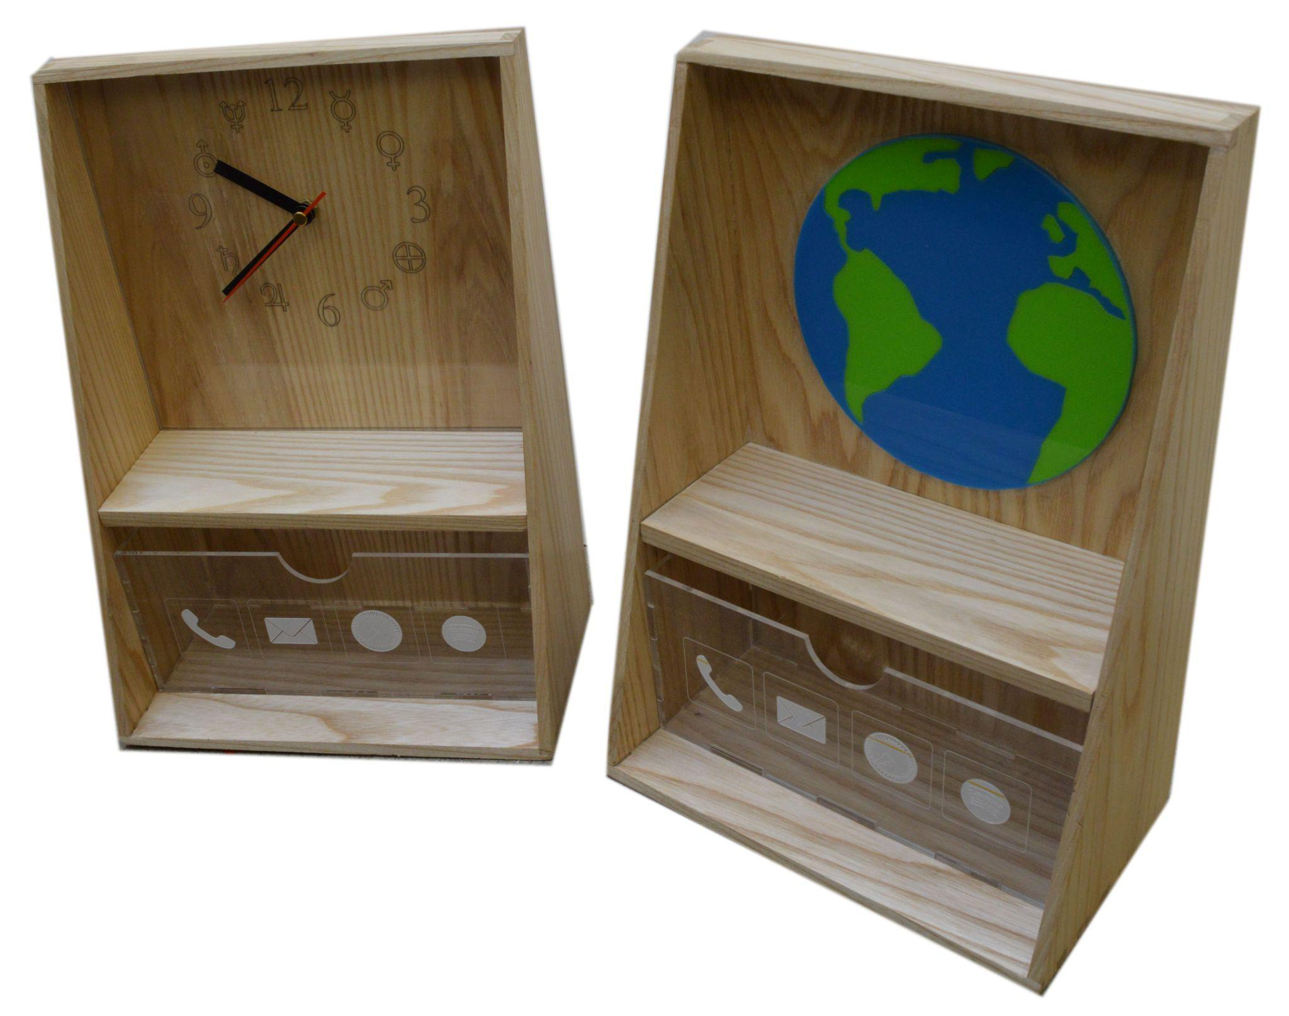
Exam Theory Preparation and Coursework.
Some lessons will focus on exam theory knowledge and understanding.
Coursework: You choose a design task from a range provided from the exam board.
Then produce a design folder and practical final outcome.
Y11

Slide 10
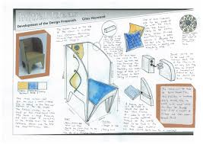
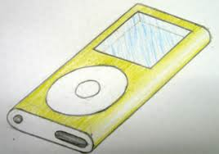
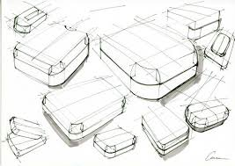
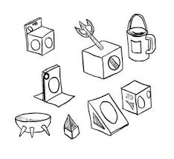
Drawing Skills

Slide 11
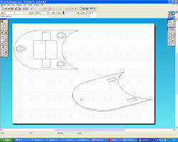
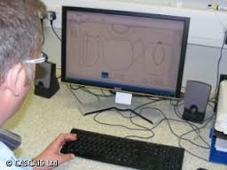
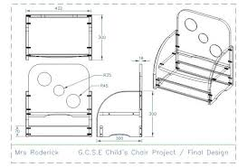
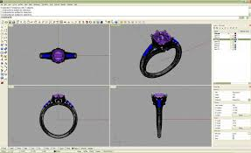
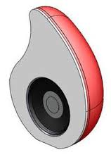
CAD Skills

Slide 12
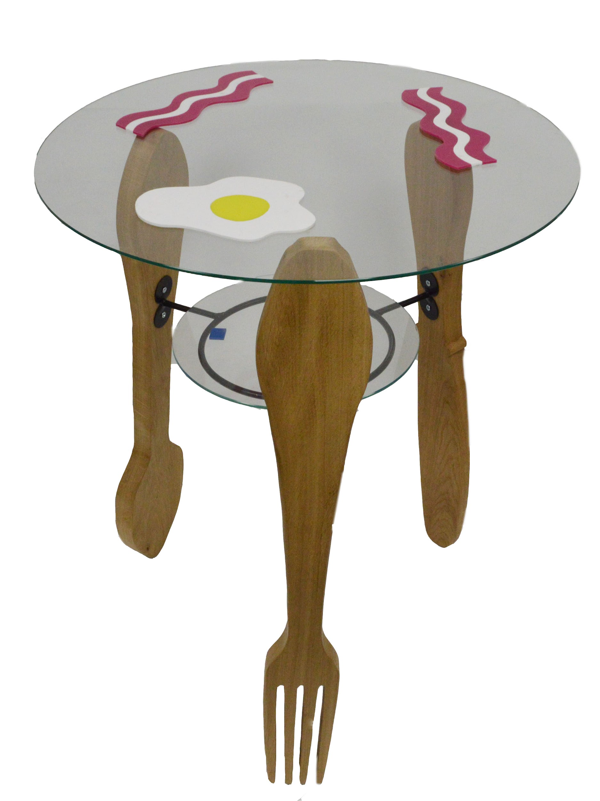
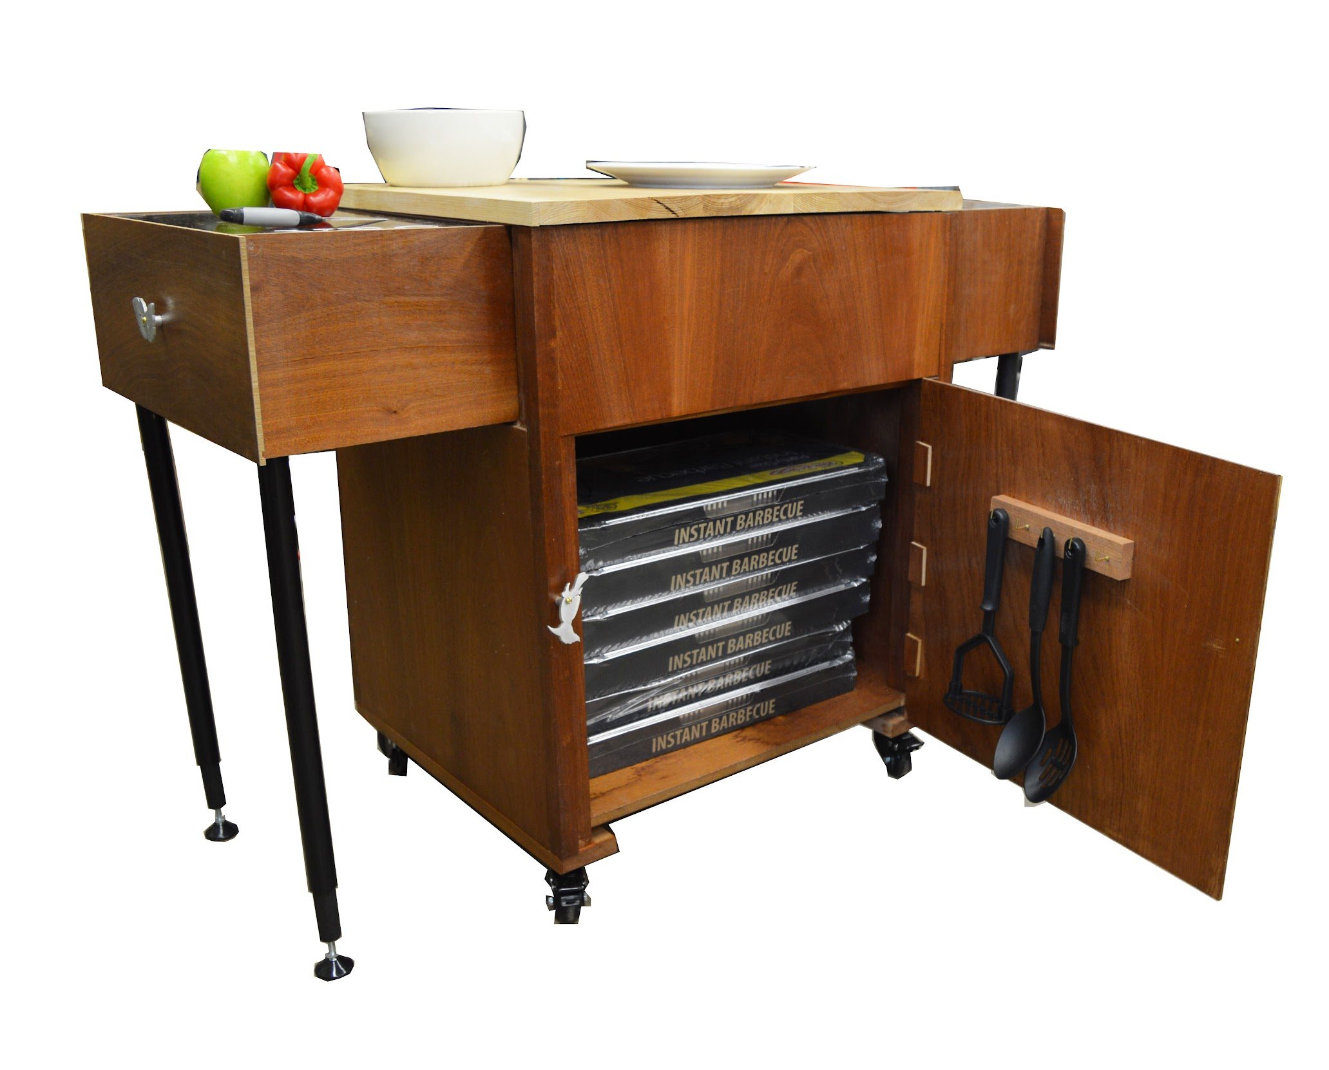
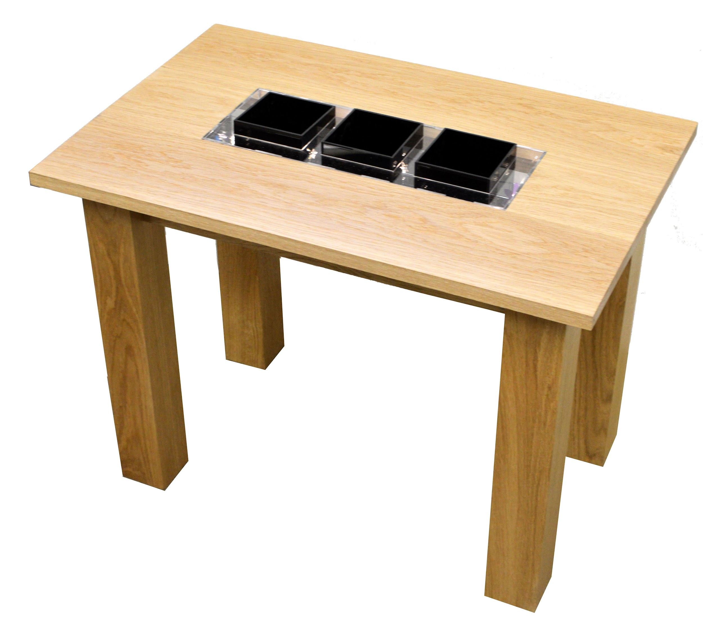
PROJECTS

Slide 13
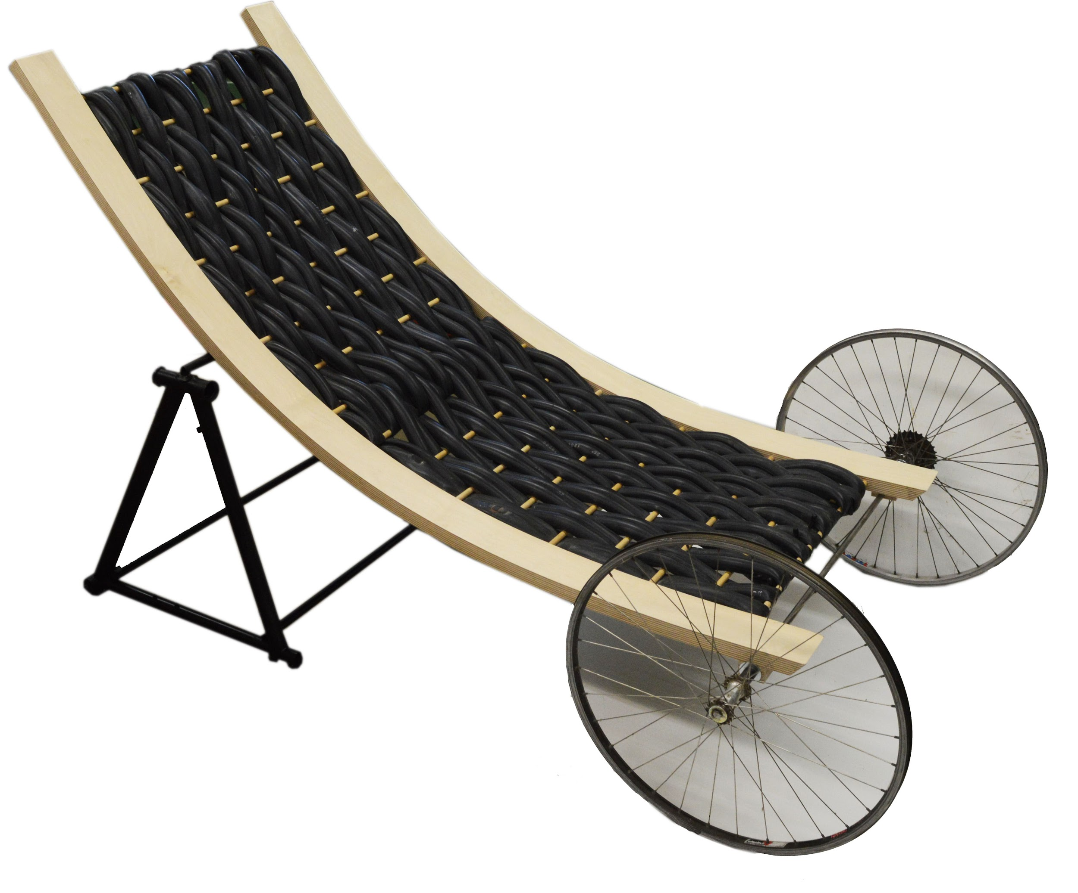
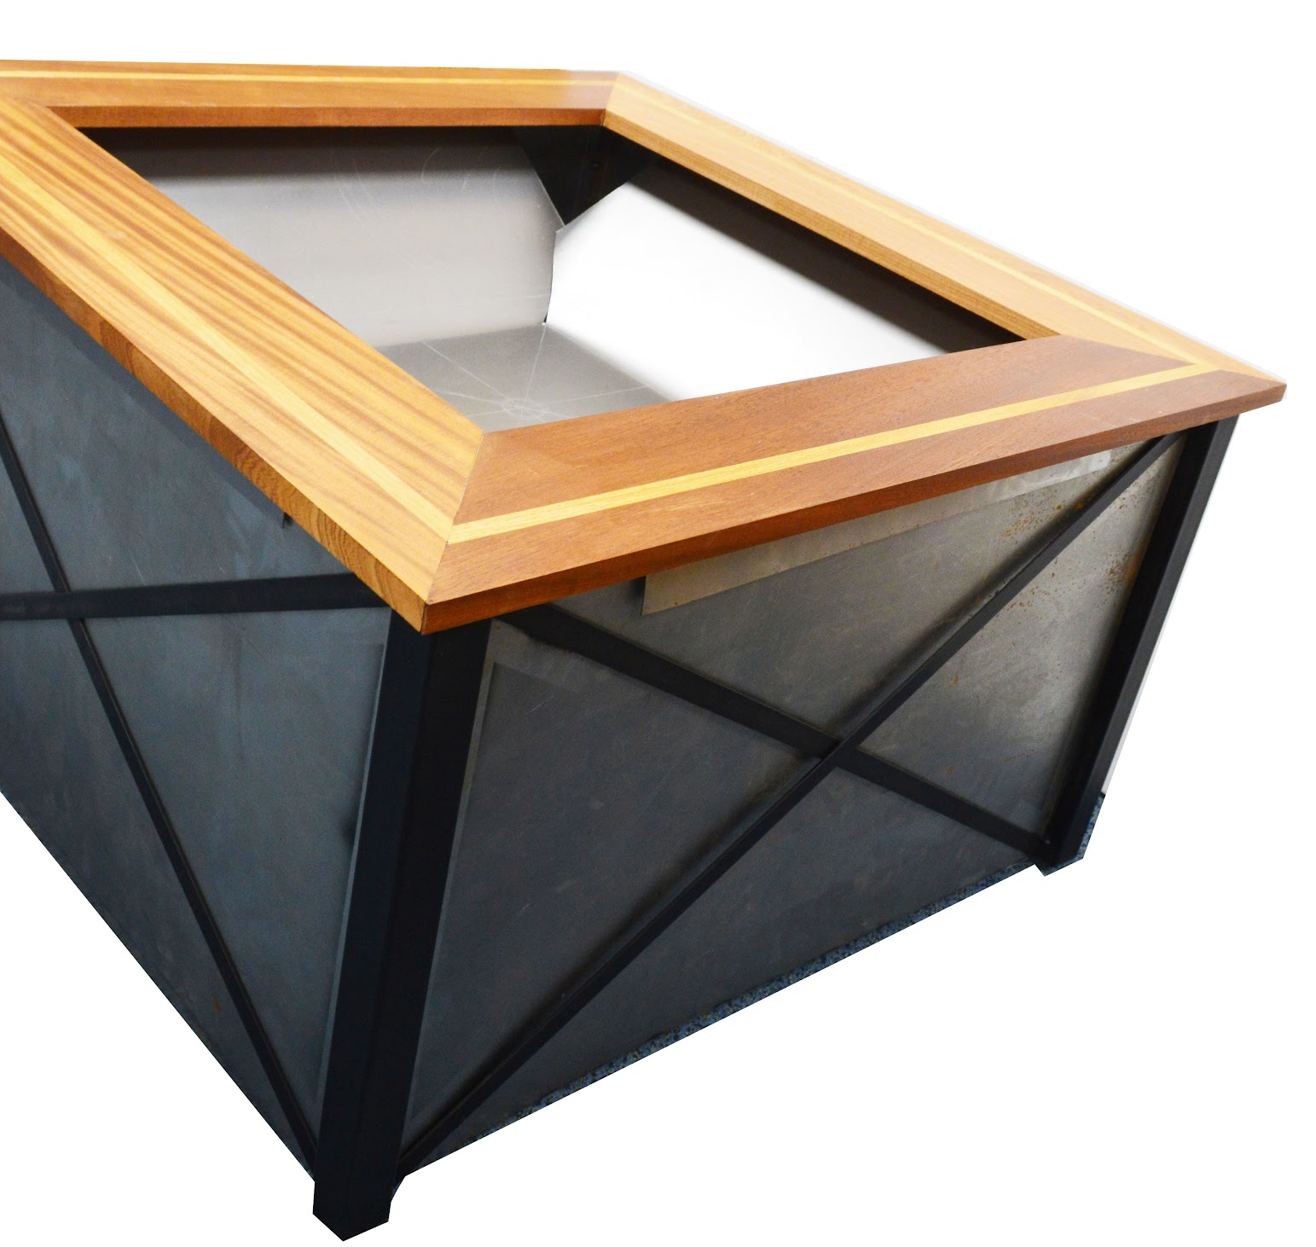
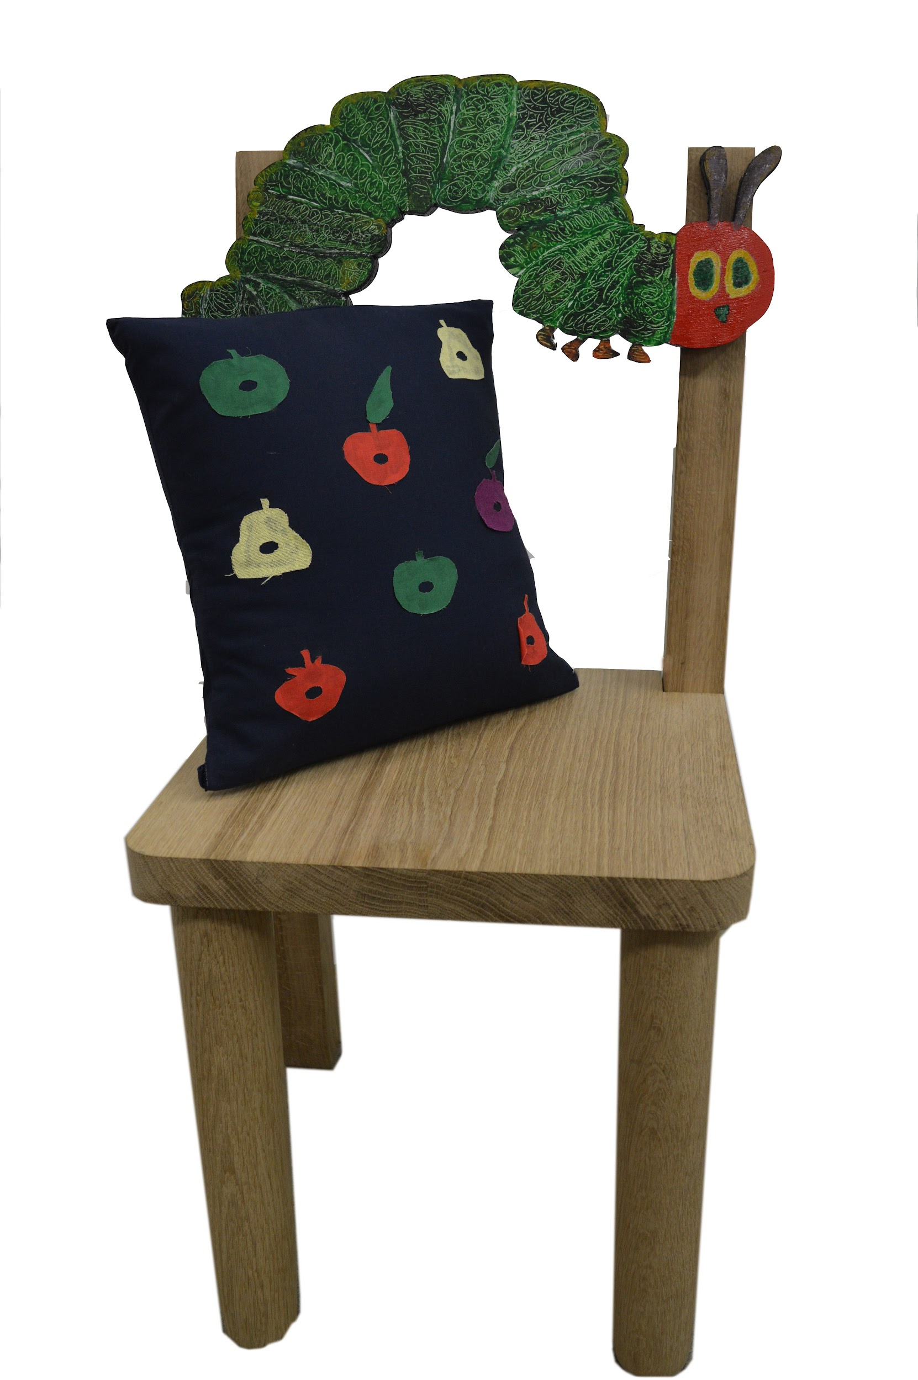
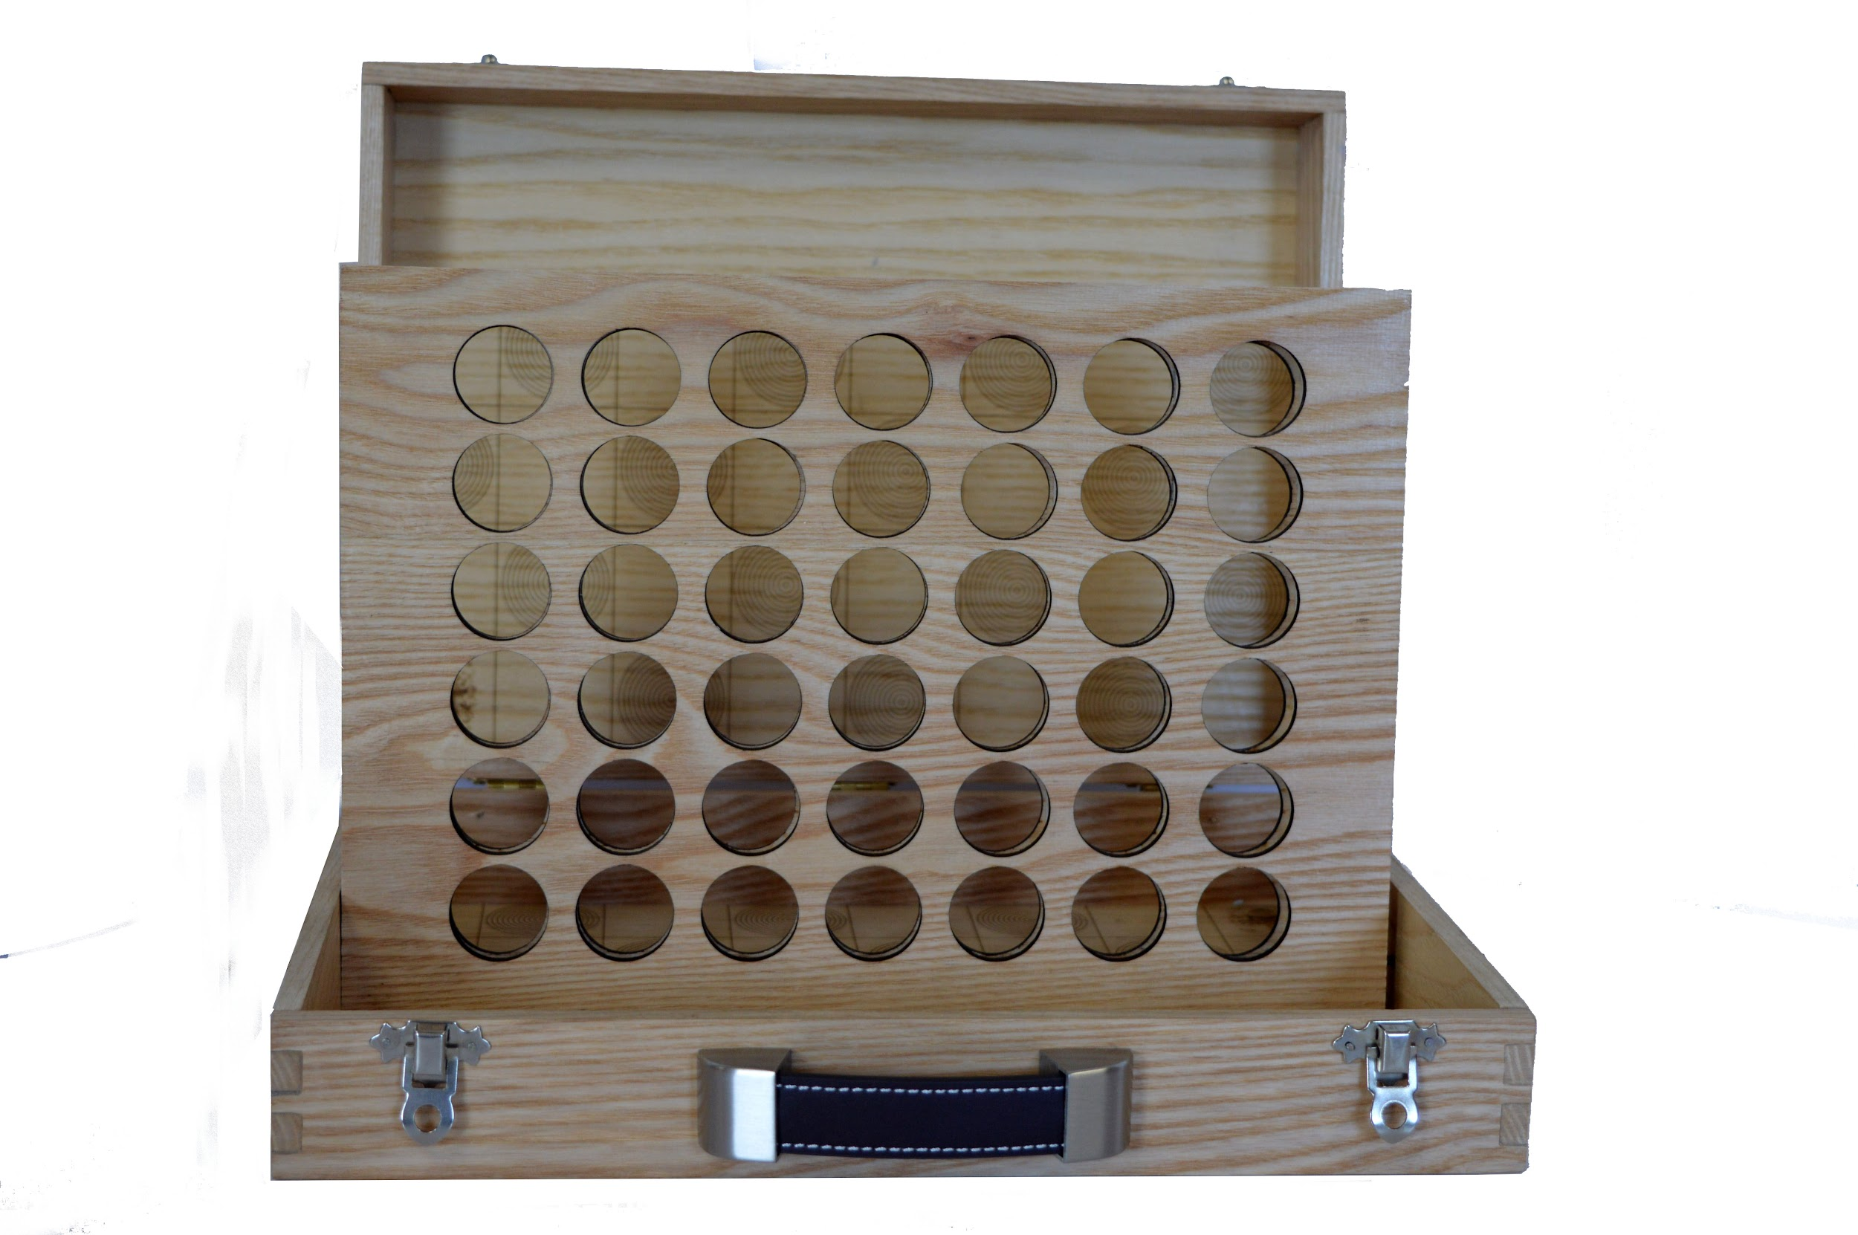

Slide 14
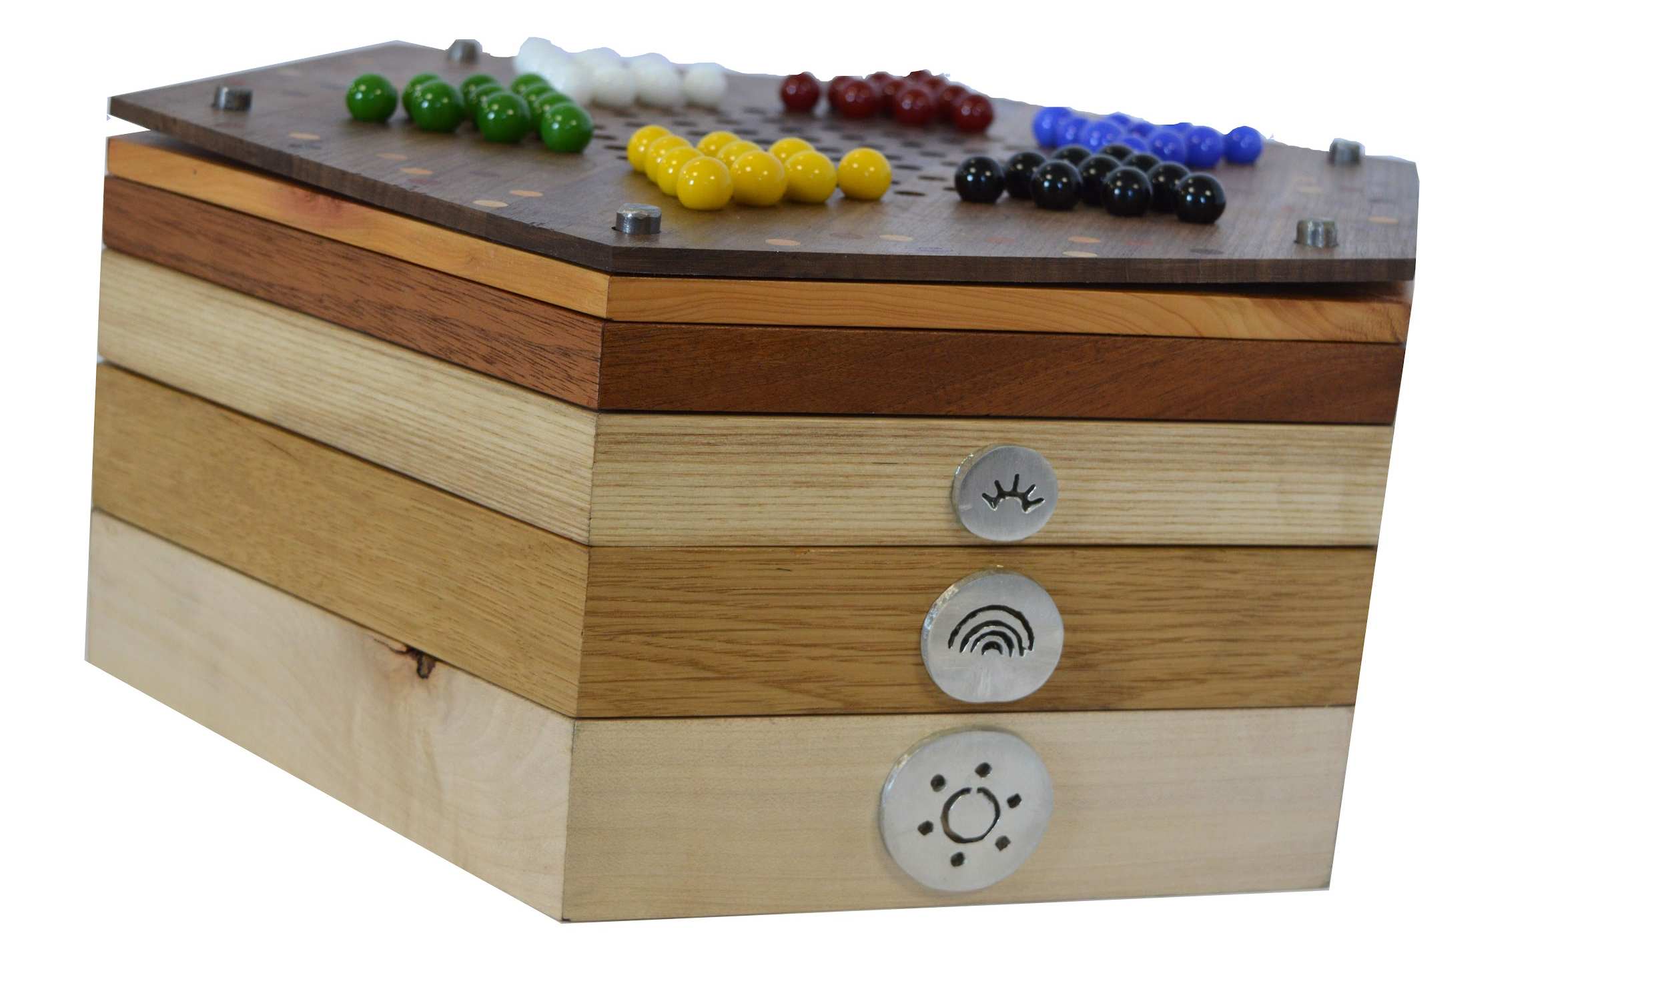
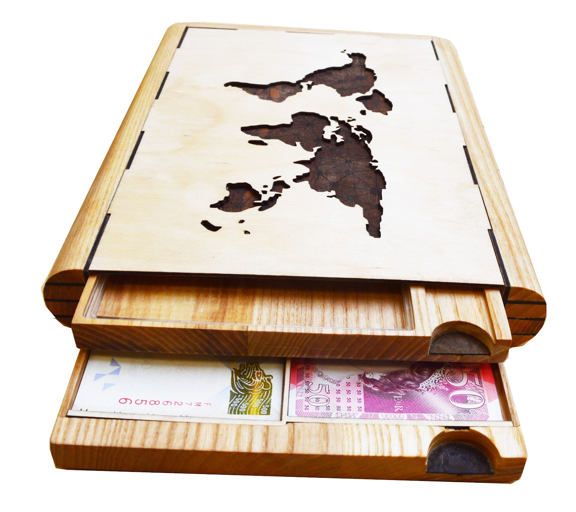
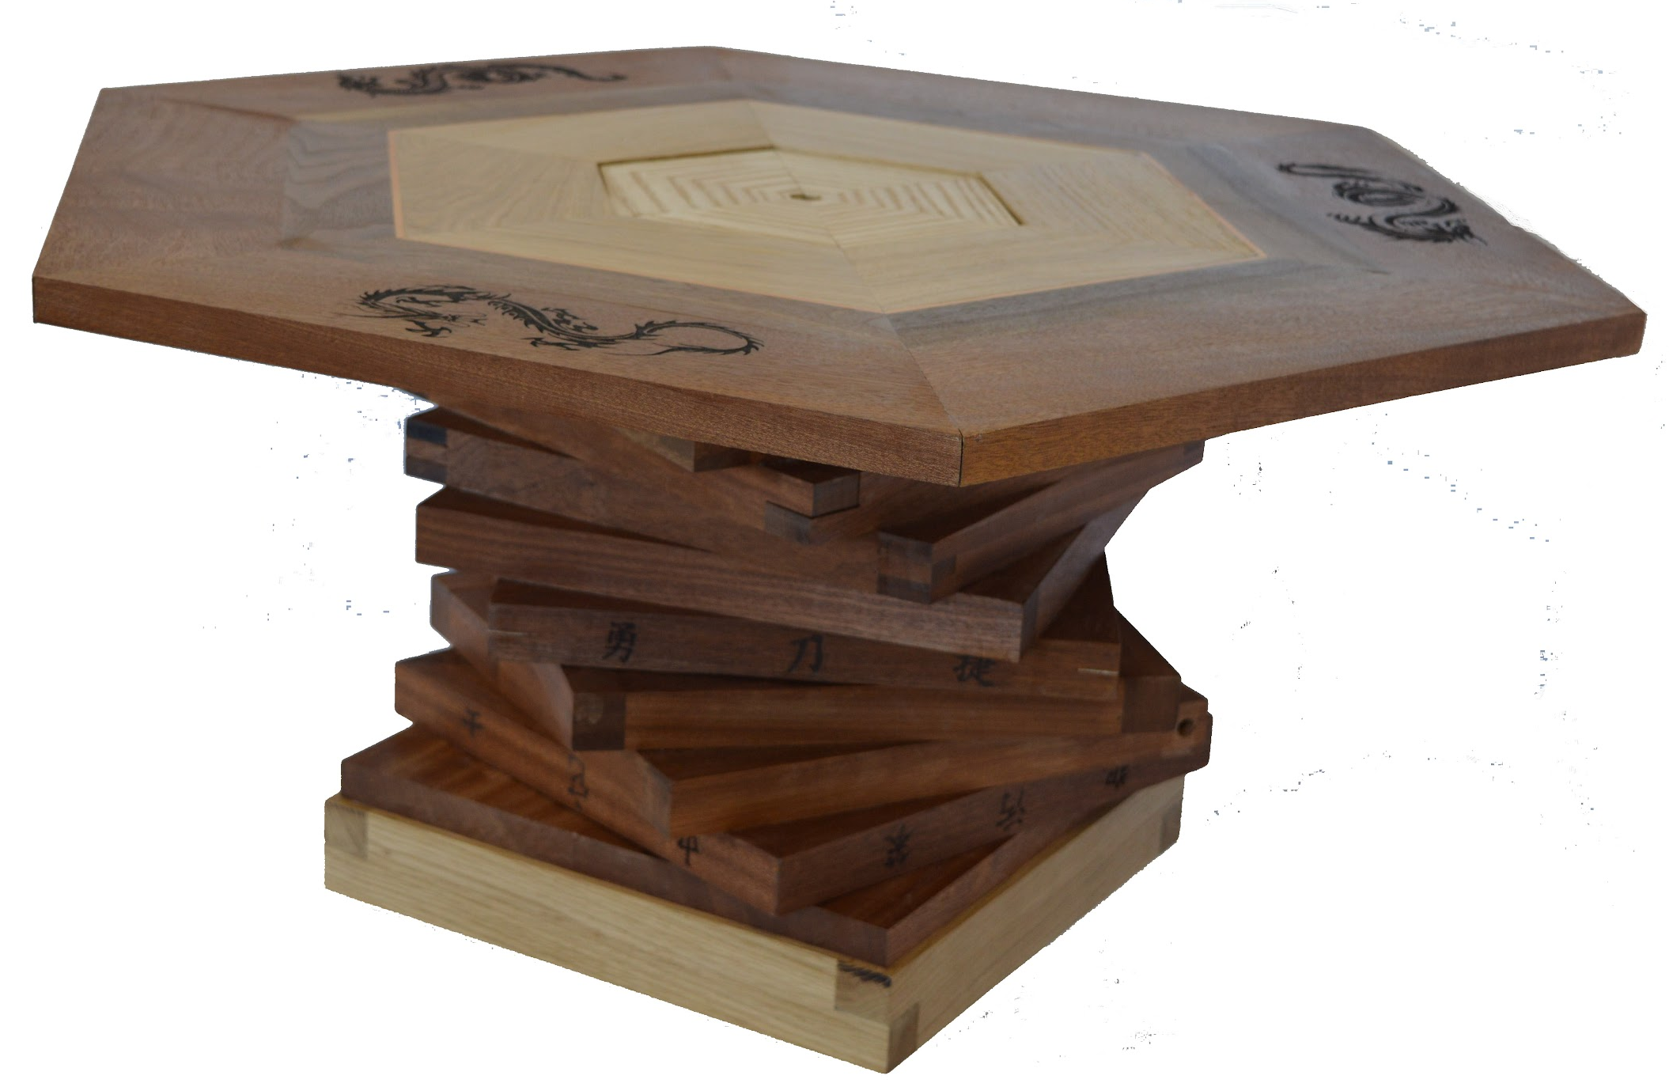

Slide 15
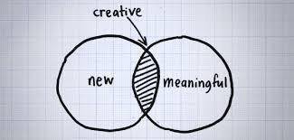
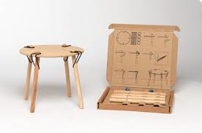
You will also be encouraged to…
Think creatively
Work independently
Problem solve
Engineer and invent

