Slide 1

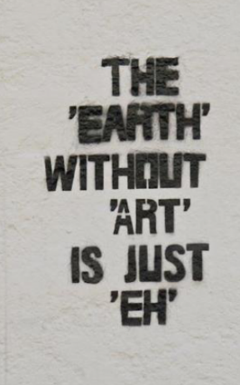
CLICK ON PICTURE
HOD MR WILLIAMS

Slide 2

What Can I Do?
Content:
On the Fine Art course, you can explore and develop your skills in a wide range of creative disciplines, including:
Painting
Sculpture
Graphics
Architecture
AI Design
Photography
Fashion
Animation
Game Design
...and so much more!

Slide 3
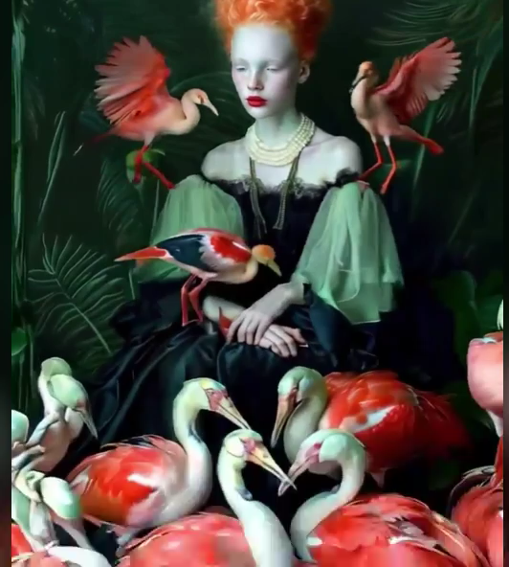
How Is the GCSE Art Course Set Up?
CLICK ON PICTURE
Split into two main components:
Portfolio (60%): Build a collection of your best work, showcasing a variety of skills, techniques, and ideas.
Externally Set Assignment (40%): A creative project based on a theme provided by the exam board, culminating in a final piece.
Learn about famous artists and movements to inspire your own work.
Develop research and sketchbook skills to present your ideas.
Explore personal themes and create unique, meaningful artwork.
Develop skills in media, AI and virtual graphics.

Slide 4
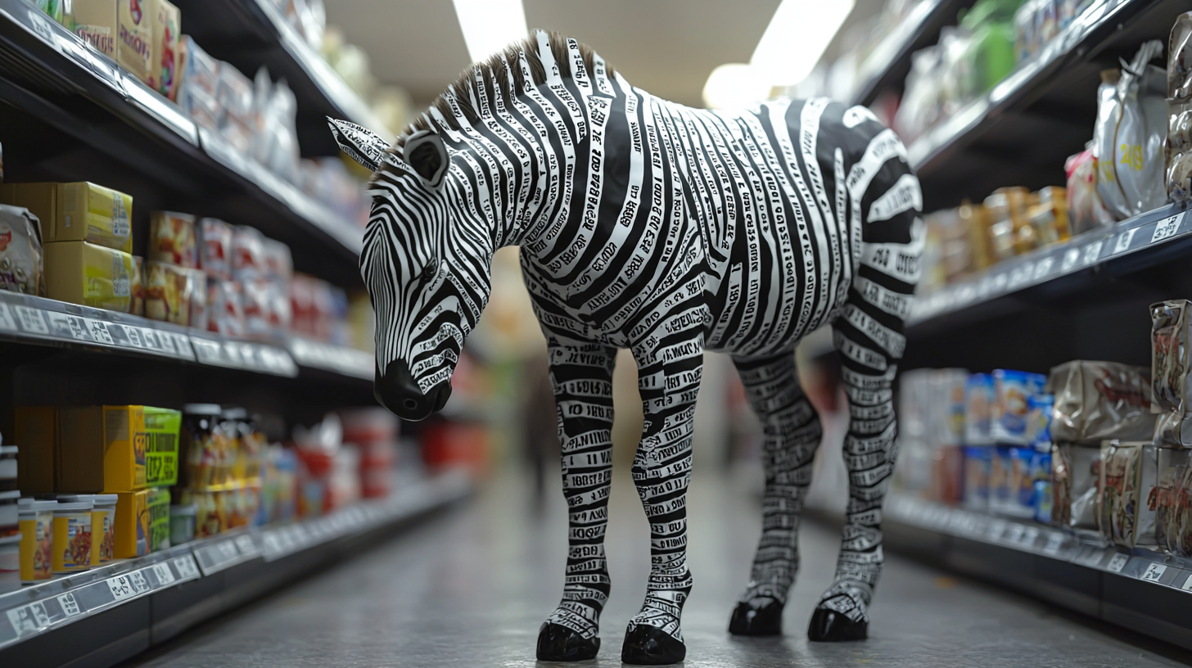
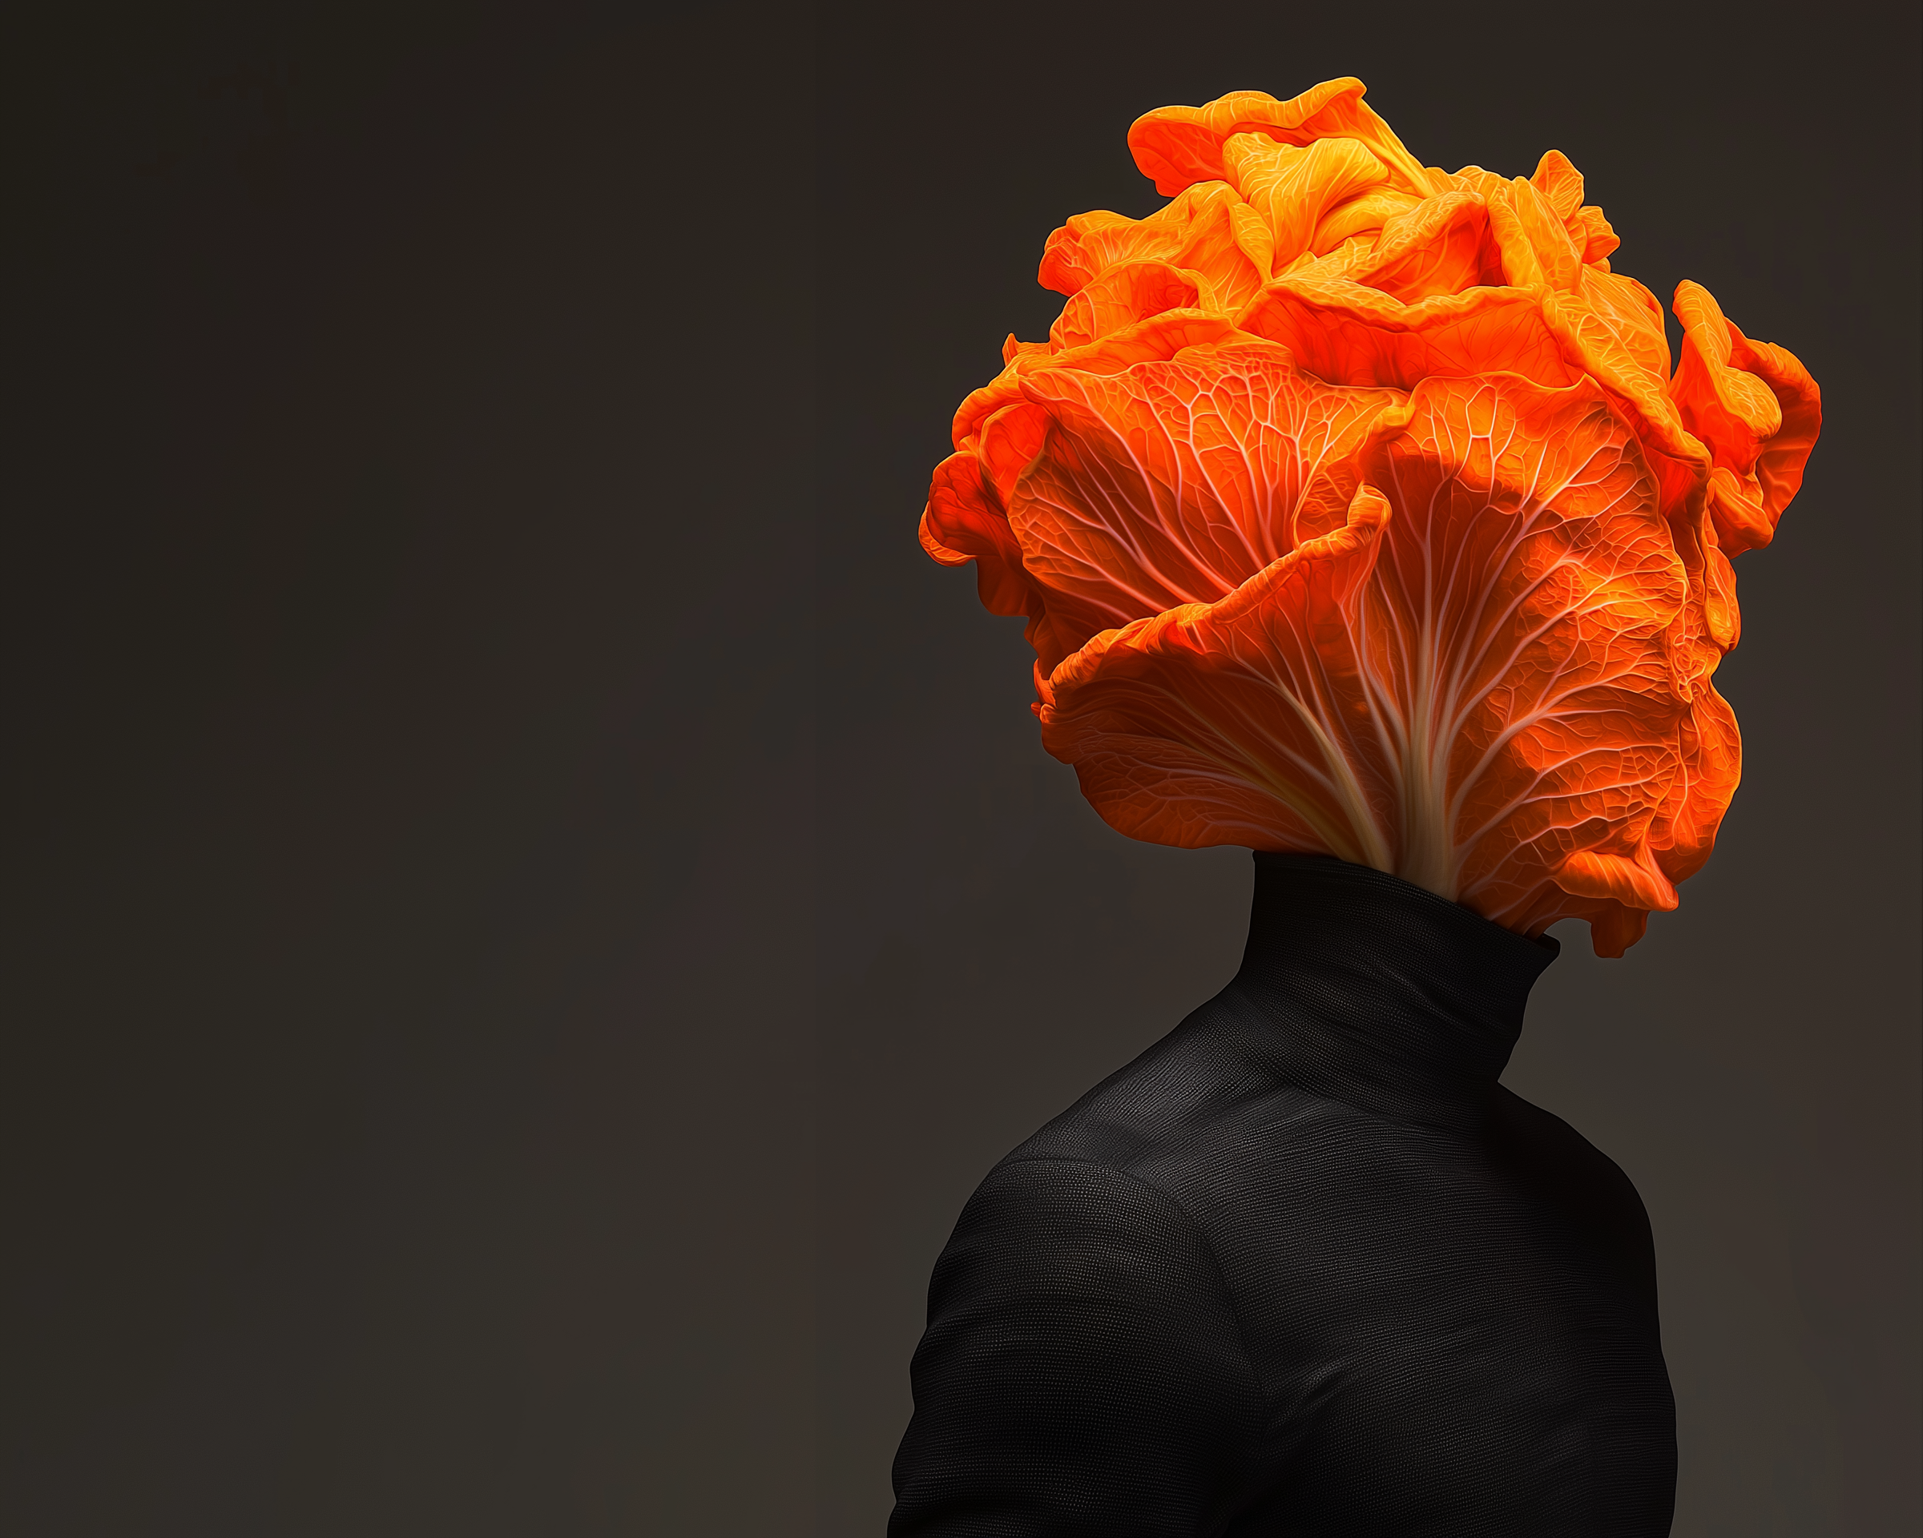
What skills will you learn?
Developing Creative Thinking: Students will learn how to generate innovative ideas and solve problems creatively, skills highly valued by universities and future employers in diverse fields.
Building a Strong Portfolio: Through coursework, students will create a personal art portfolio that showcases their creativity, a crucial requirement for university applications in creative disciplines.
Understanding Adaptability and Innovation: Fine art encourages students to explore unconventional approaches, preparing them for future careers where adaptability and innovation are essential.
Enhancing Visual Communication Skills: Students will master the ability to convey ideas visually, a skill increasingly sought after in industries such as marketing, design, architecture, and technology.
Fostering Independent Learning: The course emphasizes self-directed projects, teaching students time management, critical reflection, and resilience—qualities that universities and workplaces prioritize.
Preparing for Future Career Flexibility: As automation rises, jobs requiring creative problem-solving and artistic thinking, such as those in media, tech, and design, will remain in demand, making fine art a future-proof choice.
Nurturing Emotional Intelligence: By exploring diverse themes and self-expression, students will develop empathy and emotional awareness, traits essential for leadership roles and collaborative environments.

Slide 5
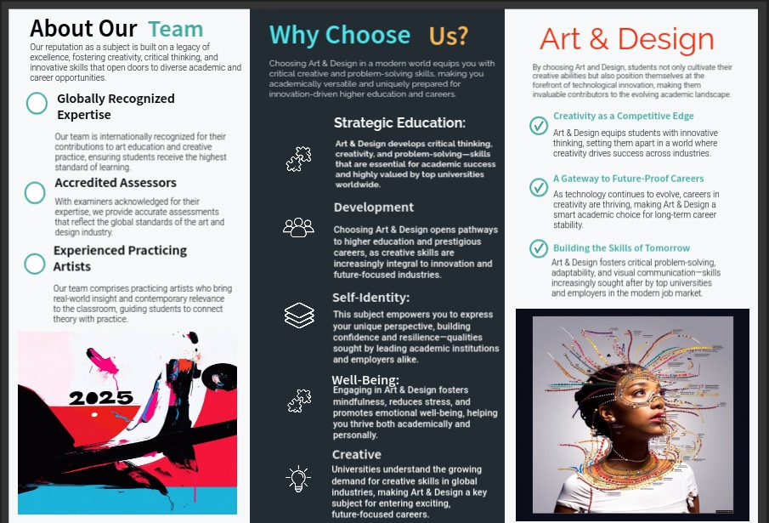

Slide 6

How will I be assessed?
The course is assessed by awarding marks for your collected coursework (60%) and an unaided two-day exam creating a work of art (40%).
For a more detailed explanation of assessment please link to the platform below
https://www.flipsnack.com/8B87CBAA9F7/swa-ks3-4-handbook/full-view.html
metatogether.com
unite4diversity.com

Slide 7
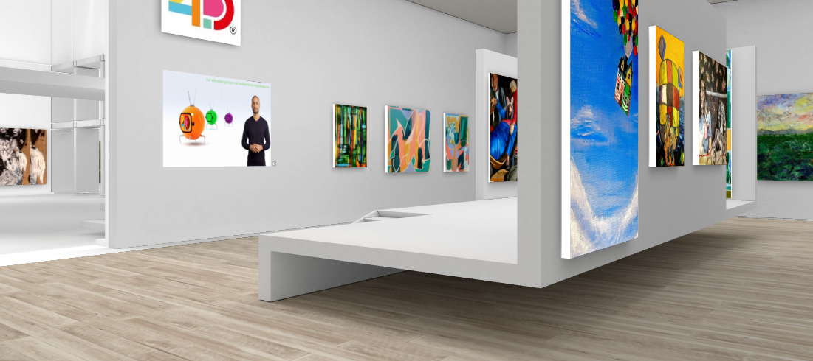
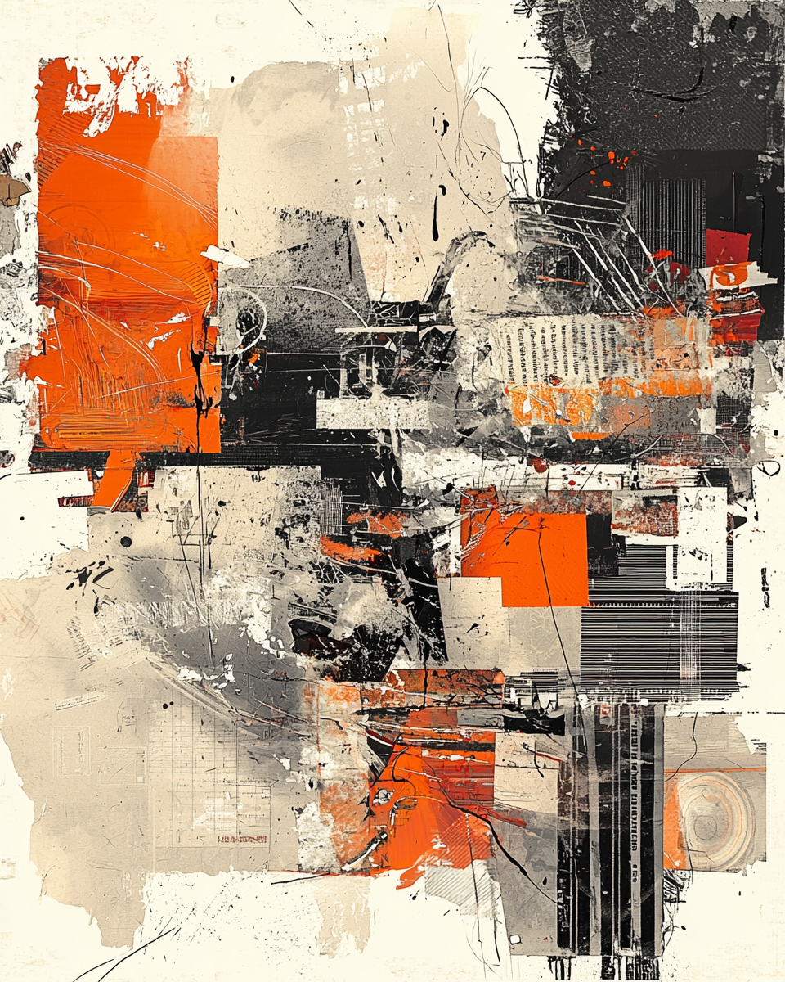
Common misconceptions and general advice
"Art and Design is only for creative people who can draw"
It DOES NOT REQUIRE specialist skills in observational drawing – these will be taught to you individually. This course focuses on individuals' ideas and narratives. Skills are taught on a one-to-one basis and relevant to personal aims and objectives.
‘Art and Design is not an academic subject’.
In many ways it is probably the most academic subject as it focuses on creating both visual and written commentaries and analysis of both past and present societies, social development, personal reflection and creativity throughout history.
‘It won't lead to a good career path!’
This is complete nonsense. All industries expect you to have metacognitive and self-regulated skills which are less needed in other subjects. Infact, try to think of something made by humans that is not creative in conception!

Slide 8

What are the possible progression opportunities?
There are endless options to progress from this award both in further education and careers.
Creativity specialisms now dominate the marketplace and are the number one area of country income.
Please take the time to follow the departments Flipbook link and read through our very extensive career paths section. You also might want to look at our alumni interviews which set out the career paths chosen by ex-students now successfully working in the profession. Our students work also appears on the OECD, ENACTUS and United Nations Education platforms.
www.metatogether.com
https://padlet.com/nwilliams249/3zokxeuqw0p3ji4h

