Slide 1

Intent
English
Intent

Slide 2
English
Why is English important?
At Wells Hall Primary, we believe that all of our pupils deserve a high quality English curriculum that is ambitious and aspirational. We aim to broaden pupil’s experiences of the world through a rich diet of literature that captures their imagination, engages and excites them. We use this same literature to teach writing skills that are revisited regularly within and across year groups, enabling pupils to build on prior learning.
We study a variety of high-quality texts, teaching our pupils the key characteristics of different genres so they can navigate the texts, make meaningful connections and understand authorial intent. We provide opportunities to revisit keys skills; building pupil confidence and fluency.
By the end of their time at Well Hall, we want our pupils to have developed a love of writing and to have a toolkit of skills and strategies that they can apply to make their writing effective.
Intent

Slide 3

English
National Curriculum Aims
The overarching aim for English in the national curriculum is to promote high standards of language and literacy by equipping pupils with a strong command of the spoken and written word, and to develop their love of literature through widespread reading for enjoyment. The national curriculum for English aims to ensure that all pupils:
read easily, fluently and with good understanding
develop the habit of reading widely and often, for both pleasure and information
acquire a wide vocabulary, an understanding of grammar and knowledge of linguistic conventions for reading, writing and spoken language
appreciate our rich and varied literary heritage
write clearly, accurately and coherently, adapting their language and style in and for a range of contexts, purposes and audiences
use discussion in order to learn; they should be able to elaborate and explain clearly their understanding and ideas
are competent in the arts of speaking and listening, making formal presentations, demonstrating to others and participating in debate.
Intent
Intent
Intent

Slide 4

Intent
Intent
https://assets.publishing.service.gov.uk/government/uploads/system/uploads/attachment_data/file/335186/PRIMARY_national_curriculum_-_English_220714.pdf

Slide 5
English
At Wells Hall Primary, our English curriculum is shaped by two key resources; SoundsWriteand CUSP (Curriculum for Unity Schools Partnership) Reading. These together make up our main teaching resources.
SoundsWrite is a synthetic and systematic phonics scheme which is utilised to support pupils with their early reading skills – see separate phonics policy.
The CUSP Reading curriculum works alongside the writing curriculum in Key Stage One and Key Stage Two. This resource is underpinned by cognitive science and is:
Connected: Pupils are supported to make connections in their learning through the use of explicit, modelled teaching.
Cumulative: Pupils are taught fewer genres each school year but these genres are revisited throughout the academic year, and in subsequent year groups, enabling Pupils to learn them at greater depth and to develop mastery of skills within each genre.
Coherent: Sequences are systematically planned with thought given to the progression of skills, knowledge and vocabulary within and across year groups.
Intent

Slide 6
What this looks like
Phonics​ ​ Reception – Year 2 SoundsWrite​ ​ Daily 30 mins​ | Reading​ ​ CUSP Reading KS1: 2/3x per week​ KS2:Daily 30 mins​ Additional:​ (SoundsWrite pupils: 3x per week 10 mins)​ ​ | Writing​ ​ CUSP Writing ​ KS1: 2/3x per week ​ KS2: Daily 45 mins​ ​ Additiona: (Sounds Write pupils: 2x per week 10 mins)​ ​ | VGPS​ ​ CUSP Programme of Study and structure​ ​ KS1: within Writing​ ​ KS2: 2 x discrete sessions per week, plus within Writing​ | Handwriting​ ​ PenPals​ ​ 15 mins x 3 per week​ | Spelling​ ​ CUSP scheme​ ​ 20 mins discrete teaching x 3 per week​ ​ ​ | Oracy​ ​ Cross-curricular, One Education progression​
Intent
Intent

Slide 7
Spaced Retrieval Practice Approach
Our English curriculum is built around a broad and varied literature spine for reading and an increased frequency model for writing – this deliberately returns to key skills and text types throughout the academic year with opportunities to introduce and revisit key concepts. This approach enables staff to deepen pupil understanding and embed learning.
Our curriculum maps clearly show how our CUSP English curriculum delivers (introduces and revisits) the National Curriculum expectations for Reading and Writing within and across year groups.
Intent
Intent

Slide 8
Intent
English Reading
Intent

Slide 9
Each cohort will have a suite of core texts that will form the depth study for the academic year. These texts represent a promise from the school to every pupil that it serves of the literature that it is committed to studying throughout a pupil’s school journey. These texts have been mapped carefully to ensure a breadth of experiences, authors, texts and themes is addressed across the Primary years. In addition to these texts, there are core poems that each year group will study in detail.
Other texts that will be studied in part will be outlined within the curriculum. This spine represents the core texts for depth study only.
Intent

Slide 10
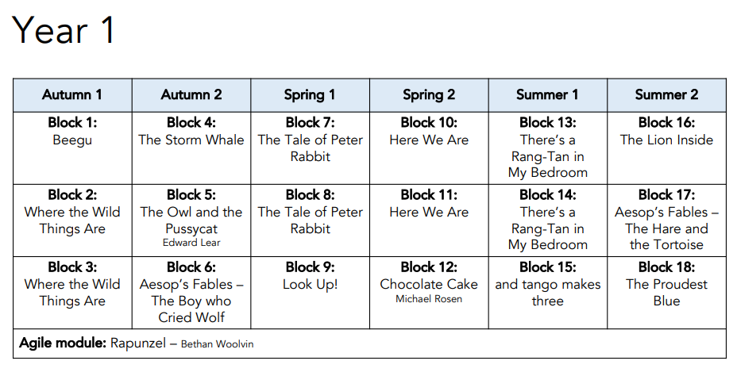
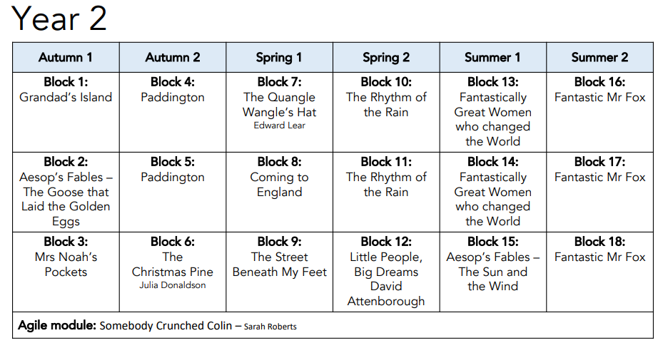
Reading Spine
Intent
Intent
Intent

Slide 11
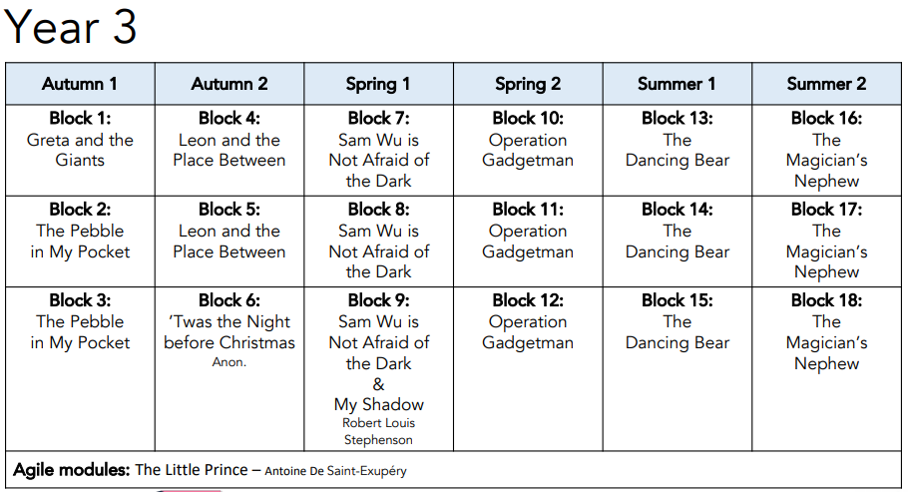
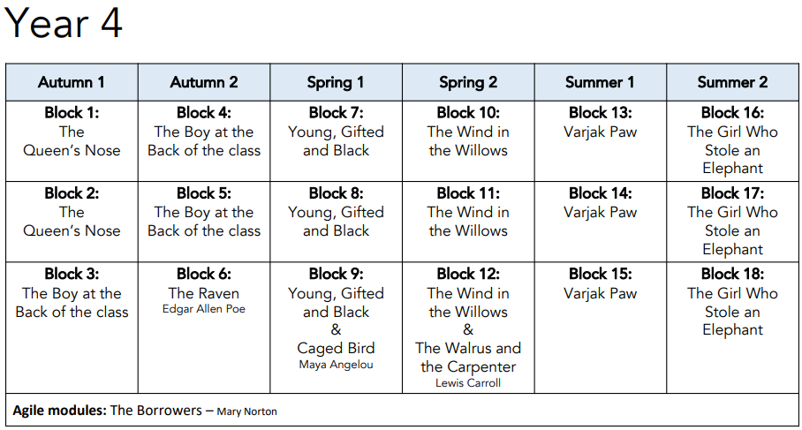
Intent
Intent

Slide 12
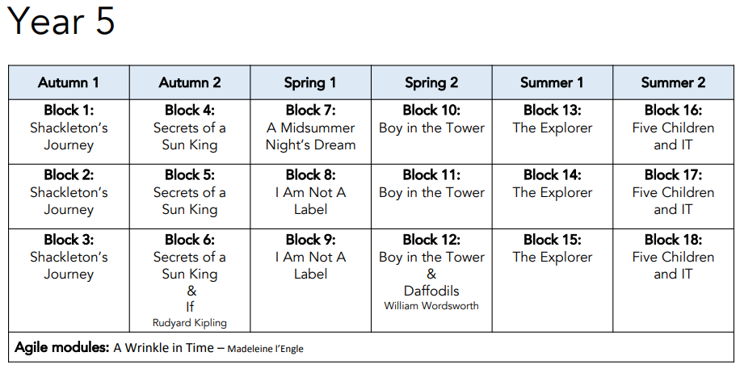
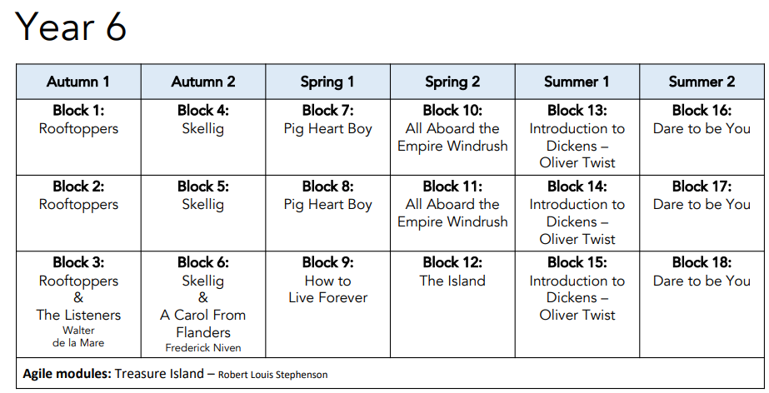
Intent
Intent

Slide 13
Spaced Retrieval Approach
Our Reading curriculum revisits key question skills (retrieval, sequencing, summarising and inferring) regularly – clearly linking these with National Summative assessments. This approach enables staff to deepen pupil understanding and embed learning.
In addition to this, the literature spine is mapped against relevant and important themes such as “Continuity of author, Heritage texts, BAME author or protagonist, Strong female role model and Specific social, ethical, moral issues.
Intent
Intent

Slide 14
Intent
English Writing
Intent

Slide 15
Our writing curriculum has been systematically mapped against the End of Year Expectations for each year group.
The breadth of curriculum ensures that pupils are exposed to a wide range of text types and conventions within each year group and these different text types are explored and developed in greater detail and to a greater depth as the pupils move through the school.
Text types and conventions are introduced in the first half of the year and then revisited in the second half of the year.
Intent
Intent

Slide 16
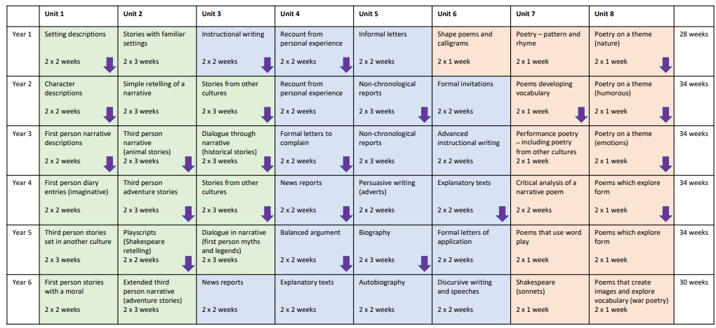
Long Term Writing Overview
Intent
Intent

Slide 17
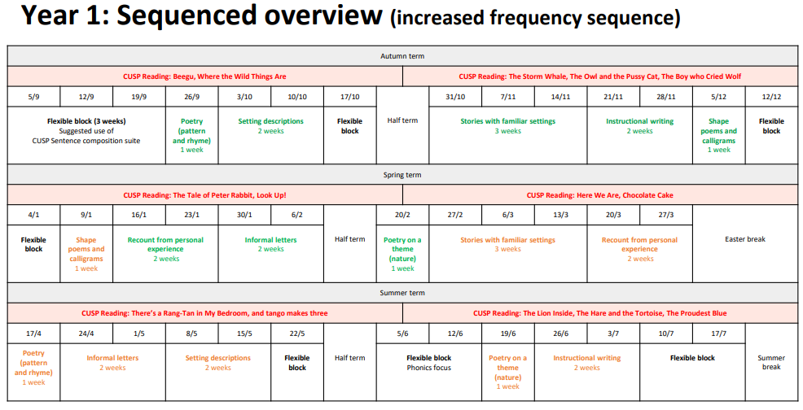
Intent
Intent

Slide 18
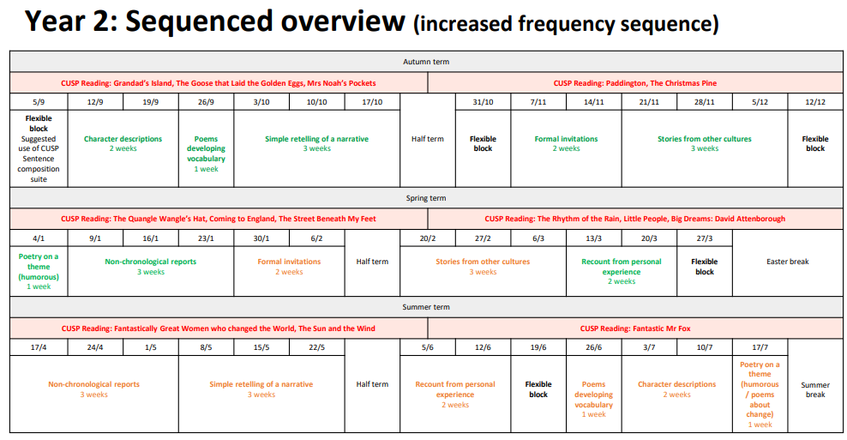
Intent
Intent

Slide 19
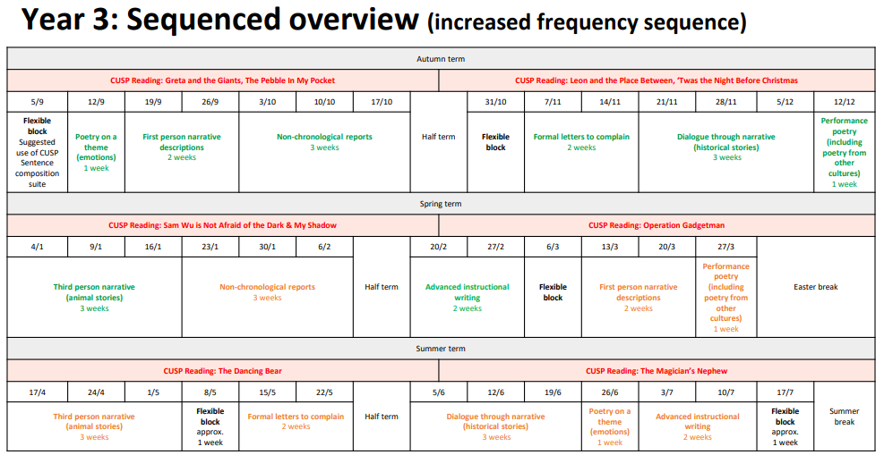
Intent
Intent

Slide 20
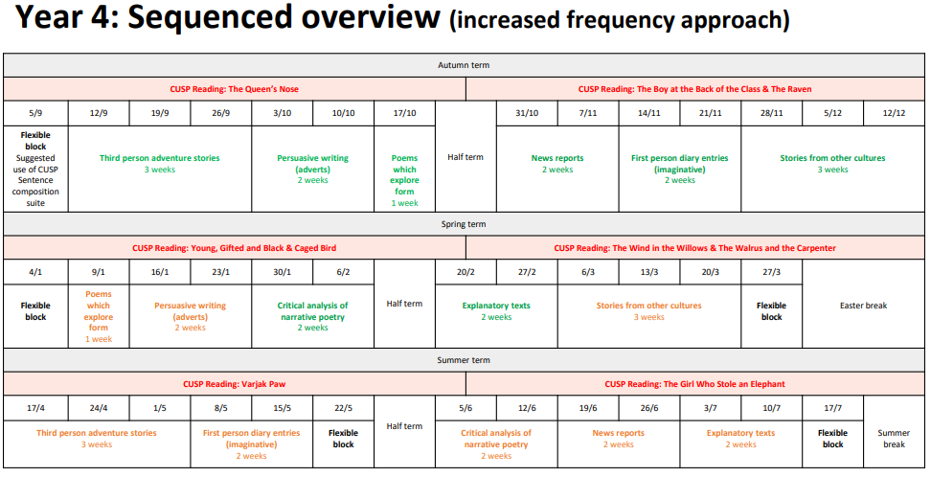
Intent
Intent

Slide 21
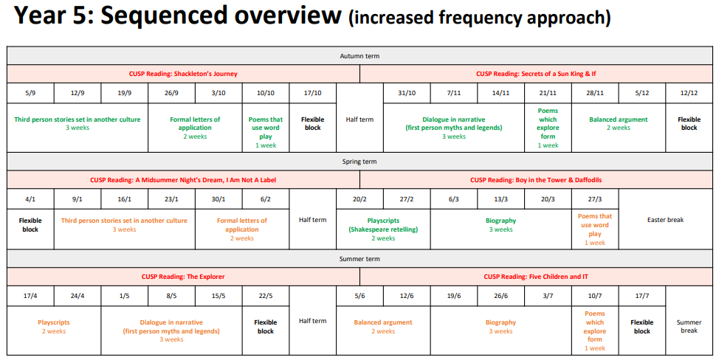
Intent
Intent

Slide 22
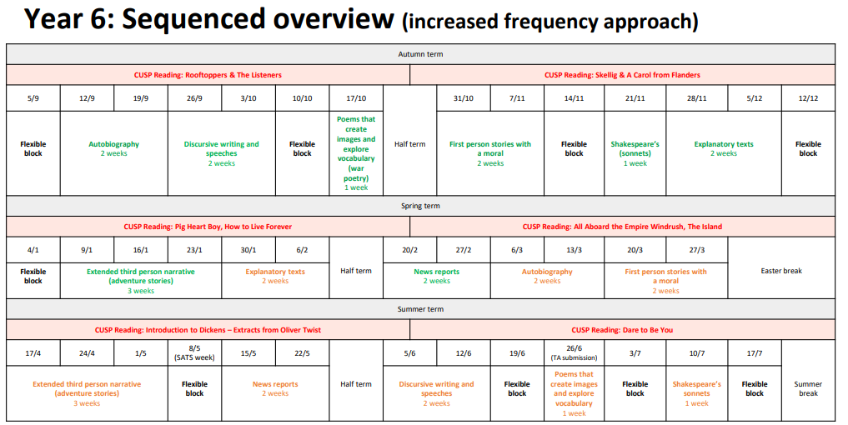
Intent
Intent

Slide 23
Spaced Retrieval Approach
Our writing curriculum is separated into 8 units which cover a wide range of text types and conventions. These units are then subdivided into 2 parts: Block A at the start of the year; were children are exposed to text conventions and supported in writing to the desired outcome; and Block B in the second half of the year; were children return to the text types introduced in Block A but complete the tasks with much greater independence and less scaffolding from the teachers – this deliberately returns to key skills and text types throughout the academic year with opportunities to introduce and revisit key concepts. This approach enables staff to deepen pupil understanding and embed learning.
Intent
Intent

Slide 24
Intent
English - Spelling
Intent

Slide 25
Spelling
The CUSP Spelling curriculum is organised into 2-week blocks, with each block covering a particular set of key concepts, including spelling patterns, etymology and morphology and reasoning about spelling. These blocks are made up of three lessons per week: 2 x 15 minute (minimum) discrete Spelling lessons and 1 x Spelling starter for the final Writing lesson of each week.
Systematic revisiting and incremental progression is inherently written into the long term sequence, both within and across year groups. Years 2-6 have 16 x 2-week blocks, leaving a small number of weeks for flexible content. This could include revisiting, assessment or enrichment. Year 1 has 6 blocks, which can be delivered during the Summer term to begin to build on pupils’ strong grasp of phonics at this point.
Intent

Slide 26
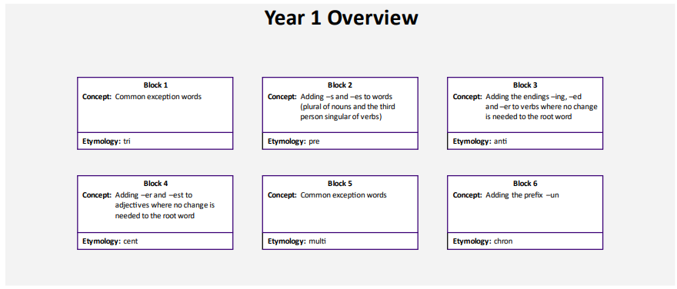
Intent

Slide 27
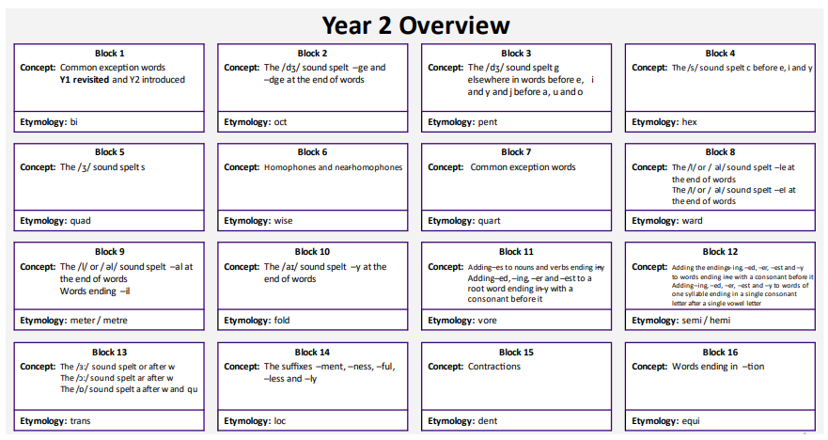
Intent

Slide 28
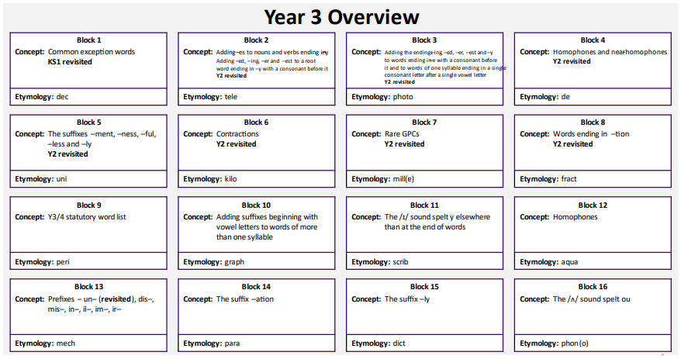
Intent

Slide 29
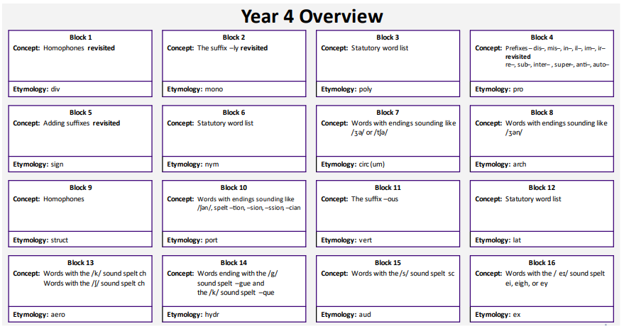
Intent

Slide 30
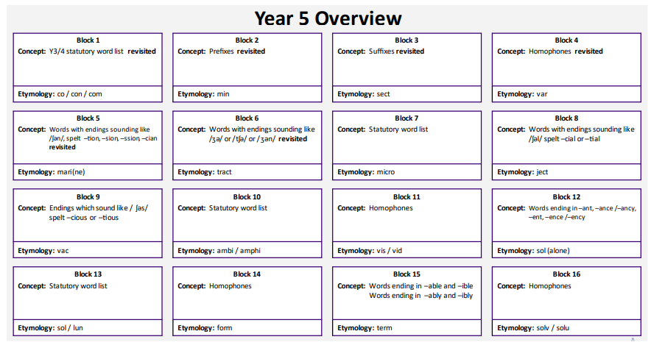
Intent

Slide 31
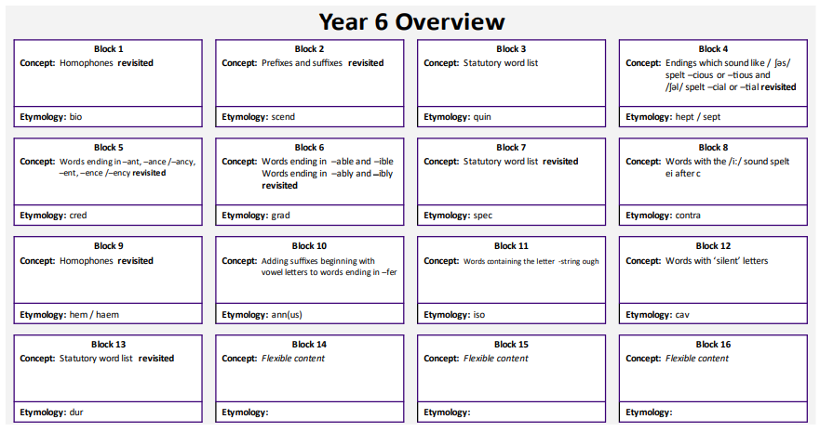
Intent

Slide 32
Intent
English - Handwriting
Intent

Slide 33

Penpals for Handwriting
Penpals for Handwriting is a complete handwriting scheme that ensures progression from early development of gross and fine motor skills to confident letter formation and accomplished joins.
Penpals takes a flexible approach that is not designed to force children to produce identical copies of the printed font. The scheme equips children with thorough knowledge of the shape and formation of letters and joins, allowing them to develop their own comfortable and legible handwriting style.
Intent

Slide 34
Early Years and Foundation Study – Early Learning Goals
Literacy
ELG: Comprehension
Children at the expected level of development will:
Demonstrate understanding of what has been read to them by retelling stories and narratives using their own words and recently introduced vocabulary;
Anticipate – where appropriate – key events in stories;
Use and understand recently introduced vocabulary during discussions about stories, non-fiction, rhymes and poems and during role-play.
ELG: Word Reading
Children at the expected level of development will:
Say a sound for each letter in the alphabet and at least 10 digraphs;
Read words consistent with their phonic knowledge by sound-blending;
Read aloud simple sentences and books that are consistent with their phonic knowledge, including some common exception words.
ELG: Writing
Children at the expected level of development will:
Write recognisable letters, most of which are correctly formed;
Spell words by identifying sounds in them and representing the sounds with a letter or letters;
Write simple phrases and sentences that can be read by others.
Intent

Slide 35
Early Years
Reading is at the heart of our Early Years curriculum and we endeavour to encourage a love of books right from the first moment a child joins us in our Caterpillars Nursery. Across the EYFS we have a literature spine which aims to expose children to a range of books that not only develop a love of reading, but have been chosen specifically to develop their oracy, vocabulary, comprehension and understanding of the world around them.
Intent

Slide 36
Early Years
Writing is an important lifelong skill. We focus on making sure every child is equipped with high standards of vocabulary, linked to the reading spine, to later support writing skills required to become successful writers. Teaching is sequenced progressively throughout their time in EYFS to ensure that skills are being re-visited, embedded and built upon. We ensure that all children are given a clear and motivational purpose to their writing, allowing them to practise the skills needed. We encourage the use of exciting vocabulary by using high quality stories and texts that children can draw upon to create their own.
Intent

Slide 37
Implementation
English - Reading
Implementation

Slide 38
Reminder:
Each year group will have a suite of core texts and text types that will form the depth study for the academic year. These texts have been mapped carefully to ensure a breadth of experiences, authors, texts and themes is addressed across the Primary years. In addition to these texts, there are core poems that each year group will study in detail. Other texts that will be studied in part will be outlined within the curriculum. This spine represents the core texts for depth study only. The literature spine has been harmonised with the wider curriculum, where appropriate.
Implementation

Slide 39


Core Text
Implementation

Slide 40


Core Text
Implementation

Slide 41


Core Text
Implementation

Slide 42
What the English Curriculum looks like in practice:
In Key Stage One, reading is primarily taught two/three times per week (which is paired alongside a writing module with writing being taught in the other sessions) over a two weekly cycle and lessons typically last for 45 minutes. Writing is taught either two or three times per week (with reading being taught on the other sessions) and lessons typically last for 45 minutes.
In Key Stage Two, pupils access a daily reading lesson which is 30 minutes in length. Pupils access a daily writing lesson which is 50 minutes in length.
Implementation

Slide 43
What the English Curriculum looks like in practice:
Each unit of reading is organised around a focus text and will cover the necessary skills needed to read for understanding and each lesson will focus on a particular skill for example retrieval practice. The purpose of this is to equip pupils with the skills required to read effectively and competently.
Each unit of writing is organised as a sequence of skills development followed by an extended writing cycle. The purpose of this is to equip pupils with the skills required to write effectively within the specified genre.
Implementation

Slide 44
English Reading lessons are typically structured in the following ways:
Lessons are taught through the 6-part, ‘Connect, Explain, Example, Attempt, Apply, Challenge’ approach, with clear modelling at the heart of this.
The connect part of the lesson supports children in situating the learning in their existing schema.
The explain stage discretely teaches the new skills that will be the focus of the lesson.
In the example part of the lesson, teachers model using the skills that are required and discuss potential pitfalls and misconceptions.
During the attempt stage, children are supported in using the taught skill and misconceptions that appear are addressed.
As the lesson progresses, children are given the opportunity to apply their new skill with increased independence and within context.
Finally, if they are confident, children will be challenged to use the skill in a new context or with greater accuracy.
Implementation

Slide 45
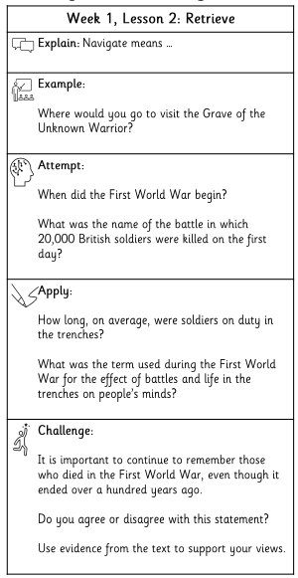
Example learning strip of our 6-part lesson
Implementation

Slide 46
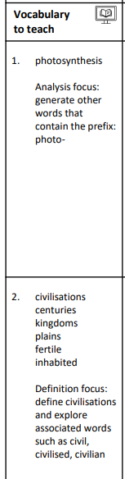
Vocabulary - Reading
Vocabulary instruction is at the heart of the curriculum and uncommon or subject specific words are introduced at the start of each lesson.
These are then unpicked – looking at the etymology of the words, defining them and making connections to the wider context in which they might be used.
Implementation

Slide 47
Implementation
English -Writing
Implementation

Slide 48
English Writing lessons are typically structured in the following ways:
In Key Stage One, writing is taught either two or three times per week (with reading being taught on the other sessions) and lessons typically last for 45 minutes.
In Key Stage Two, pupils access a daily writing lesson which is 50 minutes in length.
Each unit of writing is organised as a sequence of skills development followed by an extended writing cycle. The purpose of this is to equip pupils with the skills required to write effectively within the specified genre.
Implementation

Slide 49
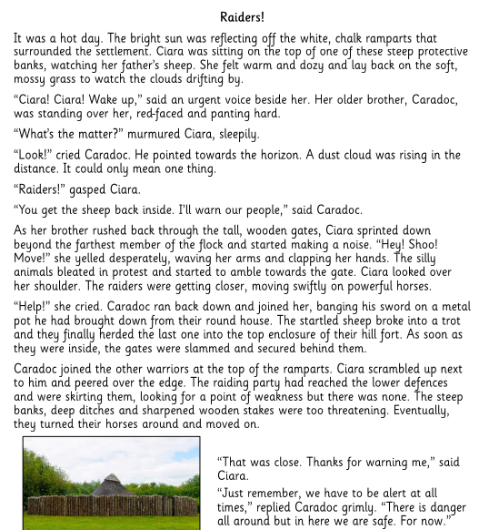
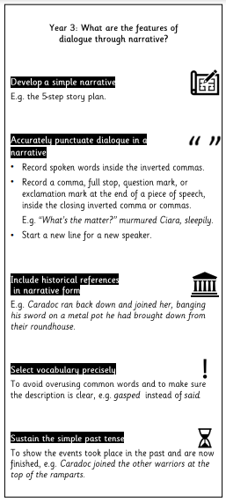
Shared Text
In writing lessons, the units always start with a shared text and the key learning from the module. These provide examples of the skills that the children need and are read together, deconstructed and analysed.
Implementation

Slide 50
English Writing lessons are typically structured in the following ways:
Lessons begin with opportunities for pupils to revisit prior learning using, ‘Remember it now,’ tasks. This supports pupils in committing new learning to their long- term memory and consequently reduces cognitive load when they are writing.
Lessons are taught through the, ‘My turn, our turn, your turn,’ approach with clear modelling at the heart of this. This offers pupils a shared schema of what success looks like, in order that they may more effectively apply taught content in their own work. It also affords all pupils with the opportunity to demonstrate their learning to their teacher.
Lessons include discrete teaching of the grammatical conventions required for the particular piece of writing.
Implementation

Slide 51
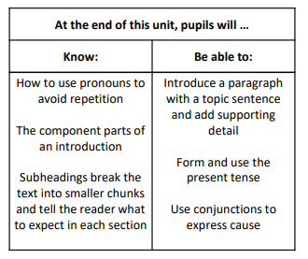
Key Learning is introduced to teachers at the start of each unit; guiding the teaching.
Implementation

Slide 52
English Writing lessons are typically structured in the following ways:
Lessons are taught through the 6-part, ‘Connect, Explain, Example, Attempt, Apply, Challenge’ approach, with clear modelling at the heart of this.
The connect part of the lesson supports children in situating the learning in their existing schema.
The explain stage discretely teaches the new skills that will be the focus of the lesson.
In the example part of the lesson, teachers model using the skills that are required and discuss potential pitfalls and misconceptions.
During the attempt stage, children are supported in using the taught skill and misconceptions that appear are addressed.
As the lesson progresses, children are given the opportunity to apply their new skill with increased independence and within context.
Finally, if they are confident, children will be challenged to use the skill in a new context or with greater accuracy.
Implementation

Slide 53
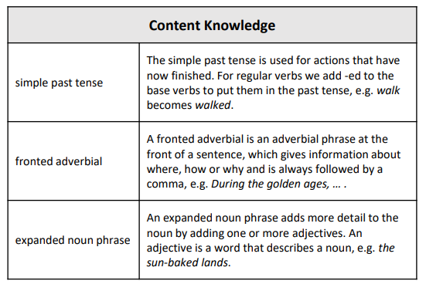
Defining content knowledge:
This supports both the subject knowledge of staff, gives the school a shared language of instruction and scaffolds the pupils’ understanding.
Implementation

Slide 54
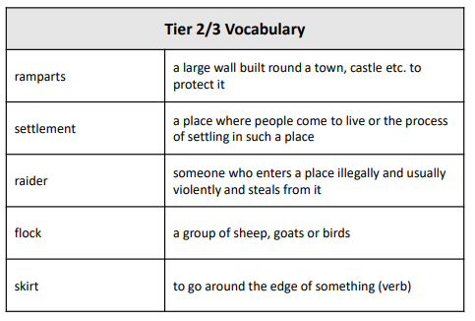
Vocabulary - Writing
Vocabulary instruction incorporated in each unit, with subject specific vocabulary (Tier 2 and 3) introduced to support the children.
Implementation

Slide 55
What the English Curriculum looks like in practice:
In EYFS, early reading strategies are explicitly taught through SoundsWrite Phonics programme (see Phonics policy). Every pupil is taught phonics daily and this continues into Key Stage One.
In EYFS, writing is taught through daily phonics lessons using the SoundsWrite programme. Pupils also have a daily English lesson which is based around a carefully considered core literature spine consisting of 30 books. These lessons offer opportunities for daily oracy skills and two guided, focused writing activities each week, in small groups.
In addition to this, pupils are offered opportunities to write throughout continuous provision where they are encouraged to mark – make, with adults frequently scribing and/or modelling writing for pupils, often in line with their interests.
Pupils are also expected to partake in, ‘Must do,’ jobs which include tasks that have a writing focus.
Implementation

Slide 56
EYFS Reading
In Reception a story is used as the starting point each week to ignite children love of learning. The text each week becomes embedded in our provision through a range of cross curricular activities. Through this, children learn new vocabulary, language patterns and begin to retell stories. There is cohesion and consistency with our approach to align with the whole school CUSP Curriculum that is followed from Years 1-6:
• The inclusion of high-quality texts which are age and stage appropriate
• Modelled reading and re-telling opportunities across lessons
• A focus on Tier 1, 2 and 3 Vocabulary
• Dedicated phonics sessions
• Cooperative learning behaviours which develop oracy and independence
Implementation

Slide 57
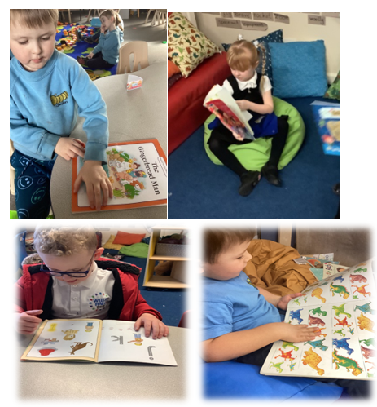
Implementation

Slide 58
Formal writing is taught in Reception beginning with letter formation linked to their SoundsWrite sound. Children begin writing initial sounds, writing sounds of words to writing CVC words and then sentences. It involves transcription, spelling and handwriting, and composition, articulating ideas and structuring them in speech, before writing. This is then carried through into writing tasks weekly linked to the story of the week, through direct and indirect teaching. Children are also encouraged and motivated to mark make and record within their play, writing labels, creating maps, writing stories, writing lists etc.
Implementation

Slide 59
From Nursery we provide lots of meaningful opportunities for children to learn about the written word and support them to understand that symbols carry meaning through their play.
To support transcription, we give children opportunities to develop finger strength (fine motor skills). In the early stages children need lots of fun, play activities to prepare for writing, activities like manipulating dough, completing puzzles or threading blocks onto a rope.
Implementation

Slide 60
We also plan for activities on a large scale to develop gross motor skills. Using brushes on walls outside, using chunky crayons or pencils. Along with giving them opportunities to develop core strength and ‘muscle isolation’, a crucial first step towards writing. Activities like reaching across the body to put on socks and shoes help children to use their right, or left, body side without the other side moving at the same time. We also encourage activities like climbing, throwing and catching.
Implementation

Slide 61
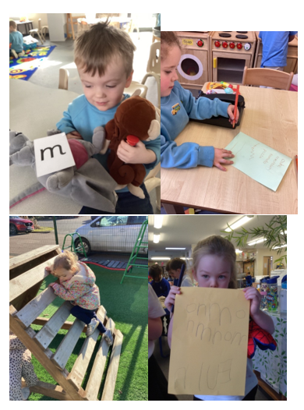
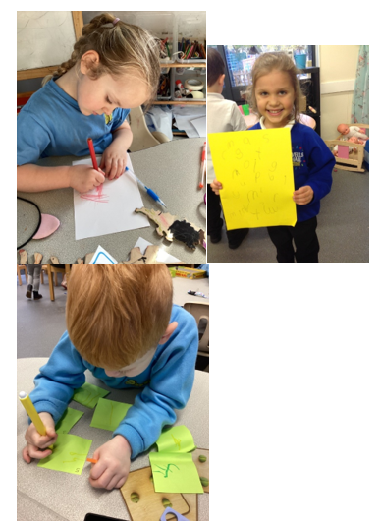
Implementation

Slide 62
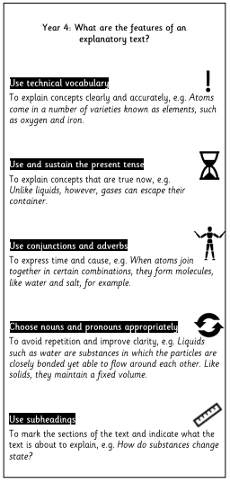
Knowledge Notes
Accompanying each module is a Knowledge Organiser which contains key skills which all pupils are expected to understand and use.
Knowledge notes are the elaboration and detail which help pupils acquire the content of each module.
These knowledge notes are introduced at the start of a sequence of learning and used to unpick the shared text. Teachers will often highlight examples in the shared text to draw pupils’ attention to the skill.
Implementation

Slide 63
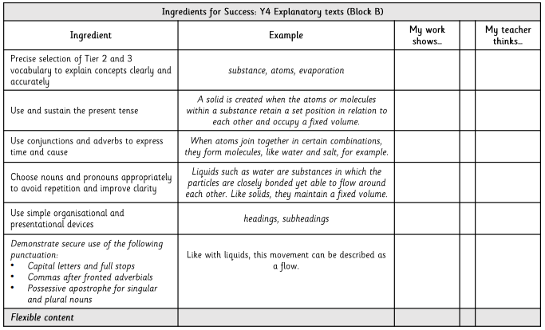
Ingredients for Success
Implementation
The pupils use an Ingredients for Success checklist to guide their writing and systematically go through the checklist at the end of a writing model to check their writing.

Slide 64
Implementation
English -Spelling
Implementation

Slide 65
Spelling lessons are typically structured in the following ways:
In Key Stage One, Spelling is taught in Year 2 three times per week and in Year 1 three times per week after the May half-term.
In Key Stage Two, pupils access a Spelling lesson which are 20 minutes in length 3 times a week straight after registration.
Each unit of Spelling is supplemented by 2 home learning sheets.
Implementation

Slide 66
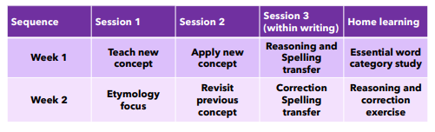
What a sequence of Spelling looks like:
Implementation

Slide 67
What a good lesson of Spelling looks like:
Lessons are taught through the 6-part, ‘Connect, Explain, Example, Attempt, Apply, Challenge’ approach, with clear modelling at the heart of this.
The connect part of the lesson supports children in situating the learning in their existing schema.
The explain stage discretely teaches the new skills that will be the focus of the lesson.
In the example part of the lesson, teachers model using the skills that are required and discuss potential pitfalls and misconceptions.
During the attempt stage, children are supported in using the taught skill and misconceptions that appear are addressed.
As the lesson progresses, children are given the opportunity to apply their new skill with increased independence and within context.
Finally, if they are confident, children will be challenged to use the skill in a new context or with greater accuracy.
Implementation

Slide 68
Different foci of lesson:
Focus on morphemes: Pupils will have a chance to explore the etymology (word origins) and morphology (how words are structured) of words that they will meet across the curriculum.
Dictionary task: Pupils should be encouraged to use a range of dictionaries efficiently and accurately to support them with checking spelling and word meaning.
Word meaning: Pupils may be asked to complete sentences, sort words or match words according to their meaning.
Implementation

Slide 69
Different foci of lesson:
Dictation: Sentences are read aloud several times. Pupils orally rehearse this sentence so that they can say the whole thing aloud before they write it. Pupils then read back what they have written to ensure that they have attempted each word in the sentence.
Spotlight on spelling task: Pupils identify any words that use the taught concept from this unit and sort them according to those that they have spelled correctly and those that they have spelled incorrectly. Pupils then use this in their own extended writing for this task but they can use the passages provided in each block instead if necessary.
Implementation

Slide 70
Implementation
English
Implementation

Slide 71
Tailoring for SEND
At Wells Hall we aim for all English lessons and learning to be accessible to all pupils.
Pre-teaching of vocabulary provides all children with the opportunity to demonstrate an understanding of subject specific language.
In Reading: Expert, Echo and partner reading support pupils in accessing the core text.
In Writing: Shared analysis of the text and clear foci help chunk the learning and make it clear.
The 6-part structure of the lessons scaffold the pupil’s learning into smaller more manageable chunks allowing each to succeed.
In addition, knowledge notes are utilised in all lessons to minimise cognitive overload.
Sentence stems can be used where necessary to aid with written evidence.
Implementation

Slide 72
Oracy
When discussing their findings or presenting information, pupils are encouraged to speak using full sentences and incorporating key vocabulary. This is modelled by teachers e.g. using my turn, our turn, your turn.
Implementation

Slide 73
Continuous Professional Development
All staff have undergone CPD in Cognitive Load Theory, Spaced Practice Retrieval Theory and planning the English curriculum through the use of Knowledge Notes and lesson strips.
In addition to this, staff have accessed planning sessions with Lauren Meadows (author of the Reading and Writing curriculum) to support them in effectively planning sequences of work using the materials provided within the modules.
All staff have completed CPD from library.
Implementation

Slide 74
Impact
English
Impact

Slide 75
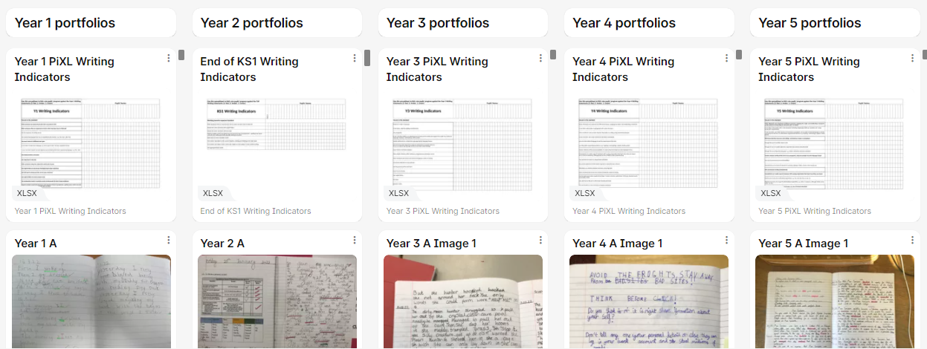
Pupil book study
Impact
Trust wide pupil book study. Teachers used the writing indicators to assess a wide variety of pupils’ work from across the age groups.

Slide 76
Impact
English - Reading
Impact

Slide 77
Assessment Reading
Whole class feedback sheets are completed in lessons with pupil progress being assessed against the lesson focus. These sheets are used to identify misconceptions in learning, including when these will be addressed and shared with pupils the next lesson or when the skill type is revisited (see feedback and marking policy).
In Early Years and Year 1 SoundsWrite assessments are completed half termly and the groups are reorganised in accordance with the results to place pupils on the most appropriate group. At the end of Year 1, pupils complete the Phonics screening to confirm that all pupils have learned phonic decoding to an age-appropriate standard. Pupils who have not reached this level receive extra support from our school to ensure they can improve their decoding skills. This is monitored on a half termly basis. These pupils will then have the opportunity to retake the phonics screening check in Year 2. Alongside this, whole class phonics sessions are completed in Year 2 to consolidate and secure the pupil’s learning.
Impact

Slide 78
Assessment Reading continued
Years 2 – 6 complete termly PiXL reading assessment or previous year’s SATs papers. Teachers then complete QLA for each assessment and use the data to inform future planning, direct subsequent lessons and their instruction. Data is submitted to Unity Schools Partnership on agreed tracker (date set by USP) to ensure coherency within the trust.
Pupils are assessed termly for their reading speeds, this highlights pupils who need additional support through reading interventions and allows teachers to monitor the progress of all.
Reading is monitored through the Accelerated Reader programme for Years 2 - 5.
Impact

Slide 79
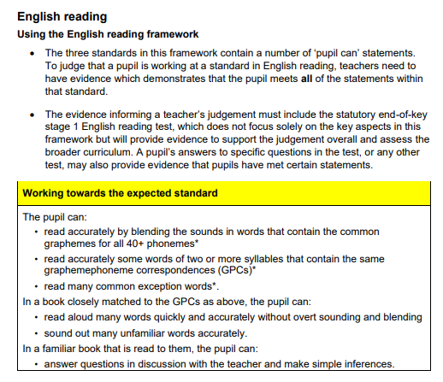
Assessment Reading Framework: End of Key Stage 1
Impact

Slide 80
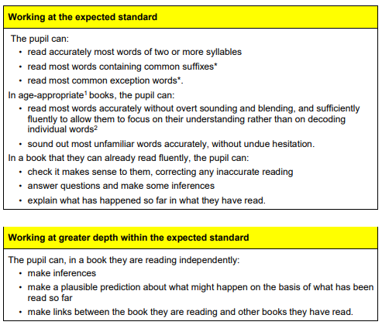
Impact

Slide 81
Impact
English - Writing
Impact

Slide 82
Assessment Writing
Whole class feedback sheets are completed in lesson with pupil progress being assessed against the lesson success criteria. These sheets are used to identify key next steps in the pupils learning, including when these will be addressed, (see feedback and marking policy).
Within each writing unit, there is a short set of genre specific, assessment criteria, ‘Ingredients for success,’ which are used for pupils to self-assess their work and for staff to identify key teaching points for the future.
A trust wide assessment calendar stipulates set assessment points throughout the year. At these assessment points, staff use PiXL writing indicators to assess pupils writing (usually once each term). These assessments are used to create a, ‘gap analysis,’ for individuals, groups and cohorts. This analysis is used to shape planning for the teaching of writing.
In addition to this, pupils in each year group (Years 1 – 6), take part in an Assessing Primary Writing (APW) task once a year.
Impact

Slide 83
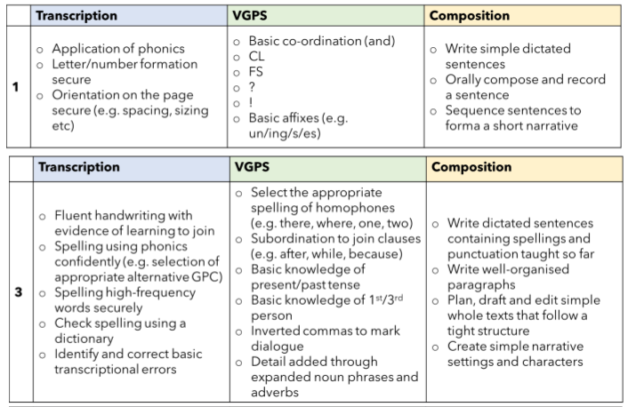
Assessment Writing Framework
Impact

Slide 84
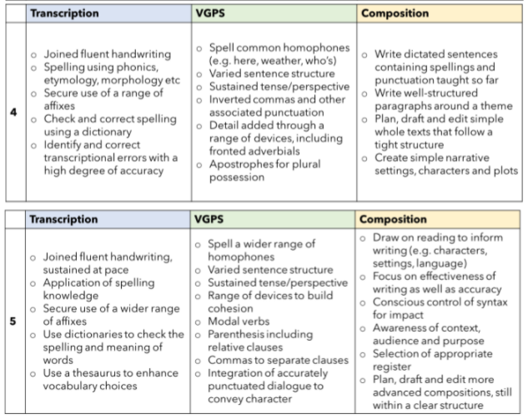
Assessment Writing Framework
Impact

Slide 85

Assessment Writing Framework: End of Key Stage 1
Impact

Slide 86
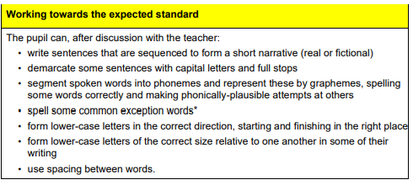
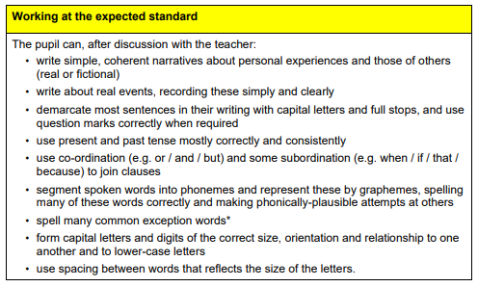
KS1
Impact

Slide 87
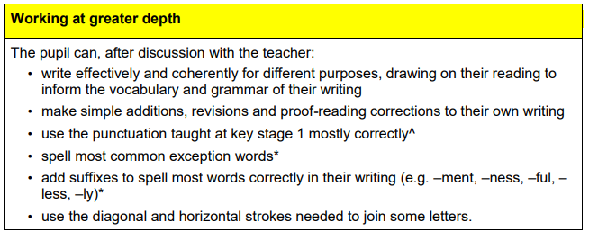
KS1
Impact

Slide 88
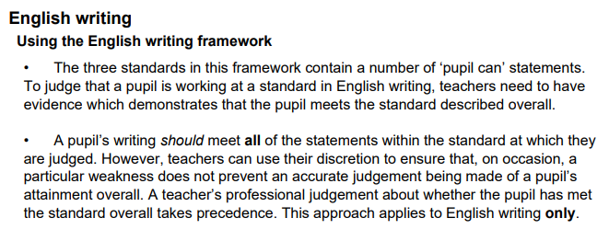
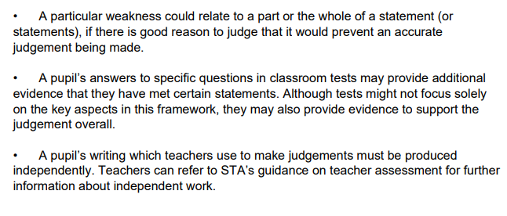
Assessment Writing Framework: End of Key Stage 2
Impact

Slide 89
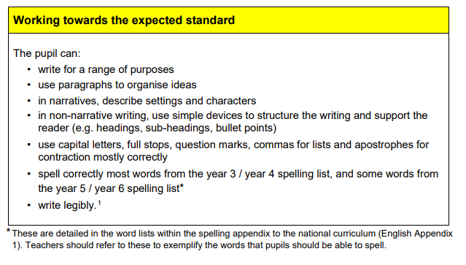
KS2
Impact

Slide 90
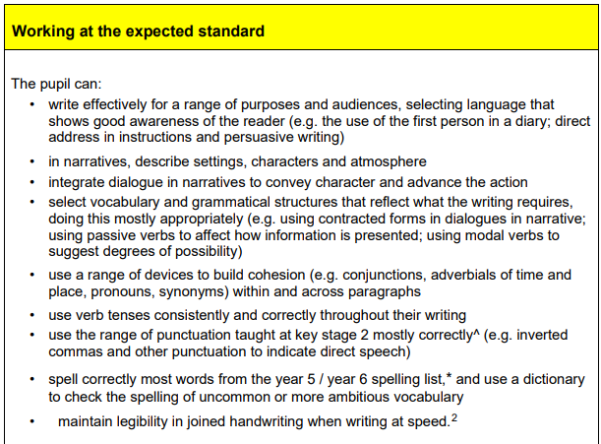
KS2
Impact

Slide 91
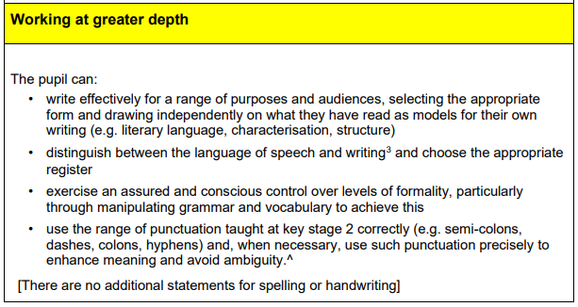
KS2
Impact

Slide 92
Sequence of learning: Reading Year 2
Impact

Slide 93
Sequence of learning: Reading Year 2
Impact

Slide 94
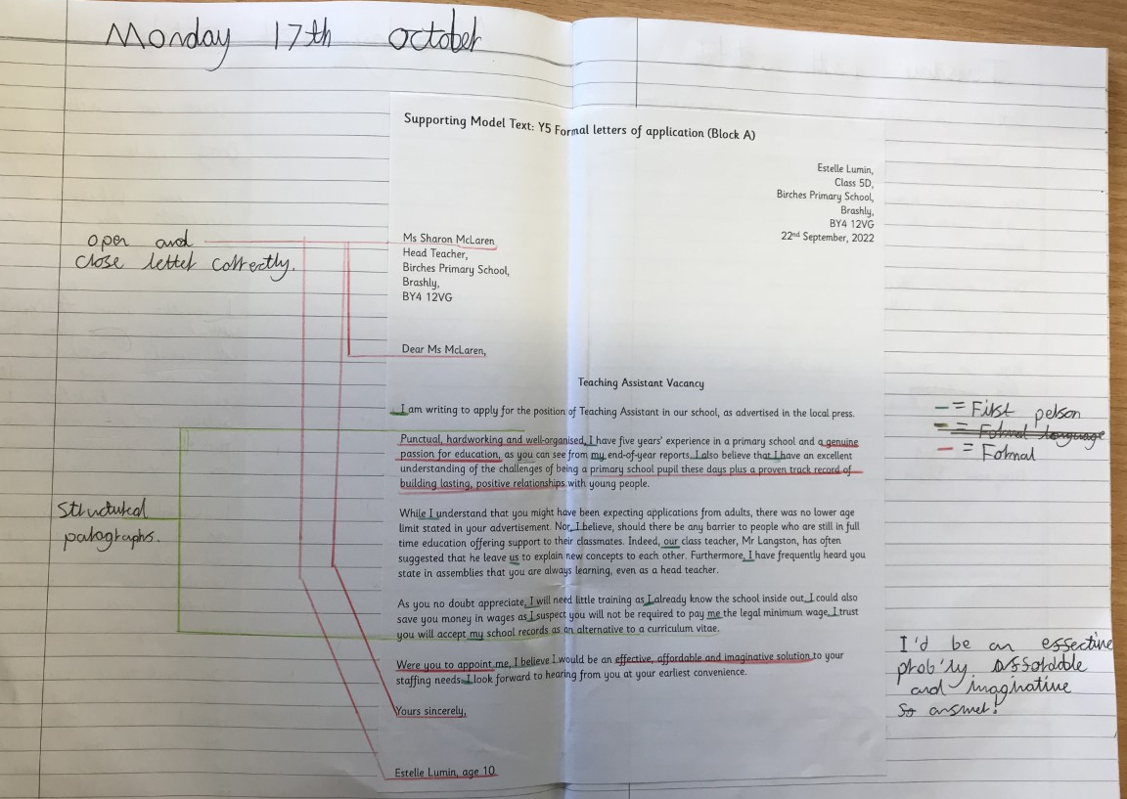
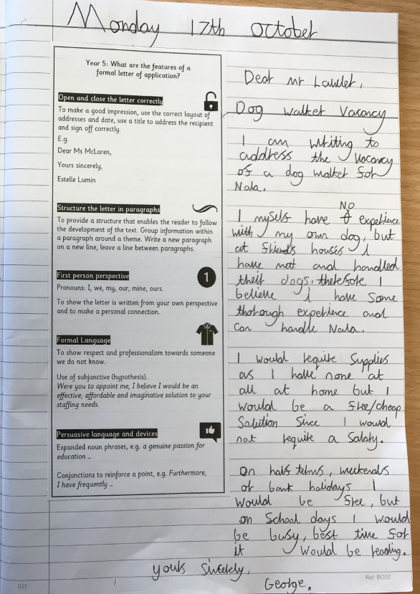
Sequence of learning: Writing Year 5
Unpicking of the model text with annotations of the key features.
Impact
Explanation, example and attempt of the key features and skills of the learning.

Slide 95
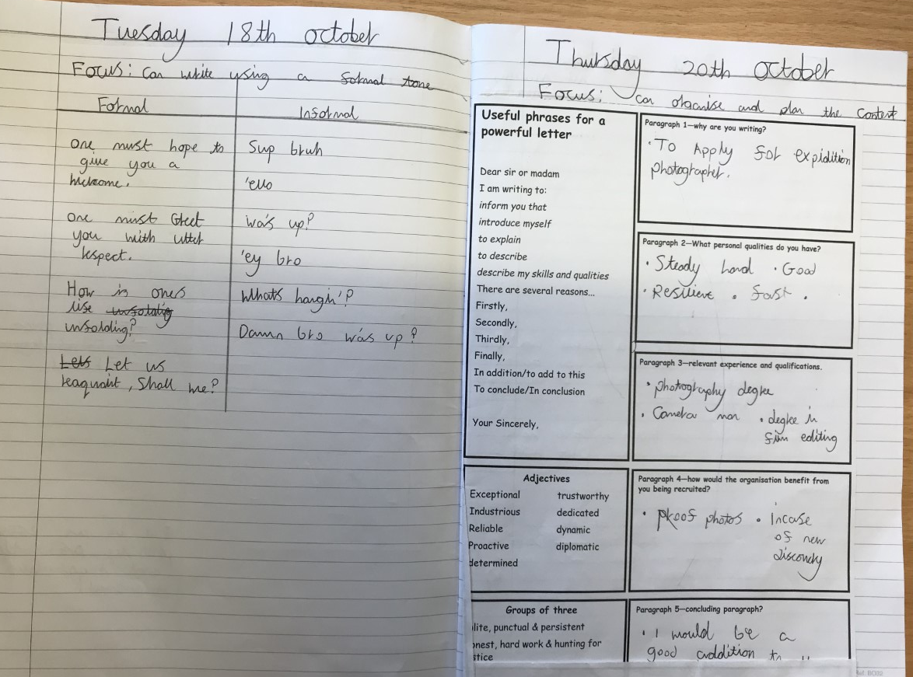
Sequence of learning: Writing Year 5
Impact
Explicit teaching of core skills and language required for the module.
Planning framework used to structure the extended piece of writing.

Slide 96
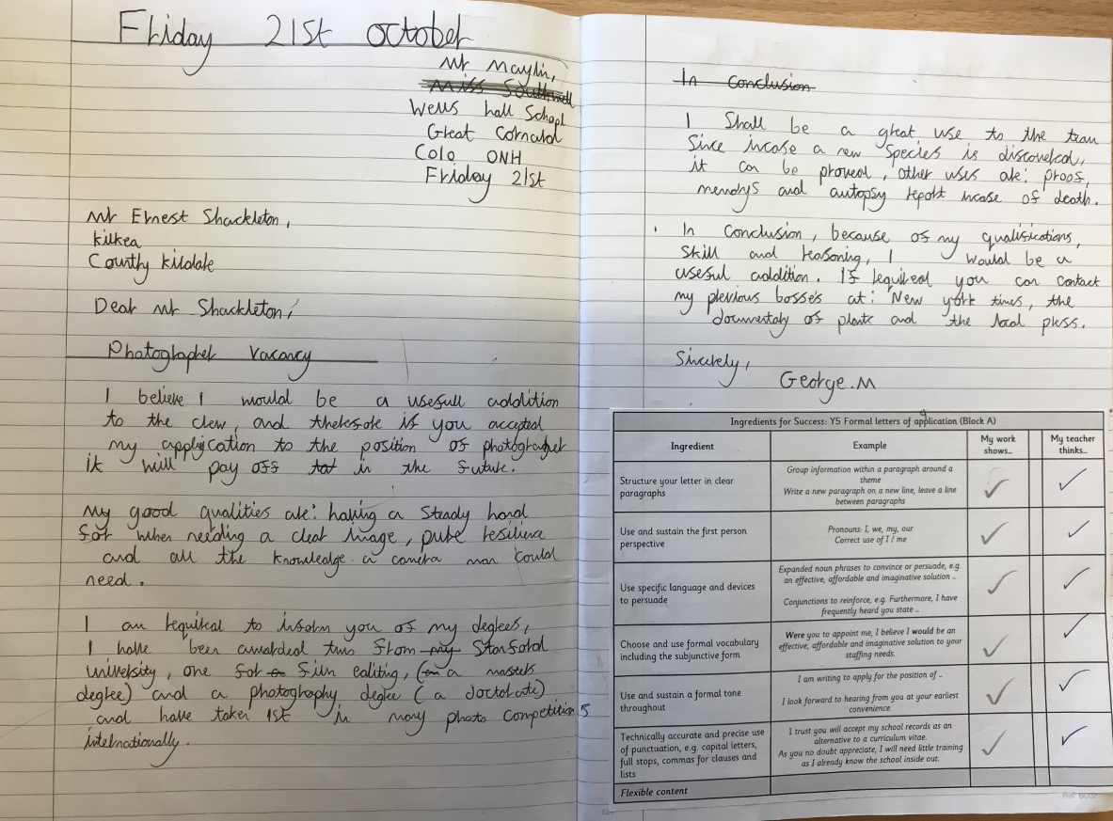
Sequence of learning: Writing Year 5
Extended writing exercise carried out over a number of days.
Impact
Ingredients for success self-marked and teacher-marked.

