Slide 1
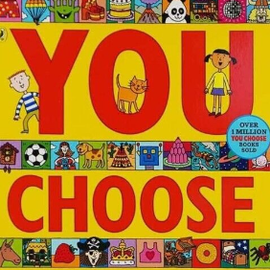
Communication and Language
Speech and Language Targets
Using PECS board to communicate needs, wants and to answer questions within a simple sentence
Makaton Signs and Star maths and vocab words of the week
Daily Attention Autism Activities
Daily Oracy development sessions.
To listen for short periods during a focused task.
Apple Class
Summer Term 1 2024
Traditional Tales
Personal, Social & Emotional Development
To ask for help using verbal communication, symbol or sign.
To pour a drink from a jug confidently without spilling.
To recognise the emotions of characters in a story.
To continue to develop turn taking activities with adult support.
To co=operate with another to carry out small jobs.
Literacy
Mark-making, letter formation and name writing using different media at individual pupils level.
Initial sound match, CVC word building and digraphs at pupil’s level
Listening to familiar stories and joining in with familiar songs and repeated phrases within daily sensory story sessions.
Who, what where questions.
To scribe initial, middle and final sounds using an alphabet mat.
To use verbs to describe what I am seeing, using colour semantic aids.
Key Texts
Physical Development
Gross Motor Skill development to include sensory circuits, bikes, trikes,dance and outdoor play
Squiggle While You Wiggle
PE Sessions- Mr Dellar
-Fine Motor Skill development to include dough disco, funky finger activities and cutting skills.
To use scissors to cut along a straight line.
To use an overarm action to throw a ball.
Mathematics
One more and one less than a given number
To recognise number patterns beyond 20.
To recognise and use 1p, 2p, 5p, 10p, 20p, 50p and £1 coins
To compare the capacity and weight of different objects.
- Length
Understanding of the World
Enrichment Activity TBC
To identify objects according to their material and texture
To complete a simple program on the ipad
To show care for living things in their environment, i.e. plants
Expressive Arts and Design
To describe what others are doing by their actions.
To retell a familiar story using props.
To follow a sequence of two actions from memory.
To explore and use different materials for a purpose.

