Slide 1
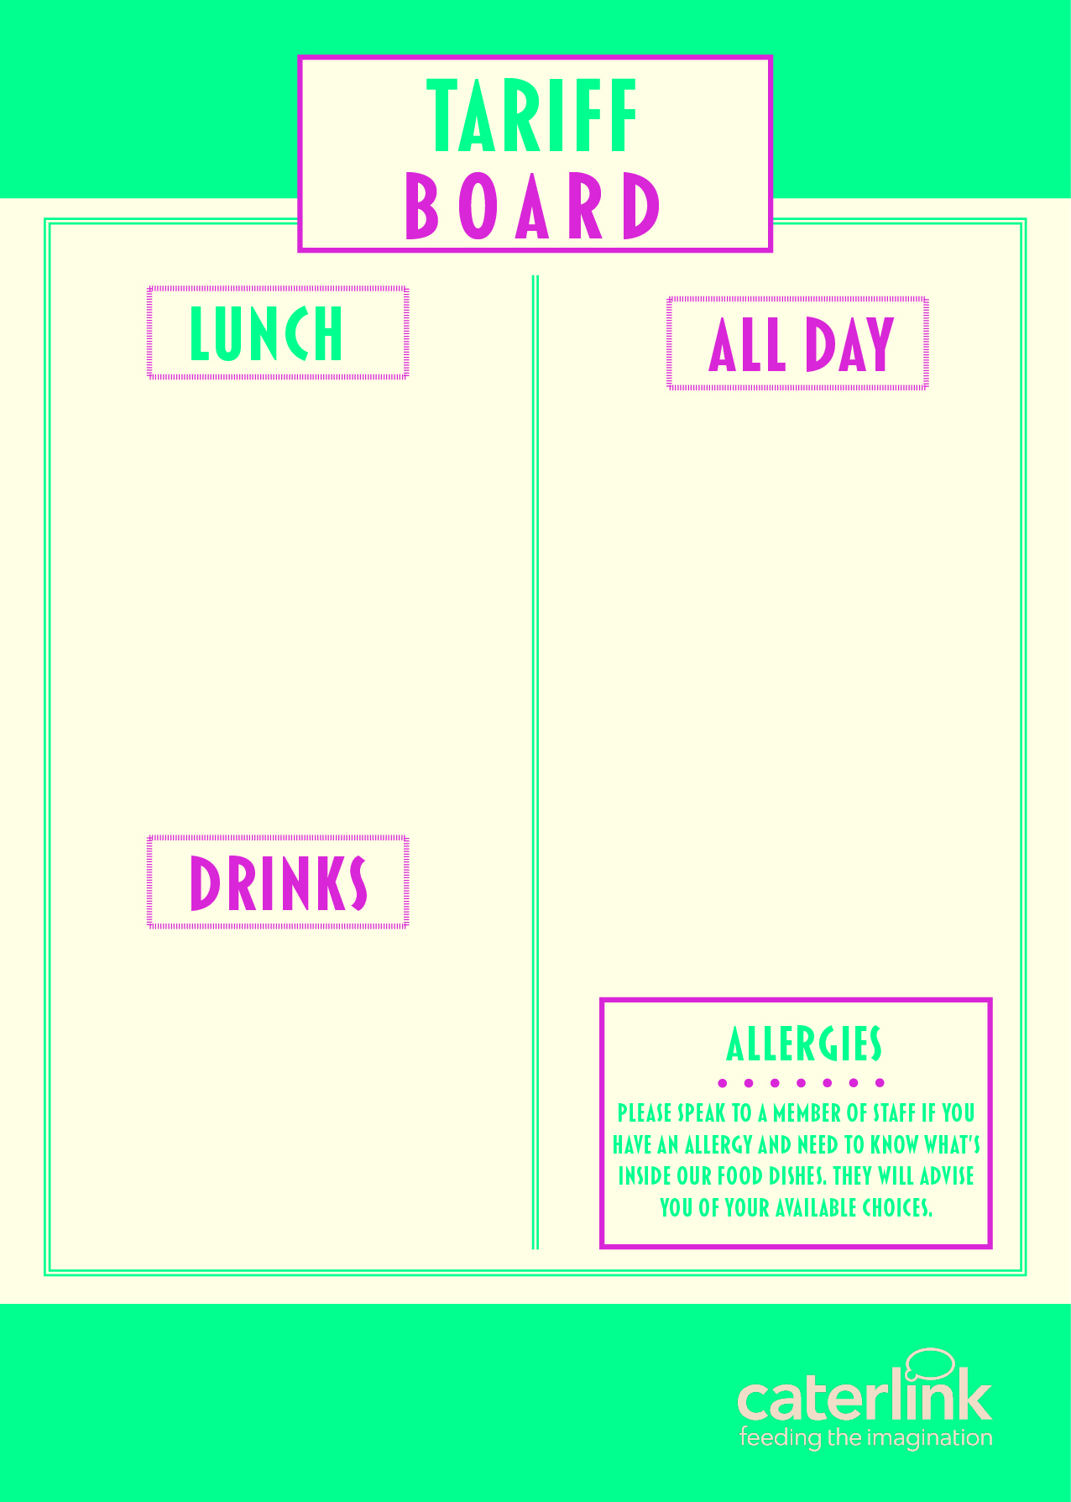
MEAL DEAL (HOT MEAL OF THE DAY + SALAD OR VEGETABLES + HOMEMADE COOKIE OR CAKE) | £2.58
PIZZA SLICE | £1.55
JACKET POTATO & 2 FILLINGG | £2.25
PASTA, SAUCE & CHEESE | £2.25
PANINI (2 FILLINGS) | £2.25
HOMEBAKE | £1.05
COOKIE | £1.05
SANDWICHES / BAGUETTES FROM | £2.25
FRUIT POTS | £1.70
WRAPS FROM | £2.25
SALAD POTS FROM | £2.00
CHIPS / WEDGES | £1.40
SAUSAGE ROLLS | £1.40
HOT FILLED ROLLS | £2.20
CROISSANT | £1.30
PAIN AU CHOCOLAT | £1.30
BEEF / CHICKEN BURGER | £2.25
WATER | £1.10
RADNOR FIZZ | £1.25
RADNOR SPLASH | £1.25
OMJ CANS | £1.30
JUICE CARTONS | £1.00
Free porridge will be available at morning break for the Autumn Term!

