Slide 1
Year 11 NEAs
Non Examination Assessments

Slide 2
Non-Examined Assessments (Coursework)
NEAs are the way Examination Boards assess students on work completed outside of the examination room in the classroom.
These assessments make up a percentage of the course from 40% up to 60%.
Examination boards change their specifications and so some have new rules whilst others are on legacy rules, please be mindful about the rules and notes in the subject maps.
Deadlines are deadlines and cannot change under the new JCQ rulings, which now state that changes in agreed deadlines will be classed as maladministration.
All subject maps and this presentation can be found on the school website under Year 11 2023-24

Slide 3
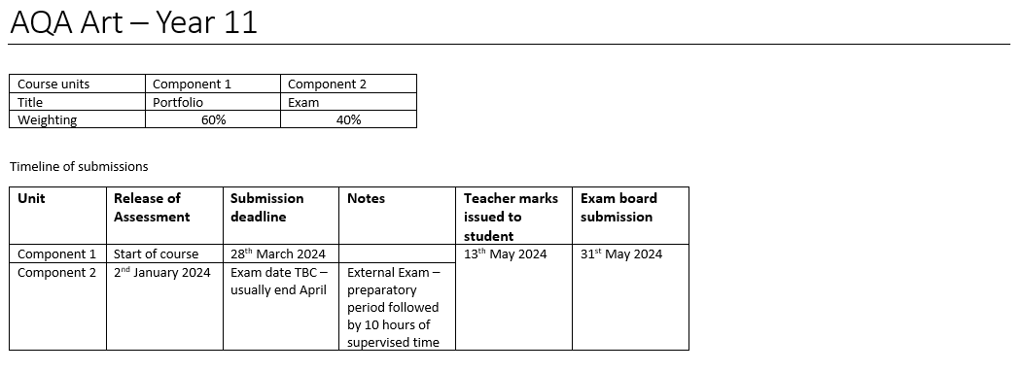

Slide 5
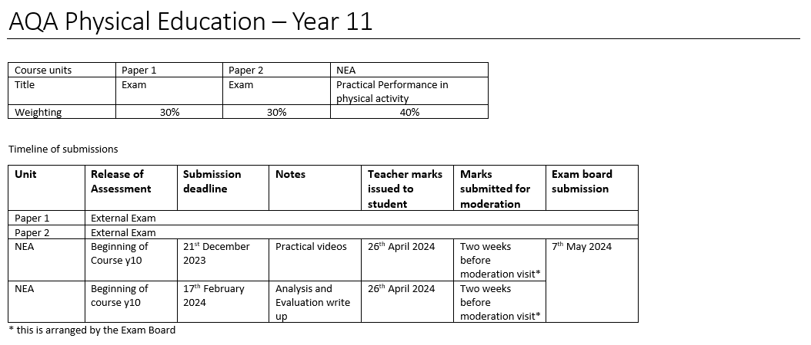

Slide 6
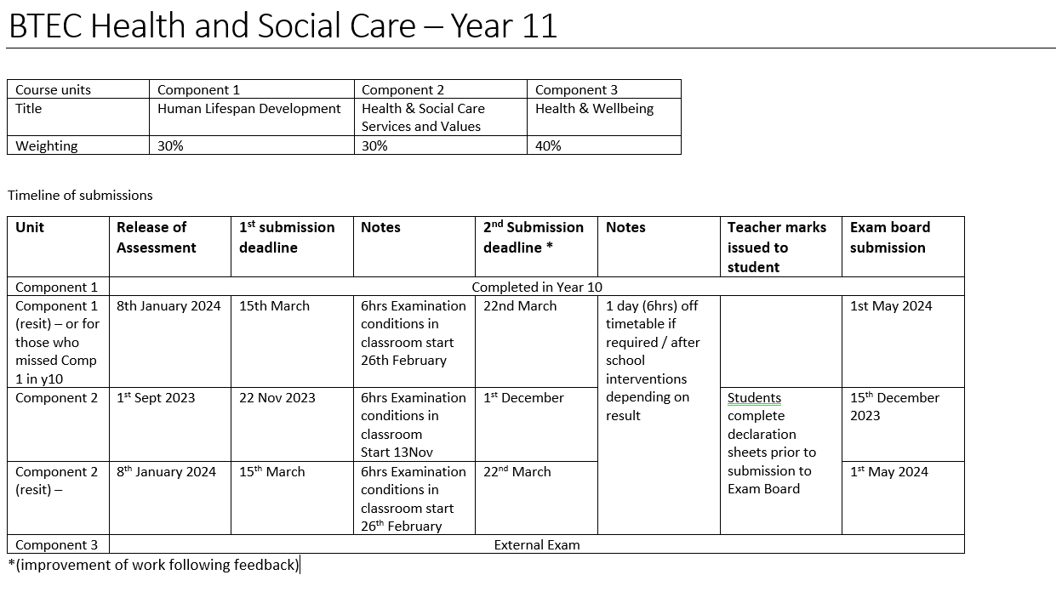

Slide 7
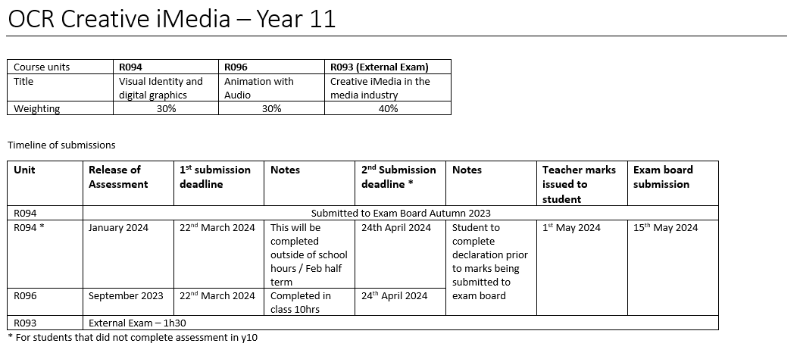

Slide 8
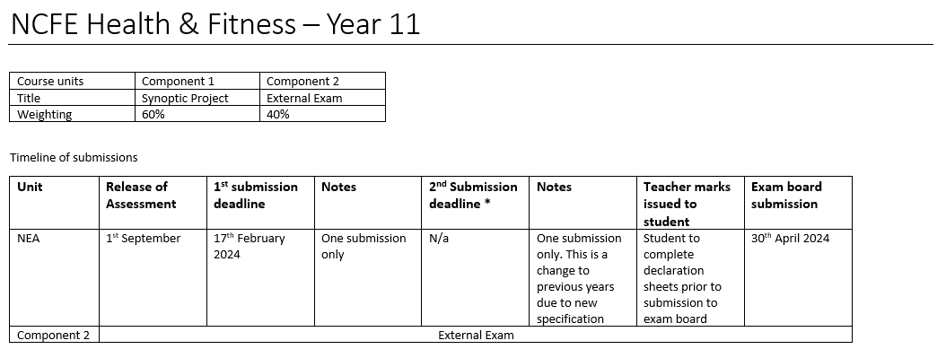

Slide 9
