Slide 1
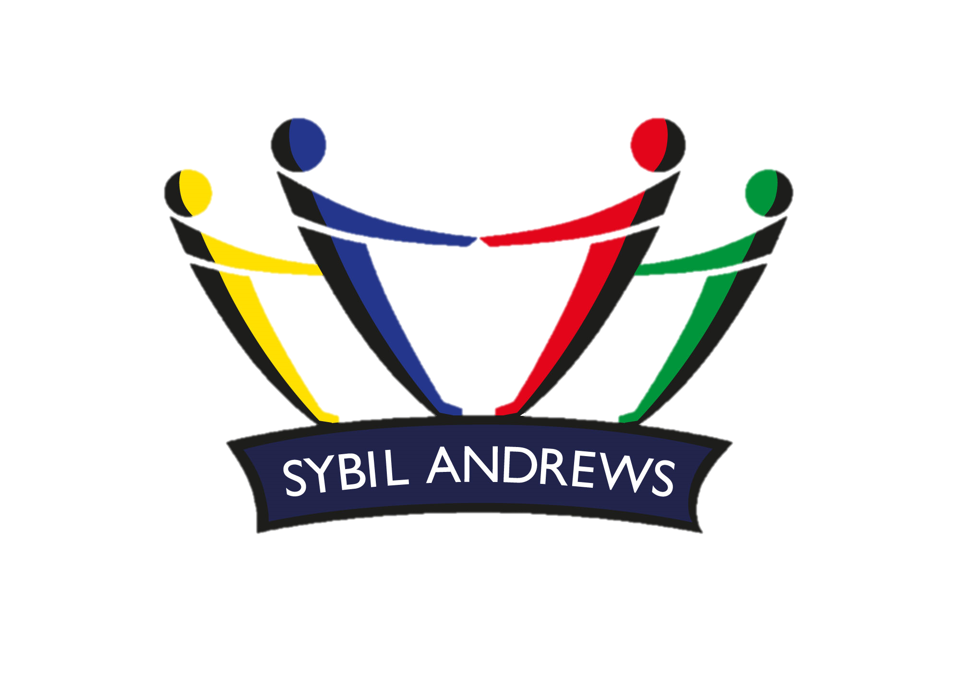
Sybil’s WOW
Word of the Week
Feeling hopeful about the future | Although his team hadn’t won a game all year, Joe was optimistic that they would win today. Alisha’s optimistic attitude helps her stay positive when she’s having a tough time.
Positive Hopeful | Pessimistic Negative
Definition
Examples
Optimistic
(Adjective)
Synonyms
Antonyms
We are kind We have courage We take responsibility

