Slide 1


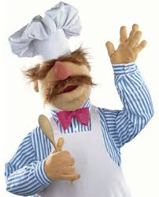




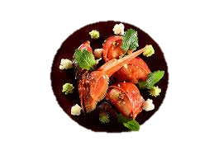

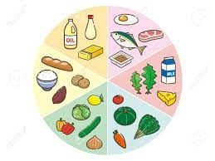



Sybil Andrews Academy
The best way to predict the future... is to create it.
Level 1/2 Hospitality & Catering 2022/23
Learning journey
How hospitality and catering provisions operate
NEA – Hospitality & catering in action
The NEA (Non-Exam Assessment) represents 60% of your final grade in Hospitality & Catering. The applied purpose of the unit is for learners to safely plan, prepare, cook and present
nutritional dishes.
Operation of the kitchen
Operation of front of house
How hospitality and catering provision meet customer requirements
Menu planning
Health & Safety
Understand the environment in which H&C providers operate.
Hospitality and catering provision to meet specific requirements
Structure of the hospitality and catering industry
Job requirements within the hospitality and catering industry
Working conditions of different job roles across the hospitality and catering industry
Factors affecting the success of hospitality and catering providers
Review options for hospitality and catering provision
Recommend options for hospitality provision
Reviewing dishes you cook
Organoleptic qualities of food
Importance of nutrition
Functions of nutrients in the human body
Nutritional needs of specific groups
Characteristics of unsatisfactory nutritional intake
How cooking methods impact on nutritional value
Factors to consider when proposing dishes for menus
How dishes on a menu address environmental issues
How menu dishes meet customer needs
Plan production of dishes for a menu
Use techniques in preparation of commodities
Assure quality of commodities to be used in food preparation
How food can cause ill health
Food related causes of ill health
Roles and responsibilities of the Environmental Health Officer (EHO)
Food safety legislation
Common types of food poisoning
Symptoms of food induced ill health
Example practical cooks:
Fresh pasta
Raspberry and white chocolate loaf cake
Focaccia
Lasagne
Hebridean pasties
Makhini Curry
Profiteroles
Puff pastry
Chicken Ballotine
Fruit lattice pie
Paella
Fish pie
How H&C provision meets health and safety requirements
Personal safety responsibilities in the workplace
Risks to personal safety in hospitality and catering
Recommend personal safety control measures for hospitality and catering provision
L1/2 Hospitality & Catering

