Slide 1

Meet the teacher
Merlin Class Year 3
Mrs Baker

Slide 2



Merlin Class Staff
Miss Pettan Brewer

Slide 3
When are the adults in the class?
Mrs Baker teaches full time with Tuesday afternoon for PPA and Wednesday afternoon for management.
Mrs Marshall will teach the class on Tuesday and Wednesday afternoons.
Mrs Marshall is in Merlin every morning.
Miss Pettan Brewer is in Merlin Class in the afternoons.

Slide 4
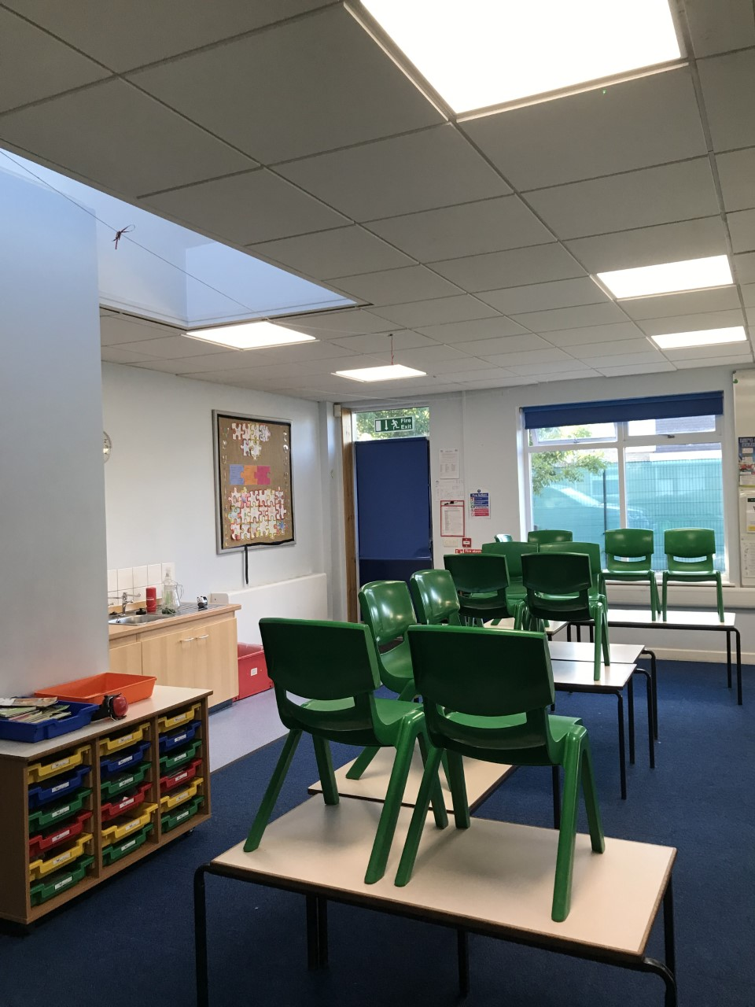
Merlin Classroom

Slide 5
PE
PE this half term will be on Monday morning and Thursday afternoon.
PE days will change each half term. Keep an eye on planners for details.
Commando Joe’s day is Friday 12th September (tomorrow).

Slide 6
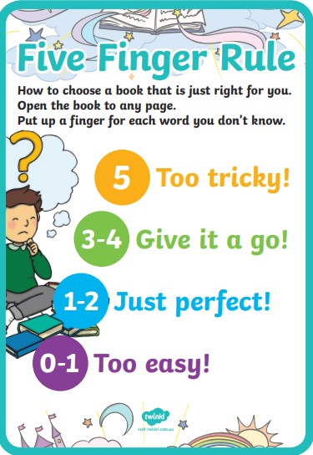
Reading
In year 3, children will be supported to choose a reading book at the appropriate level. Some children will choose a reading book from the classroom, some children will have bridging books from outside year 2 and some children will choose from the library. We will do this using the 5-finger rule.

Slide 7
Reading
They can also take a book out of the library for free reading (either one they can read independently or one to share with parents and carers).
We encourage children to read from a wide variety of genres. Whilst we want the children to read their school book, we also encourage children to read comics, magazines, newspapers, recipes, instructions, poetry etc
If the children have read a book from home you can also add this in their planner
Reading twice in one day only counts once in the weekly challenge

Slide 8
Reading
Children are expected to read a minimum of three times a week. If they don’t read three times a week, they will be asked to spend some time at playtime reading in the hall.
If they read five times a week, they will receive a certificate sticker in their planner. When they have done this 10 times, they can choose a book to keep from a collection of new books.

Slide 9
Uniform
. Dark green sweatshirt/cardigan/fleece (plain or embroidered with the school logo).
Either:
  White shirt;
  White polo shirt (plain or embroidered with the school logo); or
  Dark green polo shirt (plain or embroidered with the school logo).
Either:
  Knee length black/grey skirt;
  Pinafore dress;
  Green and white checked dress;
  Black/grey school trousers; or
  Black/grey tailored short trousers.
Plain black/grey/white/dark green tights or socks.
Plain black/grey/white/dark green leggings or shorts may be worn under dresses/skirts.
Jeans, leggings, jeggings etc. are not considered school trousers; please be advised that some shops advertise ‘school trousers’ which are not in line with this policy.
All clothing should be clearly marked with your child’s name.
For safety reasons, we expect all children with long hair to have their hair tied back at all times.
If your child needs to wear an adapted school uniform in line with their religious or cultural beliefs, please make an appointment to speak to the Headteacher in the first instance.

Slide 10
uniform
Pupils in Years 1 to 6 may bring a change of footwear if they wish to go on the field at break and lunchtimes when it is wet or muddy (e.g. wellies, trainers which are different to those worn for indoor PE) but these must not be worn all day.
We also expect all pupils to wear the correct footwear: ‘Sensible’ (i.e. no/low heel) plain black shoes or boots (no trainers, sandals, canvas shoes or sports-branded ‘trainer shoes’).

Slide 11
Pe kit
T-shirt in the colour of your child’s House (plain or embroidered with the school logo).
Plain dark green shorts.
Bare feet, plimsolls or clean trainers for indoor PE lessons, or trainers (different to those worn for indoor PE lessons) for outdoor PE lessons.
Plain black/grey/dark green leggings or jogging bottoms may be worn for outdoor PE lessons when it is cold, along with a dark green school sweatshirt/cardigan/fleece/PE hoodie (plain or embroidered with the school logo).
Pupils in Reception to Year 6 must wear their PE kit to school and remain in it for the whole day on days when they have PE, including outdoor PE wear for breaks and lunchtimes when it is cold, even if the PE lesson itself is indoors, PROVIDED THAT IT IS FULLY IN LINE WITH THE ABOVE EXPECTATIONS (INCLUDING OUTDOOR PE EXPECTATIONS – IF IT IS NOT, YOU WILL BE TELEPHONED AND ASKED TO BRING THE CORRECT PE KIT IN FOR THEM TO CHANGE INTO.
Earrings must not be worn for PE lessons and cannot be covered with tape (earrings should not be worn at all on days when your child has swimming or PE – see below).

Slide 12
curriculum
We are teaching the full National Curriculum. English and maths is taught every day.
PE is taught twice per week, as well as other activities such as the Daily Mile and half termly ‘Commando Joe’ days.
Art, DT, Geography, History, French and Science are taught weekly.
Computing and Music will alternate between weekly lessons and block days.
DT cooking will be taught in block days.

Slide 13
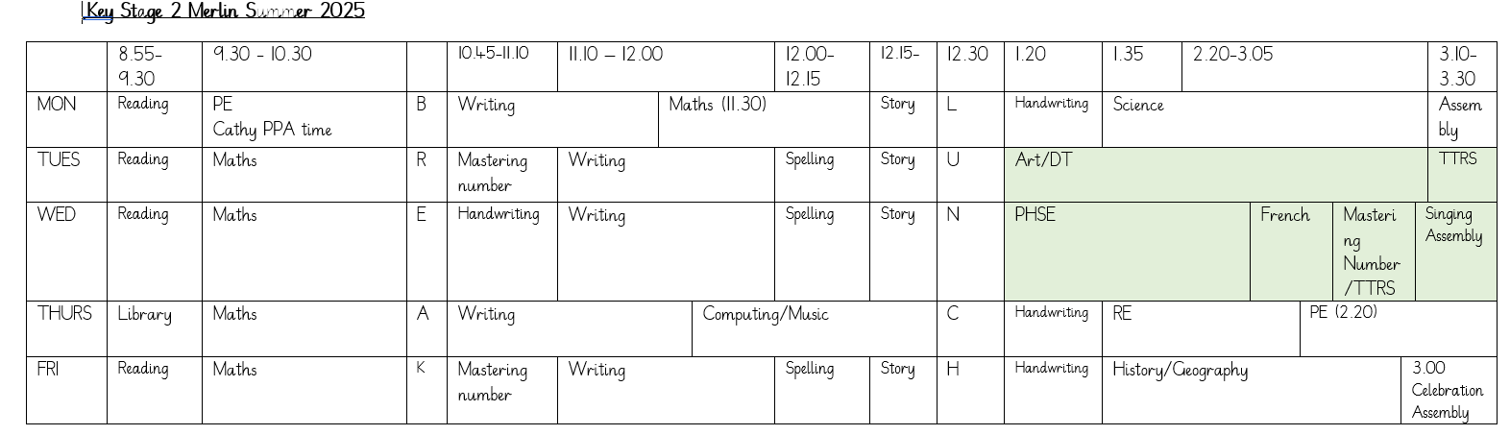
Example Timetable

Slide 14
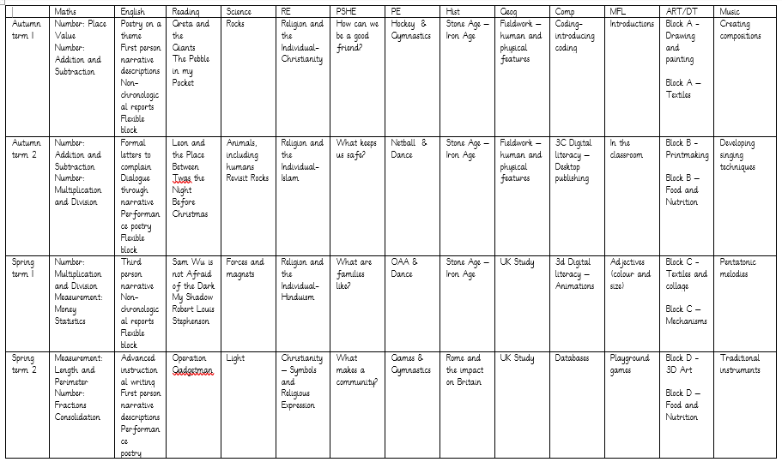
Long Term Plan

Slide 15
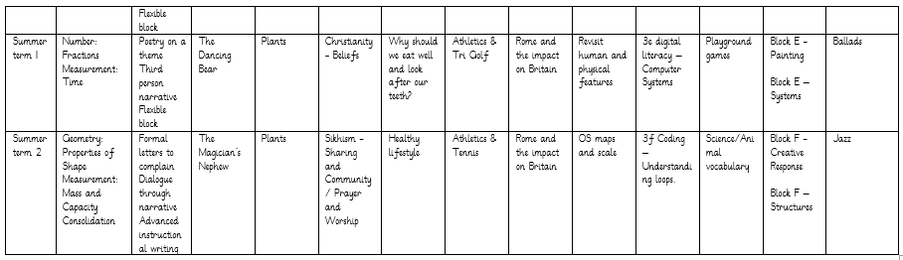
Lots of opportunities are given to revisit subjects to support retention of key facts.

Slide 16
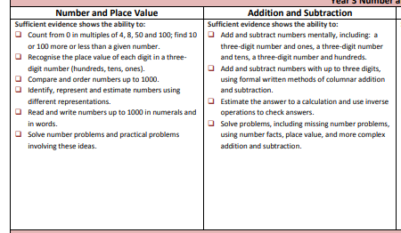
expectations

Slide 17
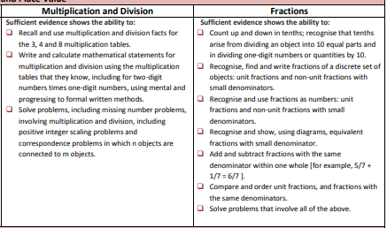

Slide 18
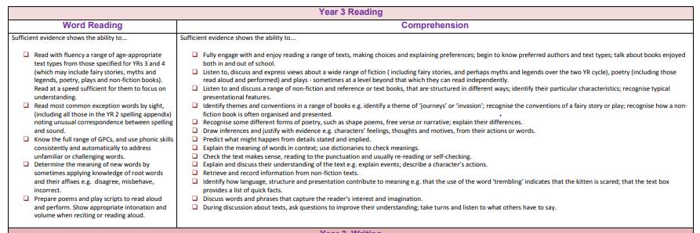

Slide 19
assessments
At the end of year 4, your child will take a times table test. This involves an online 25 question tests covering all times tables. This year we will reinforce understanding of 2, 5 and 10s and learn on our 3x, 4x and 8 x tables.
The TTRS sound check game mirrors the test.
Ways to learn times tables: arrays, reciting, pairs games etc
During year 3 your child will be assessed using Trust tests. These are new offering from the Trust and will be used to identify progress and gaps in learning. This information will then be used to inform future learning.

Slide 20
homework
All pupils are expected to read/share a book at least three times per week and record this in their planner as part of their homework. (Planners are required to be in school each day).
Years 1 to 6 will have weekly spelling activities to complete in line with our spelling programme.

Slide 21
How can you support your child?
Ensure they read regularly
Use the hints in the home school book to support your child when reading, asking comprehension questions is very important.
Help them learn their times tables through using TTRS etc
Encourage independence – they pack and carry their bag, fill their water bottle, remember their lunch box.
Teach them to tie their shoelaces.
Ask them what they enjoyed about school each day.

Slide 22
ATTENDANCE MATTERS
Our target this year is for every child to have at least 96% attendance.
This means having no more than seven days off across the whole school year!
If your child has one day off per month, their attendance would be 94%.
If they have one day off per fortnight, their attendance would be below 90%, which would be recorded by the Government as Persistent Absence.
Any child whose attendance is below 90% will be given an Attendance Plan.
As well as our usual rewards for every class whose attendance is at least 96%, we are introducing a new reward scheme for pupils, where they will get a ticket to spend in the school shop every time they are here all week – that’s a maximum of 38 tickets, which would ‘buy’ amazing prizes!
Notes:
Think of it like an arcade where the more tickets you have, the better the prize you can exchange them for. The ‘shop’ will be open at the end of each half term.

Slide 23
WHY IS ATTENDANCE SO IMPORTANT?
Every day at school counts – even a few days of missed school can have a massive effect on a child’s education and life chances.
Government research shows that primary school children who attend nearly every day are 30% more likely to reach the expected standard in reading, writing and maths than pupils who only attend 90-95% of the time.
Research also shows that pupils whose attendance is below 90% (which is the same as having one day off every two weeks) could earn £10,000 less per year as an adult than a pupil who attended school nearly every day.
We need your help to make good attendance a priority: only keep your child off school when they are genuinely too ill to attend and talk to us if there is anything that we can do to work together.
Notes:
Think of it like an arcade where the more tickets you have, the better the prize you can exchange them for.

Slide 24
Dates so Far
Commando Joe’s day is Friday 12th September (tomorrow).
World Mental health day. Parent share. (afternoon session) Friday 10th October.
Parent Consultation Evenings -3.45-6.15pm on Tuesday 25th and 4.30-7pm Thursday 27th

Slide 25
Contact us
Please do speak to us on the door if we are available and it’s appropriate
Please avoid coming up the steps as it can be a bottle neck when getting the children in and out.
For a longer/confidential discussion, please ask for a telephone or face to face appointment
You can also speak to a member of office staff or the Senior Leadership Team if you need further assistance

Slide 26
questions
Any questions?

Slide 27
Thank you

