Slide 1

Meet the teacher
Rabbit Class
Miss Noe

Slide 2
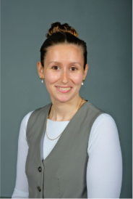
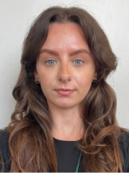
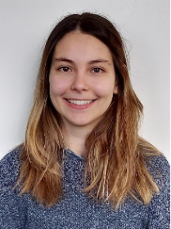

Our class
Miss Noe
Monday-Friday
Miss Parkinson
Monday-Friday
Miss Brewer
Tuesday-Friday (am)
Mr Bursford
Monday
Tuesday-Friday (pm)

Slide 3
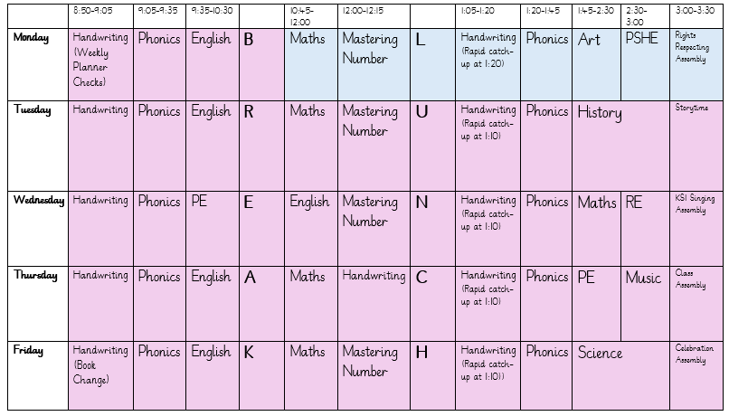
routines

Slide 4
routines
PE- Wednesday and Thursday, please come in PE clothes. All other week days children come to school in their normal uniform. See Uniform policy for further guidance.
Book changes on Friday. Children will read their book multiple times in school across the week before it is taken home. Please ensure books and planners are in bags every day.
Books are checked on Monday/Tuesday to check their weekly reads. We do not check over half terms/holidays.
Outside shoes are important as weather worsens.

Slide 5
Pe kit
Plain black/grey/dark green leggings or jogging bottoms may be worn for outdoor PE lessons when it is cold, along with a school sweatshirt/cardigan/fleece/PE hoodie (embroidered with the school logo).
Pupils should wear their PE kit to school and remain in it for the whole day on days when they have PE, including outdoor PE wear for breaks and lunchtimes when it is cold, even if the PE lesson itself is indoors
Earrings must not be worn for PE lessons and cannot be covered with tape (earrings should not be worn at all on days when your child has swimming or PE)

Slide 6
curriculum
We are teaching the full National Curriculum.
English and maths is taught every day
Science is taught weekly
PE (Physical Education) is taught twice per week, as well as other activities such as the Daily Mile and half termly ‘Commando Joe’ days.
Subjects such as history, geography, computing, PSHE, RE , art, DT and music are taught weekly or in blocks.

Slide 7
expectations
We are currently working towards the Year 2 end of year expectations. Our planning and teaching is adapted to ensure all children have the opportunity to work at the level appropriate to their needs- whether this is consolidating Year 1 work or being pushed beyond the Year 2 expectations.

Slide 8
expectations
Reading
• Read with fluency and expression
• Comment on plot, setting and characters in familiar and unfamiliar stories
• Ask and answer simple questions, and begin to make inferences and predictions
Be secure at Phase 6 Phonics
• Read and spell common exception words

Slide 9
expectations
Writing
Write different kinds of sentence: statement, question, exclamation and command
Use expanded noun phrases to add descript-tion and specification (for example the blue butterfly)
Join sentences using conjunctions(when, if, that, because, and, but)
Correct and consistent use of present tense and past tense
Correct and consistent use of a wider range of punctuation: capital letters, full stops, questions marks, exclamation marks and commas in a list
Be able to use an apostrophe for omission of letters (wasn’t, can’t)
Begin to join handwriting
Spelling
Spell common exception words (see list)
Add suffixes to spell longer words including –ment, –ness, –ful, –less, –ly

Slide 10
expectations
Maths
Compare and order numbers up to 100.
• Read and write all numbers to 100 in digits and words
• Recall and use +/- facts to 20
• Derive and use related facts to 100
• Count in multiples of 2, 3, 5 and 10 from any number up to 100
• Recall and use multiplication and division facts for 2, 5 and 10 tables to solve x and ÷ equations
• Recognise place value of any 2-digit number
• Add and subtract:
2-digit and 1-digit (43+6)
2-digit and 10s (45-20)
Two 2-digits(13+34)
Three 1-digit (4+5+7)
• Recognise and use inverse (14+5=19, so 19-5=14, 3x5=15, so 15 ÷ 3=5)
• Recognise, find, name and write 1/3; 1/4; 2/4; 3/4
• Recognise equivalence of simple fractions (2/4 =½)
• Use symbols for £ and p and add/subtract amounts of money
• Know and use standard measures, e.g. cm and g
• Tell time to five minutes, including quarter past/to
• Describe properties of 2D shape including the number of sides and lines of symmetry

Slide 11
assessments
Government tests:
Phonics screening checks.
We will provide more information about this nearer the time.
Throughout the year both informal and formal testing in school will help us to identify where children need support and to be pushed further.

Slide 12
homework
All pupils must read a book at least three times per week and record this in their planner, if this is not done they will go to the hall during one playtime and read then.
Every child who reads five times in a week receives a Reading Champion certificate/sticker.
Every time a child receives ten Reading Champion certificates, they choose a book to keep
Online homework: Children will be expected to practice TTRS after half term and phase 5 phonics at least once weekly.

Slide 13
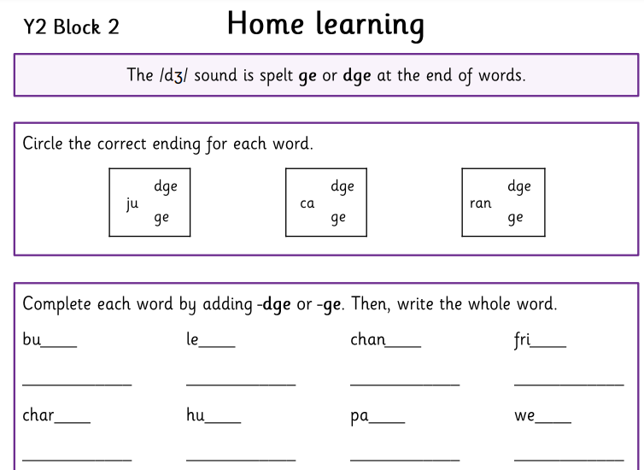
Homework
Your child will receive homework on Wednesdays which will practise the phonics sounds or spelling pattern we have been learning. This is to enable them to practice and consolidate their learning at home.
Example:
Notes:
Once we are teaching CUSP spelling.

Slide 14
How can you support your child?
Ensure they read regularly
Use the hints in the home school book to support your child when reading, asking comprehension questions is very important.
Help them learn their times tables through using TTRS etc
Encourage independence – they pack and carry their bag, fill their water bottle, remember their lunch box.
Teach them to tie their shoelaces.
Ask them what they enjoyed about school each day.

Slide 15
ATTENDANCE MATTERS
Our target this year is for every child to have at least 96% attendance.
This means having no more than seven days off across the whole school year!
If your child has one day off per month, their attendance would be 94%.
If they have one day off per fortnight, their attendance would be below 90%, which would be recorded by the Government as Persistent Absence.
Any child whose attendance is below 90% will be given an Attendance Plan.
As well as our usual rewards for every class whose attendance is at least 96%, we are introducing a new reward scheme for pupils, where they will get a ticket to spend in the school shop every time they are here all week – that’s a maximum of 38 tickets, which would ‘buy’ amazing prizes!
Notes:
Think of it like an arcade where the more tickets you have, the better the prize you can exchange them for. The ‘shop’ will be open at the end of each half term.

Slide 16
WHY IS ATTENDANCE SO IMPORTANT?
Every day at school counts – even a few days of missed school can have a massive effect on a child’s education and life chances.
Government research shows that primary school children who attend nearly every day are 30% more likely to reach the expected standard in reading, writing and maths than pupils who only attend 90-95% of the time.
Research also shows that pupils whose attendance is below 90% (which is the same as having one day off every two weeks) could earn £10,000 less per year as an adult than a pupil who attended school nearly every day.
We need your help to make good attendance a priority: only keep your child off school when they are genuinely too ill to attend, and talk to us if there is anything that we can do to work together.
Notes:
Think of it like an arcade where the more tickets you have, the better the prize you can exchange them for.

Slide 17
Contact us
Please do speak to me on the gate if I am available and it’s appropriate
For a longer/confidential discussion, please ask for a telephone appointment
You can also speak to a member of office staff or the Senior Leadership Team if you need further assistance
If your child is going home with someone else at the end of the day please let us know. Alternatively if you have a regular arrangement with a trusted adult already please write this in their planner.

Slide 18
questions
Any questions?

Slide 19
Thank you

