Slide 1

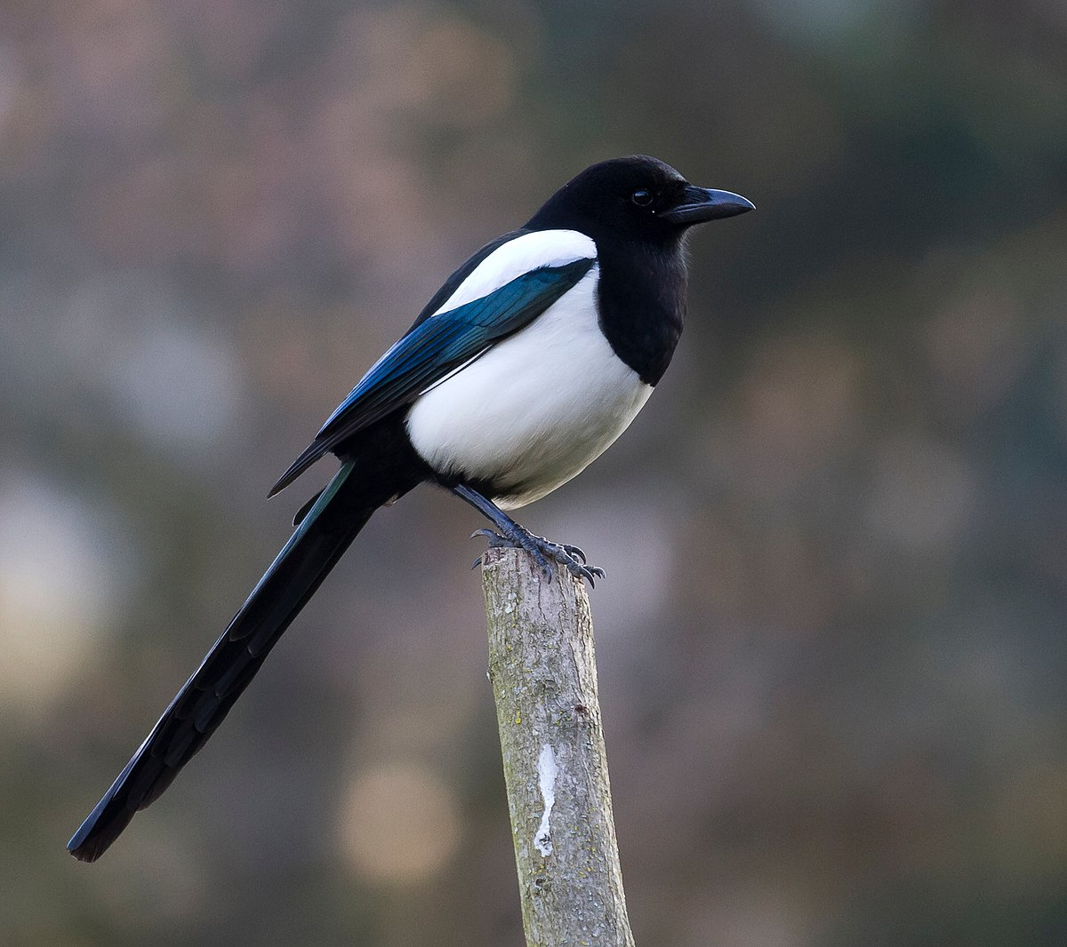
Meet the teacher
Mr Knapp – Magpie class

Slide 2


Our class
Mrs Beech
Wednesday afternoon
Friday afternoons
Mr Knapp
All the time except Wednesday afternoon, Thursday afternoon and Friday afternoon
Mrs Dalton – Thursday afternoons
Teaching Assistant and ELSA practitioner
Reading and writing support

Slide 3
routines
Monday | Mr Knapp teaching
Tuesday | Mr Knapp teaching
Wednesday | Mrs Beech teaching Art/DT
Thursday | Swimming in the morning and Mrs Dalton teaching Science in the afternoon
Friday | Mrs Beech teaching and assembly

Slide 4
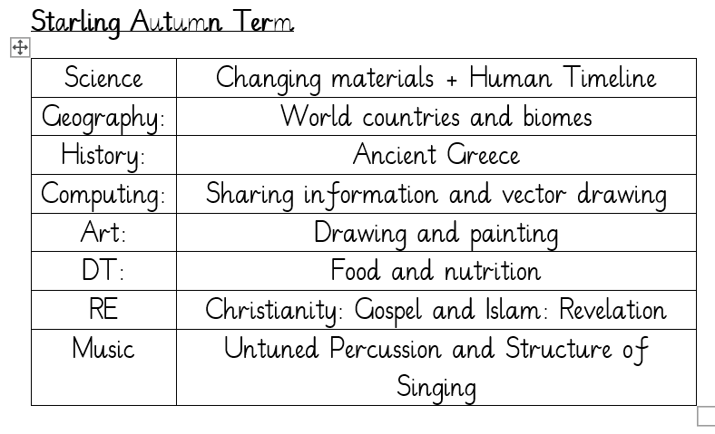
Magpie Class Subjects Autumn Term

Slide 5
Routines
Every Friday we add house points and Laureate Miles
We have the class marble jar which, when filled, earns a full extra 15 minutes break time. We can earn marbles for everybody in the class following instructions, listening when needed etc.
In the mornings we come in and do early morning work on the iPads. After lunch we all come in and read our five finger check book.

Slide 6
uniform
Pupils in Years 1 to 6 may bring a change of footwear if they wish to go on the field at break and lunchtimes when it is wet or muddy (e.g. wellies, trainers which are different to those worn for indoor PE) but these must not be worn all day (pupils who do not have a change of footwear will be allowed to go on the field at break and lunchtimes when it is dry; pupils who do not have the correct footwear in school will not be allowed to go on the field or sports court at break or lunchtimes).
Correct school uniform must be worn at all times. A note will be put in planners if uniforms are incomplete.

Slide 7
Pe kit
Plain black/grey/dark green leggings or jogging bottoms may be worn for outdoor PE lessons when it is cold, along with a school sweatshirt/cardigan/fleece/PE hoodie (embroidered with the school logo).
Pupils should wear their PE kit to school and remain in it for the whole day on days when they have PE, including outdoor PE wear for breaks and lunchtimes when it is cold, even if the PE lesson itself is indoors
Earrings must not be worn for PE lessons and cannot be covered with tape (earrings should not be worn at all on days when your child has PE)

Slide 8
curriculum
English and maths is taught every day
PE (Physical Education) is taught twice per week we also have the daily mile and Commando Joe’s
We are teaching Geography, History, Computing, Art, and DT weekly.
Music, RE (Religious Education), French and PSHE (Personal, Social & Health Education)will be taught weekly or in blocks depending on the half-term in question.

Slide 9
expectations
We are incredibly lucky to have 3 TA’s working with us to support us in each lesson (Mrs Wright, Mrs Beech and Ms Brewer)

Slide 10
homework
You need to read/share a book at least three times per week and record this in your planner
Every child who reads five times in a week receives a Reading Champion certificate
Every time a child receives ten Reading Champion certificates, they choose a book to keep
Weekly extra maths questions based on the arithmetic test will be on Showbie.
Weekly practice of TT Rockstars will also help!

