Slide 1

Meet the teacher
Merlin
Mrs Baker

Slide 2




Merlin Class Staff
Ms Parr
Miss Pettan Brewer

Slide 3
When are the adults in the class?
Mrs Baker teaches full time with Monday afternoon for PPA and Wednesday afternoon for management.
Mrs Marshall will teach the class on Monday and Wednesday afternoons.
Mrs Marshall and Ms Parr are in Merlin all week.
Miss Pettan Brewer is in Merlin Class on Monday and Wednesday afternoon.

Slide 4
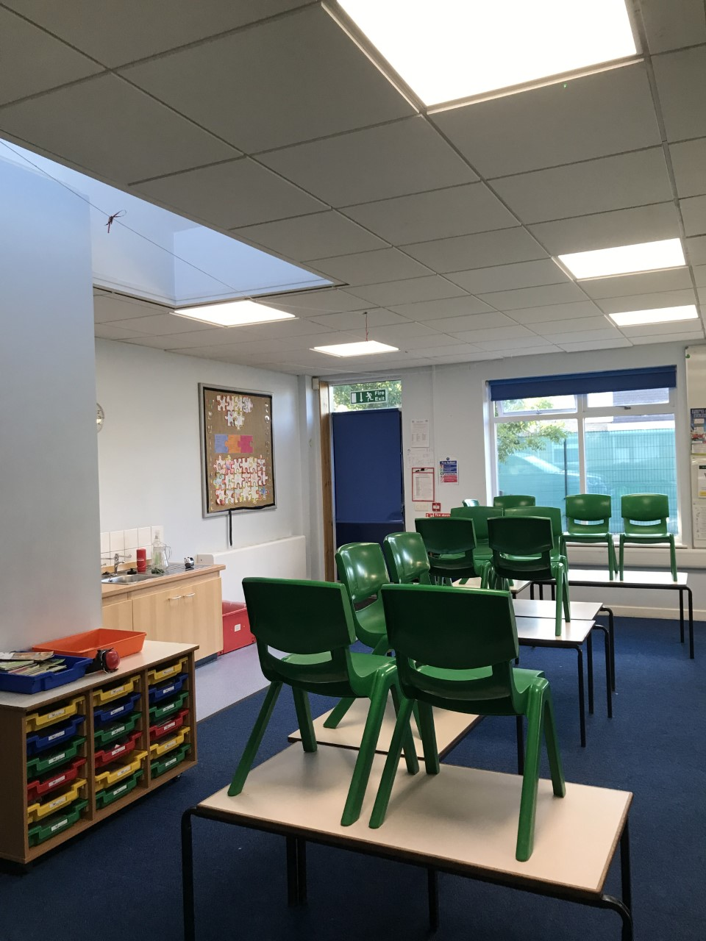
Merlin Classroom

Slide 5
PE
PE this half term will be on Tuesday and Friday.
PE days will change each half term. Keep an eye on planners for details.

Slide 6
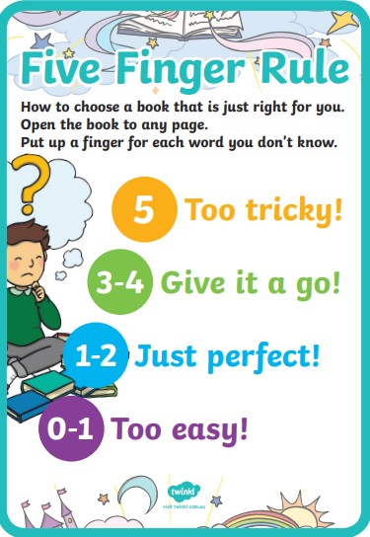
Reading
In year 3, children will be supported to choose a reading book at the appropriate level. Some children will choose a reading book from the classroom (when they arrive) and some children will chose from the library. We will do this using the 5 finger rule.

Slide 7
Reading
They can also take a book out of the library for free reading (either one they can read independently or one to share with parents and carers).
We encourage children to read from a wide variety of genres. Whilst we want the children to read their school book, we also encourage children to read comics, magazines, newspapers, recipes, instructions, poetry etc
If the children have read a book from home you can also add this in their planner
Reading twice in one day only counts once in the weekly challenge

Slide 8
Reading
Children are expected to read a minimum of three times a week. If they don’t read three times a week, they will be asked to spend some time at playtime reading.
If they read five times a week, they will receive a certificate sticker in their planner. When they have done this 10 times, they can choose a book to keep from a collection of new books.

Slide 9
Uniform
At Laureate, we expect all children to wear the correct school uniform:
Dark green sweatshirt/cardigan/fleece (plain or embroidered with the school logo).
White shirt or polo shirt (plain or embroidered with the school logo).
Either:
Knee length grey skirt;
Pinafore dress;
Green and white checked dress;
Black/grey school trousers; or
Black/grey tailored short trousers.
Plain black/grey/white/dark green tights or socks.
Plain black/grey/white/dark green leggings or shorts may be worn under dresses/skirts.
Jeans, leggings, jeggings etc. are not considered school trousers; please be advised that some shops advertise ‘school trousers’
which are not in line with this policy.
All clothing should be clearly marked with your child’s name.
For safety reasons, we expect all children with long hair to have their hair tied back at all times.
If your child needs to wear an adapted school uniform in line with their religious or cultural beliefs, please make an
appointment to speak to the Headteacher in the first instance.

Slide 10
uniform
Pupils in Years 1 to 6 may bring a change of footwear if they wish to go on the field at break and lunchtimes when it is wet or muddy (e.g. wellies, trainers which are different to those worn for indoor PE) but these must not be worn all day.
We also expect all pupils to wear the correct footwear: ‘Sensible’ (i.e. no/low heel) plain black shoes or boots (no trainers, sandals, canvas shoes or sports-branded ‘trainer shoes’).

Slide 11
Pe kit
We expect pupils in Reception to Year 6 to wear the correct PE kit:
T-shirt in the colour of your child’s House (a plain white t-shirt may be worn if families are unable to purchase a House
t-shirt).
Plain green shorts.
Bare feet, plimsolls or clean trainers for indoor PE lessons, or trainers (different to those worn for indoor PE lessons) for outdoor PE lessons.
Plain black/grey/dark green leggings or jogging bottoms may be worn for outdoor PE lessons when it is cold, along with a school sweatshirt/cardigan/fleece/PE hoodie (embroidered with the school logo).
Pupils in Reception to Year 6 should wear their PE kit to school and remain in it for the whole day on days when they have PE, including outdoor PE wear for breaks and lunchtimes when it is cold, even if the PE lesson itself is indoors, this must still be in line with the uniform expectations. If not you will be telephoned and asked to bring a correct PE kit or they will be given a spare PE kit to change into.
Earrings must not be worn for PE lessons and cannot be covered with tape unless an exemption has been agreed with school for cultural or religious reasons.

Slide 12
curriculum
We are teaching the full National Curriculum. English and maths is taught every day.
PE (Physical Education) is taught twice per week, as well as other activities such as the Daily Mile and half termly ‘Commando Joe’ days.
Art, DT (Design Technology), Geography, History, Music, French and Science are taught weekly.
Computing and DT cooking will be taught in block days.

Slide 13
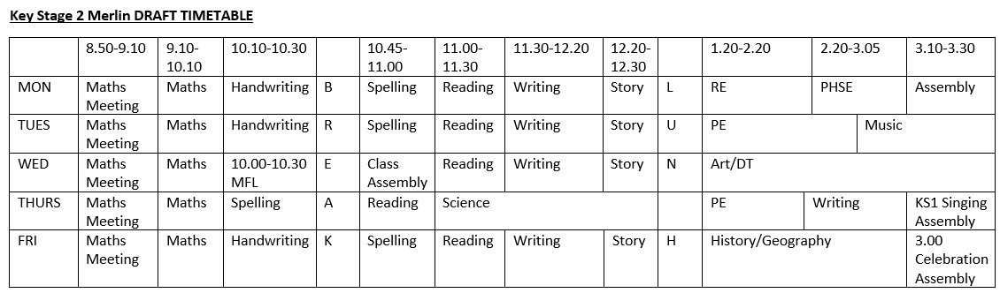
Example Timetable

Slide 14
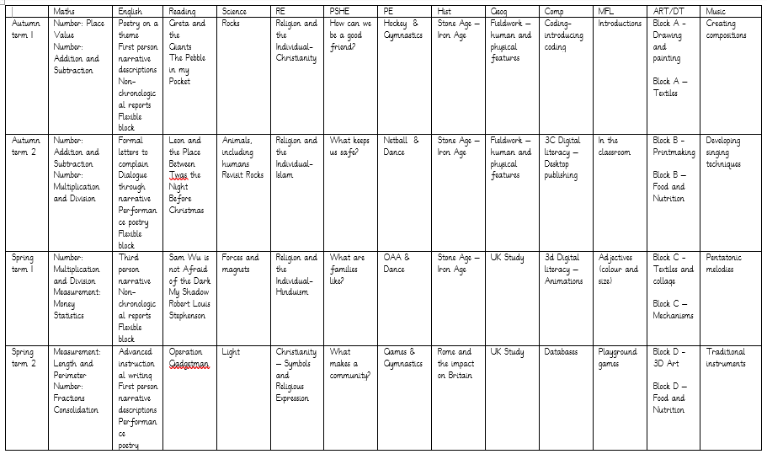
Long Term Plan

Slide 15
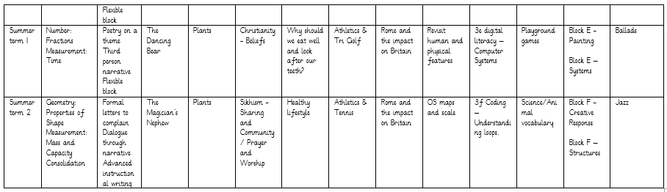
Lots of opportunities are given to revisit subjects to support retention of key facts.

Slide 16
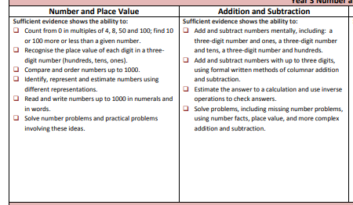
expectations

Slide 17
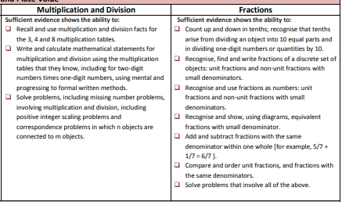

Slide 18
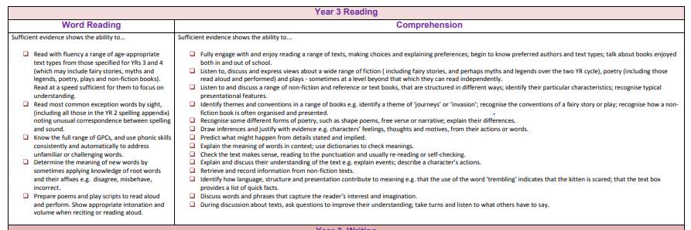

Slide 19
assessments
At the end of year 4, your child will take a times table test. This involves an online 25 question tests covering all times tables. We begin the work towards this in year 2 where the children learn their 2, 5 and 10 times tables. This year we will reinforce understanding of 2, 5 and 10s and learn on our 3x, 4x and 8 x tables.
More information will be provided when they move to year 4.
The TTRS sound check game mirrors the test.
Ways to learn times tables: arrays, reciting, pairs games etc
During year 3 your child will be assessed using PIXL tests. These are purely used to help adults look at strengths and development points to ensure we support your child in the best way possible. We encourage children to do their best and adapt our planning following analysis of results.

Slide 20
homework
All pupils are expected to read/share a book at least three times per week and record this in their planner as part of their homework. (Planners are required to be in school each day).
Years 1 to 6 will have weekly spelling activities to complete in line with our spelling programme.

Slide 21
How can you support your child?
Ensure they read regularly
Use the hints in the home school book to support your child when reading, asking comprehension questions is very important.
Help them learn their times tables through using TTRS etc
Encourage independence – they pack and carry their bag, fill their water bottle, remember their lunch box.
Teach them to tie their shoelaces.
Ask them what they enjoyed about school each day.

Slide 22
Dates so Far
Co Jo day Friday
Week beginning 16th September International day of democracy afternoon.
Thursday 10th October World Mental health day, parent share session.

Slide 23
questions
Any questions?

Slide 24
Contact us
Please do speak to us on the door if we are available and it’s appropriate
Please avoid coming up the steps as it can be a bottle neck when getting the children in and out.
For a longer/confidential discussion, please ask for a telephone or face to face appointment
You can also speak to a member of office staff or the Senior Leadership Team if you need further assistance

Slide 25
Thank you

