Slide 1
Meet the teacher
Miss Harvey

Slide 2
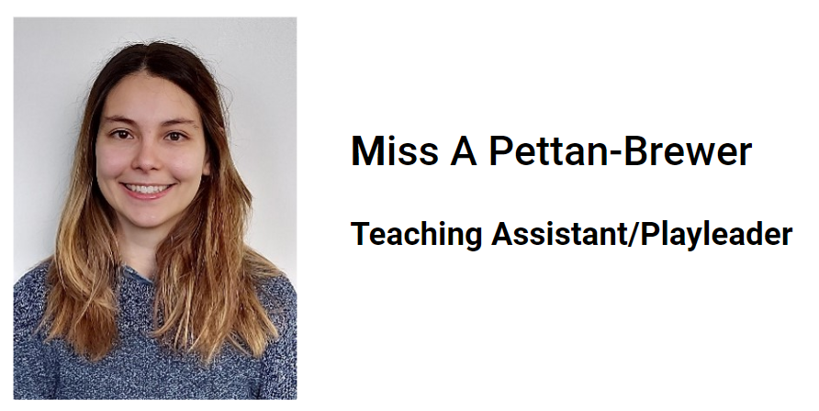
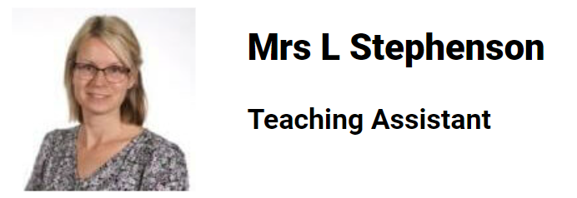
Our class
Miss Harvey
All the time except for Tuesday afternoons

Slide 3
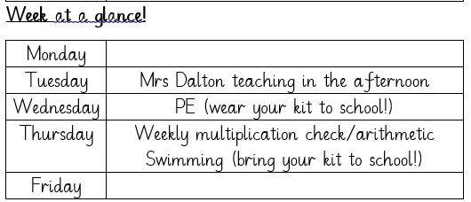
Routines

Slide 4
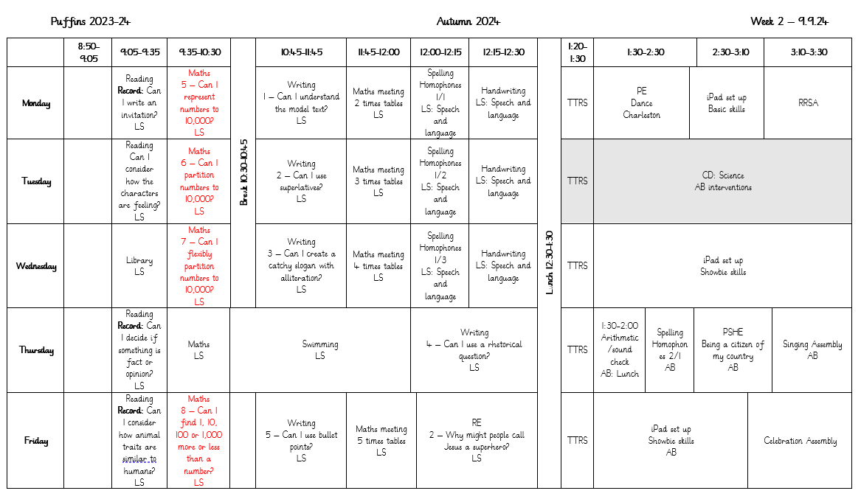
routines

Slide 5
routines
PE is on Monday and Thursday – Autumn 1. Please come in your kit.
(Swimming is Thursday)
Planners are checked on Mondays
TTRS are done every morning.

Slide 6
uniform
Pupils may bring a change of footwear if they wish to go on the field at break and lunchtimes when it is wet or muddy (e.g. wellies, trainers which are different to those worn for indoor PE) but these must not be worn all day
Pupils in Years 1 to 6 may bring a change of footwear if they wish to go on the field at break and lunchtimes when it is wet or muddy (e.g. wellies, trainers which are different to those worn for indoor PE) but these must not be worn all day (pupils who do not have a change of footwear will be allowed to go on the field at break and lunchtimes when it is dry; pupils who do not have the correct footwear in school will not be allowed to go on the field or sports court at break or lunchtimes).

Slide 7
Pe kit
Plain black/grey/dark green leggings or jogging bottoms may be worn for outdoor PE lessons when it is cold, along with a school sweatshirt/cardigan/fleece/PE hoodie (embroidered with the school logo).
Pupils should wear their PE kit to school and remain in it for the whole day on days when they have PE, including outdoor PE wear for breaks and lunchtimes when it is cold, even if the PE lesson itself is indoors
Earrings must not be worn for PE lessons and cannot be covered with tape (earrings should not be worn at all on days when your child has swimming or PE)

Slide 8
curriculum
English and maths is taught every day
PE (Physical Education) is taught twice per week (Wednesday and Thursday), we also have the daily mile and Commando Joe’s
We are teaching Geography, History, Computing, Art, and DT (Design Technology, Music, RE (Religious Education), French and PSHE (Personal, Social & Health Education) will be taught weekly. DT and Art alternate every 3 weeks.

Slide 9
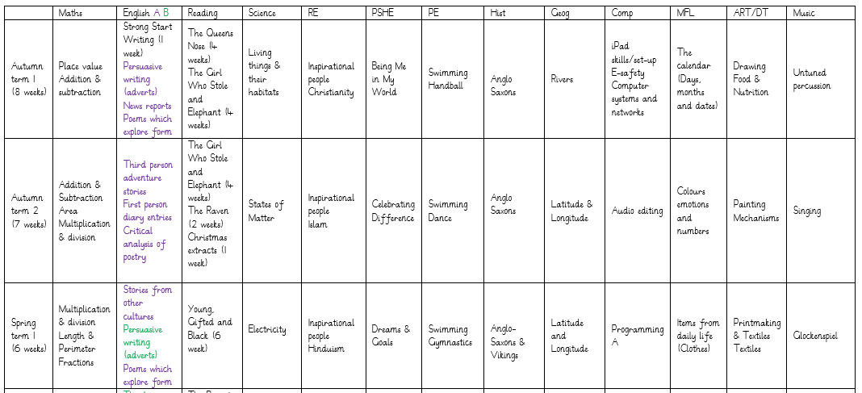
Curriculum

Slide 10
curriculum
Any concerns around PSHE curriculum then please let me know and I can provide the materials from the lessons.

Slide 11
Curriculum
iPads – sending them home
Meeting dates on Monday 30th September and Thursday 3rd October at 3:30pm.

Slide 12
expectations
Same expectations as always!
We are incredibly lucky to have 2 TA’s working with us to support us in each lesson.
If we feel your child needs some additional support, we may add on a post teach or intervention in the afternoon.

Slide 13
assessments
Every term we do internal school assessments to monitor how the children are progressing and what help they need.
In June, we also have the Multiplication Check. This is a test of their times tables knowledge up to 12 x 12.

Slide 14
homework
All pupils must read/share a book at least three times per week and record this in their planner
Every child who reads five times in a week receives a Reading Champion certificate
Every time a child receives ten Reading Champion certificates, they choose a book to keep
We are also adding in a weekly spelling activity, this will be set on a Monday and be expected in on the following Monday
We are also asking for at least 3 times a week, practicing of TTRS to allow for the best possible outcomes later in the year.

Slide 15
questions
Any questions?

Slide 16
Contact us
Please do speak to us on the gate if we are available and it’s appropriate
For a longer/confidential discussion, please ask for a telephone or face to face appointment
You can also speak to a member of office staff or the Senior Leadership Team if you need further assistance

Slide 17
Thank you

