Slide 1
Intent
History
Intent

Slide 2
History: Why is History important?
Intent
At Laureate Community Academy we aim to offer a high quality history education that will enable children to gain a coherent knowledge and understanding of Britain’s and the wider world’s past and the impact this has had on life today. Unity Schools Partnership curriculum plans are used to teach history.
These are:
Informed by the National Curriculum;
Carefully planned and structured to ensure that current learning is linked to previous learning;
Informed by current pedagogy such as quizzing and retrieval practice.

Slide 3
Metacognition in history
Activate prior knowledge
Recap learning from previous history blocks – develop knowledge of chronology.
Make links to prior eras/civilisations. For example, make explicit similarities and difference between ancient Greece and the Maya.
Explicit strategy instruction
What is the skill you are learning today. Chronological understanding, drawing conclusions, making comparisons and explain what strategy we can use to help us.
Modelling of learned strategy
Demonstrate how you can apply this strategy using the content of this lessons learning or the previous lesson. Use thinking aloud to make explicit the train of thought that you are using and following.
Memorisation of learned strategy
Through questioning and discussion, check that children have made links between the historical knowledge learned and the skill being practiced that lesson.
Guided practice
Work through the opening stages of approaching that task with the children. Stop to question for understanding. What is happening? How can I compare these two people? Why did they make that decision? Leave model on flip chart/smartboard as scaffold.
Independent practice
Children to complete their own attempt at modelled example.
Intent

Slide 4
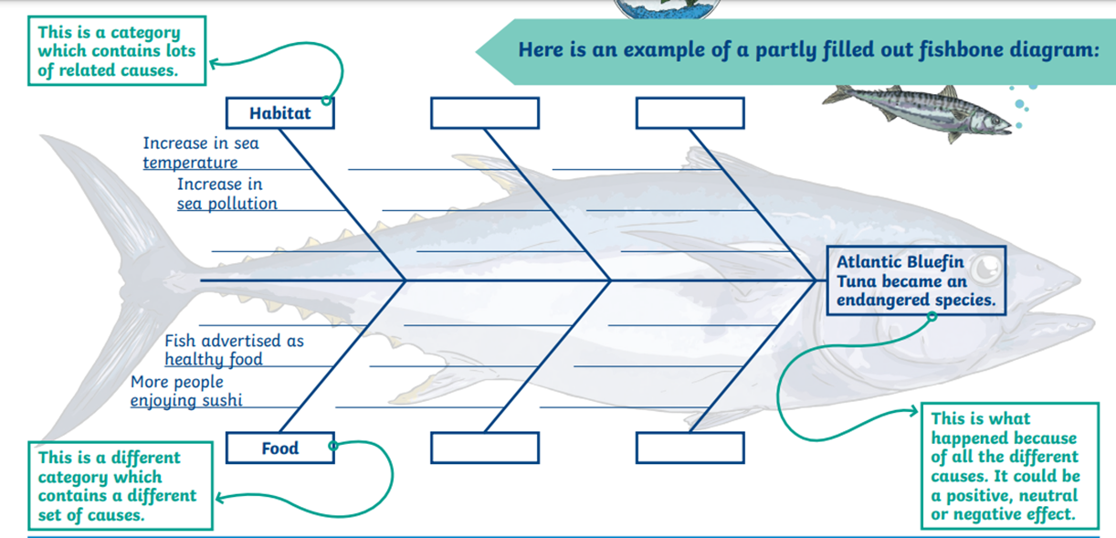
Worked example
Activate prior knowledge
The teacher discusses with pupils the different causes that led to World War Two while making notes on the whiteboard.
Explicit strategy instruction
The teacher then explains how the fishbone diagram (pictured below) will help organise their ideas with the emphasis on the cognitive strategy of cause and effect model of history to better organise ideas.
Modelling of learned strategy
The teacher uses the initial notes on the causes of the war to model one part of the diagram.
Memorisation of learned strategy
The teacher tests if pupils have understood and memorised the key aspects of the fishbone strategy, and its main purpose through questioning and discussion.
Guided practice
Teacher models one further fishbone causes with whole group with pupils verbally contributing.
Independent practice
Pupils complete their own fishbone diagram analysis.
Intent

Slide 5
History
Aims of the History Curriculum
The national curriculum for history aims to ensure that all pupils:
know and understand the history of these islands as a coherent, chronological narrative, from the earliest times to the present day: how people’s lives have shaped this nation and how Britain has influenced and been influenced by the wider world
know and understand significant aspects of the history of the wider world: the nature of ancient civilisations; the expansion and dissolution of empires; characteristic features of past non-European societies; achievements and follies of mankind
gain and deploy a historically grounded understanding of abstract terms and vocabulary
understand historical concepts such as continuity and change, cause and consequence, similarity, difference and significance, and use them to make connections and draw contrasts.
understand the methods of historical enquiry, including how evidence is used rigorously to make historical claims, and discern how and why contrasting arguments and interpretations of the past have been constructed
gain historical perspective by placing their growing knowledge into different contexts, understanding the connections between local, regional, national and international history; between cultural, economic, military, political, religious and social history; and between short- and long-term timescales.
Intent

Slide 6
History:
Laureate Community Academy aspires to provide excellent opportunities for history so that children develop the following skills:
Chronology: Children will gain a coherent knowledge and understanding of Britain’s past and that of the wider world which helps to stimulate their curiosity to know more about the past.
Using evidence: Children will be able to analyse different sources of evidence; they will understand concepts such as bias and conjecture, and will use these to make their own judgements.
Critical thinking: Children will be encouraged to ask perceptive questions, weigh evidence, sift arguments, and develop perspective and judgement.
Making world connections: Children will use prior learning to make links between the history of different countries, the diversity of societies and the relationships between different groups, as well as their own identity and the challenges of their time.
Intent

Slide 7
History:
Key Stage 1:
In Key Stage 1 children will begin to develop an awareness of the past, using common words and phrases relating to the passing of time. They will ask and answer questions and look at ways we find out about the past.
They will study:
changes within living memory.
events beyond living memory that are significant nationally or globally e.g. the Great Fire of London.
the lives of significant individuals in the past who have contributed to national and international achievements, e.g. Mary Anning, Neil Armstrong.
significant historical events, people and places in their own locality.
Intent

Slide 8
History:
Key Stage 2:
In Key Stage 2 children will continue to develop a chronologically secure knowledge and understanding of British, local and world history. They will look at connections, contrasts and trends over time and develop the appropriate use of historical terms, using a range of sources.
In Lower Key Stage 2
They will study:
changes in Britain from the Stone Age to the Iron Age
Rome and it’s Impact on Britain.
Anglo –Saxons
Vikings
Ancient Egypt
Intent

Slide 9
History:
Upper Key Stage 2:
In Upper Key Stage 2 Children will study:
Ancient Greeks
Maya – comparison study with Anglo-Saxons
Windrush
Beyond 1066 - five significant monarchs or the Battle of Britain
Local Study
Intent

Slide 10
Spaced Retrieval Practice Approach
Our History curriculum is taught in a modular approach throughout the year. This allows children to build on prior knowledge and to make connections with new learning.
Intent
This shows an example from Year 2. History lessons are shown in purple. This example shows the regular pattern of teaching throughout each term which includes revisiting of learning.

Slide 11
Early Years
In Early Years, History is taught as children explore their understanding of the world, people and communities. They will:
talk about their lives and those of the families and people round them.
explore celebrations and events throughout the year.
explore differences to their own past and now.
begin to explore the past through stories.
Intent

Slide 12
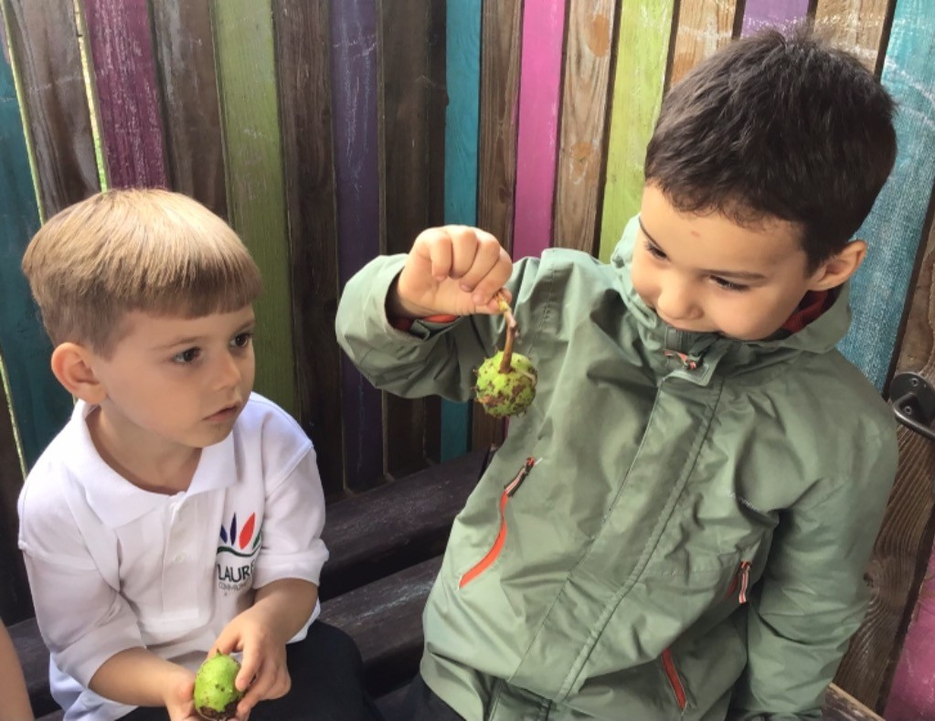
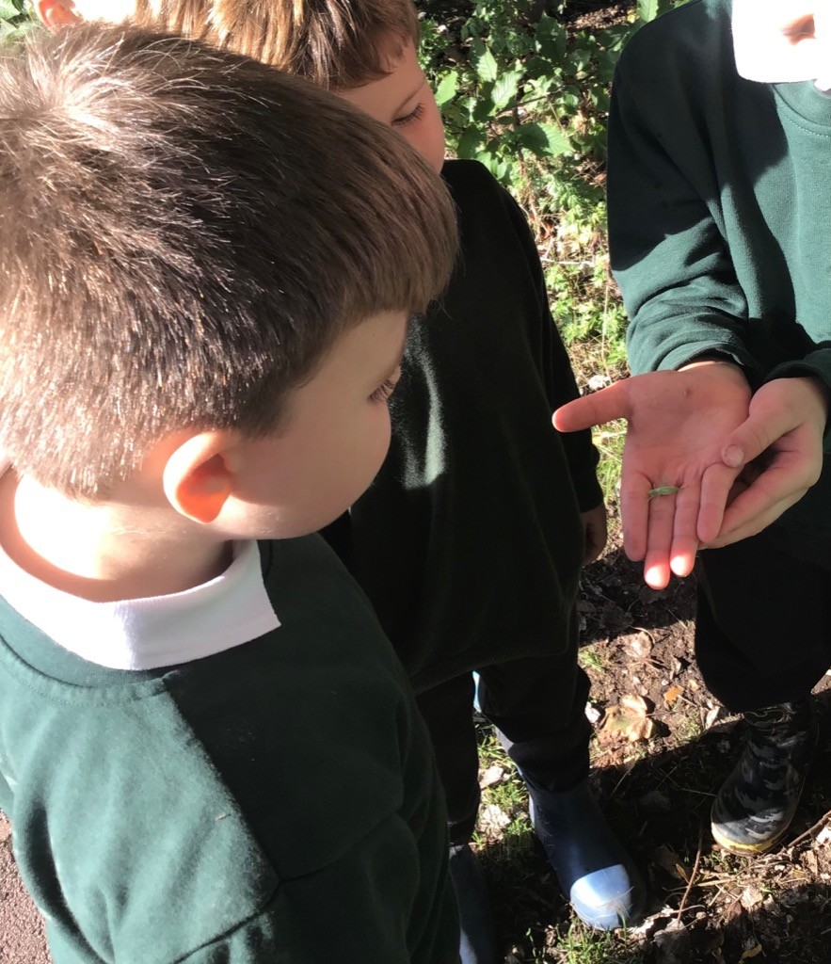
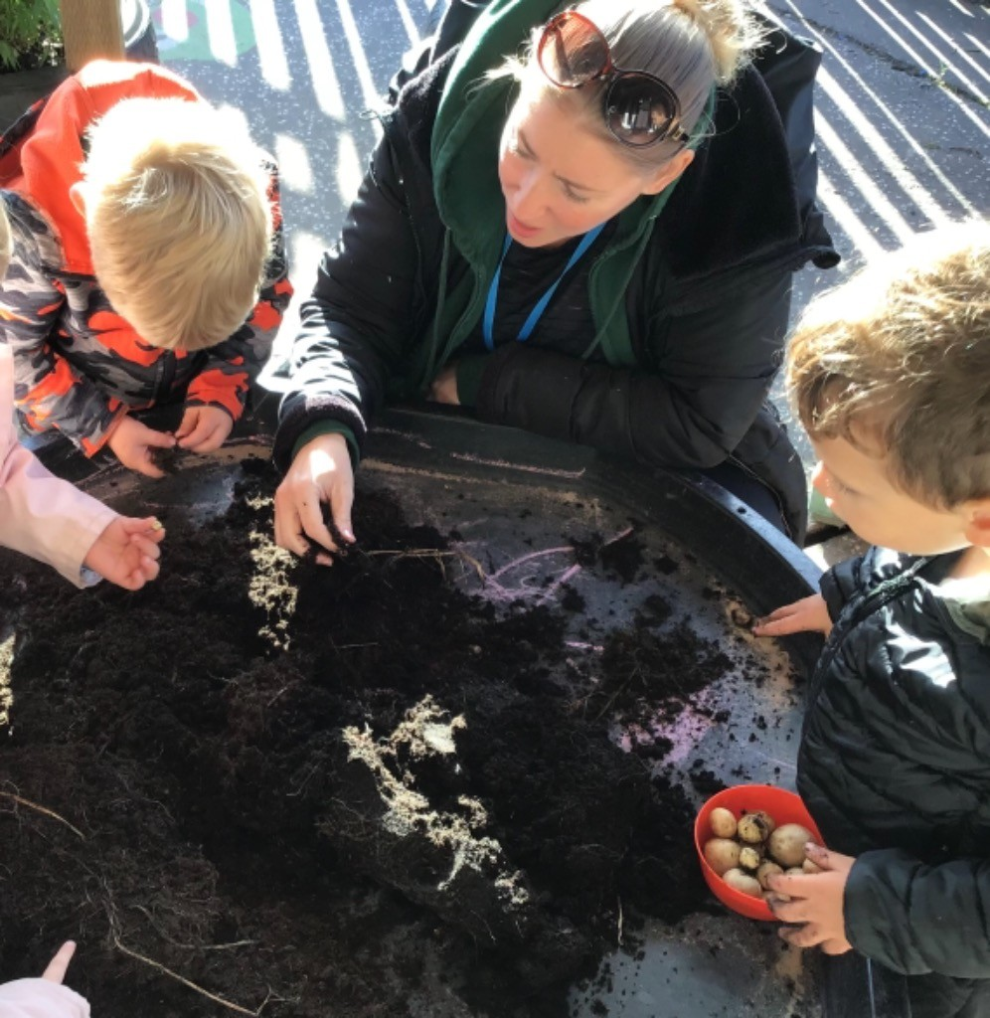
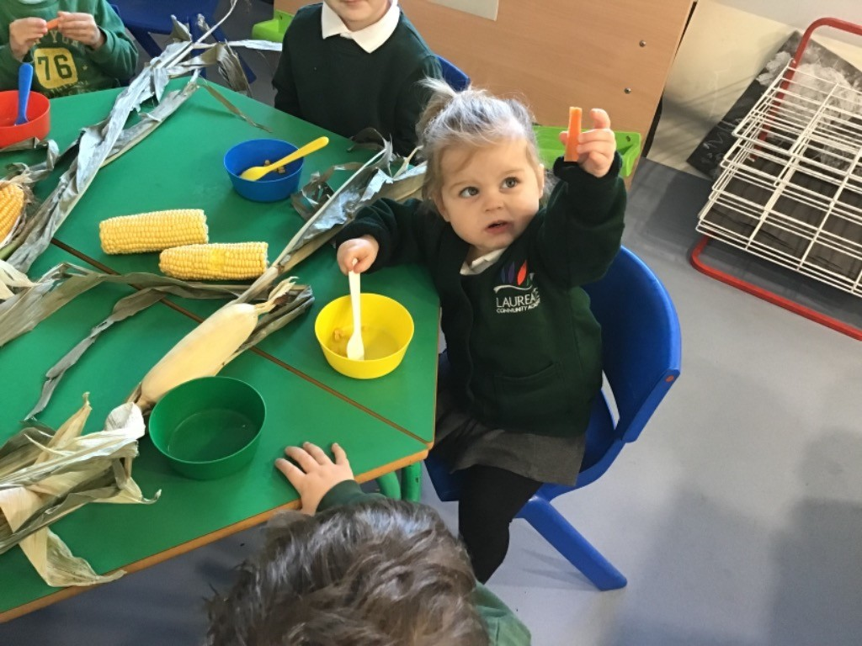
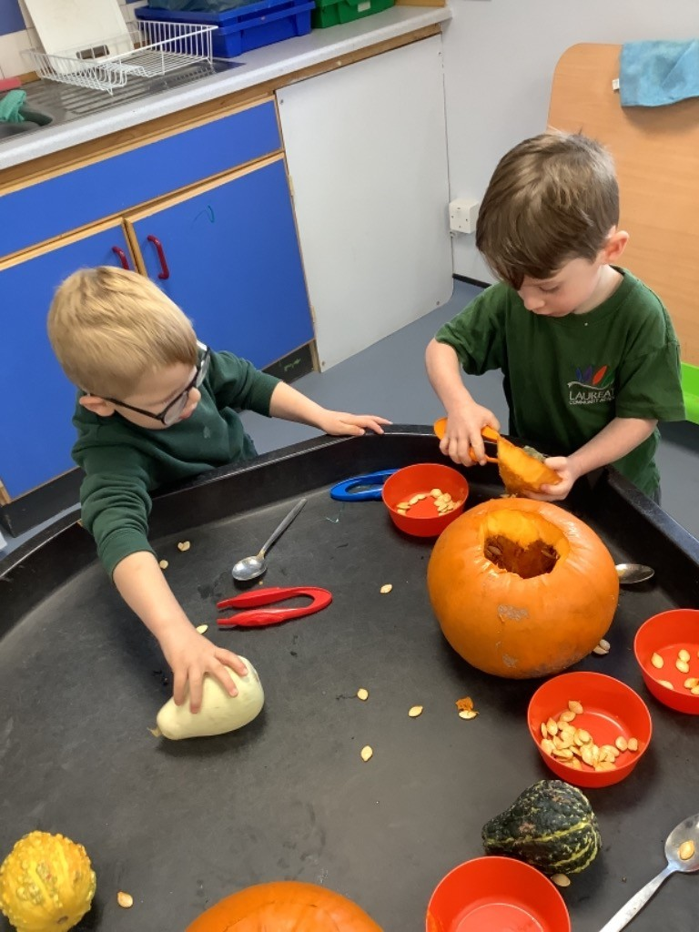
History in EYFS
Intent
EYFS children learning about the past through enjoying celebrations and exploring changes around them.

Slide 13
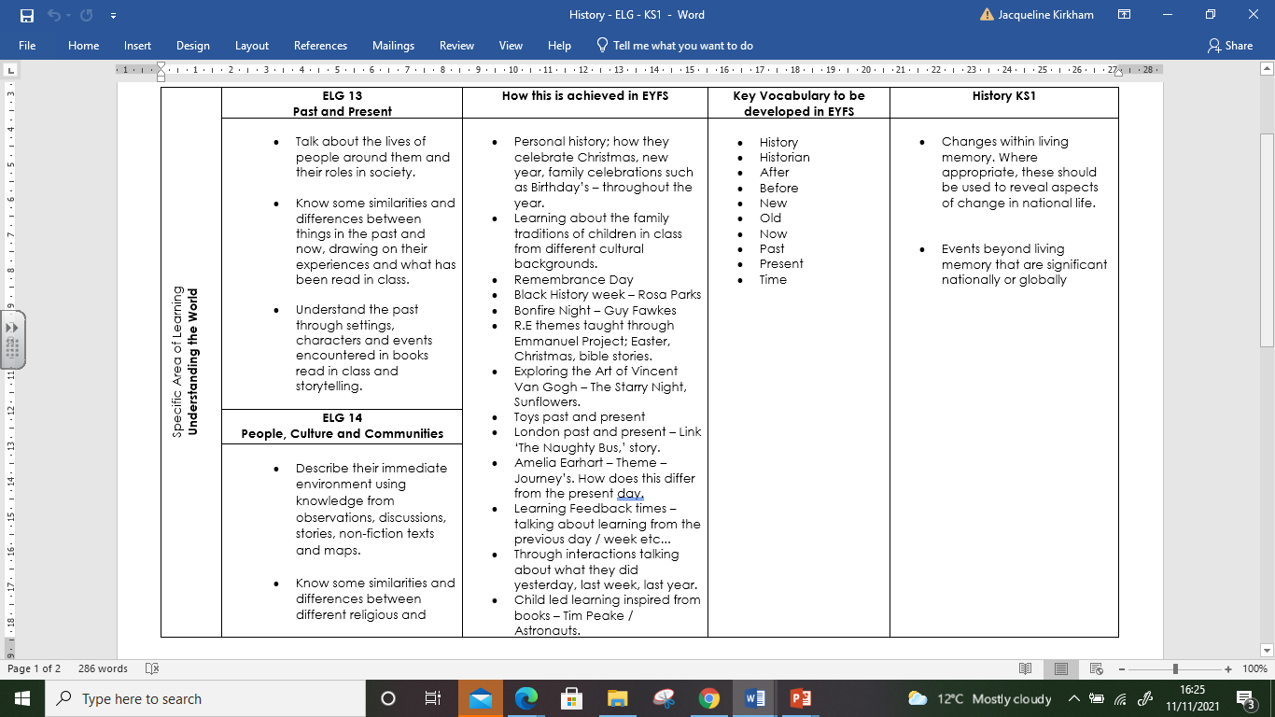
Content and sequence - EYFS to Key Stage 1
Intent

Slide 14
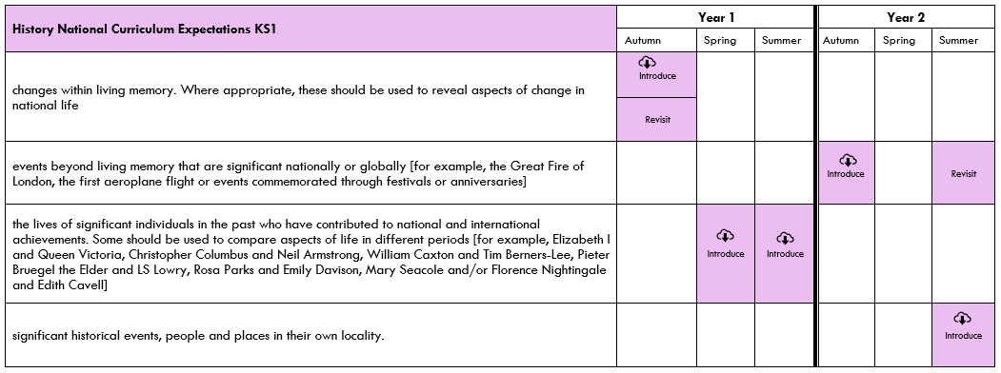
Content and Sequence: Key Stage 1
Intent

Slide 15
Content and Sequence: Year 1
Changes within living memory:
Children will look at similarities and differences between things in the past and now, investigating changes in their own lives.
Study the lives of significant individuals
The lives of significant individuals in the past who have contributed to national and international achievements.
The Year 1 Spring Term study focuses on Mary Anning and David Attenborough.
The Year 1 Summer Term focuses on Neil Armstrong, Mae Jemison, Bernard Harris Jr and Tim Peake.
Intent

Slide 16
Content and Sequence: Year 2
Events Beyond Living Memory – Great Fire of London
This study looks at the cause and effect of the Great Fire of London.
This event happened a long time ago – over 350 years. The chronology focuses on the events over a few terrible days rather than a depth study into the period of time.
Historical events, people and places in their own locality: Newmarket
Significant historical events, people and places in their own locality:
James 1, Charles 11, Bill Tutte, and their connections to Newmarket, the Fire of Newmarket and the WW2 Bombing of Newmarket High Street.
Intent

Slide 17
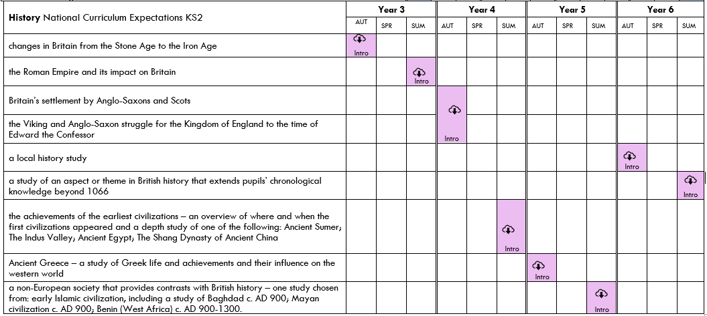
Content and Sequence: Key Stage 2
Intent

Slide 18
Content and Sequence: Year 3
Study changes in Britain from the Stone Age to the Iron Age
Includes:
A focus on evidence – artefacts, burials, monuments and places
Paleolithic, Mesolithic and Neolithic periods
Bronze Age religion, technology and travel, for example, Stonehenge
Iron Age hill forts: tribal kingdoms, farming, art and culture
The Roman Empire and its impact on Britain:
The Roman Empire and its impact on Britain.
This study looks back at the Iron Age and the difference that the Romanisation of Britain made.
Intent

Slide 19
Content and Sequence: Year 4
Britain’s settlement by Anglo-Saxons and Scots:
Exploring why the Anglo-Saxons come to Britain
Understanding where the Anglo Saxons came from
Everyday life for Anglo Saxons in Britain
The kingdoms that were formed by the Anglo Saxons
Investigating different sources of evidence.
The religion of Anglo Saxons and how this influenced them.
The achievements of the earliest civilisations – Ancient Egypt
The achievements of the earliest civilizations – an overview of where and when the first civilizations appeared and a depth study of Ancient Egypt.
Intent

Slide 20
Content and Sequence: Year 4 continued
The Viking and Anglo-Saxon struggle for the Kingdom of England to the time of Edward the Confessor
Causation of why the Vikings invaded and settled in England, Northern Britain and Ireland, as well as Normandy
Power struggle between Viking and Anglo-Saxon armies
Struggle between Alfred the Great and King Guthrum
Establishment of Danelaw
Significant actions and consequences between English and Viking kings: Ethelred The Unready – King Sweyn – King Canute
Establishment of monarchy through a single ruler – Viking or Anglo-Saxon
Consequences of Edward the Confessor’s lack of an heir and legacy of his father’s connections with Normandy
Intent

Slide 21
Content and Sequence: Year 5
Ancient Greece:
Beliefs of the Ancient Greeks
Comparison between the city-states of Athens and Sparta
Birth of democracy in Athens
Importance of theatre, myths and fables
Significance of the Battle of Marathon, Thermopylae and Salamis
Importance and purpose of Olympic Games
Impact Alexander the Great had on Ancient Greece
Study a non European society that provides contrasts with British history – Maya c. AD 900:
A non-European society that provides contrasts with British history – Maya civilization c. AD 900
Intent

Slide 22
Content and Sequence: Year 6
The Windrush Generation
A study of an aspect or theme in British history that extends pupils’ chronological knowledge beyond 1066.
A study about:
The Caribbean.
The part Caribbean men and women played in World War 2.
The Windrush pioneers; their struggles and successes.
Battle of Britain: A study of an aspect or theme in British history that extends pupils’ chronological knowledge beyond 1066 or
Study five monarchs to extend pupils’ chronological knowledge from 1066.
A study of an aspect or theme in British history that extends pupils’ chronological knowledge beyond 1066.
A Local History Study
Intent

Slide 23
History:
Implementation
Implementation

Slide 24
Modular Approach – Knowledge
At Laureate, History is taught across each year group in modules that enable pupils to study in depth historical periods, skills and vocabulary.
Each module is carefully sequenced to enable pupils to build on learning from previous sessions to facilitate the acquisition and retention of key historical knowledge and skills.
All modules have a sequenced overview outlining recommended number of sessions, key concepts, knowledge and vocabulary to be taught.
Implementation

Slide 25
The Big Ideas
Each module begins with the ‘The Big Idea.’ This gives the children an overview of their learning. It also shows how each lesson fits within the module sequence.
Implementation

Slide 26
National Curriculum objectives and how these links to prior learning are evident at the beginning of every module.
Implementation

Slide 27
Development of History skills:
Each module is designed to enable pupils the opportunity to develop their skills as a historian. Skills are displayed on each of the modules for both Key Stage 1 and Key Stage 2. It is clear which of the objectives are being taught throughout a specific module which ensures full coverage and allows for skills to be built upon.
Implementation

Slide 28
Cumulative Quizzing Model (Supporting Cognitive Load)
Children are given opportunities to retrieve information and to demonstrate their learning throughout each module. Each module contains quiz questions which can be used to reinforce and revisit both learning and vocabulary.
Prior learning will be revisited at the start of every lesson, checking recall of previous lessons. This could be verbally, in books or via Socrative.
Implementation

Slide 29
Cumulative Quizzing Model (Supporting Cognitive Load)
Implementation

Slide 30
Minimum lesson expectations
Knowledge strip are used to support learning. They are evident in books and referred back to throughout the lesson
Explicit teaching of vocabulary is planned for
Opportunity is given throughout the lesson for the use of this subject specific vocabulary
Revisiting of prior learning through retrieval practice and quizzing
Applying the skills targeted for the lesson
High quality work to evidence learning in pupil's books
Where appropriate evidence sources will be explored and investigated
Further opportunities for reading may be given
Implementation

Slide 31
Vocabulary
EYFS
At Laureate, we want our children to have an expansive vocabulary and through teacher modelling and planning, children are given opportunity to use and apply appropriate vocabulary. The use of stories, discussions and visitors all contribute towards the building of a rich historical vocabulary.
Vocabulary in Years 1 – 6
Vocabulary instruction is at the heart
of the curriculum and subject specific
words are incorporated in each module.
These are taught explicitly to the children
and used throughout the lessons.
Implementation

Slide 32
Knowledge organisers and Knowledge Notes
Accompanying each module is a Knowledge Organiser which contains key vocabulary, information and concepts which all pupils are expected to understand and retain.
Knowledge Notes are the elaboration and detail which help pupils acquire the content of each module. They support vocabulary and concept acquisition through a well-structured sequence that is cumulative. Each Knowledge Note begins with questions that link back to the cumulative quizzing, focussing on key content to be learnt and understood.
Knowledge Organisers and Knowledge Notes are dual coded to provide pupils with visual calls to aid understanding and recall. Knowledge Organisers and Knowledge Notes are referenced throughout each module.
Implementation

Slide 33
Knowledge organisers and Knowledge Notes
Implementation
Year 2 knowledge organiser and accompanying knowledge note.

Slide 34
Planning
Lesson planning is completed with the use of the suggested lesson sequence, in conjunction with content from the Knowledge Organisers.
Implementation

Slide 35
Tailoring for SEND
Lessons are adapted to ensure that all students are supported so they can access the lessons.
There are more challenging aspects of lessons to stretch higher-attaining students, but delivery will vary for those needing more help to achieve the same outcome.
As a result of book monitoring and learning conversations, we are bringing in editable knowledge strips to tailor these for children with specific needs.
Implementation

Slide 36
Reading
All history modules are underpinned by high quality texts which support wider curriculum reading. Unity Schools Partnership are working closely with Curriculum Visions to ensure our subject content has supporting materials which can be accessed by pupils in school and at home.
Implementation

Slide 37
Oracy:
Oracy is embedded across the curriculum. When discussing their learning, children are encouraged to speak using full sentences and incorporating key vocabulary. Opportunities to discuss their learning helps children to understand historical concepts and to deepen their knowledge.
Writing:
At Laureate, children are expected to write across all areas of the curriculum with teachers modelling how to write purposefully in each subject.
Implementation

Slide 38
Continuous Professional Development
All staff have undergone CPD in Cognitive Load Theory, Spaced Practice Retrieval Theory and planning the wider curriculum through the use of Knowledge Notes. This has supported the development of the wider curriculum.
In addition to this, staff have accessed planning sessions with Alex Bedford (author of CUSP) to support them in effectively planning sequences of work using the materials provided within the modules.
Ongoing CPD is provided both individually and to all staff through planning workshops, dialogue and staff meeting inputs.
Implementation

Slide 39
History:
Impact​
Impact

Slide 40
Cumulative quizzing
Teachers use cumulative quizzing and retrieval to check prior knowledge, tailor lessons accordingly and use flexible teaching time to revisit areas as necessary.
Impact

Slide 41
Pupil book study
The Subject Leaders conduct book studies to review pupil progress. The Trust Primary Director has also worked with subject leaders to review work in books and conduct pupil dialogues. The information gained by doing this is then utilised to identify and refine additional CPD.
Impact

Slide 42
Teacher assessment
Teachers assess throughout each lesson using the Whole Class Assessment Sheets below to monitor pupils and inform planning for subsequent sessions. Pupils working below expected will be supported in future lessons whilst pupils working at above expected standard will be identified and challenged appropriately to extend their learning. Evidence of this support
or challenge and necessary
feedback will be clear in
books.
Most feedback is verbal
and live during the session
in accordance with our
Feedback Policy.
Subject leaders will analyse
end of unit WCAS to
identify trends and areas
where support may be needed.
Impact

