Slide 1


Year 6
SATs
Information
Evening

Slide 2
Aims of the session
To share important information about KS2 SATs
To answer any questions about KS2 SATs
To share ideas about how you can help your child at home

Slide 3
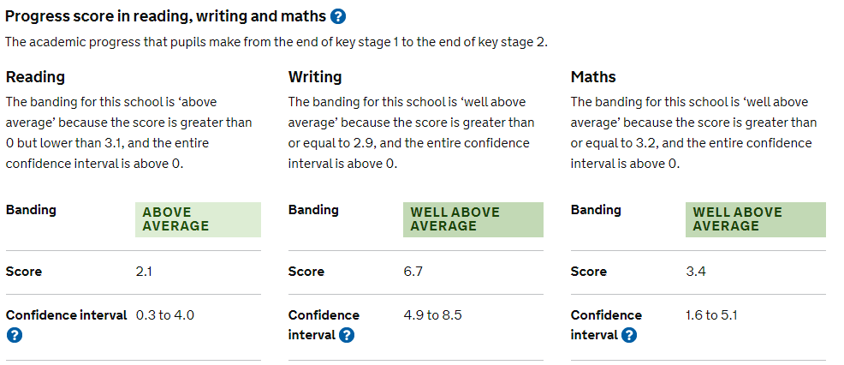
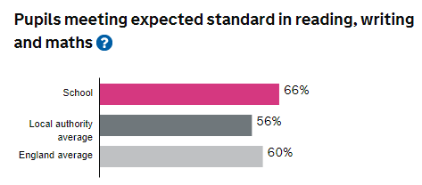
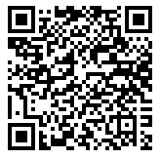
School Performance Data 2022-2023

Slide 4

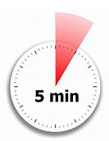
5 minutes late each day
= 25 minutes lost each week
= 950 minutes lost each year
= 15 hours and 50 minutes lost each year
=nearly 4 days learning lost!

Slide 5
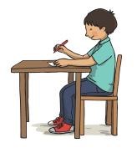
What are KS2 SATs?
Standard Assessment Tests
All children must be tested before they go to secondary school
They provide assessment information for secondary schools
They assign a ‘raw’ and ‘scaled score’ to children before they leave primary school – comparing them to other children across the country.

Slide 6
What are the expectations for Year 6 children?
A scaled score of below 100 means that a child is working below the expected level for Year 6.
To achieve ‘age expectation’ – where the Government expect a Year 6 child to be – they should achieve a scaled score of 100.
A scaled score of above 100 means that a child is working above the expected level for Year 6 with 110 being a ‘high score’ (sometimes called ‘Greater Depth’ or GDS).

Slide 7
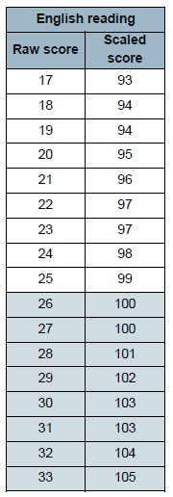

Scaled Scores
The ‘score’ in each test is converted to a ‘scaled score’ – 100 here means that you have achieved ‘expected’ standard.
For ‘high score’ – a scaled score of 110 or more is needed.

Slide 8

What information does my child’s secondary school want?
It varies depending on which secondary school your child is going to!
SATs results for reading, maths and SPAG (spelling, punctuation and grammar).
Teacher assessments for writing.
Information about friendship groups, general behaviour and any concerns.
Secondary schools may also administer
their own tests on transition days or at the
start of term.

Slide 9
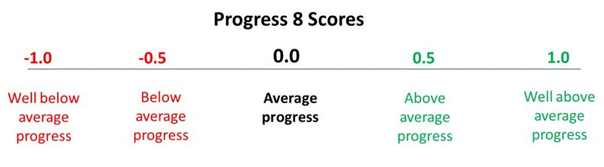
Why are SATs results important for your child (and you) at secondary school?
Progress 8 is a type of 'value-added' measure that indicates how much a secondary school has helped a pupil improve (or progress) over a five-year period when compared to a government-calculated expected level of improvement.
A score of zero means that a pupil has progressed at a rate in line with their results at the end of Key Stage 2.
A score above zero means that a pupil has progressed more than their results at the end of Key Stage 2.
A score below zero means that a pupil has made less progress than their results at the end of Key Stage 2.

Slide 10

How is SATs week organised?
A timetable is issued to school, telling us on which days tests must be administered.
All children must sit the tests at the same time.
Test papers are opened in front of the pupils; they can only be opened 1 hour before the tests begin for special reasons (e.g. to photocopy onto coloured paper).
Tests are completed in classrooms, with any displays that may help covered over.
Children are divided into groups for test administration to ensure they are properly supported and feel secure.

Slide 11
Save the Date!
Year 6 SATs Week 13th – 16th May 2024
Monday 13th May | Tuesday 14th May | Wednesday 15th May | Thursday 16th May
English – Grammar, punctuation 45 mins Spelling test 15-20 mins | English – Reading Test 60 mins | Maths Paper 1 Calculation 30 mins Maths Paper 2 Reasoning 40 mins | Maths Paper 3 Reasoning 40 mins

Slide 12
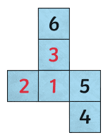
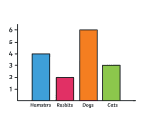
Mathematics
The mathematics SATs consist of:
Test 1: Arithmetic test
Test 2: Reasoning paper
Test 3: Reasoning paper
Calculators are not allowed in any of the tests.

Slide 13
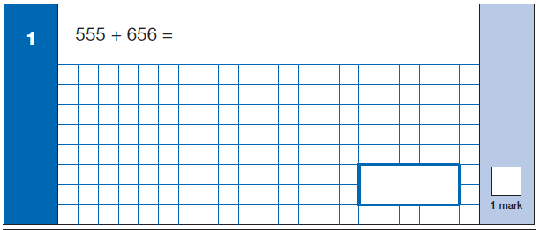
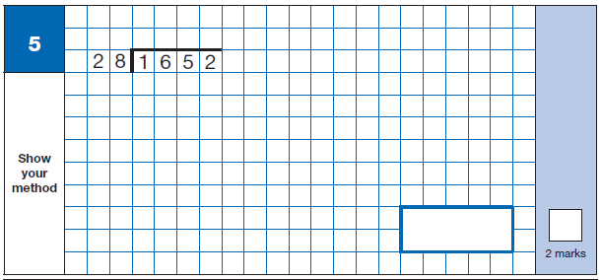
Paper 1: Arithmetic
30 minutes - 40 possible marks
To assess confidence in using mental and written methods of calculation.
If answers are incorrect, 1 mark may be given for using a ‘formal’ method.

Slide 14
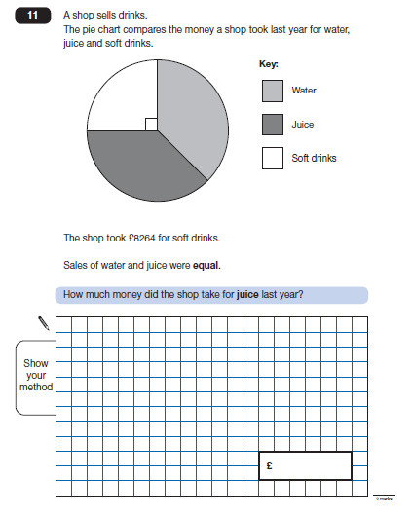
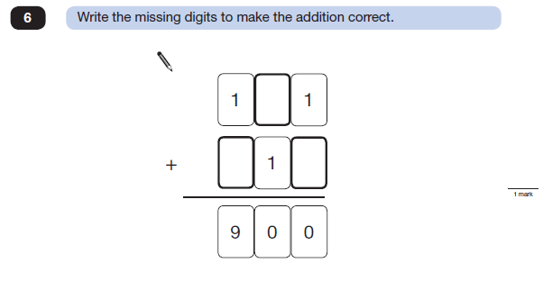
Papers 2 and 3: Reasoning
40 minutes each - 70 possible marks overall
To assess mathematical fluency, solving mathematical problems and mathematical reasoning.

Slide 15
Mathematics
Some questions are worth one mark and therefore accuracy is important.
Other questions are worth two marks and even if the answer is wrong, a mark may be given for correct working towards the answer.
Teachers may read questions in Papers 2 and 3 to pupils if asked.

Slide 16
How can parents help
with Maths?
Support with homework – not just helping with the maths but asking your child to read the question and underline important information can really help.
TIMES TABLES!!!
Help your child to check their work through – this will help them to spot mistakes that can sometimes be easily fixed.
Communicate in your child’s planner – any successes or difficulties that we could help with?

Slide 17
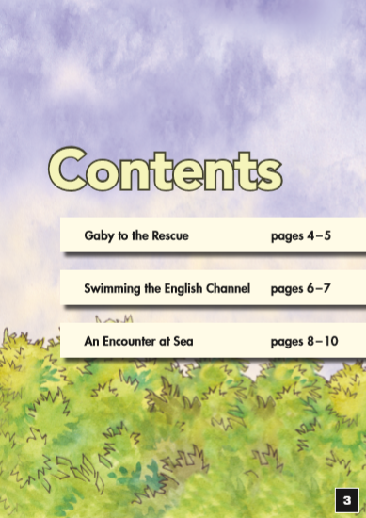

Reading Test
Collection of fictional and non-fictional texts (no common theme).
Texts and questions are in order of difficulty.

Slide 18
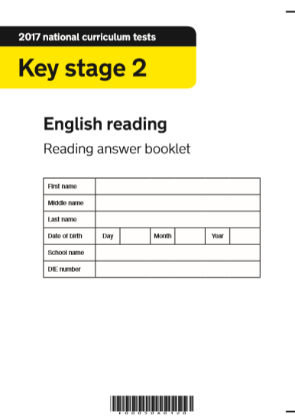
60 minutes to read the booklet and answer questions.

Slide 19
There are a variety of different questions to be answered in different ways, such as:
Literal – answer is there in the text.
Inference – read between the lines.
Vocabulary – give/explain the meaning of words in context.
Organisation – layout, use of different fonts.
Author’s intent – e.g. Why does an author use a particular word?

Slide 20
How can parents help with reading ?
Ensure your child reads every night / regularly.
Encourage your child to read a range of types of materials; fiction and non-fiction.
Increase reading speed and duration of reading time. There’s a lot to read in the test and it needs to be read quickly.
Listen to your child read:
ask them to explain what words mean in the text or help them to look up words they do not understand.
Ask questions about the text – what is happening and why; how do characters feel and why?
Show how the more they back up the answer from the text, the more marks will be awarded. (Point, Evidence, Explain - PEE)
Help them with the different skills of reading, especially ‘skim’ reading where they are looking for key words in the text.
Increase their ability to check what the question is really asking for.

Slide 21
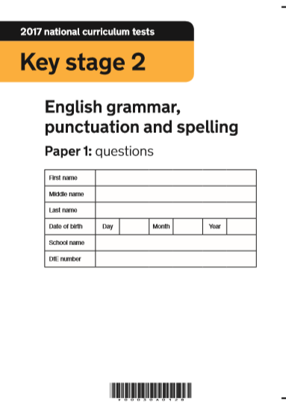
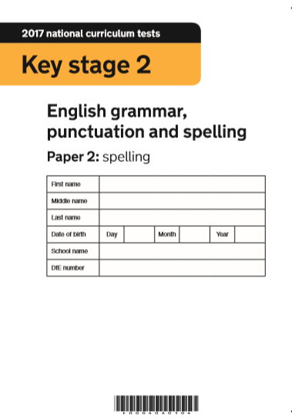
Grammar, Punctuation and Spelling Test
Around 15 minutes
45 minutes to fill in answers

Slide 22
Grammar, Punctuation and Spelling Test
Grammatical terms / word classes E.g. nouns, verbs, adjectives, connectives, pronouns, adverbs, prepositions, articles…
Features of sentences E.g. statements, questions, commands
Complex sentences E.g. clauses, phrases, subordinating connectives
Standard English E.g. tenses, double negatives, use of ‘I’ and ‘me’
Formal/informal language E.g. did not → didn’t
Vocabulary E.g. meanings, synonyms/antonyms, prefixes/suffixes, singular/plural
Punctuation E.g. from capital letters, full stops…. to brackets, apostrophes, colons

Slide 23
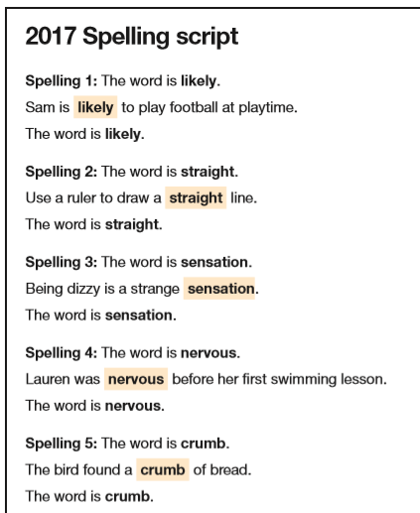
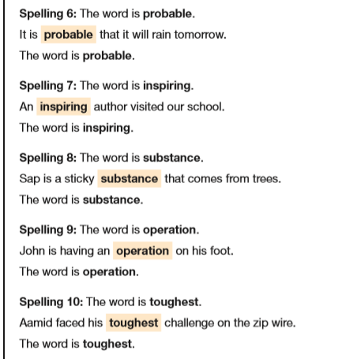

Slide 24
How can parents help with spellings ?
Encourage your child to try out a spelling for themselves e.g. Ask does it look right?
Show your child spelling patterns, e.g. station, nation… .
Use the Year 5/6 spelling lists in planners.
Talk about unusual spellings in the books you read.
Help your child memorise spellings (Look, cover, write, check), apply spellings rules, e.g. tious/cious; tion/cian.
Help with words which sound the same but look different e.g. through/ threw, poor/ paw/pour
Encourage your child to read regularly.

Slide 25

Writing
Writing is internally marked and assessed throughout the year.
What makes
a good piece
of writing?

Slide 26
Writing must have good:
Sentence Structure and Punctuation
  A variety of sentence types.
  Correct use of a wide range of punctuation.
  Good connective words and phrases.
Text Structure and Organisation
  A good structure.
  A beginning, a worthwhile middle and a satisfactory ending.
  Detailed paragraphs.
Composition and Effect
  An interesting style
  Well-chosen vocabulary.
  It should fit the task, i.e. be persuasive, inform or explain etc.

Slide 27
How can parents help with writing?
Read, read, read! The more children read, the more familiar they become with different text types.
Provide opportunities for your child to write: journals, postcards, letters, stories, poems, research topics, instructions, posters, plays…
Encourage use of dictionaries/ thesauruses/ punctuation.
Remind your child that expectations of presentation and ‘the basics’ apply to all written work!

Slide 28
What’s happening in Year 6 to support pupils in their SATS...
Regular practice of SAT papers: Maths, Reading Comprehension and SPaG Tests - adapted timetable from January will specifically focus on these areas.
Afternoon revision sessions for reading and maths.
Before-school booster sessions for reading, arithmetic and maths reasoning.
Any ‘gaps’ are being regularly identified and individuals or small groups are working with staff using PiXL resources to address these.
Over-staffing in Year 6 – Mrs Fisher, Mrs Beech, Mrs Wright, Mrs Dixon, Mrs Baxter (and other regular volunteers).

Slide 29
What’s happening in Year 6 to support pupils in their SATS...
Revision books will be given to pupils for English, Maths and Grammar.
Easter Homework Booklet (much better to do ‘little and often’ rather than in one go).
Homework will be set – we will alert you when this begins.
iPads – permission to take home. Should be in school every day and taken home every night.
All children have an in-school mentor.

Slide 30
Useful Websites
www.primaryhomeworkhelp.co.uk/
http://www.bbc.co.uk/bitesize/ks2/
http://www.funenglishgames.com/grammargames.html
https://www.topmarks.co.uk/english-games/7-11-years/spelling-
and-grammar
https://www.merriam-webster.com/word-games/spell-it
http://studyjams.scholastic.com/studyjams/jams/math/index.htm
https://ttrockstars.com
http://www.amathsdictionaryforkids.com
http://www.kidsmathgamesonline.com/

Slide 31

Tips for supporting your child
Remember: the children will be
working hard at school and will be
given revision tasks – they will be tired!
Show interest in what they are doing.
Be positive and give praise.
When looking at their work, mention good things first. If you spot errors, only mention one or two.
If you want to do extra revision, keep it to short activities. Little and often!
Notes:
31

Slide 32
Tips for supporting your child
Look for opportunities to build revision
into everyday activities.
Keep language positive –
“Well done, good try, do your best, much improved” etc.
Avoid – pass/fail, slow, untidy etc.
Focus on what your child can do to build their confidence.
If you are worried about anything or there is anything that we need to know which may be affecting your child, speak to Mrs Fisher, Mr Perkins, Mrs Dalton or any of the Year 6 team.
Notes:
32

Slide 33

Tips for supporting your child during SATs week - or any week!
Make sure your child has a good night’s sleep the night before each test.
Make sure your child has a nutritious breakfast* on the morning of each test and that your child is feeling happy and confident when they leave for school.
Make sure your child arrives at school on time and not in a rush.
Encourage your child to do their best but reassure them that there is no such thing as a pass or fail.
Ask about how they feel they did but avoid searching questions about questions or what they wrote.
*School will provide a snack on each day
that tests are taking place!
Notes:
33

Slide 34

Junior PTA
Led by Mrs Beech
Raises money for Leavers Hoodies
Raises money for Leavers Event
Works with the PTA

Slide 35

Any questions?

