Slide 1

Intent
Religious Education

Slide 2
Religious Education
Why is RE important?
Intent
Religion is an integral part of many cultures and can provide opportunities to learn about global issues and historical events that changed the world.
It also relates directly to events going on in the world today. Events children will see on television and social media. It is important that students have the ability to manage media and understand it factually and objectively.
It is important that children are able to gain a coherent knowledge of religious beliefs, traditions and celebrations, enabling them to value their own beliefs as well those around them in the local, national and global community.

Slide 3
RE
Aims of the RE Curriculum
The Agreed Suffolk Syllabus for RE focuses on learning about and learning from religion and belief:
Learning about religion and belief
acquiring knowledge and developing understanding of Christianity and the other principal religions represented in Great Britain
developing an understanding of the influence of beliefs, values and traditions on individuals, communities, societies and cultures, and of how religion can influence the lives of people who embrace it
developing the ability to consider and reflect on religious and moral issues in order to make informed choices in the context of a growing knowledge of the teachings of the principal religions represented in Great Britain.
Learn from religion and belief
developing awareness of the fundamental questions of life raised by human experiences, and of how religious teachings can relate to them
responding to such questions with reference to the teachings and practices of religions, and to their own understanding and experience
reflecting on their own beliefs, values and experiences in the light of their study.
help pupils develop a positive attitude towards other people, respecting their right to hold beliefs different from their own, and towards living in a society of diverse religion and belief
enhance their spiritual, moral, cultural and social development.
Intent

Slide 4
RE
Our RE curriculum is developed to provoke challenging questions about the ultimate meaning and purpose of life, beliefs about God, the self and the nature of reality, issues of right and wrong, and what it means to be human.
We give children opportunities to develop their knowledge of Christianity and other principal religions and world-views.
We encourage pupils to learn from and challenge their own ideas about the diversity of different religions, beliefs, values and traditions whilst affirming their own faith or search for meaning.
Intent

Slide 5
RE
Throughout both Reception, Key Stage 1 and Key Stage 2, pupils learn about Christianity and other religions, recognising the impact of religion and belief both locally and globally.
They:
make connections between differing aspects of religion and consider different forms of religious expression;
consider beliefs, teachings, practices and ways of life central to religion;
learn about sacred texts and other sources and consider their meanings;
begin to recognise diversity in religion
learn about similarities and differences both within and between religions, and the importance of dialogue between people of different beliefs
extend the range and use of specialist vocabulary
communicate their ideas clearly, recognising other people’s viewpoints
consider their own (and others) beliefs and values in the light of their learning in religious education.
Intent

Slide 6
RE
Early Years Foundation Stage
Children in Reception develop their knowledge of RE when focusing on the Specific Area of Learning – Understanding the World. When exploring People, Culture and Communities they will know some similarities and differences between different religions and cultural communities in this country. They will also be able to explain some similarities and differences between life in this country and in other countries.
These similarities and differences are explored through the use of six key questions. Simple encounters with other faiths are also included to broaden children’s knowledge and understanding.
Intent

Slide 7
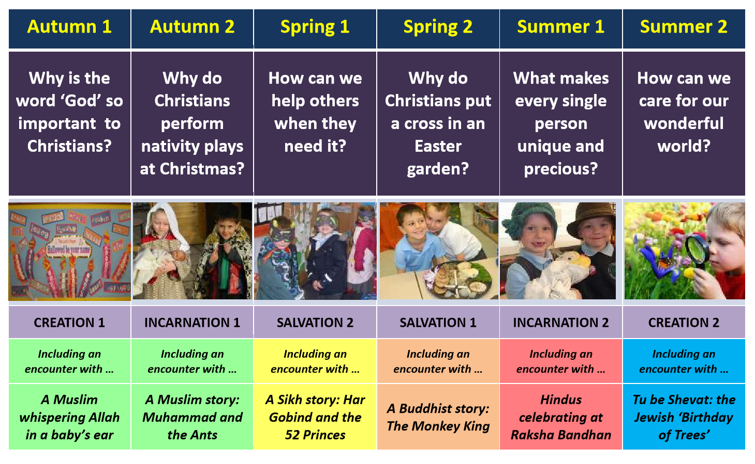
Content and sequence - EYFS
Intent

Slide 8
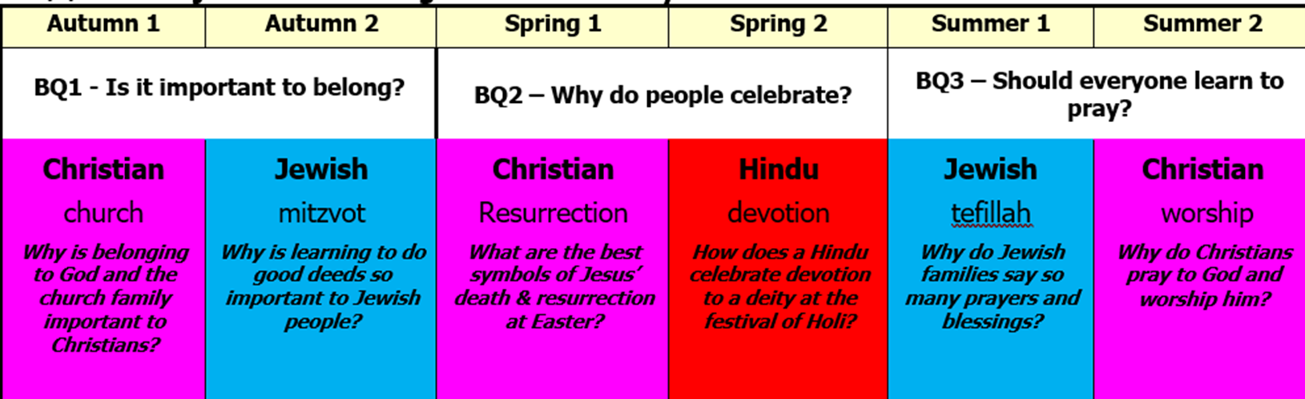
Content and sequence – year 1
Intent

Slide 9
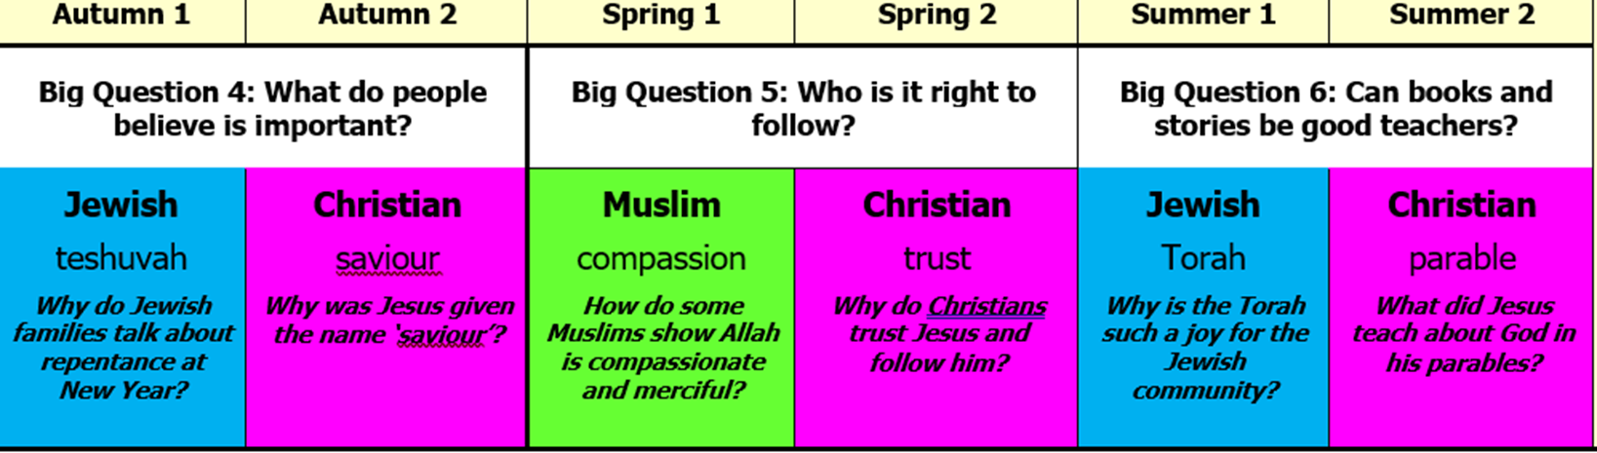
Content and Sequence: Year 2
Intent

Slide 10
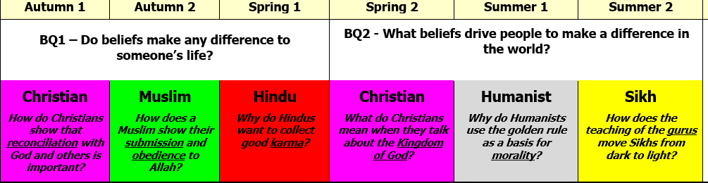
Content and Sequence: Year 3
Intent

Slide 11
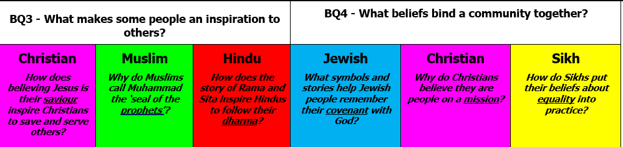
Content and Sequence: Year 4
Intent

Slide 12
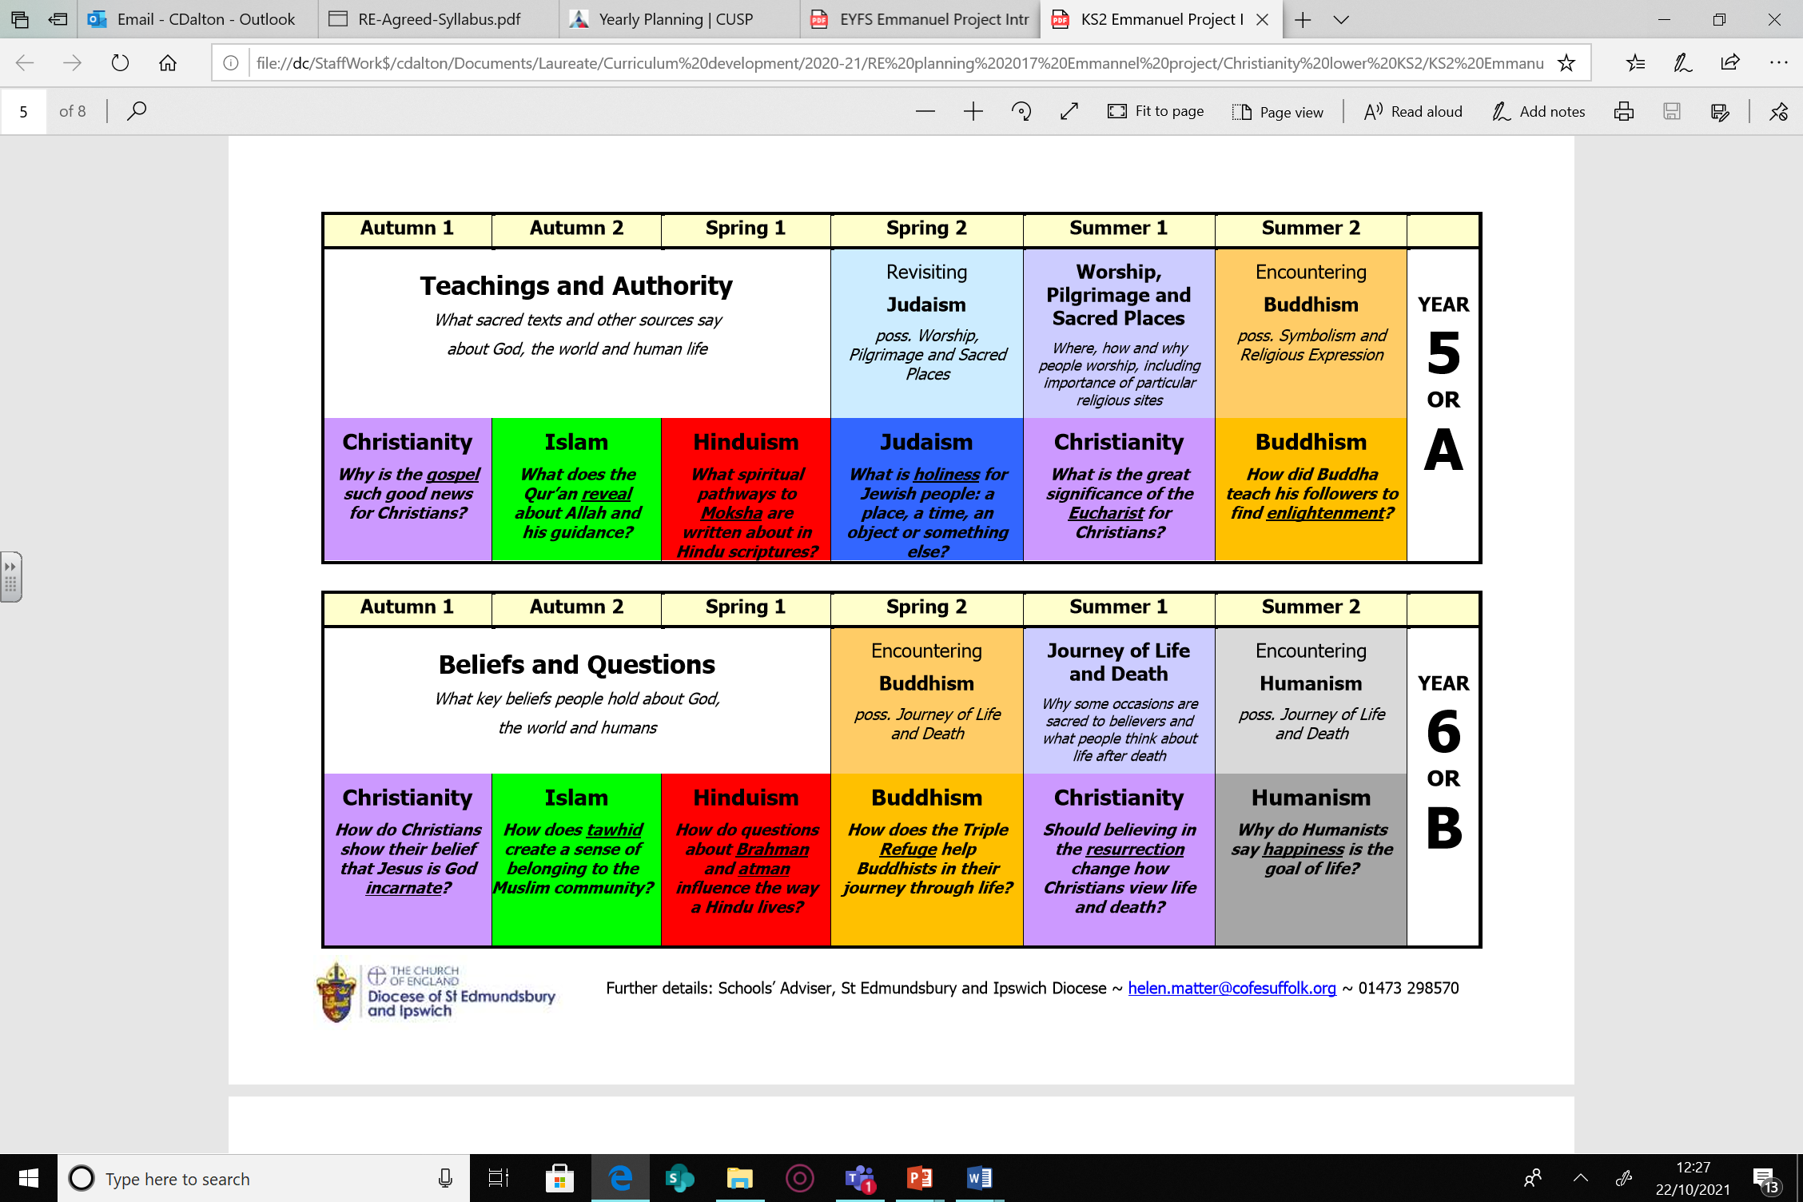
Content and Sequence: Year 5
Intent

Slide 13
Content and Sequence: Year 6
Intent

Slide 14
RE
Implementation
Implementation

Slide 15
The Big Ideas
All units have an overarching question which underpins the learning throughout the unit.
Implementation
Retrieval practice
Children will be revisiting different religions throughout their time at Laureate. What they are learning builds as they transition from Key Stage 1 to Key Stage 2. Through both informal quizzing and questioning, students will have the opportunity to revisit and revise what they have learned.

Slide 16
Minimum lesson expectations
All classes will teach RE weekly, or in some cases this will be blocked into a themed day.
The lessons will have a mixture of whole class, group and pair discussions. For discussions, pupil voice will be recorded.
A selection of recorded work will be shared in a whole class scrapbook which is kept in class for children to revisit and read.
Implementation

Slide 17
Vocabulary
At Laureate, we want our children to have an expansive vocabulary and through teacher modelling and planning, children are given opportunity to use and apply appropriate vocabulary. Key religious terms are taught and built upon with vocabulary being a focus.
Knowledge organisers are also used with the children to reinforce key religious vocabulary.
Implementation

Slide 18
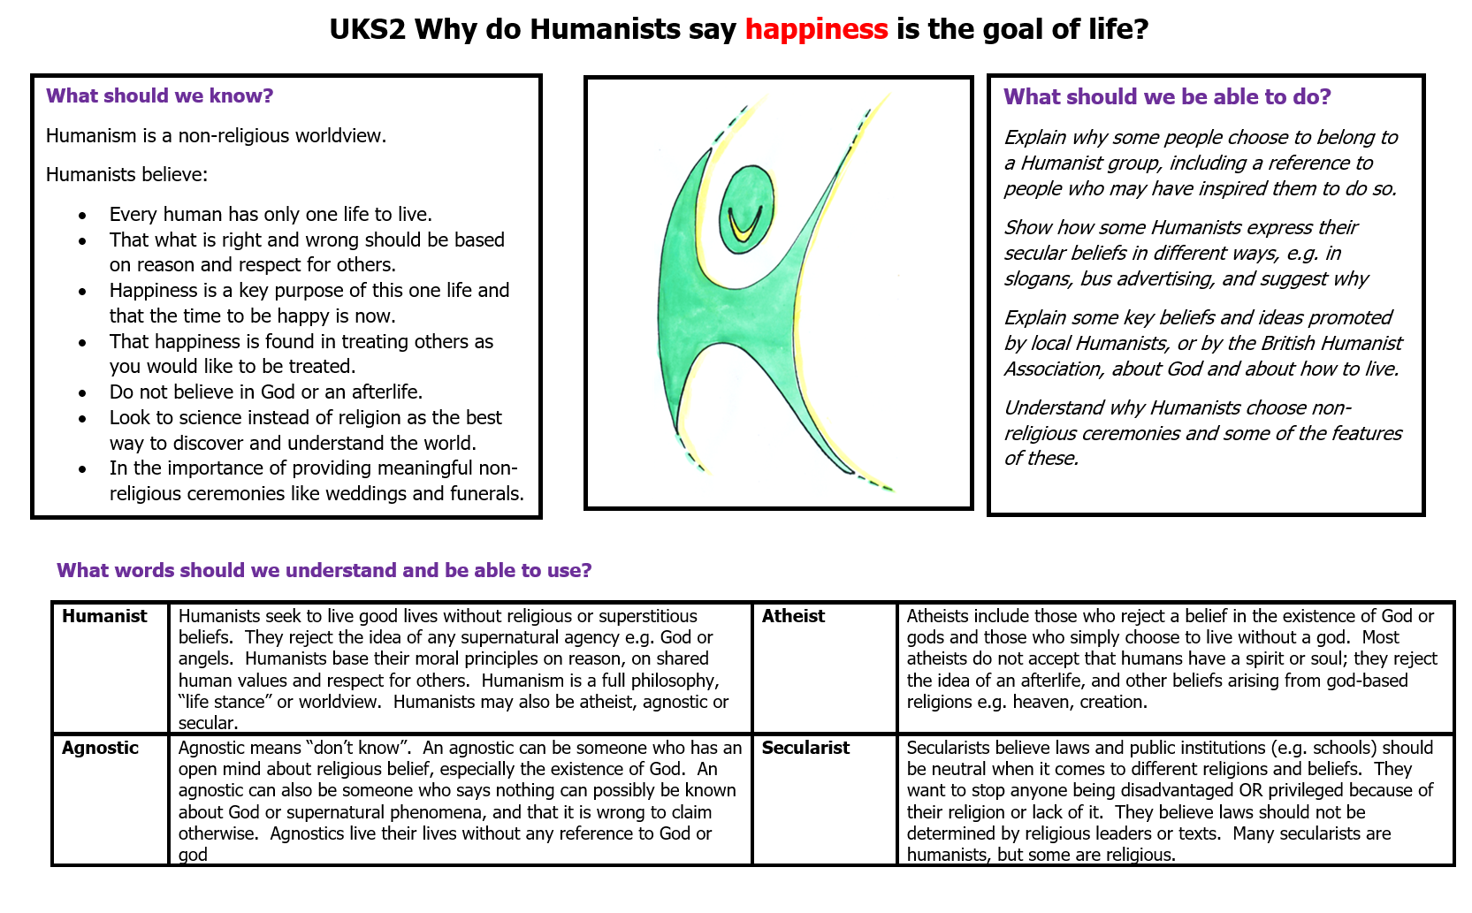
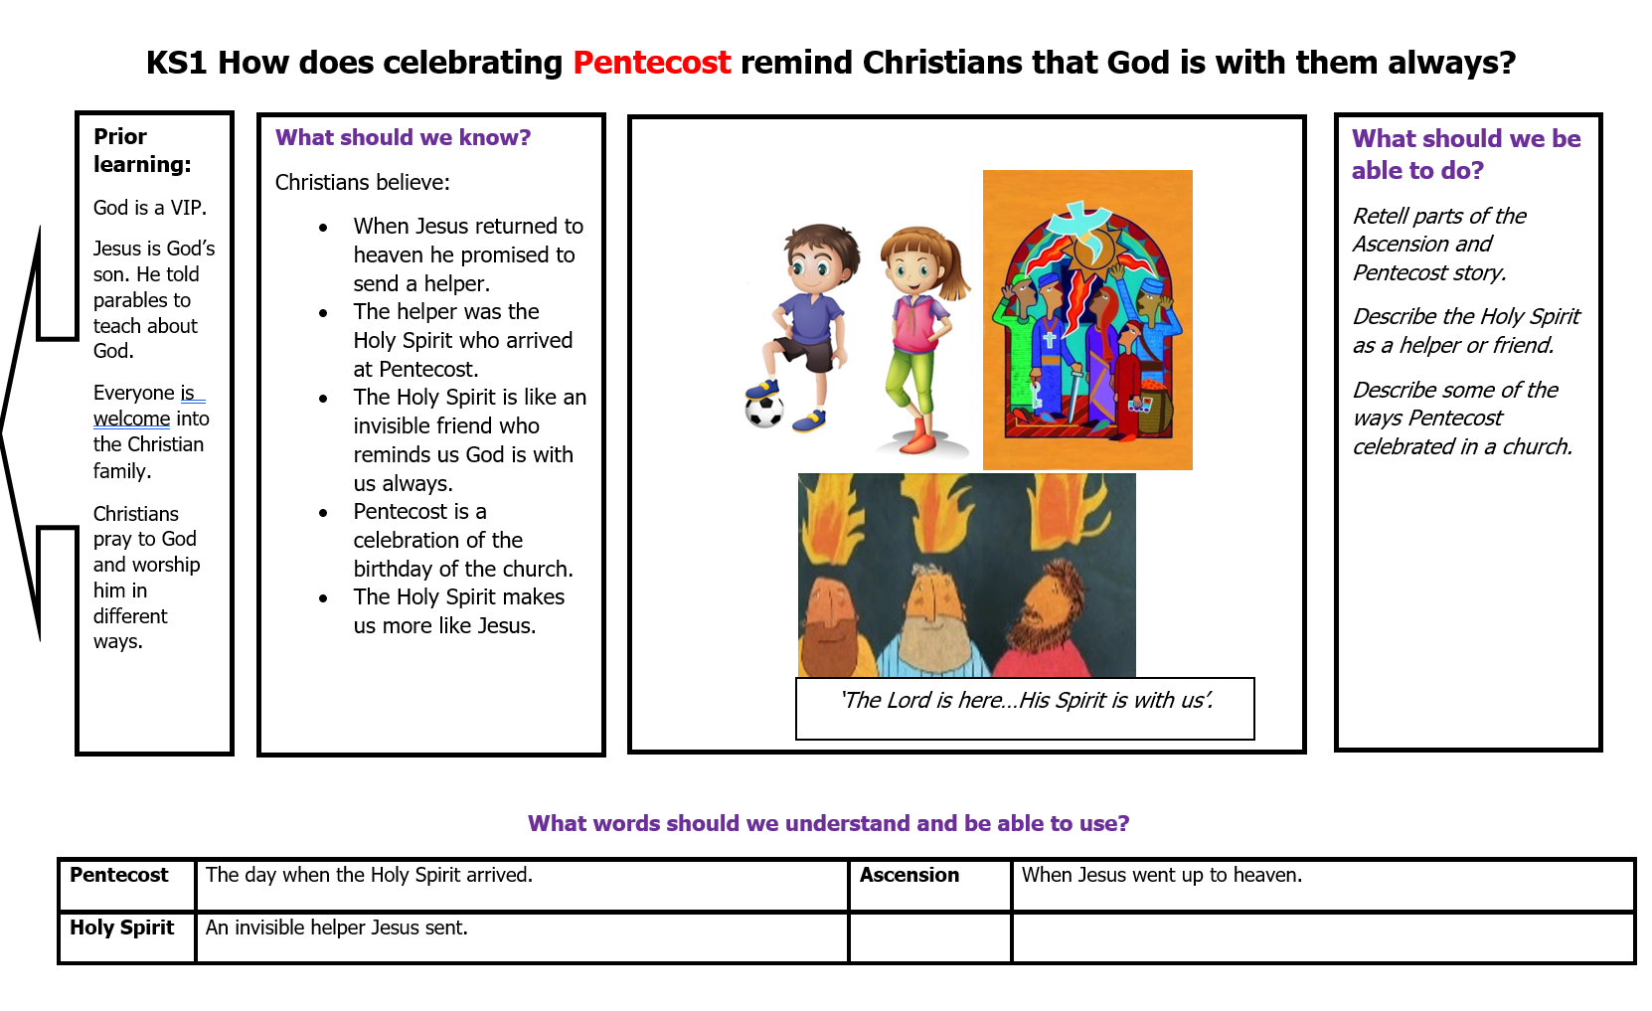
Knowledge Organisers
Accompanying each unit is a Knowledge Organiser which contains key vocabulary, information and concepts which all pupils are expected to understand and retain.
Knowledge Organisers are dual coded to provide pupils with visual calls to aid understanding and recall.
Implementation

Slide 19
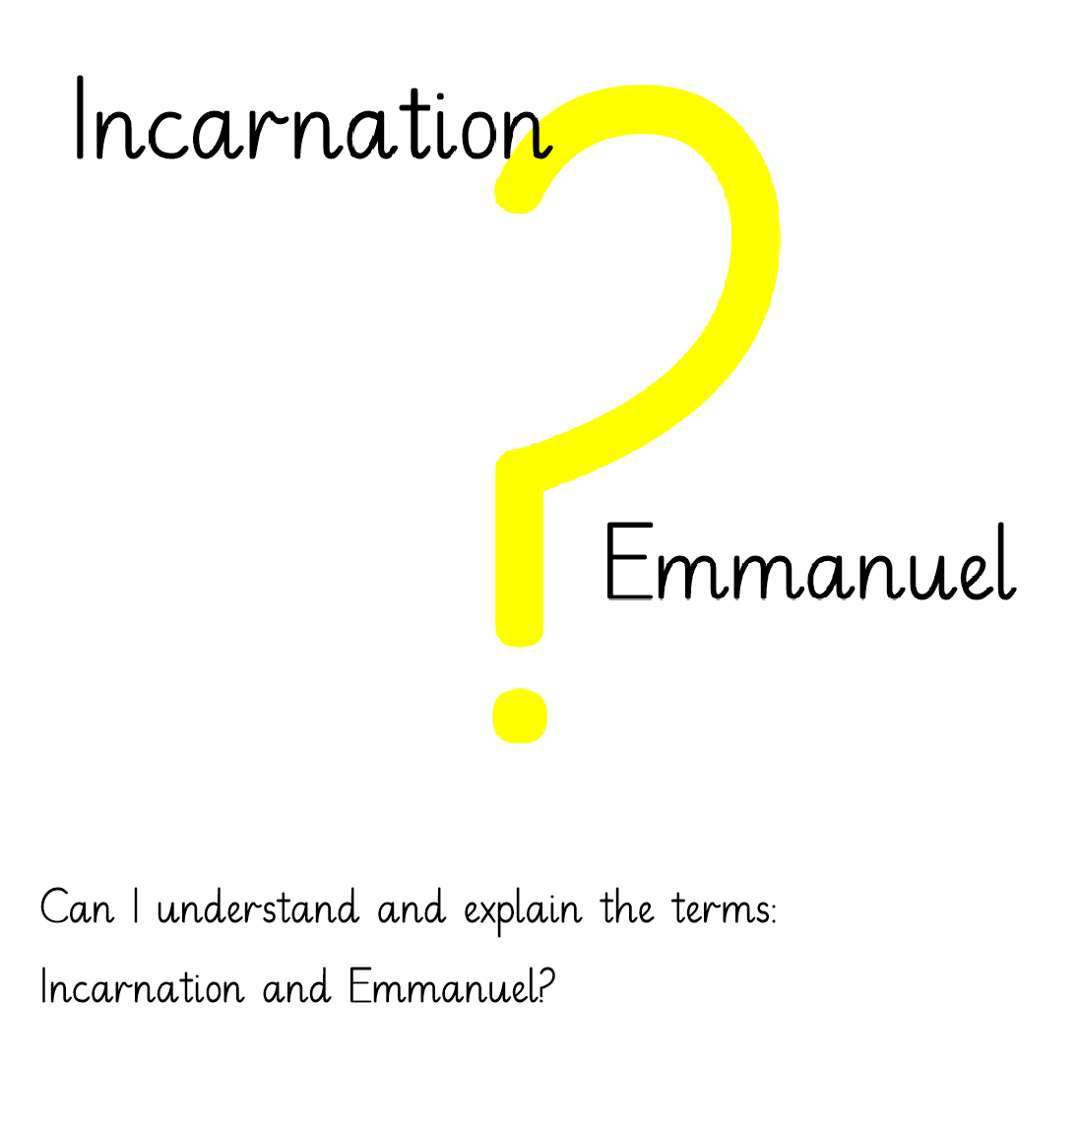
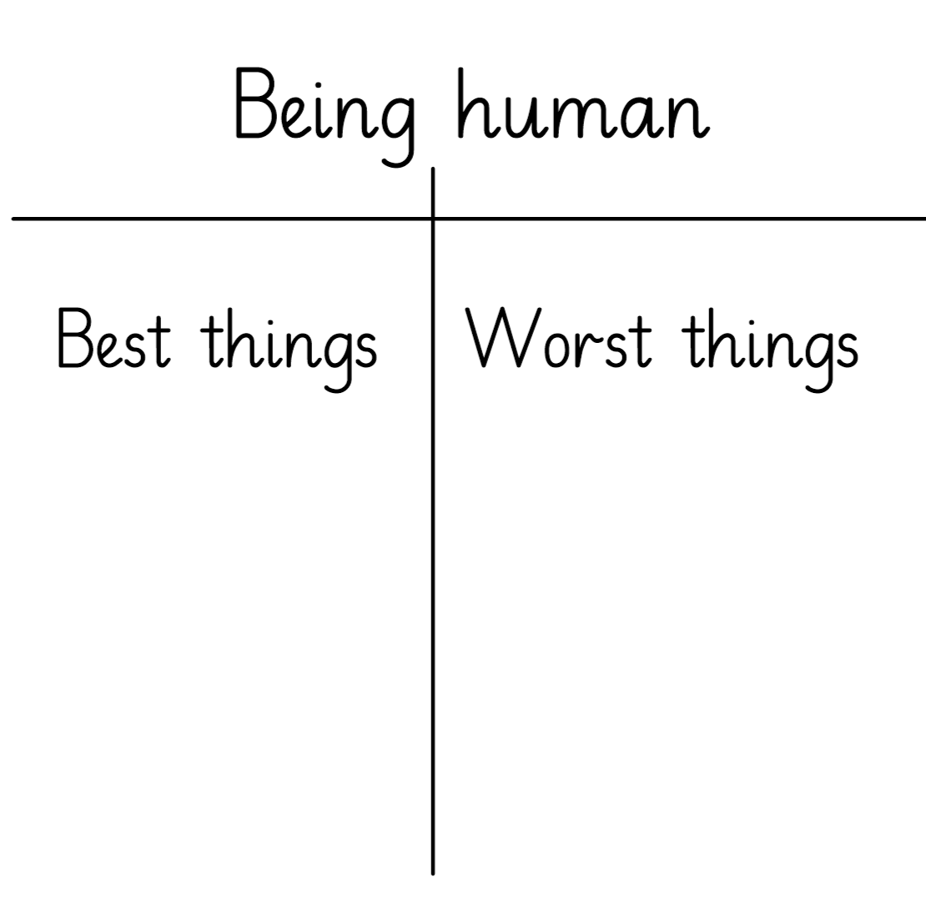
Planning
The ‘Emmanuel Project’ unit plans are used as a basis for planning. Teachers adapt these to meet the needs of all learners. Planning is evidenced through high quality class smartfiles.
Implementation

Slide 20
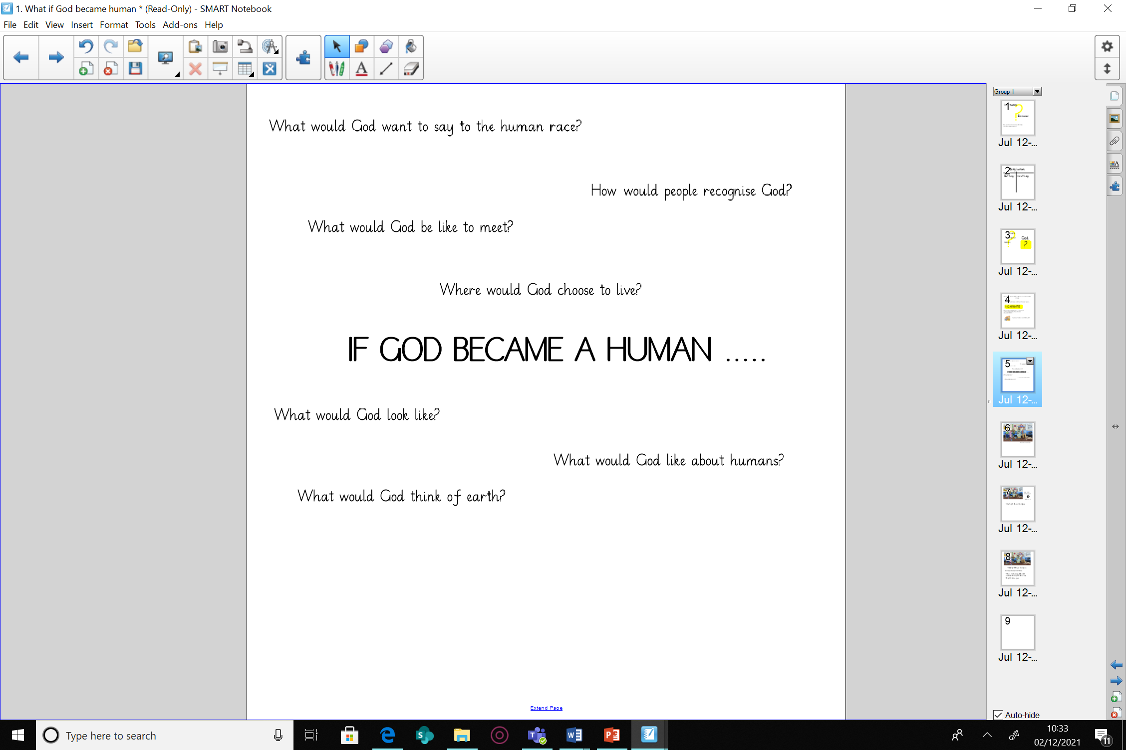
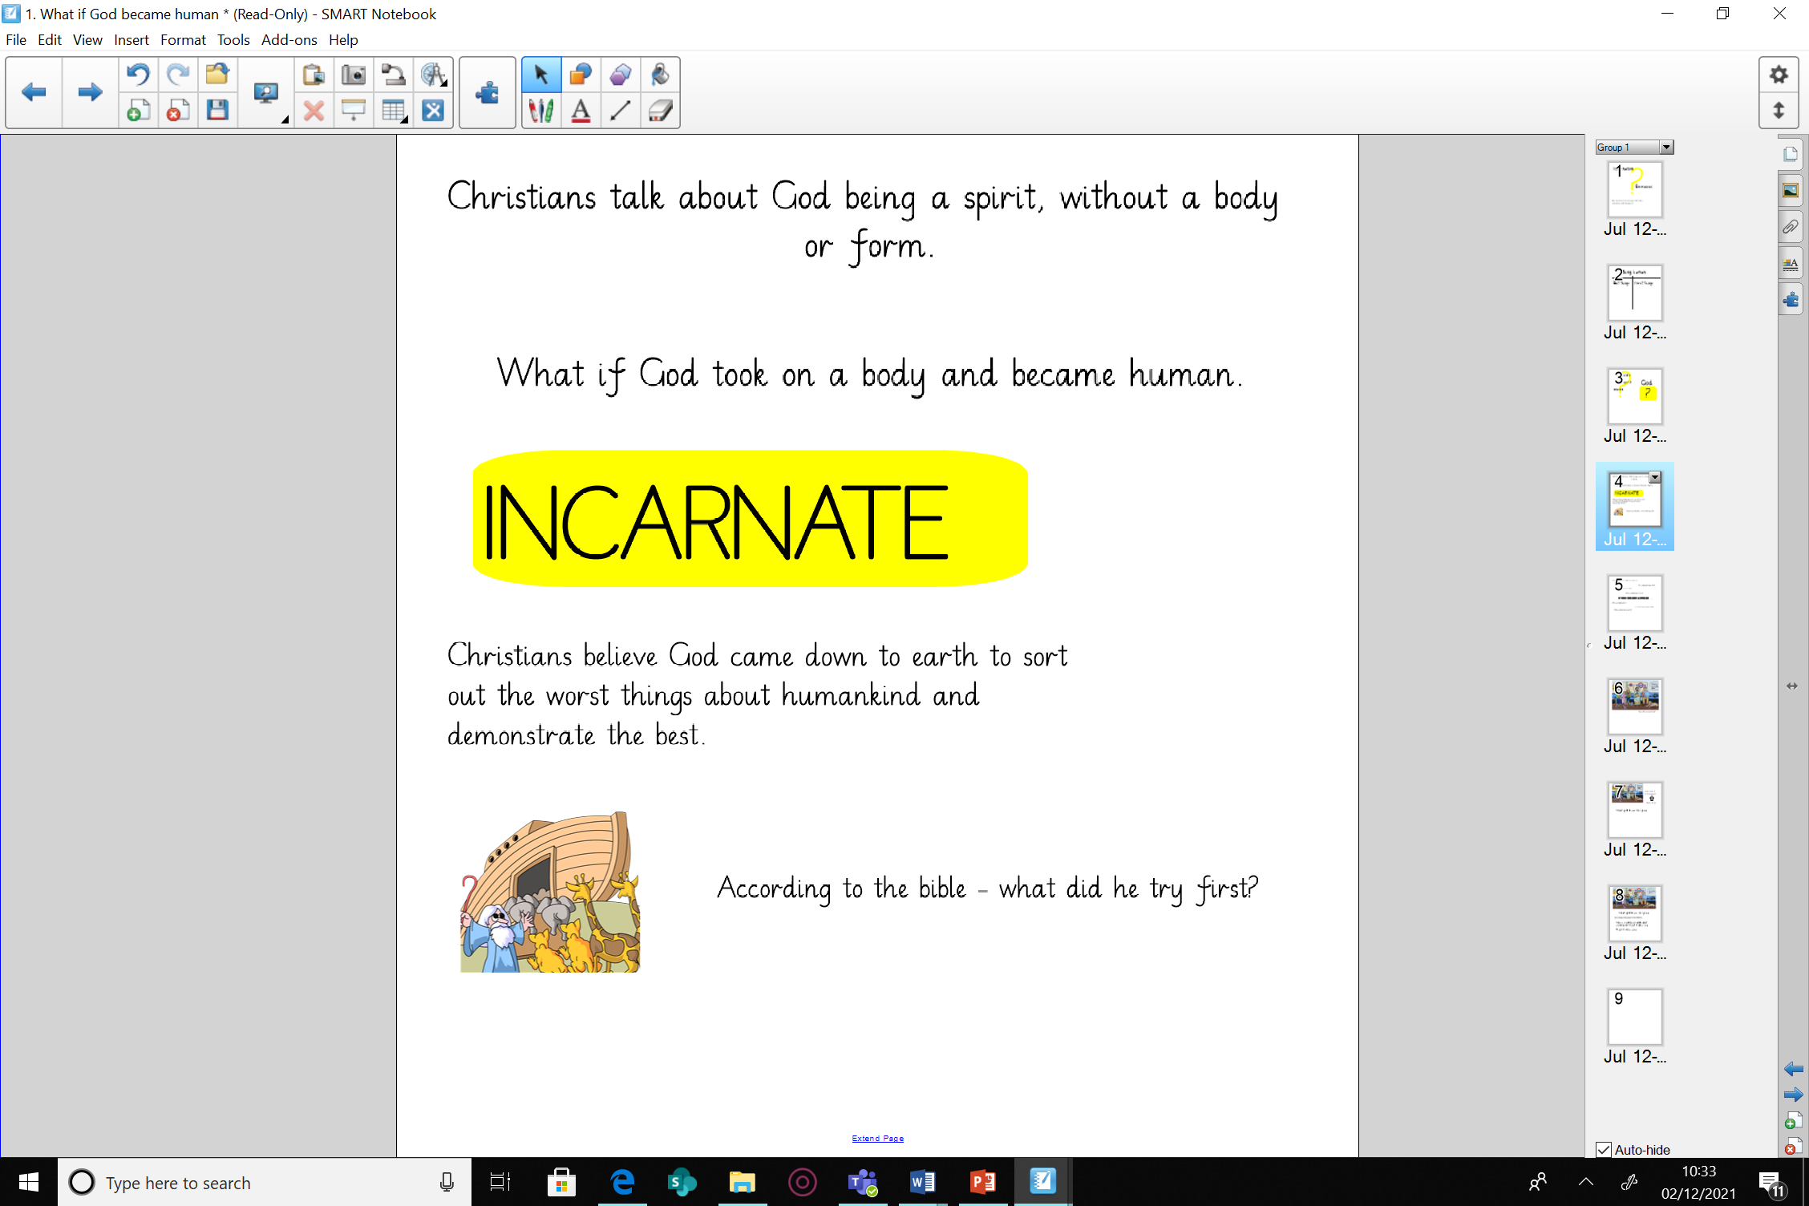
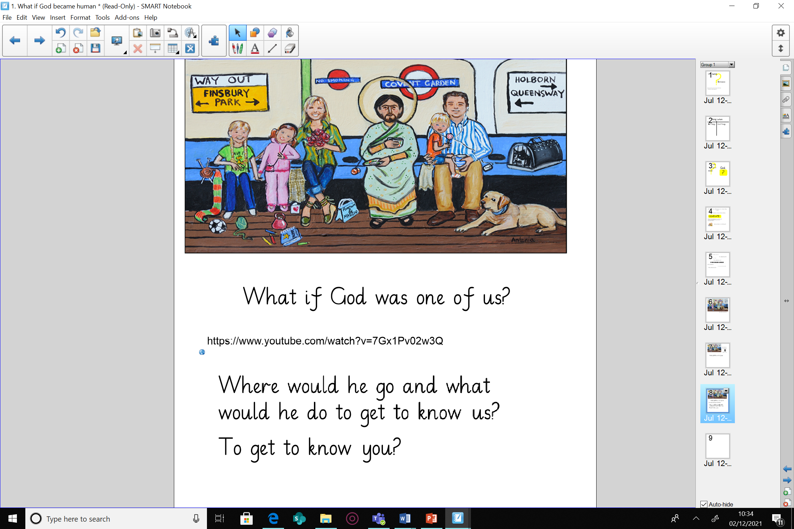
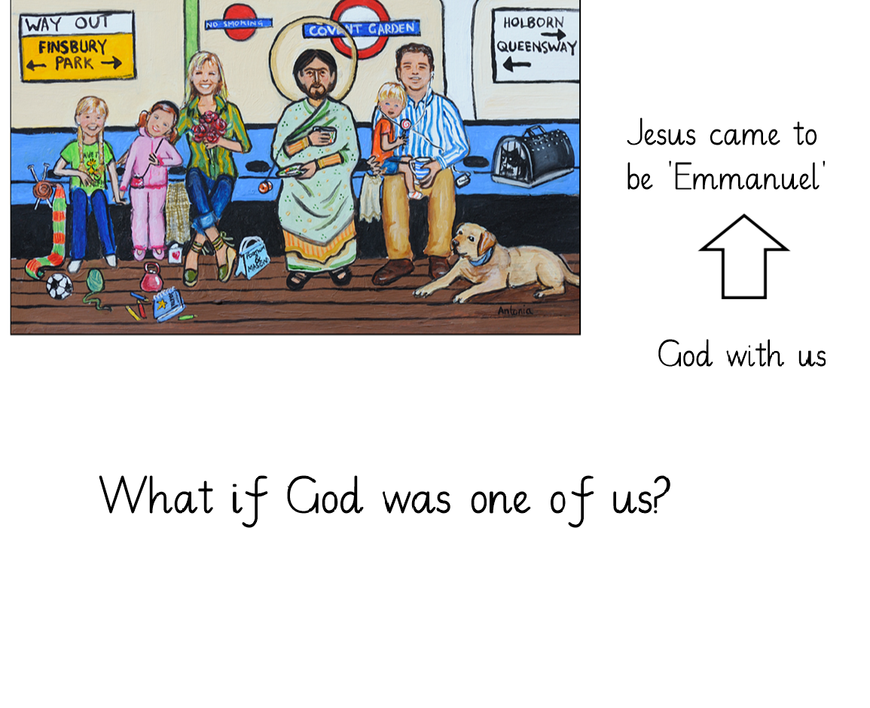
Planning
Implementation

Slide 21
Metacognition in RE
Activate prior knowledge
  Recap previous knowledge and learning vocabulary.
  Make links to other world religions. For example, make explicit similarities and difference between Christianity and Islam.
Explicit strategy instruction
  What is the skill you are learning today? Learning from or learning about religion?
  What do we know already that can help us?
Modelling of learned strategy
  Use thinking aloud to make explicit the train of thought that you are using and following.
  Use videos or teacher modelling to demonstrate expectations.
Memorisation of learned strategy
  Through questioning and discussion, check that children have made links between the skills taught and modelled and the skill being practiced that lesson.
  Model correct vocabulary.
Guided practice
  Discuss steps for success from modelling and memorisation of learned strategy. Stop to question for understanding. What is happening? Why did we make that decision?
Independent practice
  Pupils to complete the task. Reflecting on practice throughout the task.
Structured reflection
  Pupils reflect on their learning. What did they think they were successful with? What could be there next steps?
  NB. These stages will be moved through and revisited depending on need of children.
Implementation

Slide 22
Worked example – Year 6 Christianity – Beliefs and Values (Incarnate)
Activate prior knowledge
The teacher discusses with pupils the religions already studied. Discussing there similarities and differences. Outline what we have learnt about Christianity throughout EYFS-Year5.
Explicit strategy instruction
The teacher then shares the LQ: Can I understand and explain the terms: Incarnation and Emmanuel? Explore the etymology of these words and try to ascertain their meanings.
Modelling of learned strategy
Teacher scaffolds and guides discussions about Incarnation. What might happen if God began human. Share own ideas and model building on each others ideas and thoughts.
Use talking out loud to discuss thoughts and ideas. I think…..because…… I agree with …… etc.
Explore any misconceptions or mistakes eg. God would be noticeable as he is a King etc.
Memorisation of learned strategy
Questioning throughout the modelling process to ensure pupils have understood the task.
Recall over key vocab needed and it’s meanings.
Recall all steps needed to be successful with the task.
Guided practice
Pupils start the task whilst teacher and additional adults move around the room checking for understanding and guiding where necessary.
Independent practice
Pupils complete their own poster in the style of Antonia Rolls exploring what would happen if God began one with us. .
Structured reflection
Pupils share posters and discuss their own ideas. Pupils peer evaluate other’s ideas.
Implementation

Slide 23
Tailoring for SEND
We plan for the first 20% and scaffold the lesson and tasks to meet their needs. Then we remove the scaffolding, as appropriate, to meet the needs of other pupils. ​
​
We aim to provide all children with the opportunity to confidently progress in their knowledge and understanding along with working with other children. We strive for all children to access the RE curriculum equally, but this can vary in how it looks depending on individual's needs.​
​
Our RE planning has a strong emphasis on subject specific vocabulary. This is carefully and deliberately planned so that pupils revisit and embed this knowledge over time. This key vocabulary may be pre-taught for pupils who may need this. Key images are also used to represent the units big question and these are revisited throughout the unit of work.
Implementation

Slide 24
Tailoring for SEND
Pupils with language and communication difficulties (including those with ASD) may need additional visual prompts to help them understand what is expected of them. Some pupils may require individual task boards to enable them to follow a series of steps where a task has been broken down into smaller, more manageable chunks. ​
​
Some pupils may have a hearing or visual impairment. Teachers should think carefully about how these impact on pupil’s ability to hear and to read and understand key information. Teachers should think carefully about how they can adapt lessons, possibly including the use of technology, to ensure that these pupils can access the same high-quality curriculum experience.​
. ​
For some pupils who have specific challenges around processing, some of the lessons may require adaptation to ensure that all pupils can participate fully in the lesson. This may mean reducing the number of instructions or steps in a task, introducing the use of a reader for lessons with a reading element, knowledge notes might be altered to meet individuals needs so that they are not overwhelmed by too much information​, oral rehearsal could be encouraged before writing and the use of sentence stems to prompt.
Seating plans could also be altered for RE lessons to allow individuals to discuss and learn from others.
​
Implementation

Slide 25
Cross Curriculum links
Communication and Oracy RE lessons allow pupils to develop a broad and accurate religious vocabulary. They will have the opportunity to respond to a range of written and spoken language, including sacred texts, stories, poetry, prayers and worship, communicating ideas using the creative and expressive arts. They will develop insights into different religions and values, be able to reflect critically on ultimate questions of life, using reasoned arguments. Pupils will be taught how to listen and respond to other people’s comments including how to agree and disagree in a sensible and appropriate way.
Geography/History pupils will gain context from researching and locating places of religious significance. Pupils will also gain an understanding of how certain religious figures and events have had an impact on history.
Computing pupils will use the internet and media selectively to research for information about religion and belief. They may also have the opportunity to use computer programmes to present knowledge gained.
Implementation

Slide 26
Continuous Professional Development
Staff have the opportunity to share good practice during staff meetings, this includes sharing Scrapbooks and discussing successes and challenges of certain units of work.
Emmanuel Project plans have cover sheets detailing further key subject matter and concepts for the current unit.
Implementation

Slide 27
RE
Impact​
Impact

Slide 28
How do we measure the impact of RE teaching?
Pupil book study
Scrapbooks are monitored to assess the learning that has taken place. Pupil’s have the opportunity to share their learning through directed conversations linked to the class scrapbooks. This enables leaders to ascertain retention of learning.
Impact

Slide 29
Teacher assessment
Whole Class Assessment Sheets are used throughout every lesson to ensure children are achieving the intended learning outcomes. Teachers are responsive to any needs identified and use this knowledge throughout the planning and assessment cycle. At the end of the unit teachers will use the Whole Class Assessment Sheets to secure a summative judgement for each child. Subject leaders will lead pupil conferencing and will also complete data analysis of Whole Class Assessment Sheets to monitor progress and identify next steps within the RE curriculum.
Impact

Slide 30
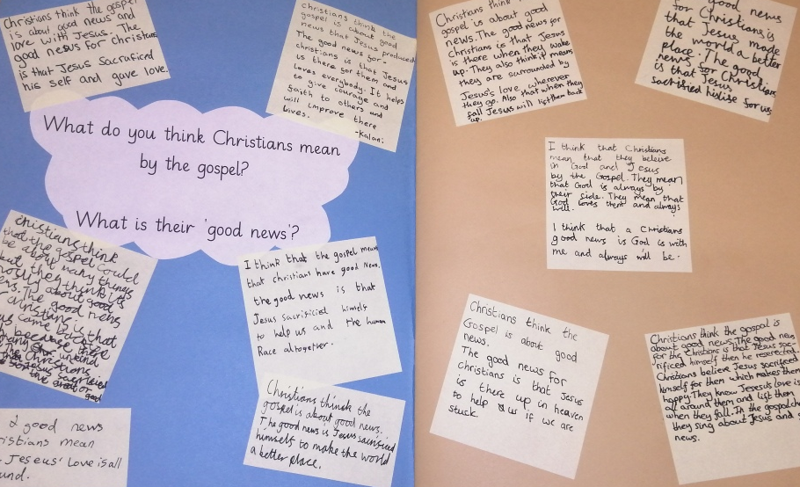
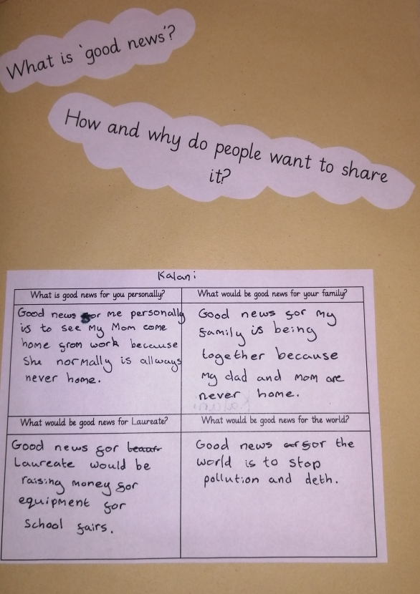
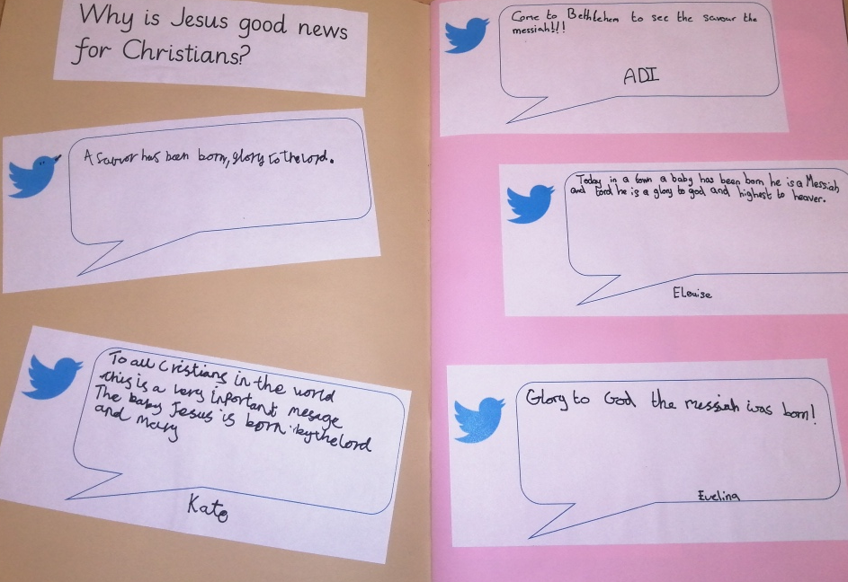
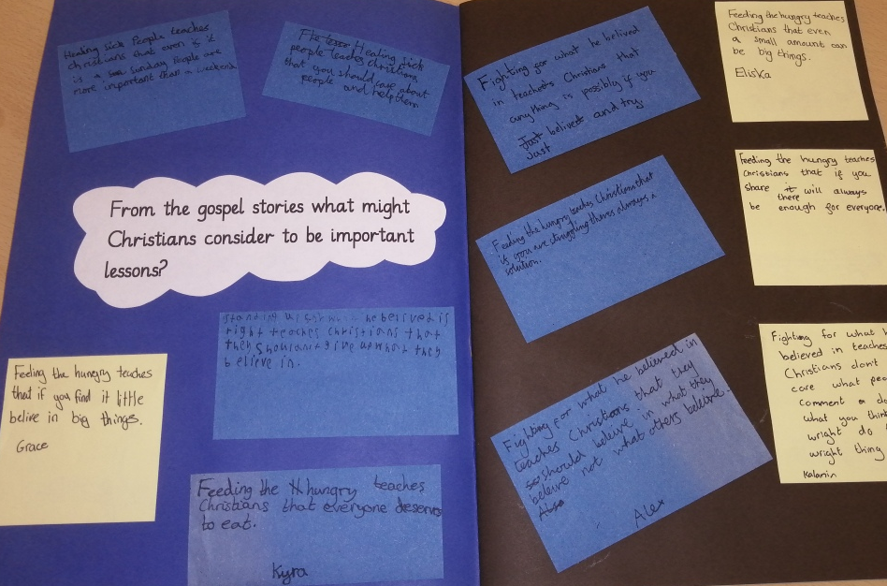
Sequence of learning
Impact

Slide 31
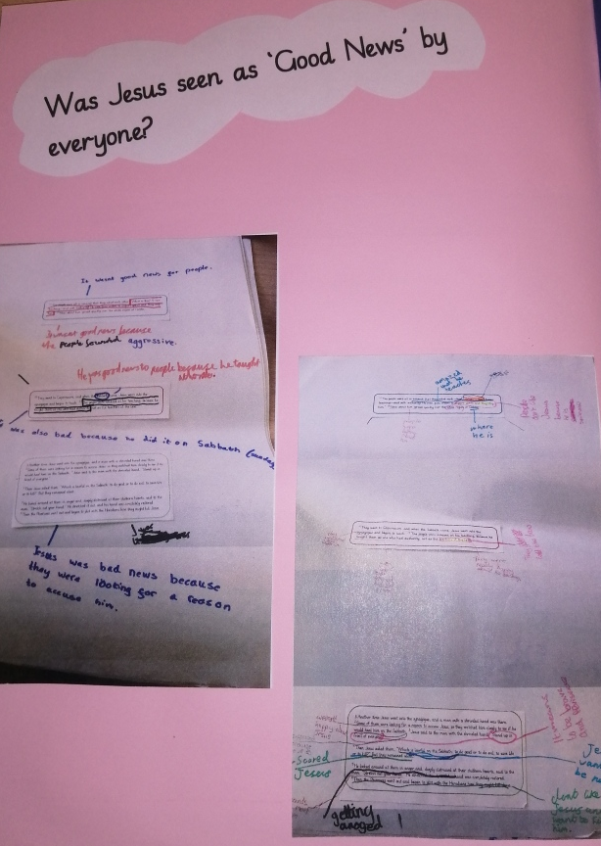
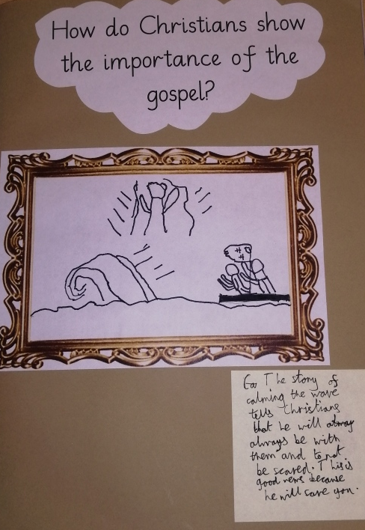
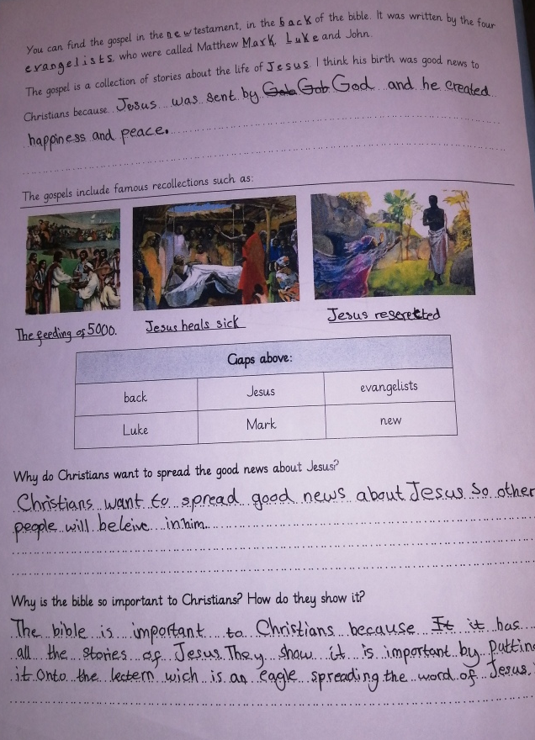
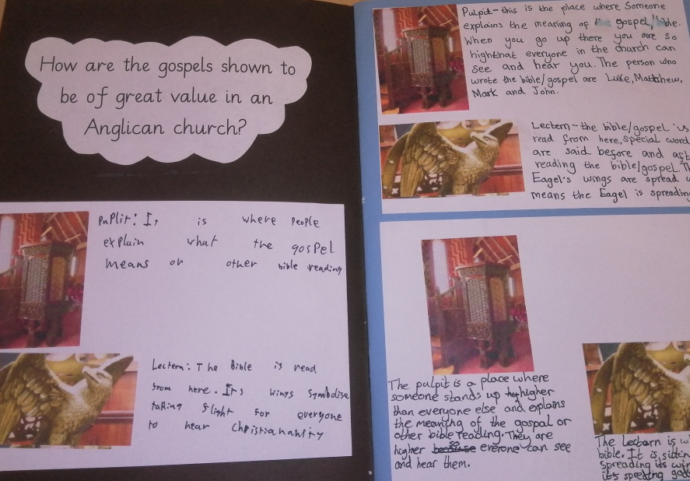
Sequence of learning
Impact

