Slide 1
Geography Why is Geography important?
At Laureate Community Academy we aim to offer a high quality geography education that will enable children to develop a curiosity and fascination about the world and its people that will remain with them for the rest of their lives. Unity Schools Partnership curriculum plans are used to teach geography.
These are:
Informed by the National Curriculum;
Carefully planned and structured to ensure that current learning is linked to previous learning;
Informed by current pedagogy such as quizzing and retrieval practice.
Intent

Slide 2
Laureate Community Academy aspires to provide excellent opportunities for geography so that children develop the following:
Location knowledge: Children will develop their knowledge of the location of globally significant places.
Place knowledge: Children will understand geographical similarities and differences between the United Kingdom and other chosen countries. This will include defining their physical and human characteristics.
Human and Physical geography: Children will explore processes which have led to the formation of key physical and human geographical features of the world.
Fieldwork: Children will collect, discuss and analyse a range of data gathered through fieldwork which will deepen their understanding of geographical processes.
Intent

Slide 3
Geography
Aims of the Geography Curriculum
The national curriculum for Geography aims to ensure that all pupils:
develop contextual knowledge of the location of globally significant places – both terrestrial and marine – including their defining physical and human characteristics and how these provide a geographical context for understanding the actions of processes.
understand the processes that give rise to key physical and human geographical features of the world, how these are interdependent and how they bring about spatial variation and change over time .
are competent in the geographical skills needed to:
- collect, analyse and communicate with a range of data gathered through experiences of fieldwork that deepen their understanding of geographical processes
- interpret a range of sources of geographical information, including maps, diagrams, globes, aerial photographs and Geographical Information Systems
- communicate geographical information in a variety of ways, including through maps, numerical and quantitative skills and writing at length.
Intent

Slide 4
Key Stage 1:
The aims of the syllabus are that students in KS1 will use:
Locational knowledge:
Name and locate the world’s seven continents and five oceans.
Name, locate and identify characteristics of the four countries and capital cities of the United Kingdom and its surrounding seas.
Place knowledge
Understand geographical similarities and differences through studying the human and physical geography of a small area of the United Kingdom, and of a small area in a contrasting non-European country.
Human and physical geography
Identify seasonal and daily weather patterns in the United Kingdom and the location of hot and cold areas of the world in relation to the Equator and the North and South Poles.
Use basic geographical vocabulary to refer to:
key physical features, including: beach, cliff, coast, forest, hill, mountain, sea, ocean, river, soil, valley, vegetation, season and weather
key human features, including: city, town, village, factory, farm, house, office, port, harbour and shop.
Intent

Slide 5
Key Stage 2:
The aims of the syllabus are that students in KS2 can:
Locational knowledge
locate the world’s countries, using maps to focus on Europe (including the location of Russia) and North and South America, concentrating on their environmental regions, key physical and human characteristics, countries, and major cities
name and locate counties and cities of the United Kingdom, geographical regions and their identifying human and physical characteristics, key topographical features (including hills, mountains, coasts and rivers), and land-use patterns; and understand how some of these aspects have changed over time
identify the position and significance of latitude, longitude, Equator, Northern Hemisphere, Southern Hemisphere, the Tropics of Cancer and Capricorn, Arctic and Antarctic Circle, the Prime/Greenwich Meridian and time zones (including day and night)
Place knowledge understand geographical similarities and differences through the study of human and physical geography of a region of the United Kingdom, a region in a European country, and a region within North or South America.
Intent

Slide 6
Continued:
Human and physical geography describe and understand key aspects of:
physical geography, including:
climate zones, biomes and vegetation belts, rivers, mountains,
volcanoes and earthquakes, and the water cycle
human geography, including:
types of settlement and land use, economic activity including trade
links, and the distribution of natural resources including energy, food,
minerals and water
Geographical skills and fieldwork
use maps, atlases, globes and digital/computer mapping to locate countries and describe features studied
use the eight points of a compass, four and six-figure grid references, symbols and key (including the use of Ordnance Survey maps) to build their knowledge of the United Kingdom and the wider world
use fieldwork to observe, measure, record and present the human and physical features in the local area using a range of methods, including sketch maps, plans and graphs, and digital technologies.
Intent

Slide 7
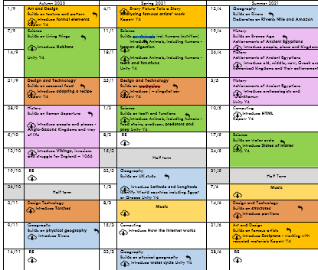
Spaced Retrieval Practice Approach
Rather than teaching a single lesson each week, our Geography curriculum is taught in a modular approach. This enables children to build on prior knowledge and make connections more easily. Children may spend two weeks learning about a topic in one term,
then a week revisiting it in the next term as in the Year 4 Rivers and Year 2 UK units.
A yearly overview shows geography coverage
in blue.
Intent

Slide 8
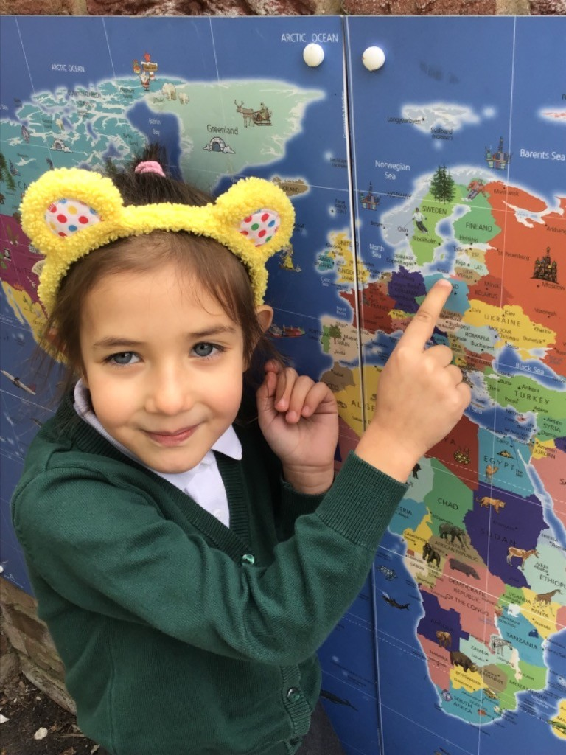
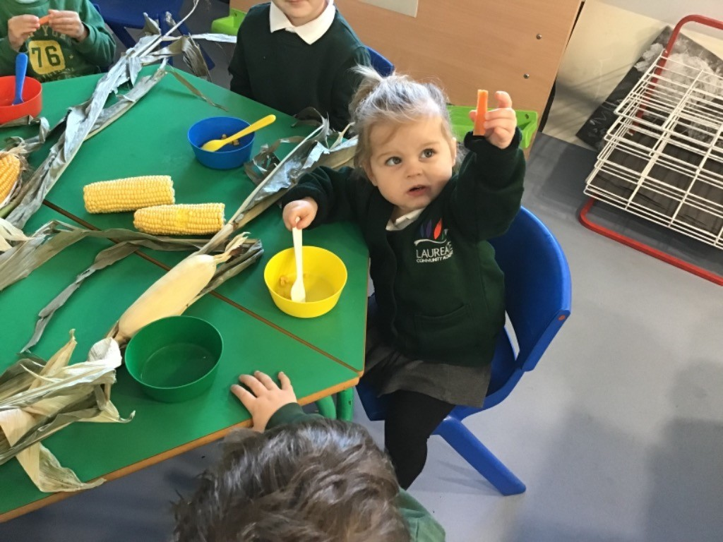
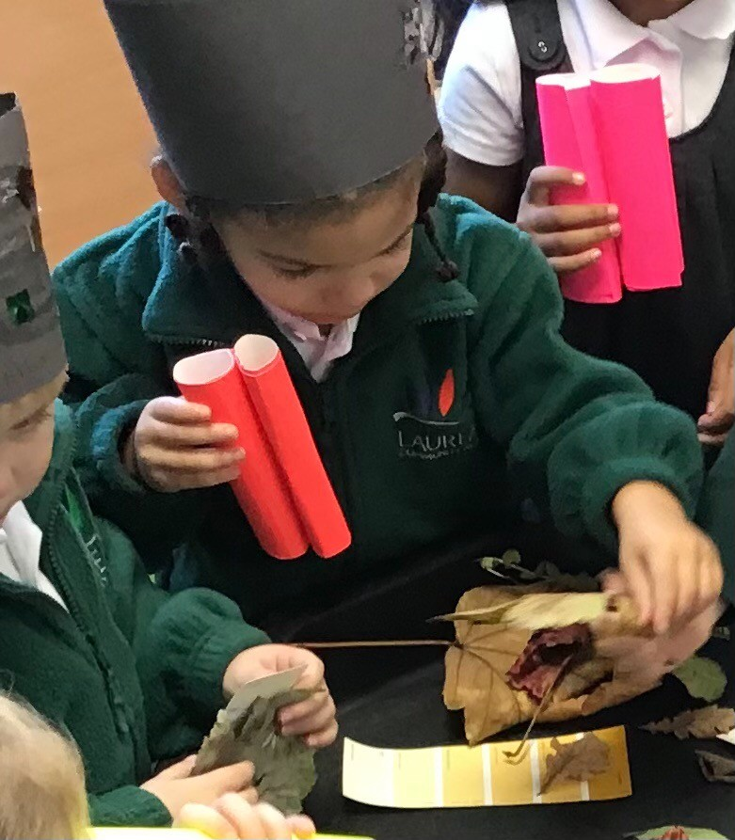
Early Years
The Early Years Foundation Stage (EYFS) follows the Statutory Framework for the EYFS which aims for all children in reception to have an Understanding of the World. This involves guiding children to know about similarities and differences in relation to places, objects, materials and living things. They will talk about the features of their own immediate environment and how environments might vary from one another.
Intent

Slide 9
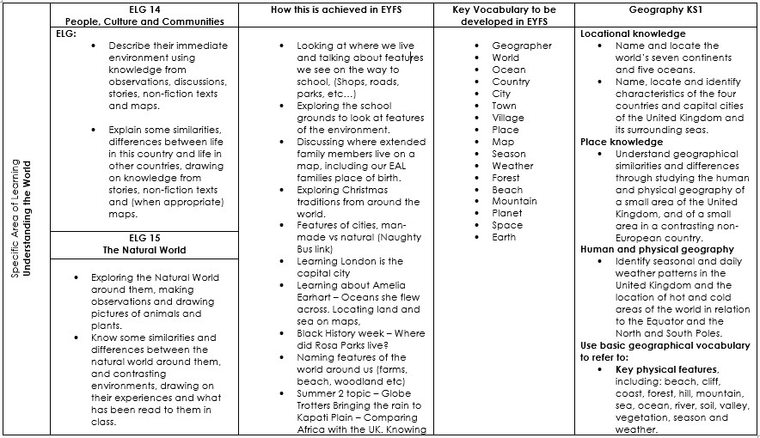
Content and sequence - EYFS to Key Stage 1
Intent

Slide 10
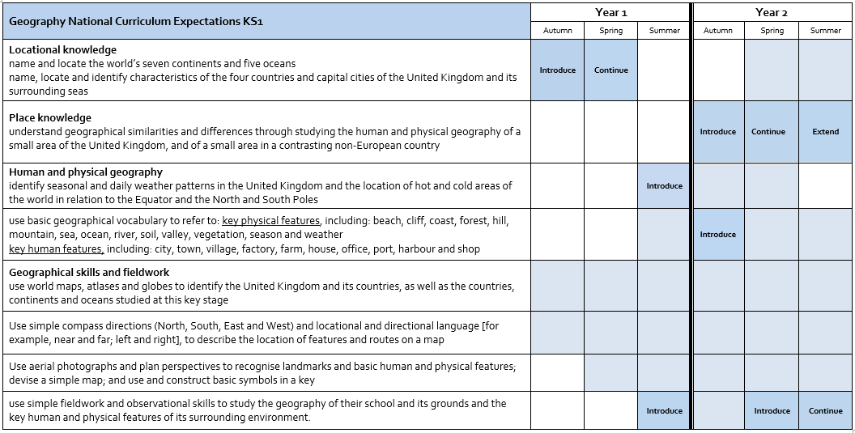
Content and sequence - Key Stage 1
Intent

Slide 11
Content and Sequence: Year 1
Continents, Oceans, UK countries, capitals and seas
Name and locate the world’s seven continents and five oceans.
Name, locate and identify characteristics of the four countries and capital cities of the United Kingdom and its surrounding seas.
Study hot and cold locations
Identify seasonal and daily weather patterns in the United Kingdom and the location of hot and cold areas of the world in relation to the Equator and the North and South Poles.
Revisit Continents, Oceans, UK countries, capitals and seas later in the year
Build on local geographical knowledge via a local walk, exploring features.
Intent

Slide 12
Content and Sequence: Year 2
Human and physical geography in the local area
Recap from Year 1 the United Kingdom and its countries, as well as the terminology and relevance to us of ‘port, harbour, urban, rural, coastal’.
Study human and physical geography of a small area of United Kingdom, and of a contrasting non-European country
Understand geographical similarities and differences through studying the human and physical geography of a small area of the United Kingdom, and of a small area in a contrasting non-European country.
Fieldwork and map skills
Use simple fieldwork and observational skills to study the geography of their school and its grounds and the key human and physical features of its surrounding environment.
Intent

Slide 13
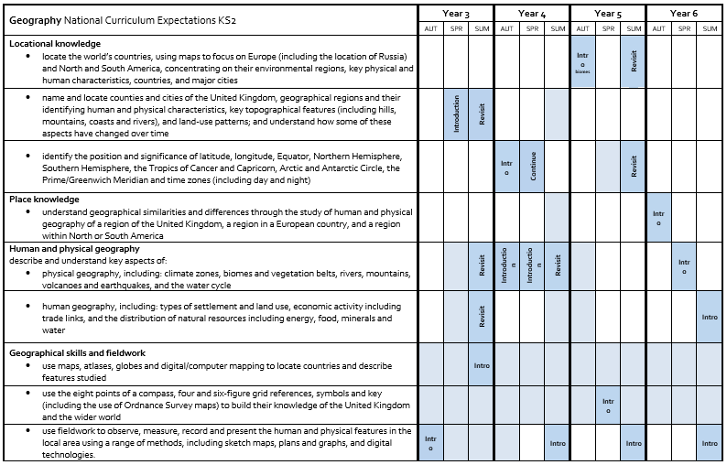
Content and Sequence – Key Stage 2
Intent

Slide 14
Content and Sequence: Year 3
Countries and regions of the UK
Name and locate counties and cities of the United Kingdom, geographical regions and their identifying human and physical characteristics, key topographical features (including hills, mountains, coasts and rivers), and land-use patterns; and understand how some of these aspects have changed over time.
Fieldwork and map skills
Making, reading and using a compass.
Intent

Slide 15
Content and Sequence: Year 4
Study Latitude and Longitude
Identify the position and significance of latitude, longitude, Equator, Northern Hemisphere, Southern Hemisphere, the Tropics of Cancer and Capricorn, Arctic and Antarctic Circle, the Prime/Greenwich Meridian and time zones (including day and night).
Rivers
Identify the features of a river. Conduct a local river study and explore major rivers of the world.
The Water Cycle
Human and physical geography
Intent

Slide 16
Content and Sequence: Year 5
Study location of countries of the world, including biomes
Locational knowledge
Human and physical geography
Geographical skills and fieldwork
Intent
Map skills
Pupils should extend their knowledge and understanding beyond the local area
to include the United Kingdom and Europe, North and South America.
This will include the location and characteristics of a range of the world’s
most significant human and physical features.
They should develop their use of geographical knowledge, understanding and skills to enhance their locational and place knowledge.

Slide 17
Content and Sequence: Year 6
Study and compare places: region in the UK, Europe and North America
This study focuses on the Lake District, Tatra mountains in Poland
and North America – Caribbean.
It links and builds upon the History module studying the Windrush generation.
Human geography – economic, settlement and trade links Types of settlement and land use, economic activity including trade links, and the distribution of natural resources including energy, food, minerals and water
Intent

Slide 18
Geography
Implementation
Implementation

Slide 19
Modular Approach – Knowledge
Geography is taught across each year group in modules that enable pupils to carry out an in depth study of a geographical unit of work. Each module aims to activate and build upon prior learning, including across subjects.
Each module is carefully sequenced to enable pupils to build on learning from previous sessions to facilitate the acquisition and retention of key geographical knowledge.
All modules have a sequenced overview outlining recommended number of sessions, key concepts, knowledge and vocabulary to be taught. Teachers use this overview to plan individual sessions lasting approximately 45-50 minutes in length.
Implementation

Slide 20
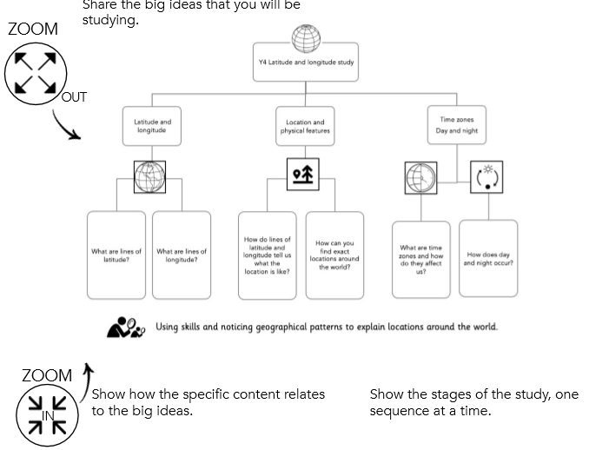
The Big Ideas
Each module begins with the sharing of The Big Idea. This gives the children an overview of what they will be learning in each year group and how this module fits within this. It also shows how each lesson fits within the module sequence.
Implementation

Slide 21
National Curriculum objectives and how these links to prior learning are evident at the beginning of every module.
Implementation
A Year 1 module building on prior learning in EYFS.

Slide 22
Development of Geography skills
As well as ensuring pupils are taught key knowledge, each module is designed to offer pupils the opportunity to develop their skills as a Geographer. The skills are identified on each of our modules for both Key Stage 1 and Key Stage 2. It is clear which of the objectives are being taught throughout a specific module which ensures full coverage and allows for skills to be built upon.
Implementation
Example of skills in Year 1 – Continents and Oceans, UK

Slide 23
Cumulative Quizzing Model (Supporting Cognitive Load)
Pupils are given opportunities to retrieve their knowledge at regular intervals throughout the unit through a 'teach – test – teach – test' model. The aim of this model is to reinforce and revisit previously taught knowledge and vocabulary using multiple choice quizzes.
Prior learning will be revisited at the start of every lesson, checking recall of previous lessons. This could be verbally, in books or via Socrative.
Implementation

Slide 24
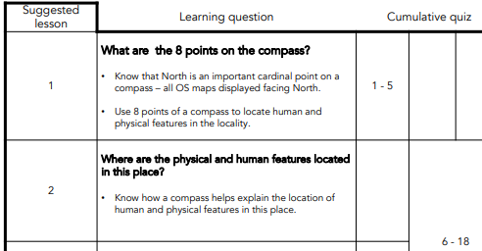
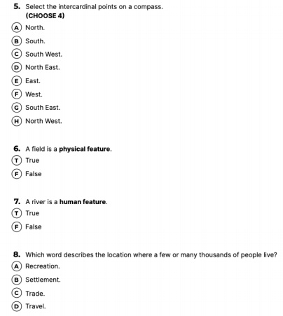
Cumulative Quizzing Model (Supporting Cognitive Load)
All plans are accompanied by a quiz which is clearly linked to previous learning.
Implementation

Slide 25
Minimum lesson expectations
Knowledge strip are used to support learning. They are evident in books and referred back to throughout the lesson
Explicit teaching of vocabulary is planned for
Opportunity is given throughout the lesson for the use of this subject specific vocabulary
Revisiting of prior learning through retrieval practice and quizzing
Applying the skills targeted for the lesson
Work to evidence learning in pupil's books
Where appropriate conduct fieldwork experiments
Further opportunities for reading may be given
Implementation

Slide 26
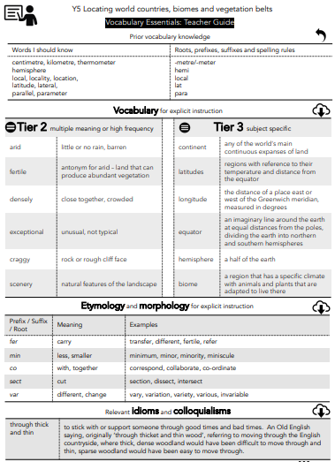
Vocabulary
EYFS
At Laureate, we want our children to have an expansive vocabulary and through teacher modelling and planning, children are given opportunity to use and apply appropriate vocabulary.
Years 1 – 6
Vocabulary instruction is at the heart of the curriculum
and subject specific words are incorporated in each module.
These are taught explicitly to the children and used throughout
the lessons.
Implementation
Vocabulary overview for a Year 5 Locating world countries and biomes module, including Tier 2 and 3 language as well as prefixes and suffixes.

Slide 27
Knowledge Organisers and Knowledge Notes
Accompanying each module is a Knowledge Organiser which contains key vocabulary, information and concepts which all pupils are expected to understand and retain.
Knowledge Notes are the elaboration and detail which help pupils acquire the content of each module. They support vocabulary and concept acquisition through a well-structured sequence that is cumulative. Each Knowledge Note begins with questions that link back to the cumulative quizzing, focussing on key content to be learnt and understood.
Knowledge Organisers and Knowledge Notes are dual coded to provide pupils with visual calls to aid understanding and recall. Knowledge Organisers and Knowledge Notes are referenced throughout each module.
Implementation

Slide 28
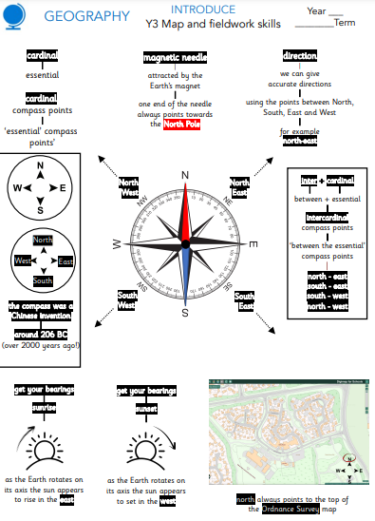
Knowledge Organisers and Knowledge Notes
Year 3 Knowledge Organiser
Implementation
Accompanying Year 3 Knowledge Note

Slide 29
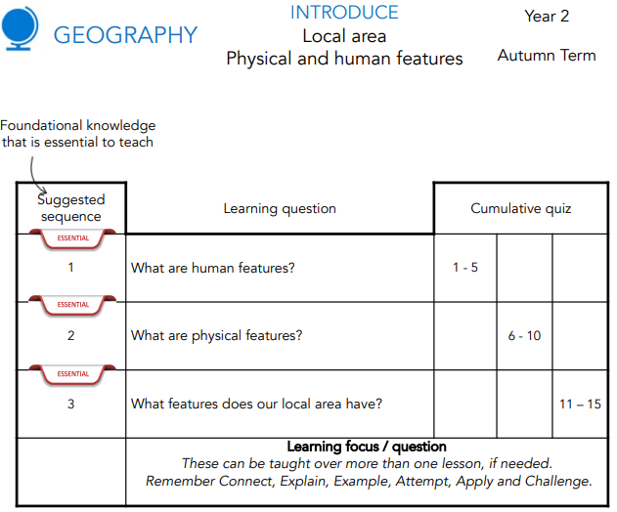
Planning
Lesson planning is completed with the use of the suggested lesson sequence, in conjunction with content from the Knowledge Organisers.
Implementation

Slide 30
Metacognition in Geography
Activate prior knowledge​
Recap learning from previous geography blocks – develop knowledge of places.​
Make links to prior areas of learning. For example, make explicit similarities and difference between UK and Kenya.​
Explicit strategy instruction​
What is the skill you are learning today. Understanding of places, drawing conclusions, using a range of sources, making comparisons and explain what strategy we can use to help us. ​
Modelling of learned strategy​
Demonstrate how you can apply this strategy using the content of this lessons learning or the previous lesson. Use thinking aloud to make explicit the train of thought that you are using and following. ​
Memorisation of learned strategy​
Through questioning and discussion, check that children have made links between the geographical knowledge learned and the skill being practiced that lesson. ​
Guided practice​
Work through the opening stages of approaching that task with the children. Stop to question for understanding. How can I compare these two countries? What is same / what is different ? Leave model on flip chart/smartboard as scaffold.​
Independent practice​
Children to complete their own attempt at modelled example. ​
Implementation

Slide 31
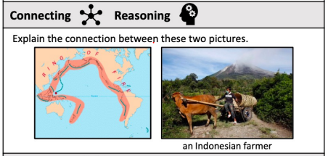
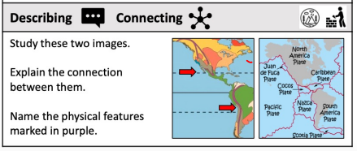
Worked example – Year 6 Volcanoes
Activate prior knowledge
The teacher discusses with pupils what tectonic plates are and how they can affect the surface of the Earth.
Explicit strategy instruction
The teacher then explains how today we are looking at particular focus between two locations and how they are linked. The teacher also explains how tectonic plates can cause volcanoes.
Modelling of learned strategy
The teacher uses the initial notes on the causes of the volcanoes to model how volcanoes can improve the quality of the surrounding land for farming.
Memorisation of learned strategy
The teacher tests if pupils have understood and memorised the key aspects of how tectonic plates cause volcanoes and the skill of how we make connections between two places through questioning and discussion.
Guided practice
Using a stem sentence teacher to model how volcanoes can improve the surrounding land.
Independent practice
Pupils complete their own sentences with an emphasis on making the connection and explaining their reasoning..
Structured reflection
Implementation

Slide 32
Tailoring for SEND
​
We plan for the first 20% and scaffold the lesson and tasks to meet their needs. Then we remove the scaffolding, as appropriate, to meet the needs of other pupils.
We aim to provide all children with the opportunity to confidently progress in their knowledge of places and physical features of our planet along with working with other children. We strive for all children to access the Geography curriculum equally, but this can vary in how it looks depending on individual's needs.​
​
CUSP Geography has a strong emphasis on the technical language, ( tier 2 and 3 vocabulary), that pupils need to articulate their understanding of the world. This is carefully and deliberately planned so that pupils revisit and embed this knowledge over time. This key vocabulary is pre-taught for pupils who may need this. Symbols and signs are used alongside the oral to help embed their understanding.
Implementation

Slide 33
Tailoring for SEND continued
Some pupils may require individual task boards to enable them to follow a series of steps where a task has been broken down into smaller, more manageable chunks and had larger written English components removed. The use of first hand experiences, e.g. going outside to observe physical features in the environment, will be beneficial for these pupils. Links will be made to CUSP reading books where available.
Some pupils may have a hearing impairment. Teachers should think carefully about how this impacts their ability to access the curriculum and their needs to be an emphasis on visual aids (pictures on knowledge strips and smartboards) and the pre-teaching of vocabulary. There may be additional changes based on the needs of the pupil.
Some pupils may have a visual impairment. This may impact their ability to read and follow tasks. Teachers can ensure a use of oral input and modelling, with a focus on tier 2 and 3 vocabulary. Scribing and oral dictation can be used as a way of recording working to access lessons.
For some pupils who have specific challenges around processing, some of the lessons may require adaptation to ensure that all pupils can participate fully in the lesson. This may mean reducing the number of instructions or steps in a task, reducing the information on knowledge notes, increased oral rehearsal, removing long written components, highlighting key vocabulary and thinking of alternative ways of recording.
Implementation

Slide 34
Reading
All Geography modules are underpinned by high quality texts which support wider curriculum reading. Unity Schools Partnership are working closely with Curriculum Visions to ensure our subject content has supporting materials which can be accessed by pupils in school and at home.
Implementation

Slide 35
Oracy
Oracy is embedded across the curriculum. When discussing their learning, children are encouraged to speak using full sentences and incorporating key vocabulary. Opportunities to discuss their learning helps children to understand geographical concepts and to deepen their knowledge.
Writing
At Laureate, children are expected to write across all areas of the curriculum with teachers modelling how to write purposefully in each subject.
Implementation

Slide 36
Continuous Professional Development
All staff have undergone CPD in Cognitive Load Theory, Spaced Practice Retrieval Theory and planning the wider curriculum through the use of Knowledge Notes. This has supported the development of the wider curriculum.
In addition to this, staff have accessed planning sessions with Alex Bedford (author of CUSP) to support them in effectively planning sequences of work using the materials provided within the modules.
Implementation

Slide 37
Geography
Impact​
Impact

Slide 38
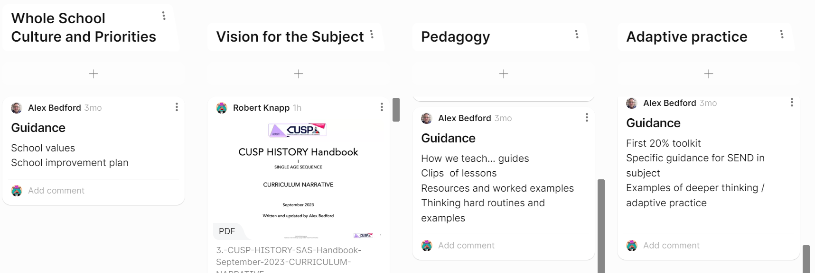
How do we measure the impact of Geography teaching?
Subject Leaders use Padlet as a self-assessment and planning tool for developing their subject, as seen in this example:
We also use the CUSP spider diagram matrix to record strengths and areas of development for our subjects
Impact

Slide 39
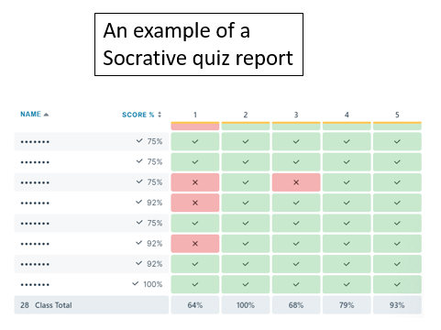
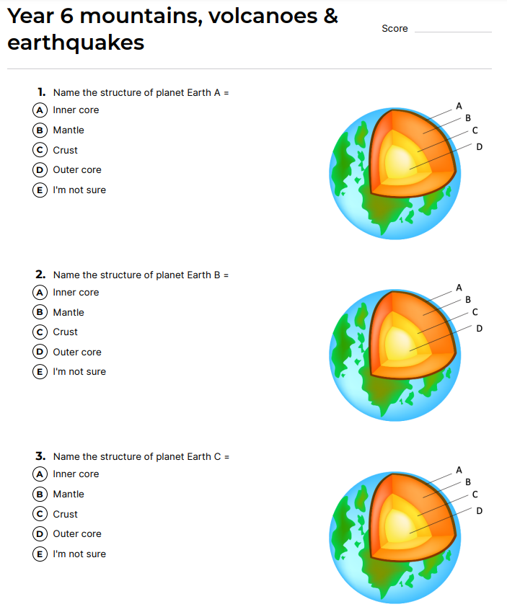
Cumulative quizzing
Teachers use the results of the cumulative quizzing to check prior knowledge, tailor lessons accordingly and use flexible teaching time to revisit areas as necessary.
Impact

Slide 40
Pupil book study
The Subject Leaders conduct book looks to review pupil progress. The Trust Primary Director also works with subject leaders to review work in books and conduct pupil dialogues. The information gained by doing this is then utilised to identify and refine additional CPD.
Impact

Slide 41
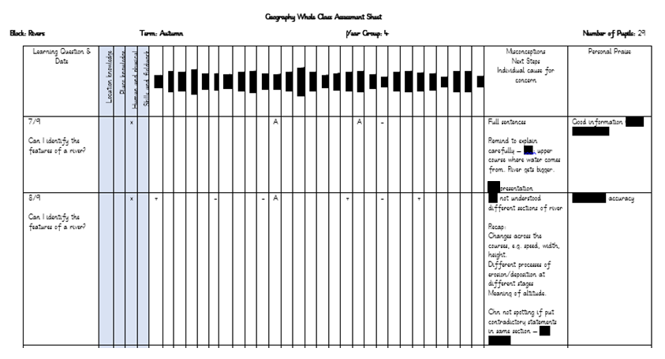
Teacher assessment
Teachers assess throughout each session using the Whole Class Assessment Sheets below to monitor pupils and inform planning for subsequent sessions. Pupils working below expected will be supported in future lessons whilst pupils working at above expected standard will be identified and challenged appropriately to extend their learning. Evidence of this support or challenge and necessary feedback will be clear in books. Most feedback is verbal and live during the session in accordance with our Feedback Policy. Subject leaders will analyse end of unit WCAS to identify trends and areas where support may be needed.
Impact

