Slide 1
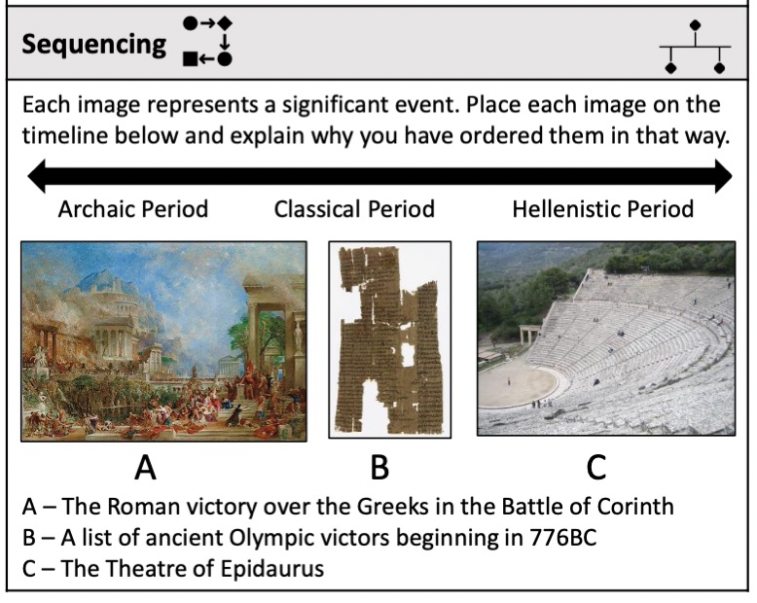
Lesson One

Slide 2
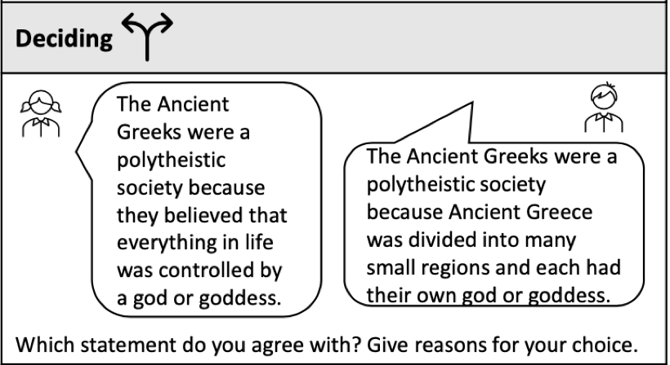
Lesson Two

Slide 3
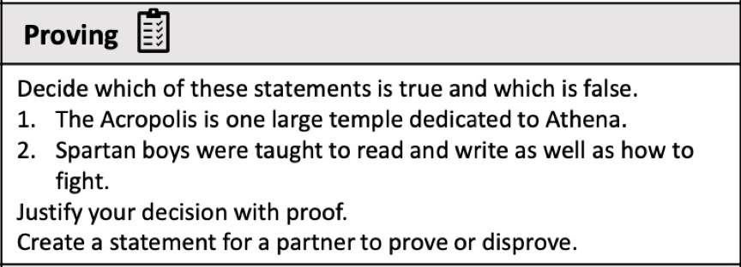
Lesson Three

Slide 4
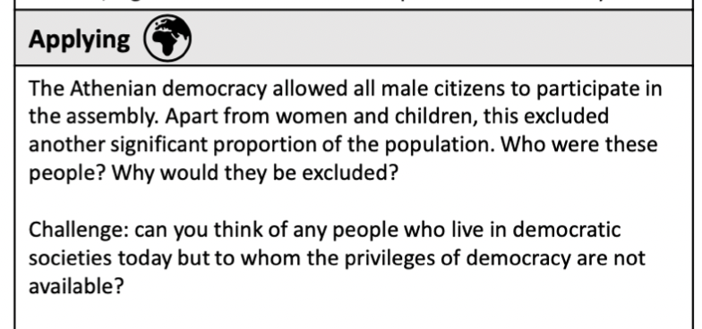
Lesson Four

Slide 5
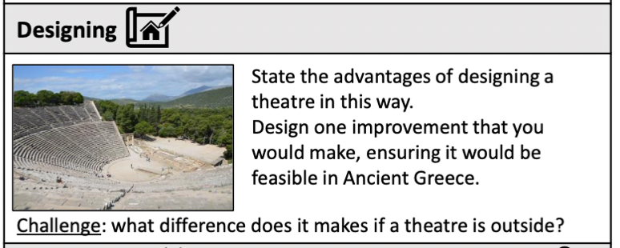
Lesson Five

Slide 6
Lesson Six

Slide 7
Lesson Seven

Slide 8
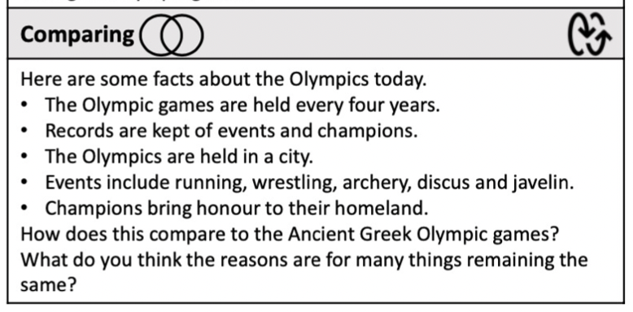
Lesson Eight

Slide 9
Lesson Nine

