Slide 1
Annual General Meeting – 20th June 2024

Slide 2
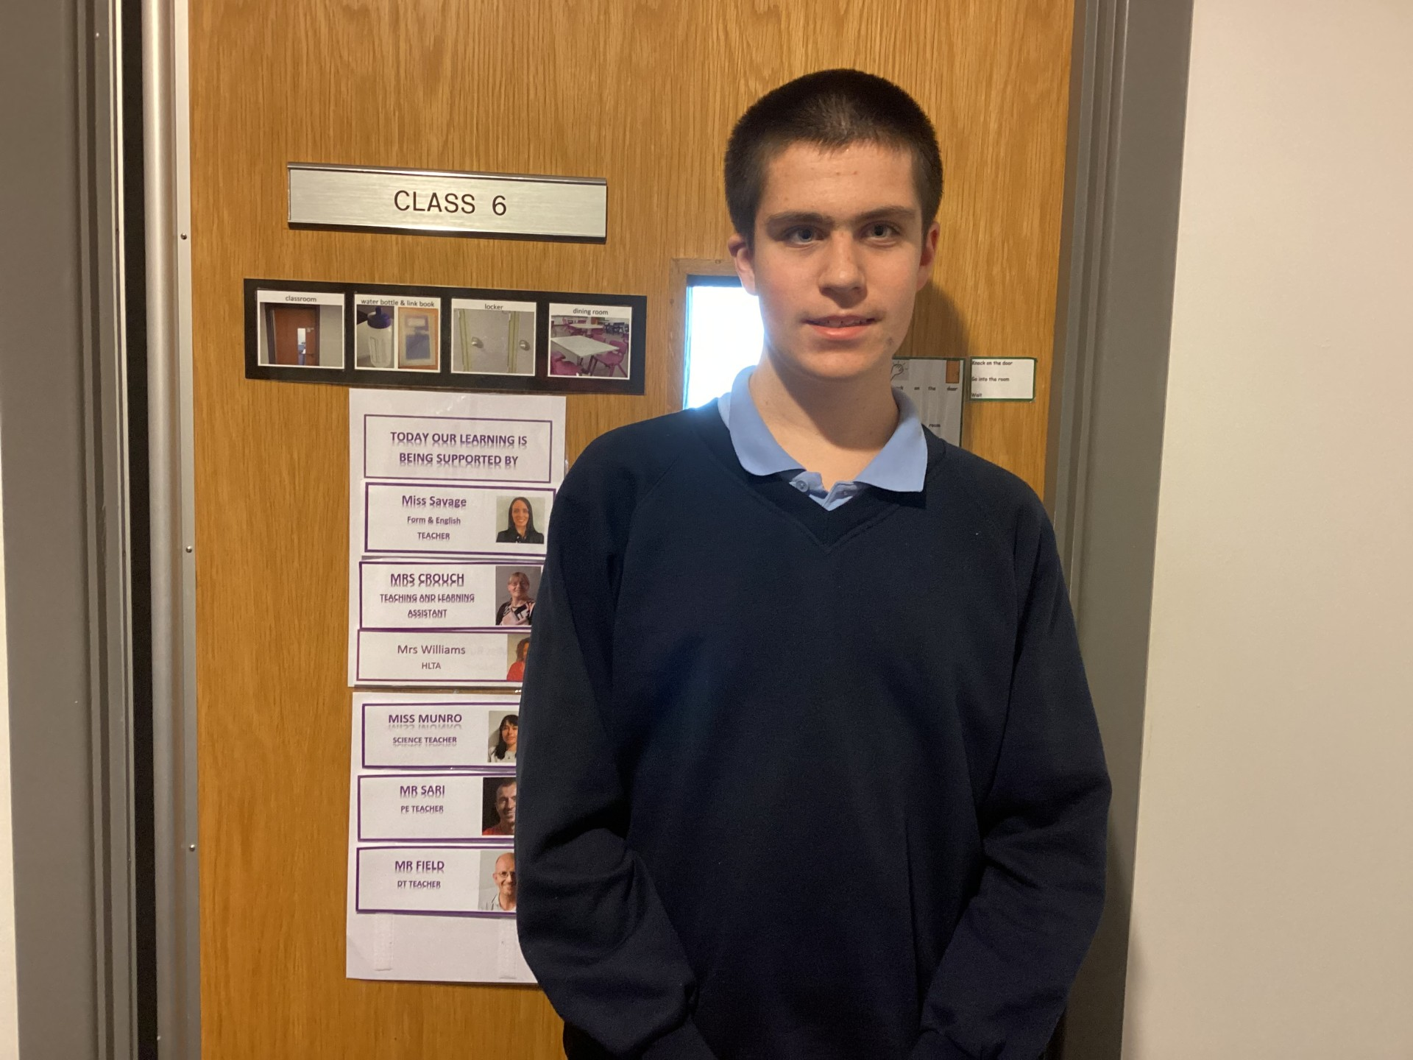
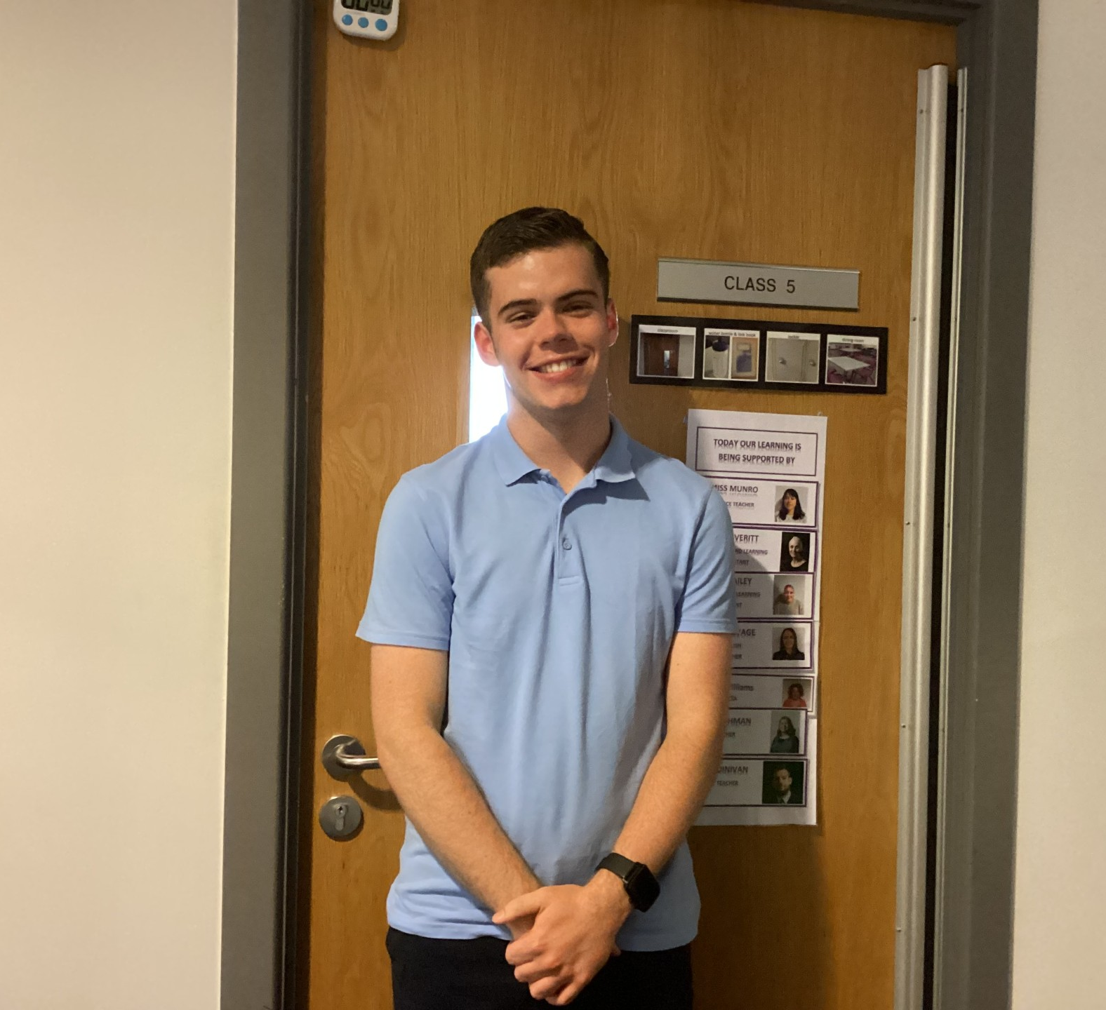
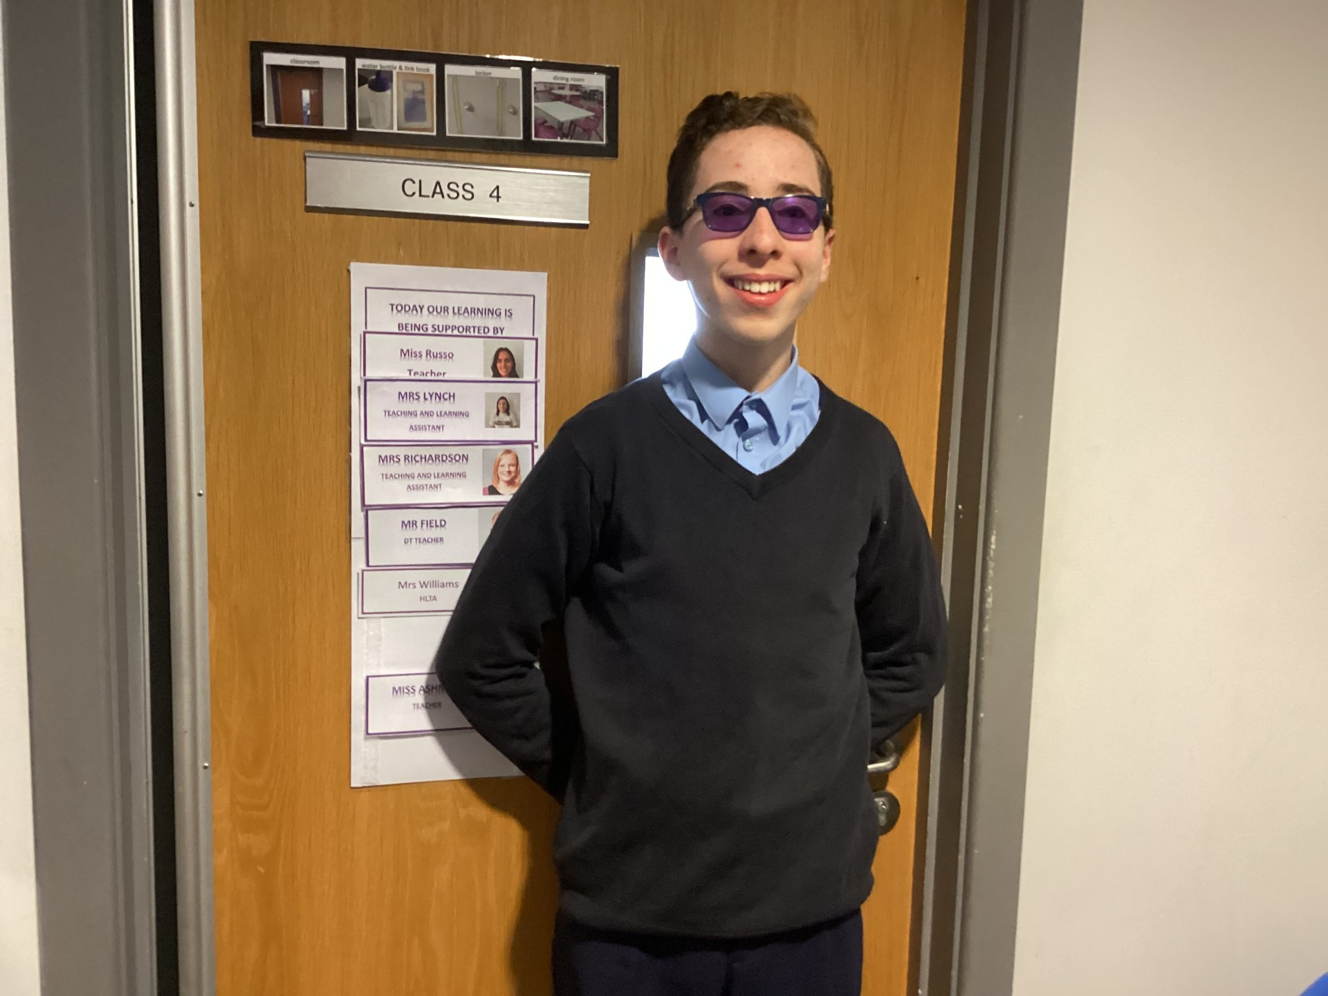
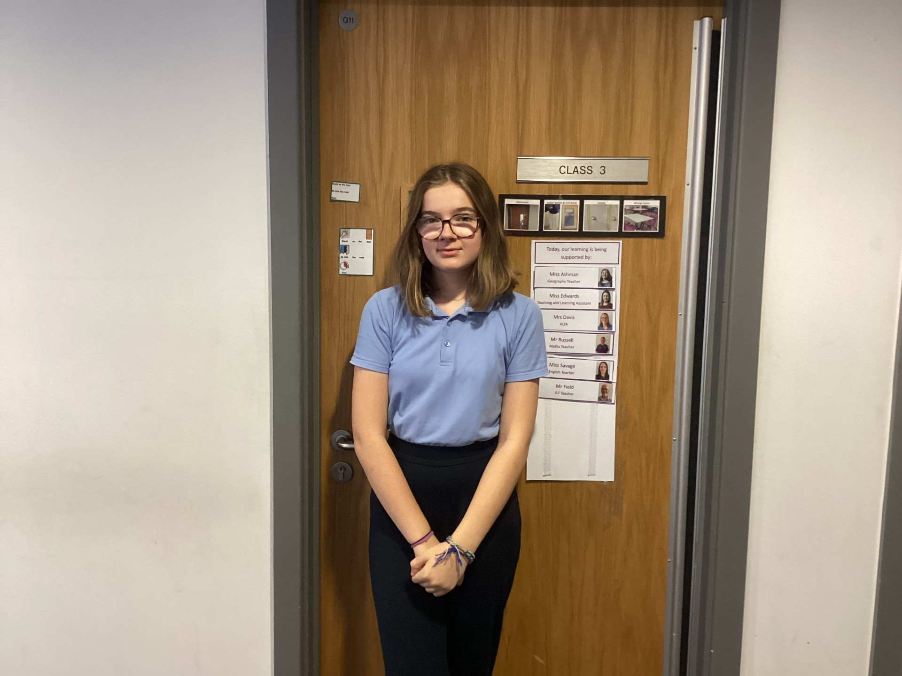
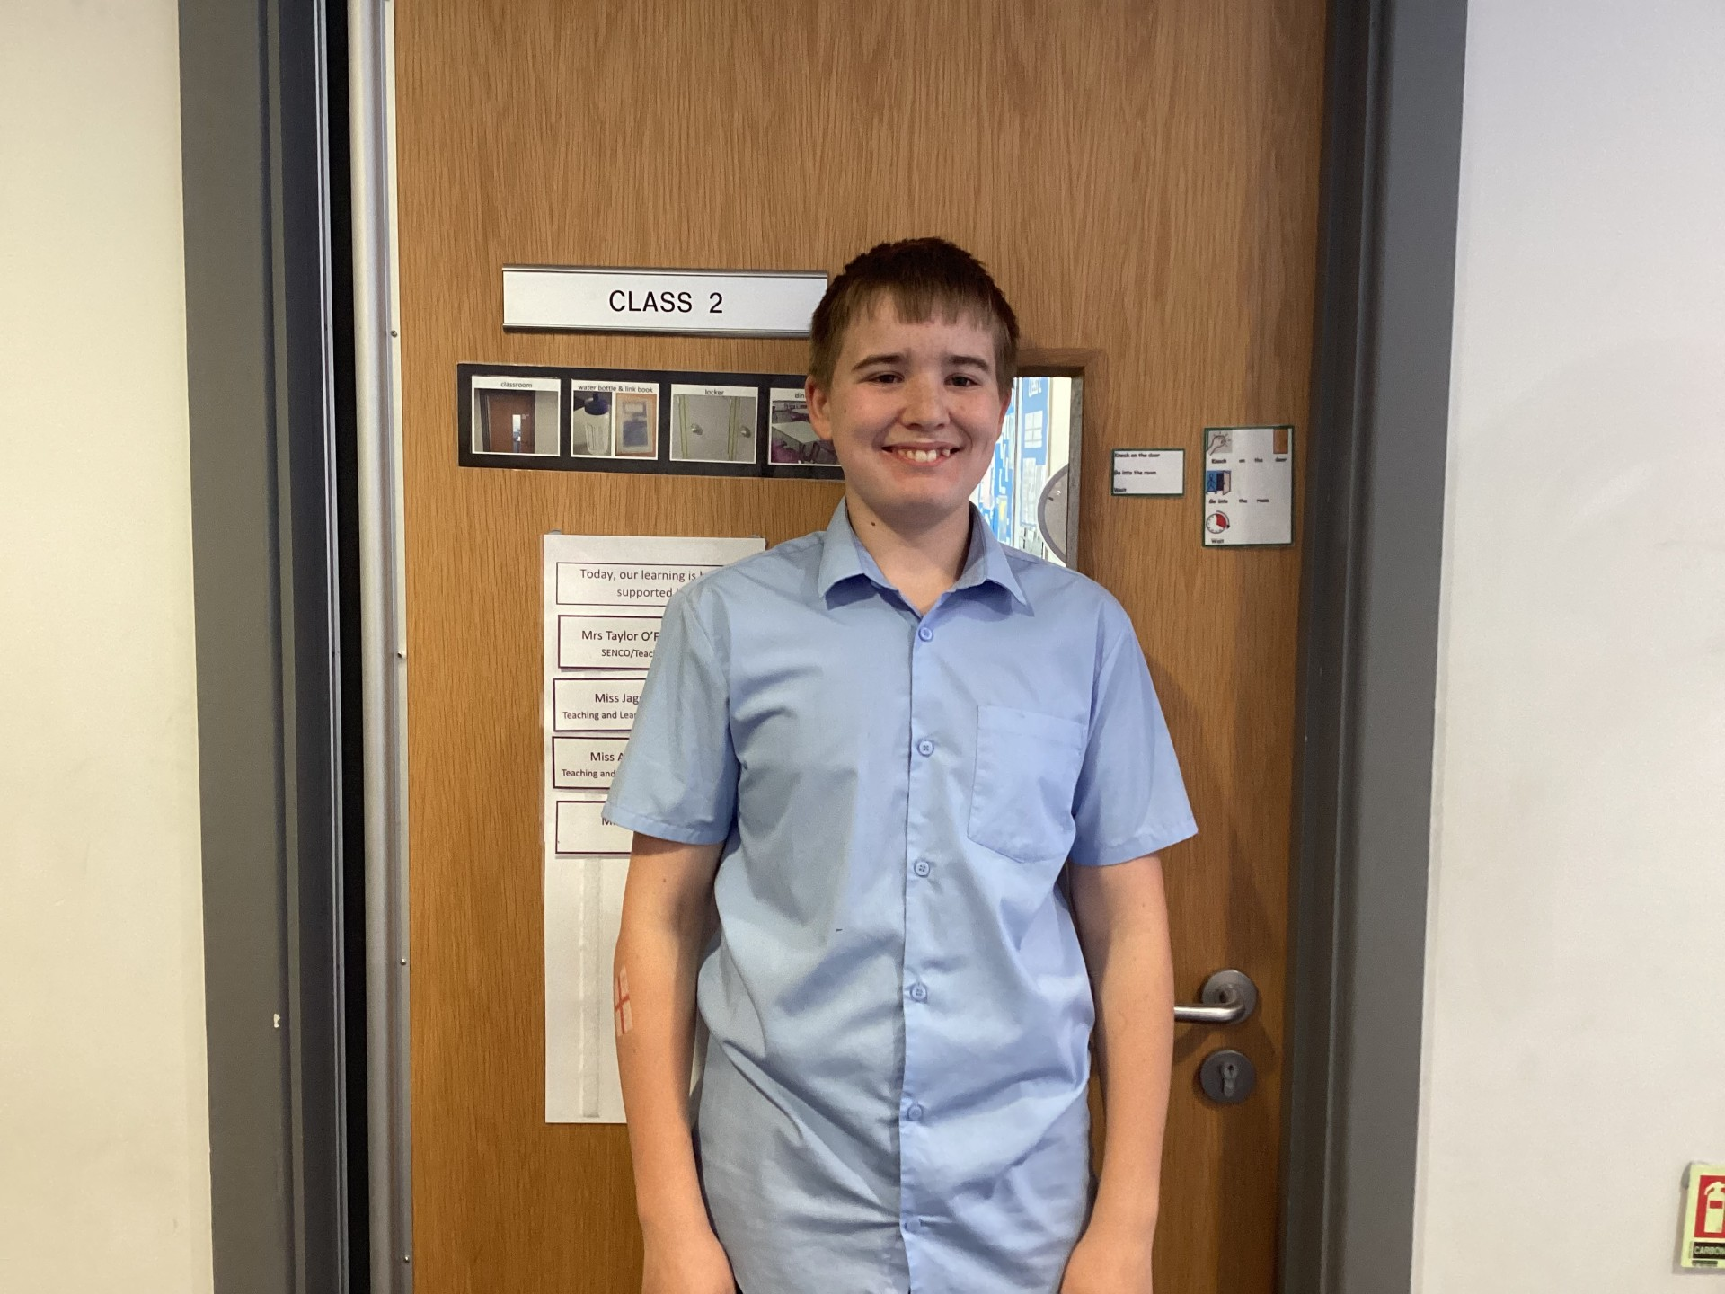
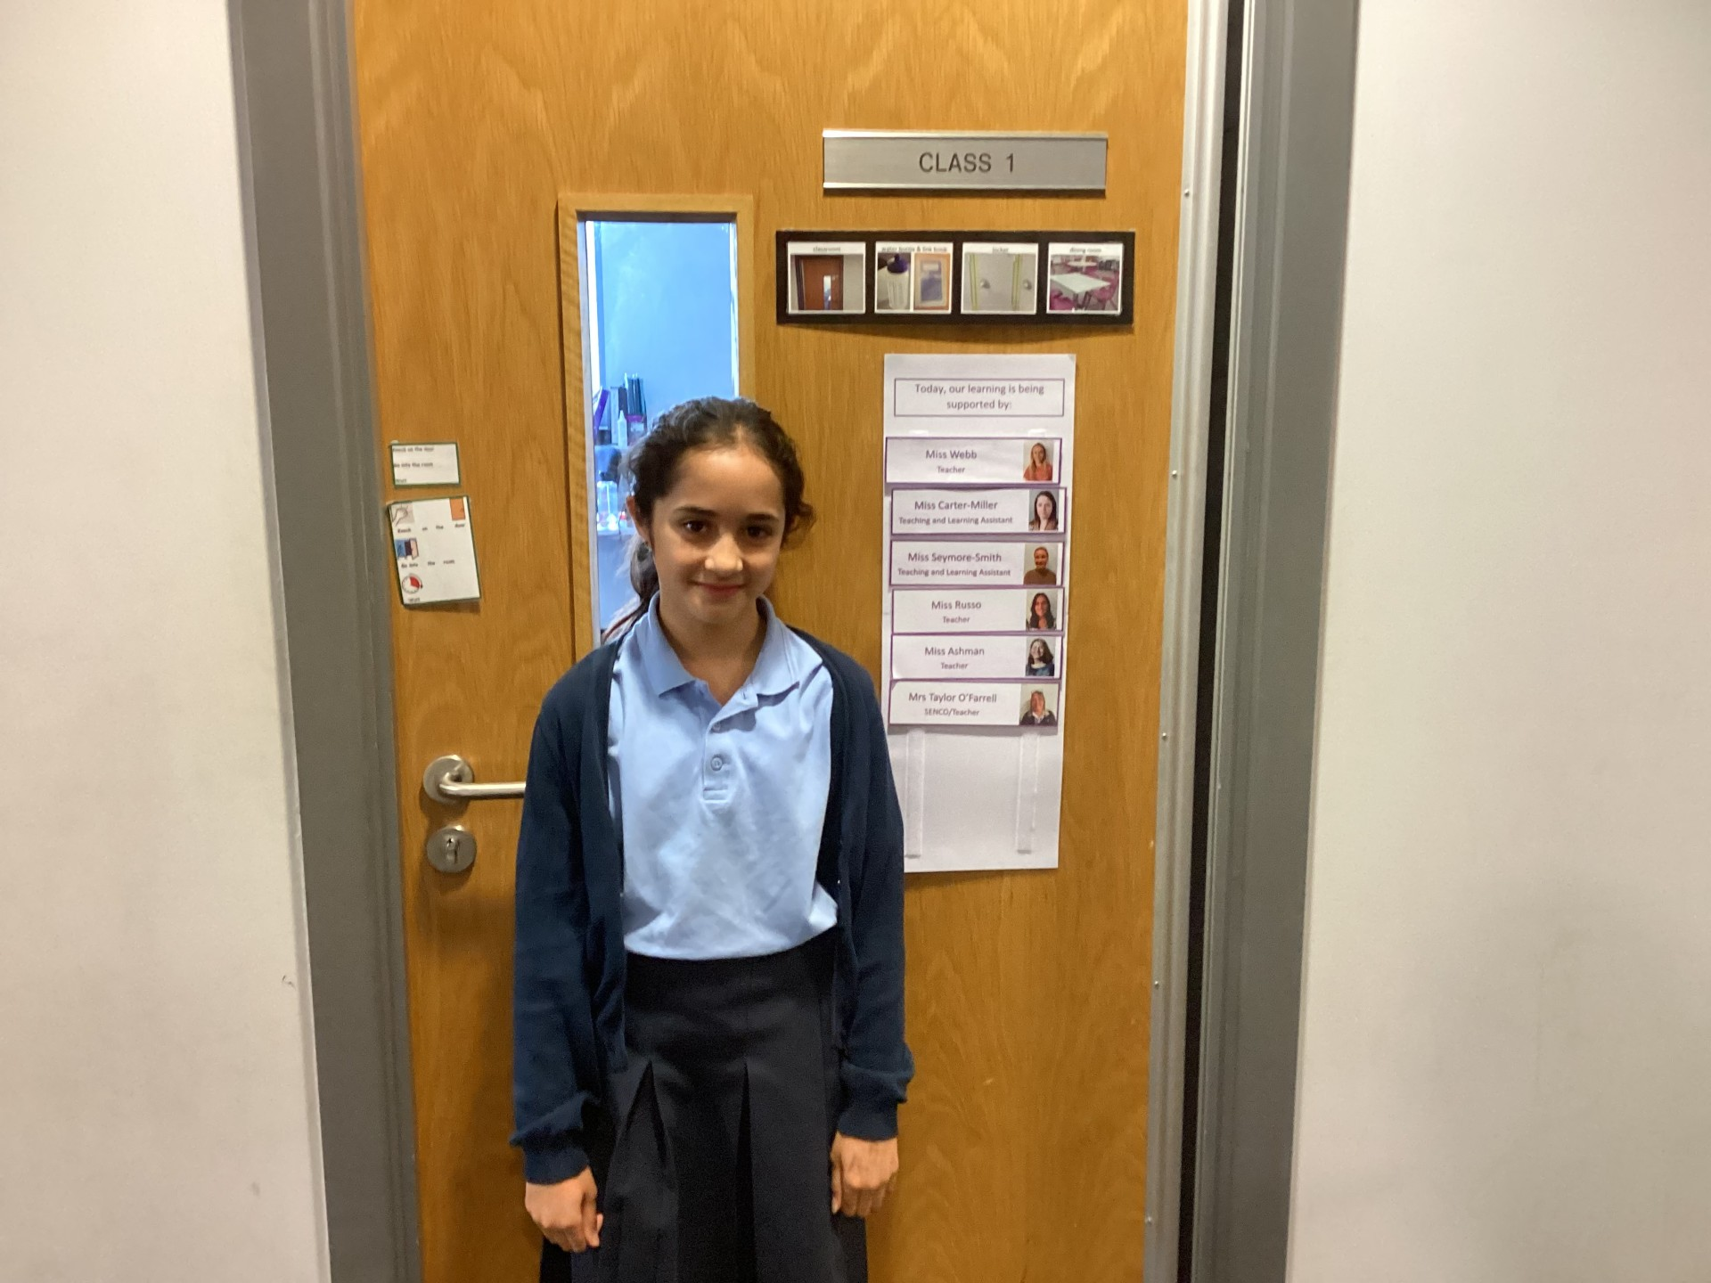
How were we elected?

Slide 3
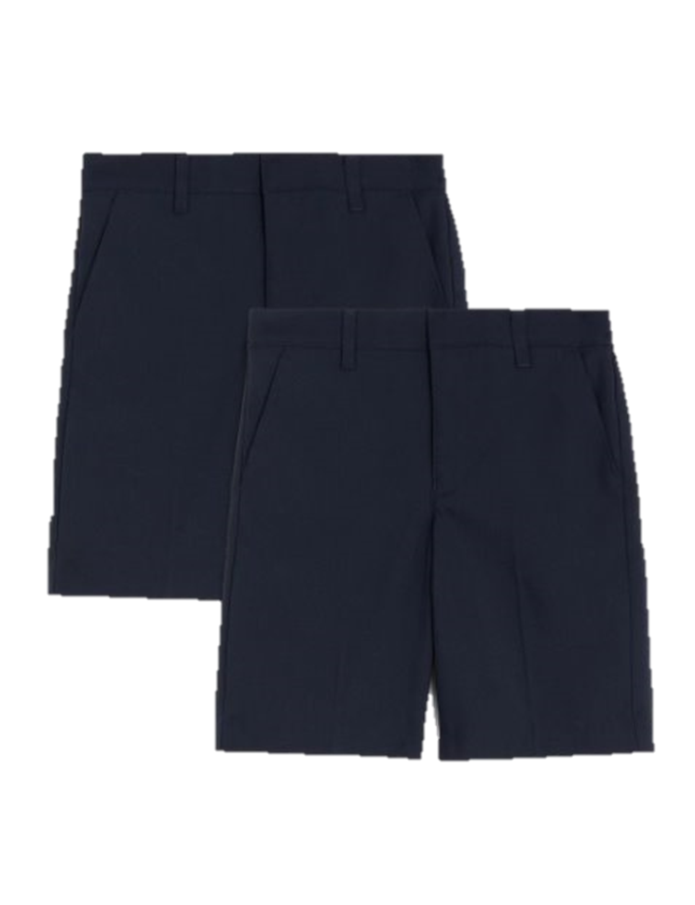
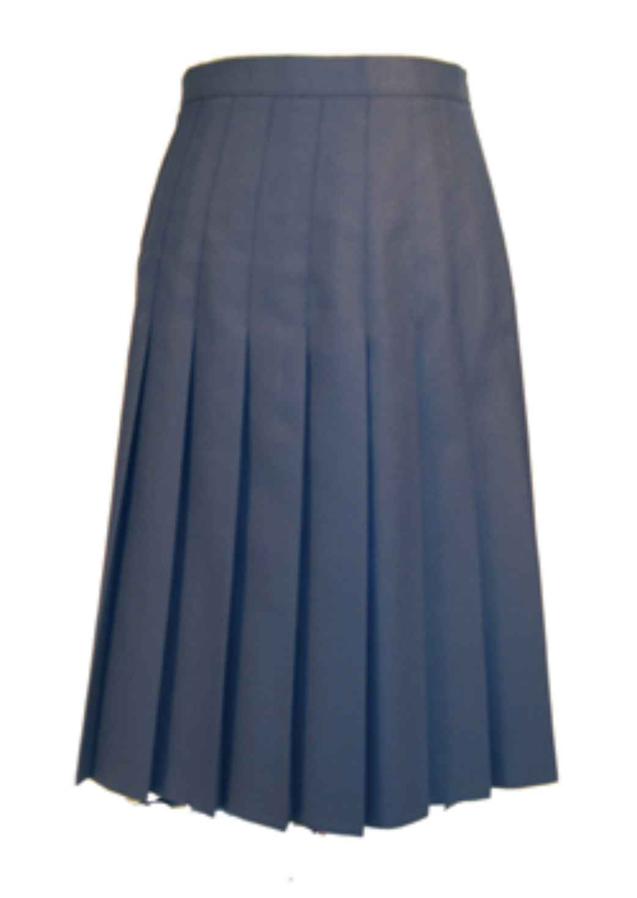
How has the Churchill parliament changed the school uniform?

Slide 4
How has the Churchill parliament changed the Lunchtime Rota?
Monday: Football
Tuesday: Basketball
Wednesday: Hockey
Thursday: Roundnet
Friday: Netball

Slide 5
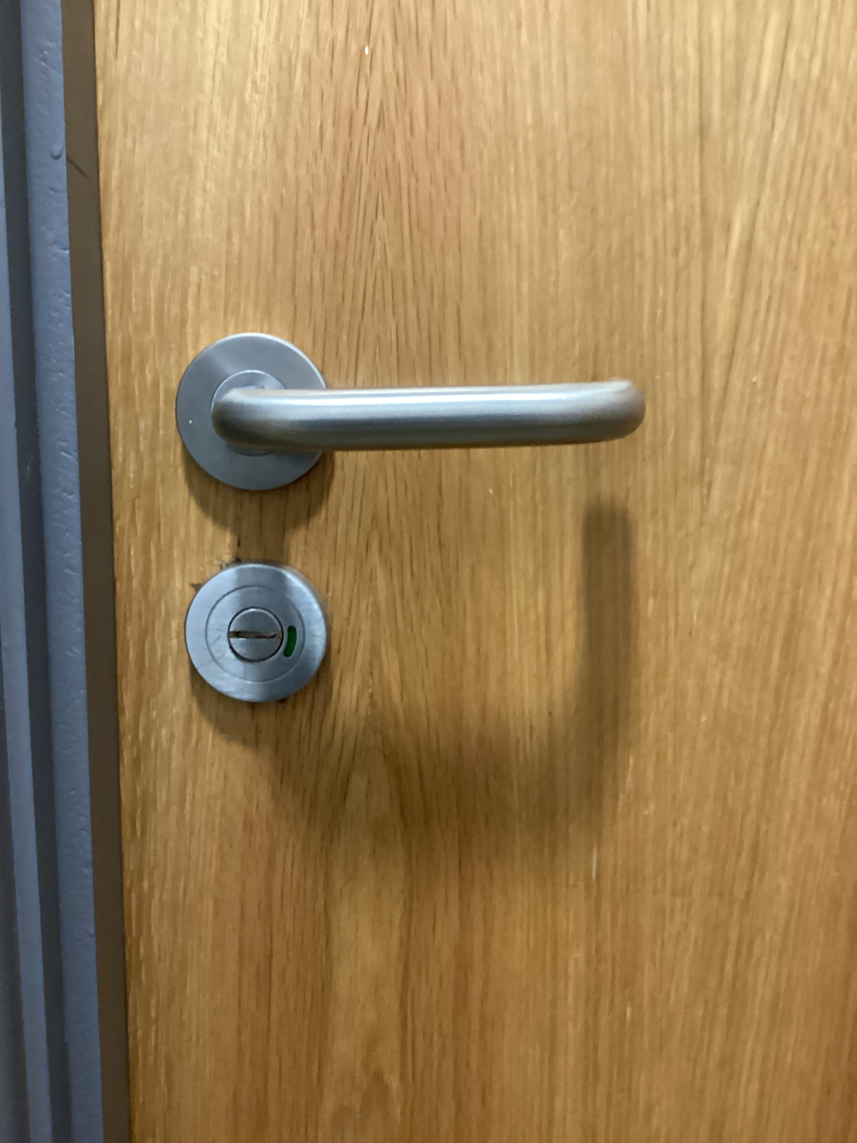
How has the Churchill parliament changed the school environment?

Slide 6
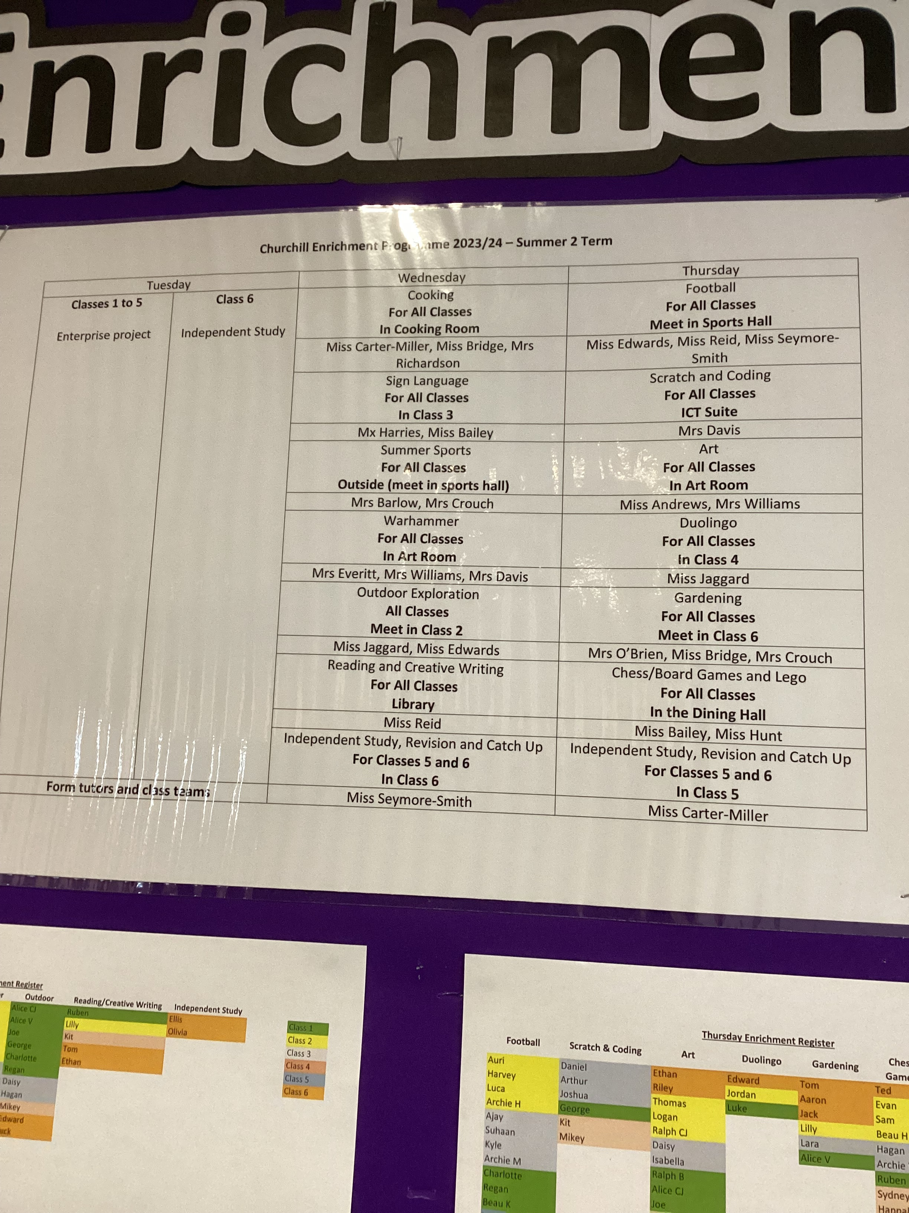
How has the Churchill parliament changed the enrichment opportunities?
Wednesday:
Cooking
Sign Language
Summer Sports
Warhammer
Outdoor Exploration
Reading and Creative Writing
Independent Study
Thursday:
Football
Scratch and Coding
Art
Duolingo
Gardening
Chess/Board Games and Lego
Independent Study

Slide 7
How do we represent the school values?
Responsibility – JH - It has taught us to be responsible by taking points and views from the members of our class and sharing them in parliament meetings.
Respect – HS - Parliament has taught us to listen and respect people's views even if you don't necessarily agree with them.
Resilience – IP – Parliament has taught us to be resilient and not to be afraid to be bold and put ourselves out there.
Courage – CD - Parliament has taught us not to give up when putting our points of views across.
Compassion – SK - Churchill Parliament has given us a sense of compassion for our fellow pupils and staff while also bringing the school together as a community.

