Slide 1
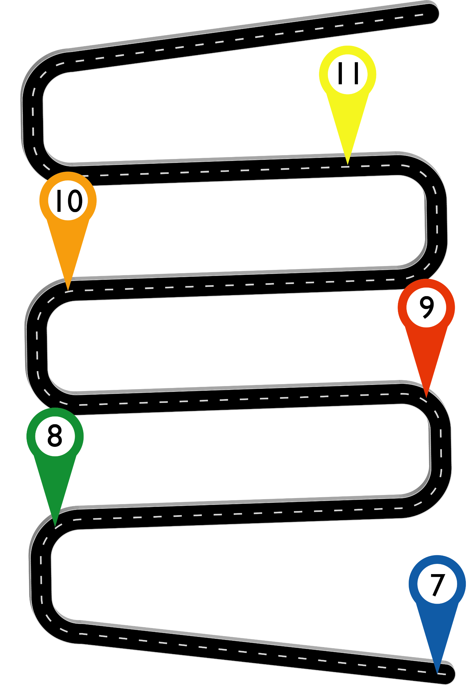

Slide 2
Mathematics Curriculum Journey
Class 6
Key Stage 4
GCSE Examinations
Trigonometry
Quadratic Equations
Statistics
Post Mock intervention
Pythagoras
Circles
Linear Equations
Simultaneous Equations
Review and extend material
Linear Algebra
Key Stage 4
Quadratic Equations
Trigonometry
Linear Algebra
Circles
Number and accuracy
Mutually Exclusive
Gradients
Proportion
Class 5
Measures & units
Functions
Vectors
Relative Frequency
Sequences
Unitary Method
Class 4
Key Stage 4
Scatter Graphs
Scale, Area and Volume Factors
Ratio & Percentages
Pythagoras
Central Tendency
Using Graphs
Standard Form
Geometric Sequences
Expressions/Formulae
Sample Spaces
Linear Equations
Modelling
Trigonometry
Special values
Compound Units
Straight Line Graphs
Angles & Polygons
Key Stage 3
Circles
Dividing into ratio
Linear Equations
Accuracy with shape
averages
Sequences
Linear equations on both sides
Class 3
Fraction Review
Transformations
Constructions
Expressions
Multiples, factors, primes
Constructions
Percentages
Sets and Unions
Class 2
Key Stage 3
Parallel angles
Lines & Angles
Powers, Roots and Rounding
Measurements
Order of Operations
Linear Equations
Ratio
Congruence & scale drawing
Place value
Decimals and negatives
Algebra
Probability
Formulae, Sequences and Roots
Interpreting Data
Shapes and Solids
Graphs of Linear Functions
Algebra
Key Stage 2
Dimensions & Scale
Accuracy & Proportion
Long Multiplication
FDP
Converting Time
Large & Negative Numbers
Angles
Shapes
Class 1
Formula and Sequences
Measures & Time
Pie Charts & Mean
Conversions
Perimeter,
Area & volume
Types of Numbers
Using Decimals & Rounding
Place Value

