Slide 1
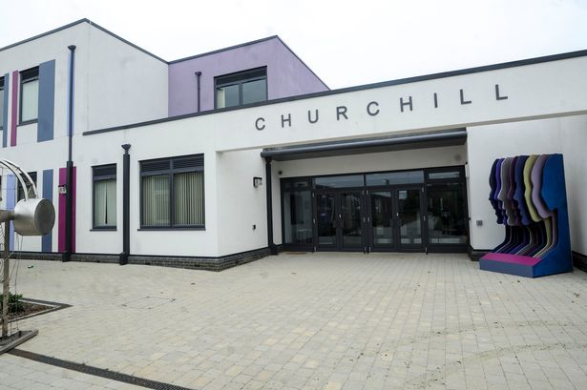
Transition Booklet
My school is called Churchill School and it is in Haverhill.

Slide 2
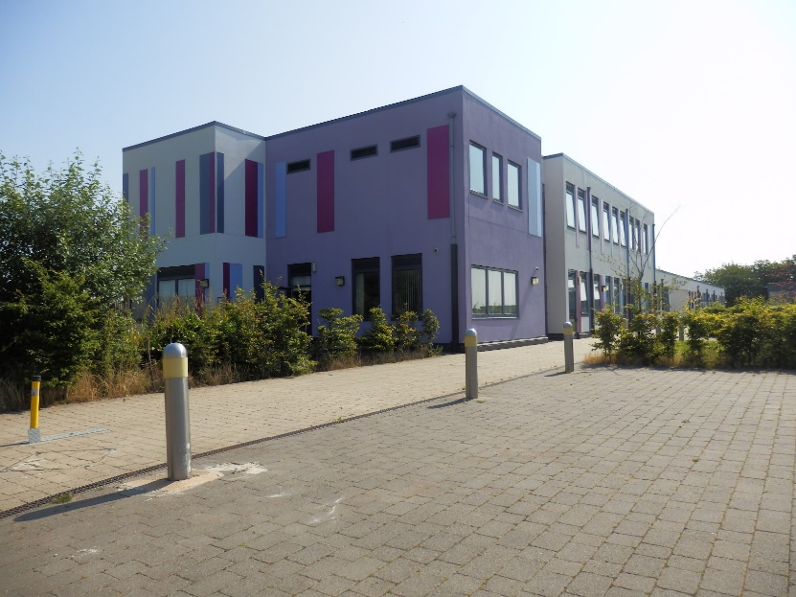
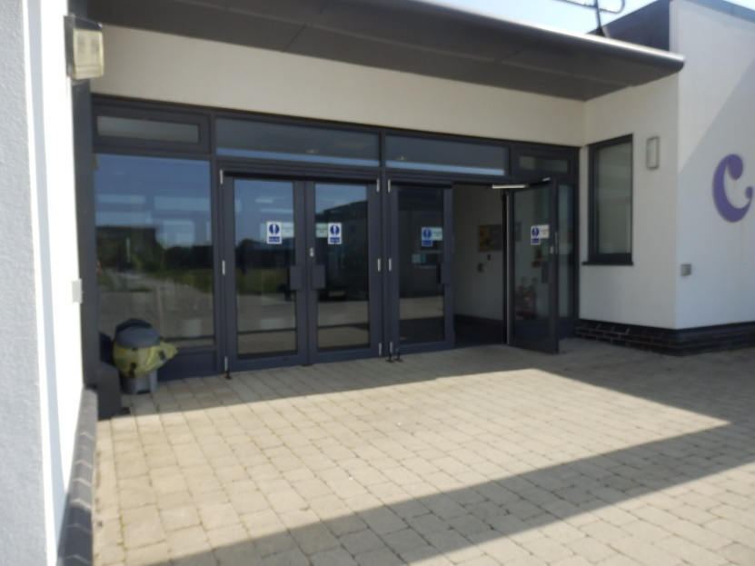
I might arrive at Churchill by taxi, by car or by walking.
This is how my school will look when I come into the car park.
This is the front entrance to my school.
This door will be open in the morning when I arrive and I can walk inside.

Slide 3
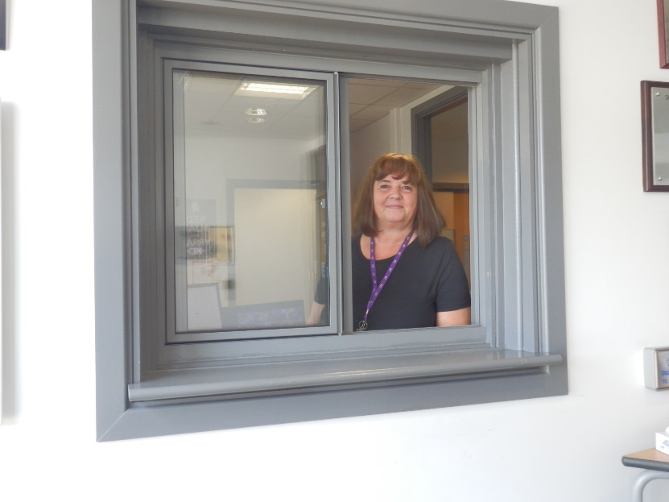
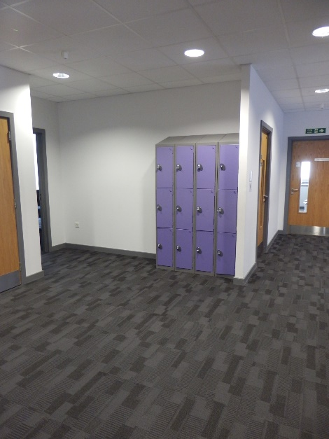
This is Mrs Naxton.
Mrs Naxton works in the school office and will open the door for me to come inside my school.
These are the lockers for my class. I will have my own locker.
An adult will be happy to show me where my locker is and I can put my school bag away here every morning.

Slide 4
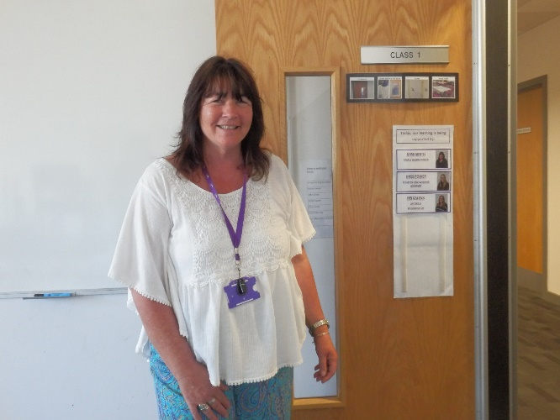
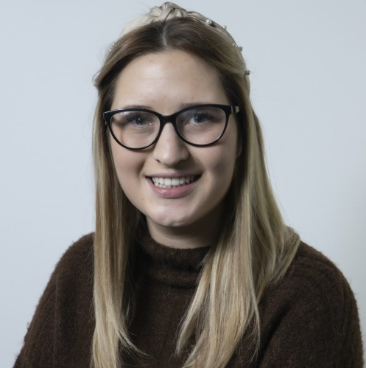
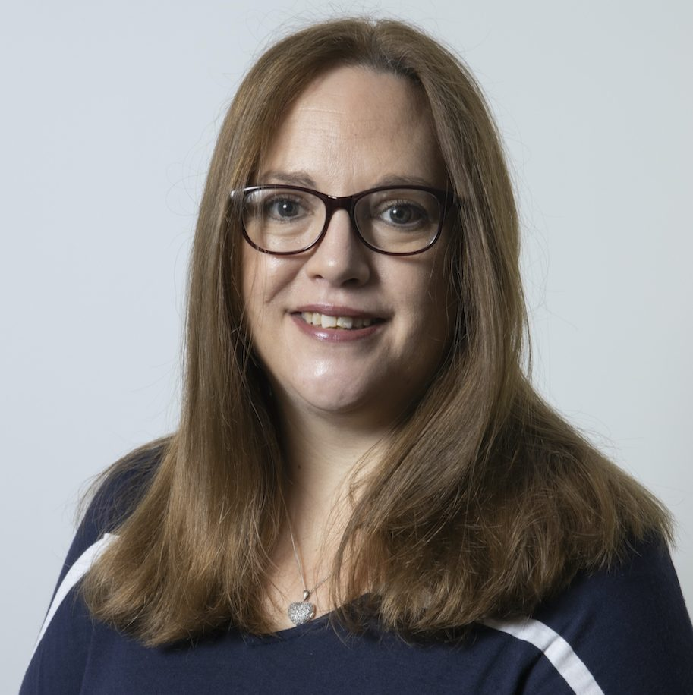
This is Miss Smith.
Miss Smith will be my teacher and is excited to welcome me to Class 1.
This is Miss Power.
Miss Power will support me in class and is excited to welcome me to Class 1.
This is Mrs Calver.
Mrs Calver will come to my classroom and support me to learn about Life Skills.

Slide 5
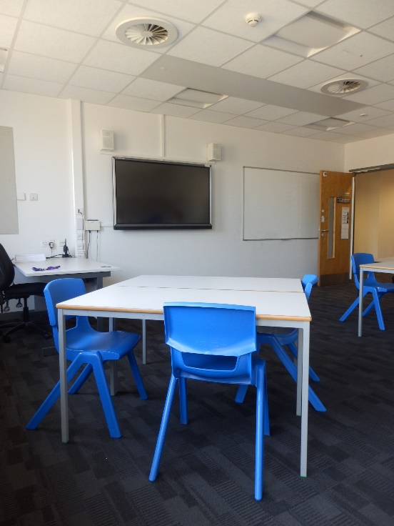
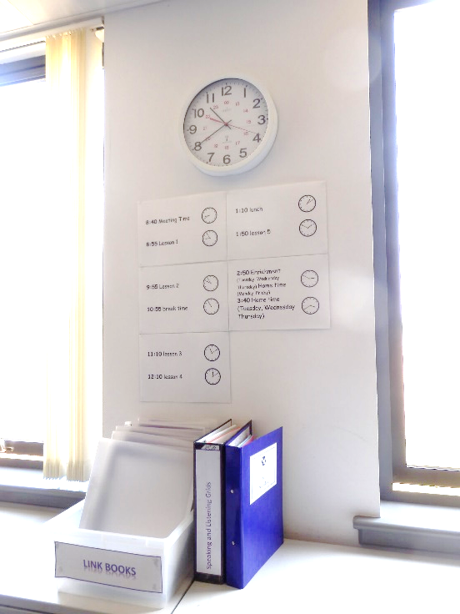
This is Class 1.
I will do most of my lessons in my classroom.
There are posters on the wall to tell me about my day.
There is a box for me to put my link book in.

Slide 6
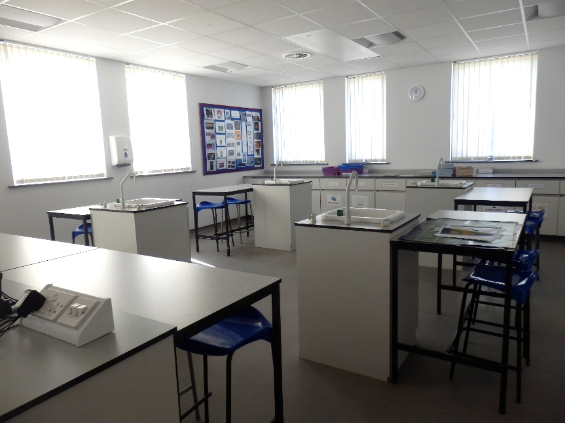
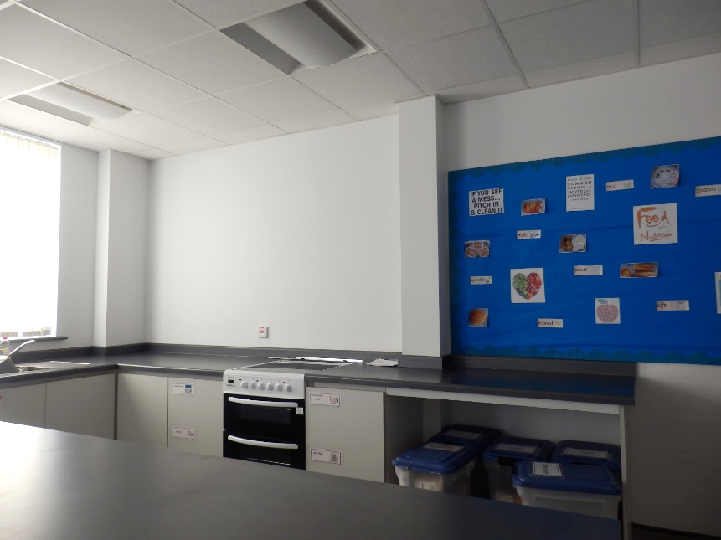
This is the Science Lab.
Sometimes the Science teacher will take my class into the Science Lab for Science lessons.
This is the Food Tech room.
Sometimes I will have cooking lessons in the Food Tech room.

Slide 7
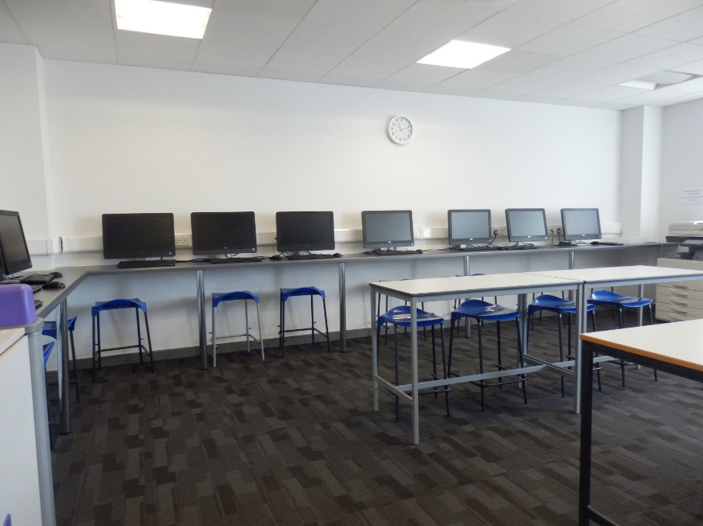
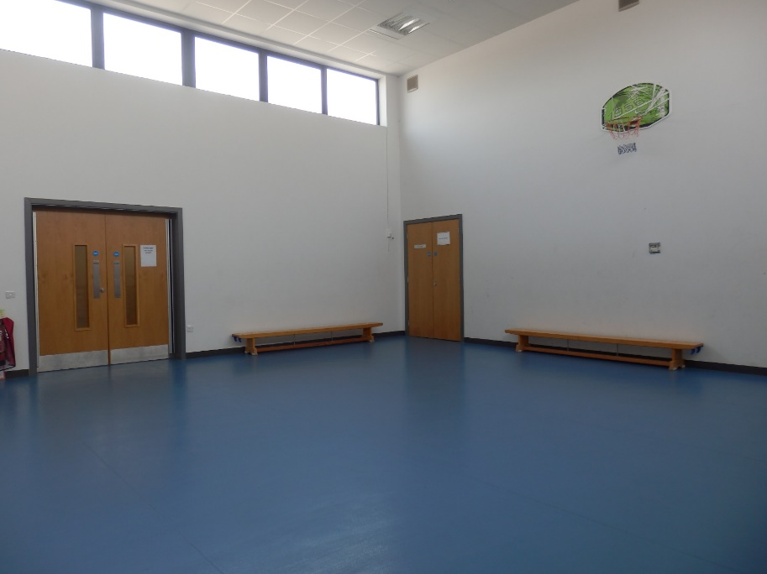
This is the ICT suite.
Some of my lessons will be in this room to use the computers.
This is the Sports Hall.
Some of my PE lessons will be in the Sports Hall.

Slide 8
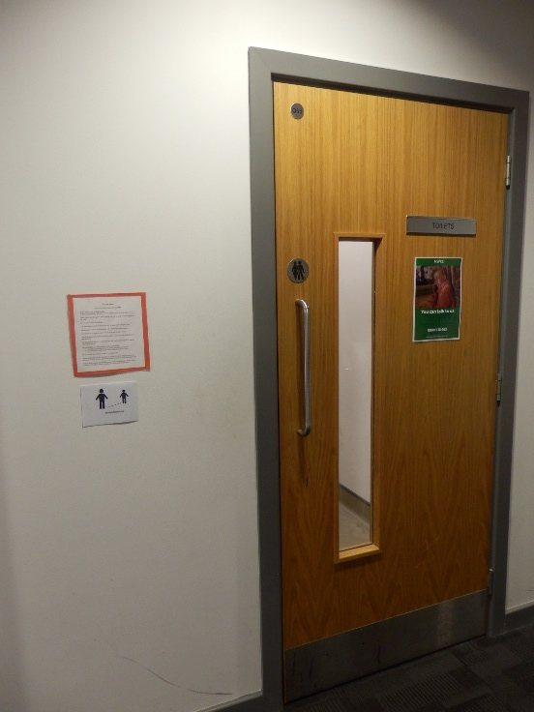
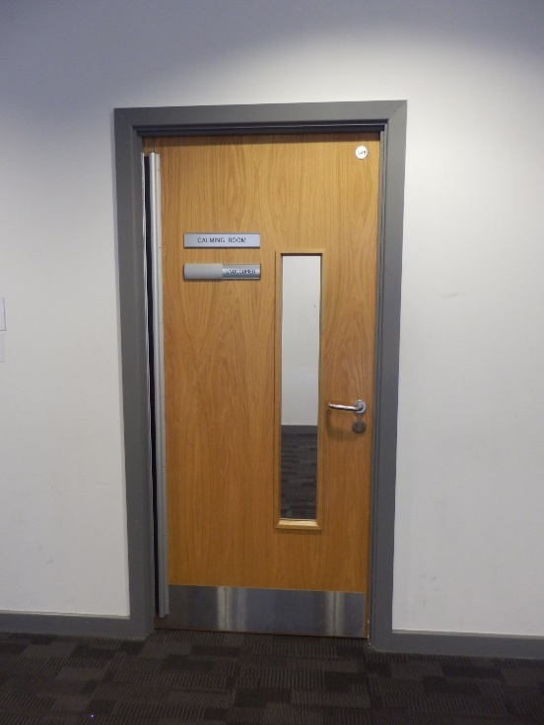
There are toilets right next door to my classroom to use when I need them.
This is a calming room.
If I need a quiet space to go, I will let an adult know I need to use a calming room.

Slide 9
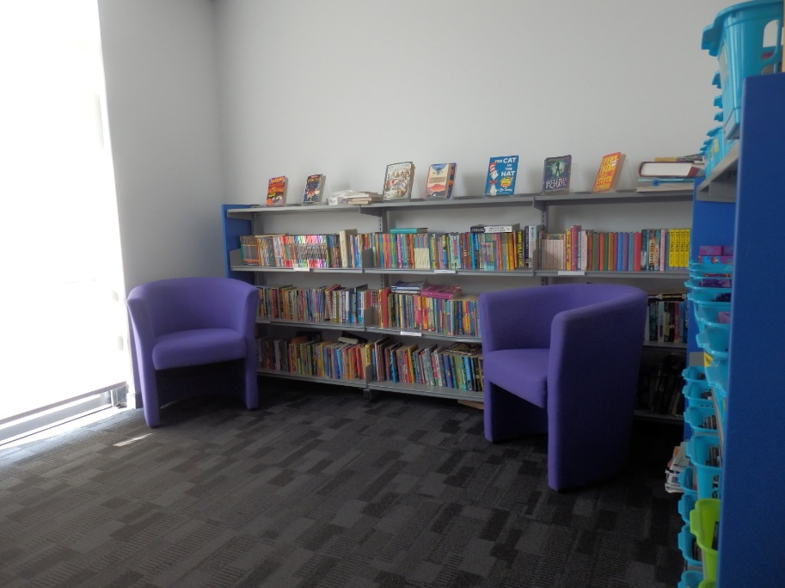
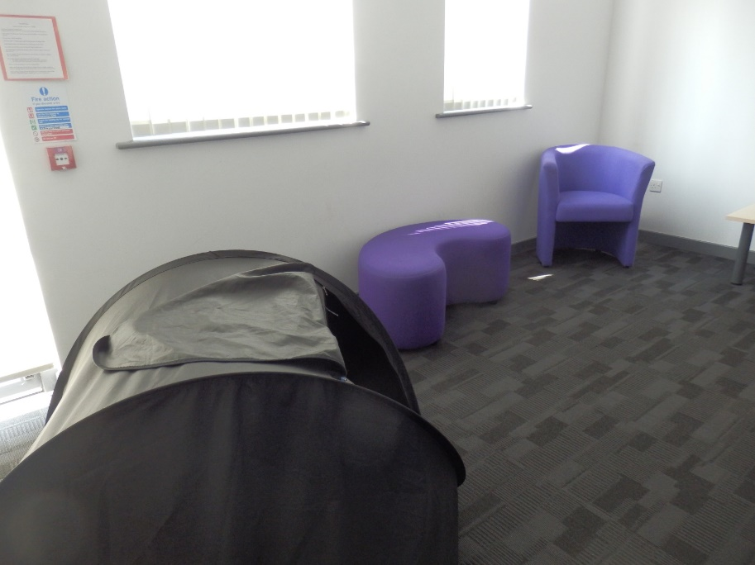
This is the Library.
This is the Cosy Room.
If I need a quiet space to talk to an adult, we might go to the cosy room.

Slide 10
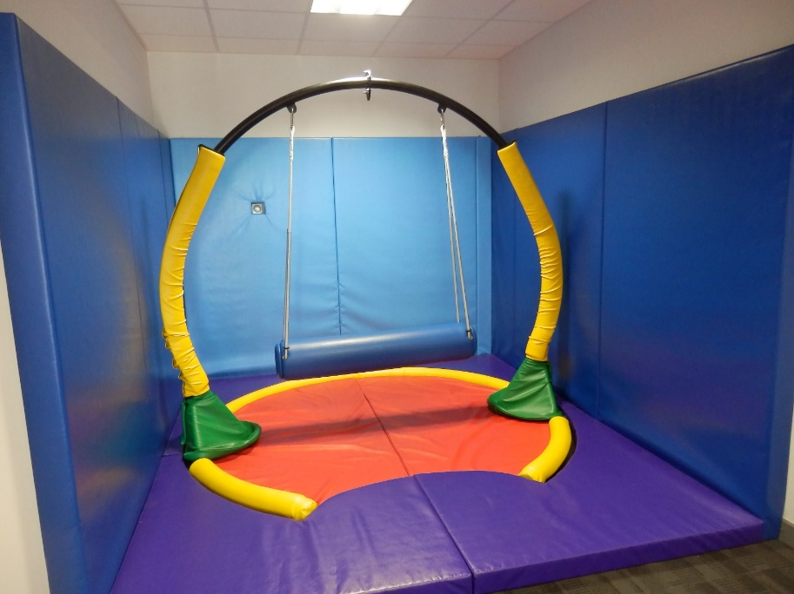
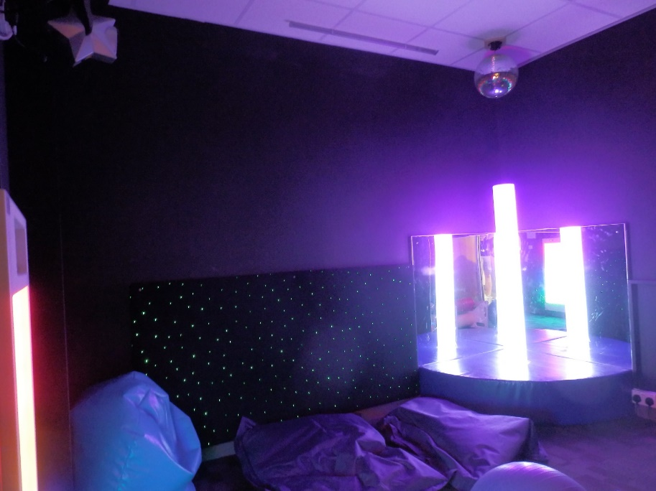
This is the Swing Room.
This is the Sensory Room.

Slide 11
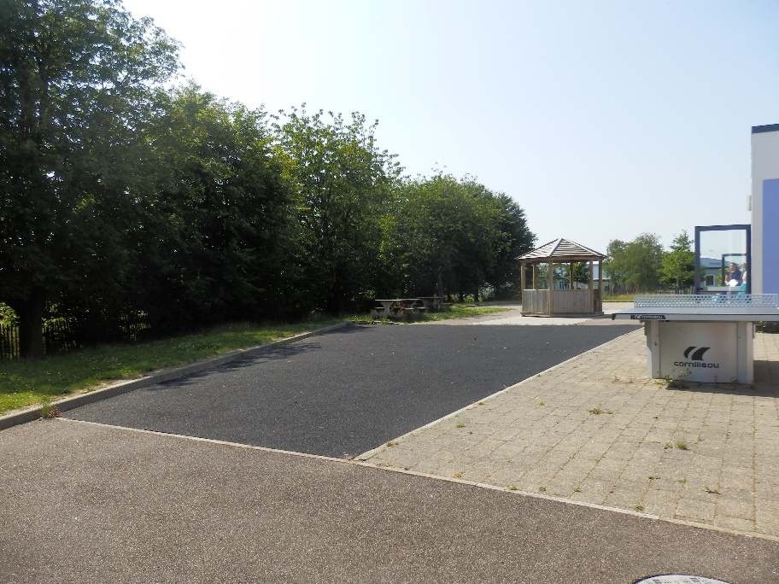
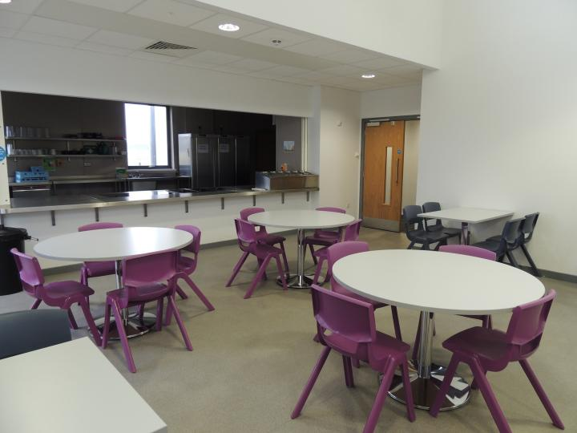
This is the playground.
This is the dining room.
I might order a school lunch or I might bring a packed lunch from home. I can choose to eat my lunch in the dining hall or the sports hall.

Slide 12
My school is called Churchill School.
The adults in school are looking forward to welcoming me.

