Slide 1
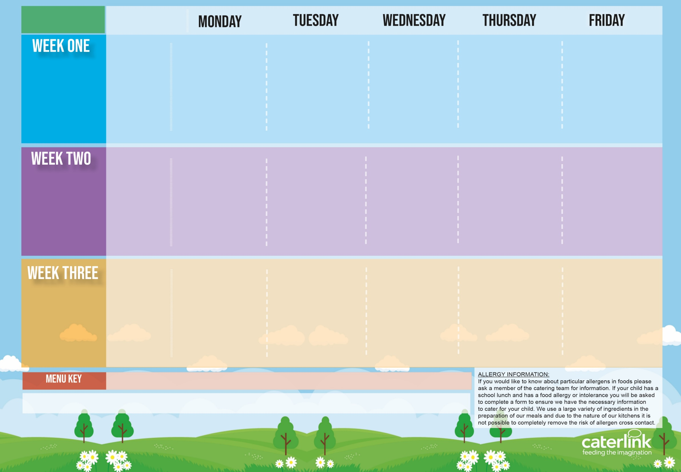
Autumn Winter
2025 2026
Option A
Option B
Vegetables
Dessert
Plant Balls in Tomato Sauce with Rice | Beef Lasagne with Garlic Bread | Roast Chicken, Stuffing, Roast Potatoes and Gravy | Chicken Tikka Masala with Rice | Sausage or Fish with Chips
Vegetable Burger in a Bun with Potato Wedges | Autumn Vegetable Lasagne | Quorn Fillet with Roast Potatoes and Gravy | Vegetable Curry with Rice | Vegan Sausage with Chips
Vegetables of the Day | Vegetables of the Day | Vegetables of the Day | Vegetables of the Day | Vegetables of the Day
Iced Vanilla Sponge | Chocolate Crunch | Apple Crumble with Custard | Fruit Muffin | Cornflake Tart
10/11/25
01/12/25
05/01/26
26/01/26
23/02/26
16/03/26
Option A
Option B
Vegetables
Dessert
Classic Cheese and Tomato Pizza with Wedges | Spaghetti Bolognaise | Roast pork, stuffing, roast potatoes and gravy Vegetable Wellington with roast potatoes and gravy | Chicken Korma with Rice | Sausage or Fish with Chips
Mild Mexican Chilli with Wedges | Vegan Spaghetti Bolognaise |  | Vegetable Curry with Rice | Vegan Sausage with Chips
Vegetables of the Day | Vegetables of the Day | Vegetables of the Day | Vegetables of the Day | Vegetables of the Day
Iced Vanilla Sponge | Chocolate Crunch | Apple Crumble with Custard | Fruit Muffin | Cornflake tart
17/11/25
08/12/25
12/01/26
02/02/26
02/03/26
23/03/26
Option A
Option B
Vegetables
Dessert
Macaroni Cheese | NEW Chicken 50% Enchilada Bake with Paprika Wedges | Sausage with Roast Potatoes and Gravy | Chicken Tikka Masala with Rice Vegetable Curry with Rice | Sausage or Fish with Chips
Tomato pasta | Vegetable Enchilada with Paprika Wedges | Vegan Sausage and Roast Potatoes with Gravy |  | Vegan Sausage with Chips
Vegetables of the Day | Vegetables of the Day | Vegetables of the Day | Vegetables of the Day | Vegetables of the Day
Iced Vanilla Sponge | Chocolate Crunch | Apple Crumble with Custard | Fruit Muffin | Cornflake Tart
24/11/25
15/12/25
19/01/26
09/02/26
09/03/26
30/03/26
Available Daily: - Option C -Freshly cooked jacket potatoes with a choice of fillings – Tuna, Cheese, Beans. Option D – Baguette filled with Ham, Cheese, Tuna or Vegan Sausage. Salad Selection. Dessert: Fresh Fruit or Yoghurt or Jelly.

